Slide 1
Growth and Development from one to three
Chapter 10-1

Slide 2
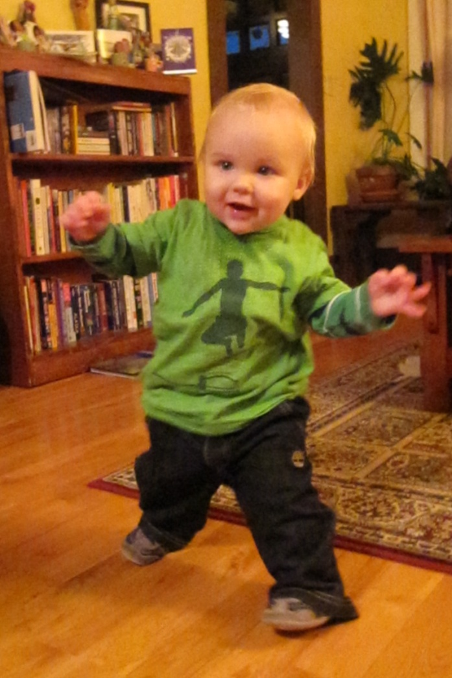
Toddlers to Preschoolers
Toddlers:
One and Two year olds
They “toddle”
By age three, children
can walk steadily

Slide 3
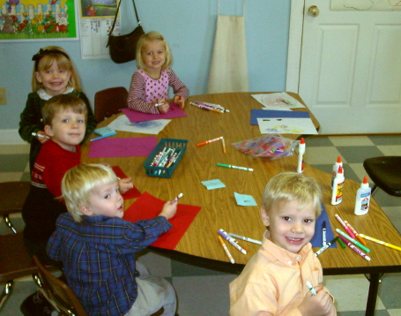
Preschoolers: Ages three to five

Slide 4
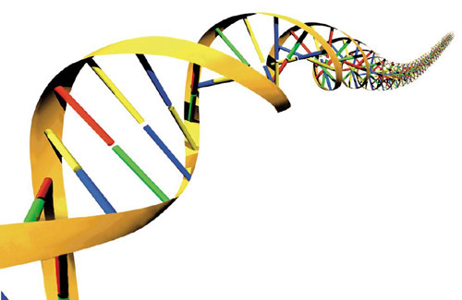
Influences on Growth and Development
Heredity
Nutrition
Health
Life Experiences/
Opportunity

Slide 5
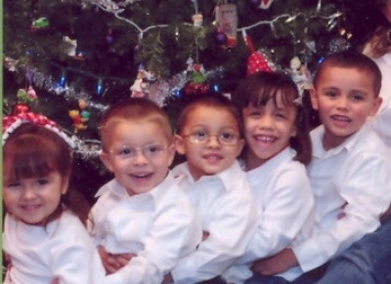
Growth from one to three
Height and Weight
Slower than in infancy
More variation can be noticed

Slide 6
Proportion and Posture
Torso and limbs lengthen
Posture is straighter
Balance and motor skills improve

Slide 7
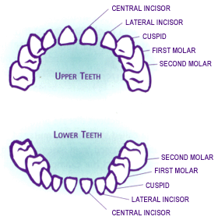
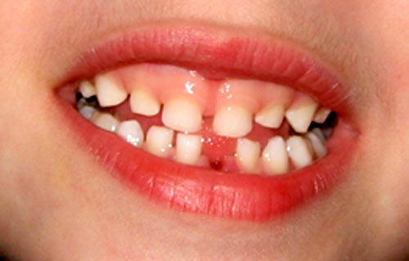
Teeth
Usually by age 3 all teeth are in (20)
Influenced by diet and mom’s diet
Calcium is important

Slide 8
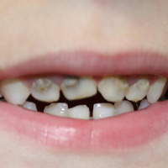
Tooth Decay
Can be caused by:
Poor diet
Heredity
Avoid sugary, gummy snacks
Don’t put child to sleep with bottle (water is OK)

Slide 9
Motor Development
Follows similar patterns as with infants
Influenced by:
Size
Heredity
Health
Diet
Interests
opportunity

Slide 10
Developmental Milestones
Charts show developmental milestones
Developmentally appropriate activities
Activities that a child can do at a given
age or level of development
Toys should be selected with this in mind

Slide 11
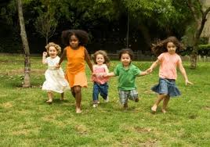
Gross Motor Skills
Exercise helps to develop these skills
Walking, running, jumping, kicking, climbing
Home safety becomes more important

Slide 12
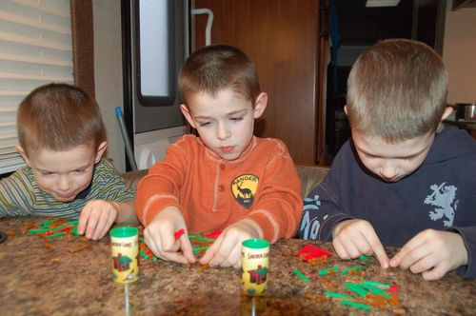
Fine Motor Skills
Pick up objects with thumb and first finger
Better hand-eye coordination
Better dexterity: ability to work with your hands
coloring, writing, turning pages, etc.

Slide 13
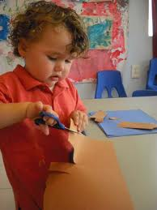
Sensory Integration
When all of the senses begin to work together to help us learn about and interact with our environment

