Slide 1
Caring for Children from one to three
Chapter 10-2

Slide 2
Sleeping
At about age two, sleep patterns change.
Less sleep is required
Daytime naps become shorter
Night time sleep becomes longer
Separation Anxiety can be a problem
Routines are even more important

Slide 3
Self-comfort techniques
Thumb sucking
Cuddling a toy or “blankie”

Slide 4
Sleep Disturbances
Toddlers often wake up in the night and cry out
Try: a trip to the bathroom
a nightlight

Slide 5
Night Terrors
Occur during deep sleep
Children may scream
Children will need reassurance

Slide 6
Nightmares
Occur during lighter sleep
Scary dreams
Children sometimes have trouble separating dreams from reality
Avoid scary television

Slide 7
Nutrition and Eating
Mealtime can become more difficult
Children become picky eaters
Give children a variety of healthy foods

Slide 8
Self-feeding
One year olds
Finger foods: banana slices, cheerios
Can start to use a spoon & sippy cup

Slide 9
Two year olds:
Can use a fork
Slow eaters
Can eat with the family

Slide 10
Three year olds
Better at eating with a fork and spoon
Teeth are in – chewing is not a problem

Slide 11
Toddlers have small stomachs. They need to eat small meals often.

Slide 12
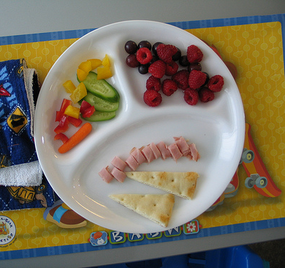
Appealing meals for children
Color
Texture
Shape
Temperature
Ease of eating

Slide 13
Adults should model good eating behavior
Only eat when hungry
Don’t use food as a reward

Slide 14
Hygiene
Washing and Bathing
This can be fun for the child
Allow children to help wash themselves. This helps to foster independence

Slide 15
Caring for Teeth
Start brushing at about age one. Use a soft toothbrush or cloth
At age two, children should try brushing their own teeth, with adult help as needed
Dental visits should begin at about 18 months

Slide 16
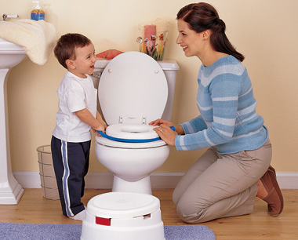
Toilet training
Usually starts during age two
Physical readiness
Control bladder, bowels, and be able to remove clothing
Recognize signals that elimination is necessary

Slide 17
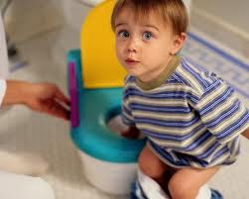
Emotional readiness
Shows interest and wants to act “grown up”
Caregivers must be encouraging and know “signs” that the child is ready
Bowel control usually comes before bladder control

Slide 18
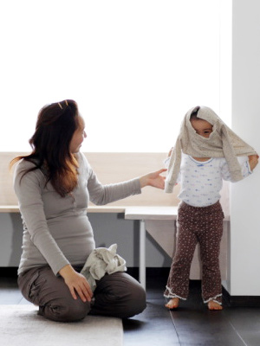
Dressing
Encouraging self-dressing as soon as the child shows interest
Helps teach independence and helps motor skills
Provide clothing that is easy to put on and off

Slide 19
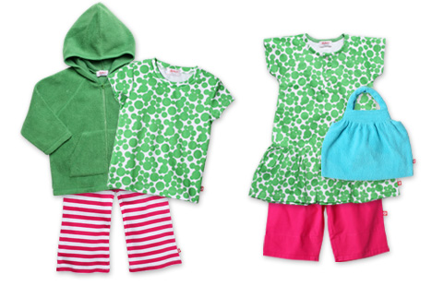
Clothing Considerations
Comfort
Allow free movement
Soft knits
Easy on/off for children

Slide 20
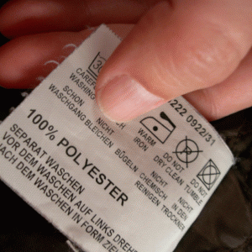
Fabrics
Natural fibers
Cotton – washes well, durable, comfortable
Synthetic fibers (polyester, nylon, spandex)
Strong, durable, wrinkle resistant, won’t shrink
Does not absorb moisture
Blends – can combine the features

Slide 21
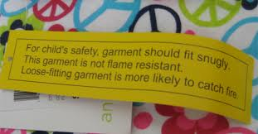
Flame resistant: the law requires this for children’s sleepwear
These fabrics can catch on fire, but burn slowly
Durability
Economical

