Slide 1
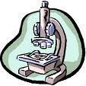
A Closer Look at Conception
Section 4-2

Slide 2
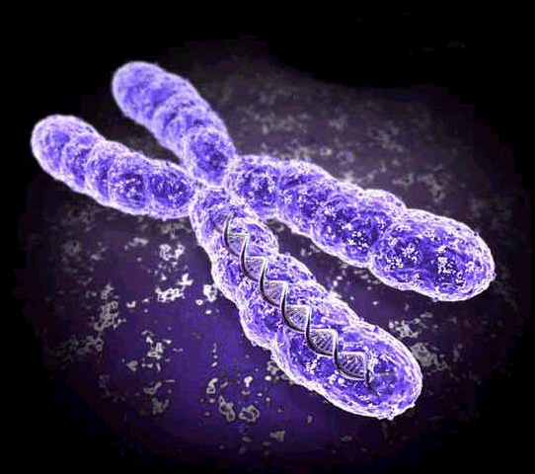
Genetics
Heredity: The passing of traits from parents to offspring.
Chromosomes: bundles of DNA in the nucleus of cells. Human cells contain 46 (23 pairs)
Half comes from the mother, half comes from the father

Slide 3
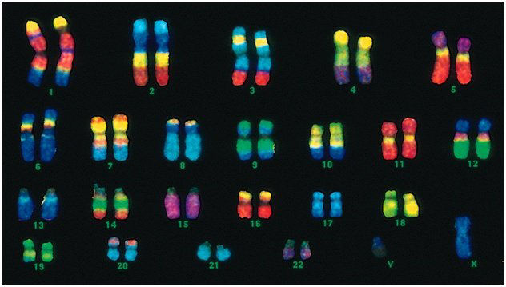

Slide 4
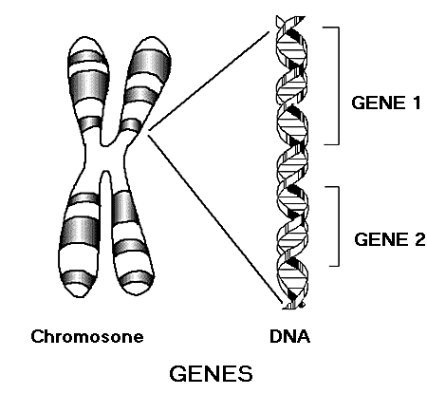
Gene: section of a chromosome that determines an inherited characteristic. Every chromosome contains hundreds of genes.

Slide 5
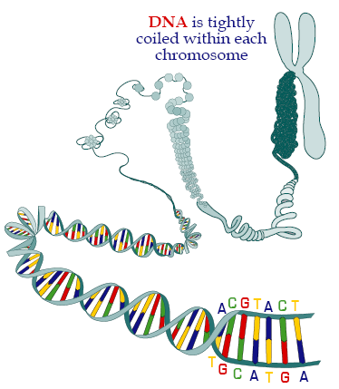
DNA: deoxyribonucleic acid.
A complex molecule
shaped like a double
helix.
DNA contains
genetic information.

Slide 6
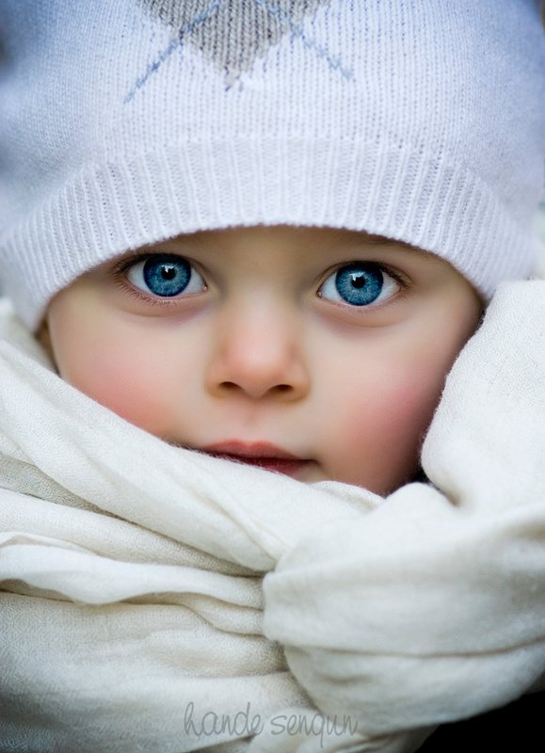
Dominant & Recessive Genes
A person has two copies of each gene, one from each parent. For example, eye color:
B = brown eyed gene b = blue eyed gene
If they are both the same, the child will have that trait. Ex. Two copies of a blue eyed gene makes blue eyes.
bb = blue eyes

Slide 7
If they are different, one will be expressed and one will be hidden. The one that is expressed is dominant. The one that is hidden is recessive.
Ex. A brown eyed gene and a blue eyed gene makes brown. Brown is dominant, blue is recessive.
Bb = brown
BB = brown

Slide 9
Some traits are determined by co-dominant inheritance.
Ex. Blood Type
MOM DAD CHILD
A & B are co-dominant. A A AA = A
O is recessive A B AB = AB
A O AO = A
B B BB = B
B O BO = B
B A BA = AB
O O OO = O

Slide 10
Most traits are influenced by more than one gene. (polygenic)
Examples include: Height, weight, skin color, etc.
Every egg & sperm cell contain different combinations of genes. This is why siblings look different. We are all unique.

Slide 11
A child’s gender is determined by the “sex chromosomes.
If a child inherits an X from its mother and an X from its father, it will be a girl.
If a child inherits an X from its mother and a Y from its father, it will be a boy
XX = female
XY = male

Slide 12
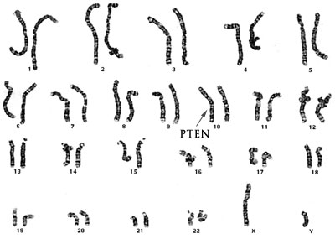

Slide 13
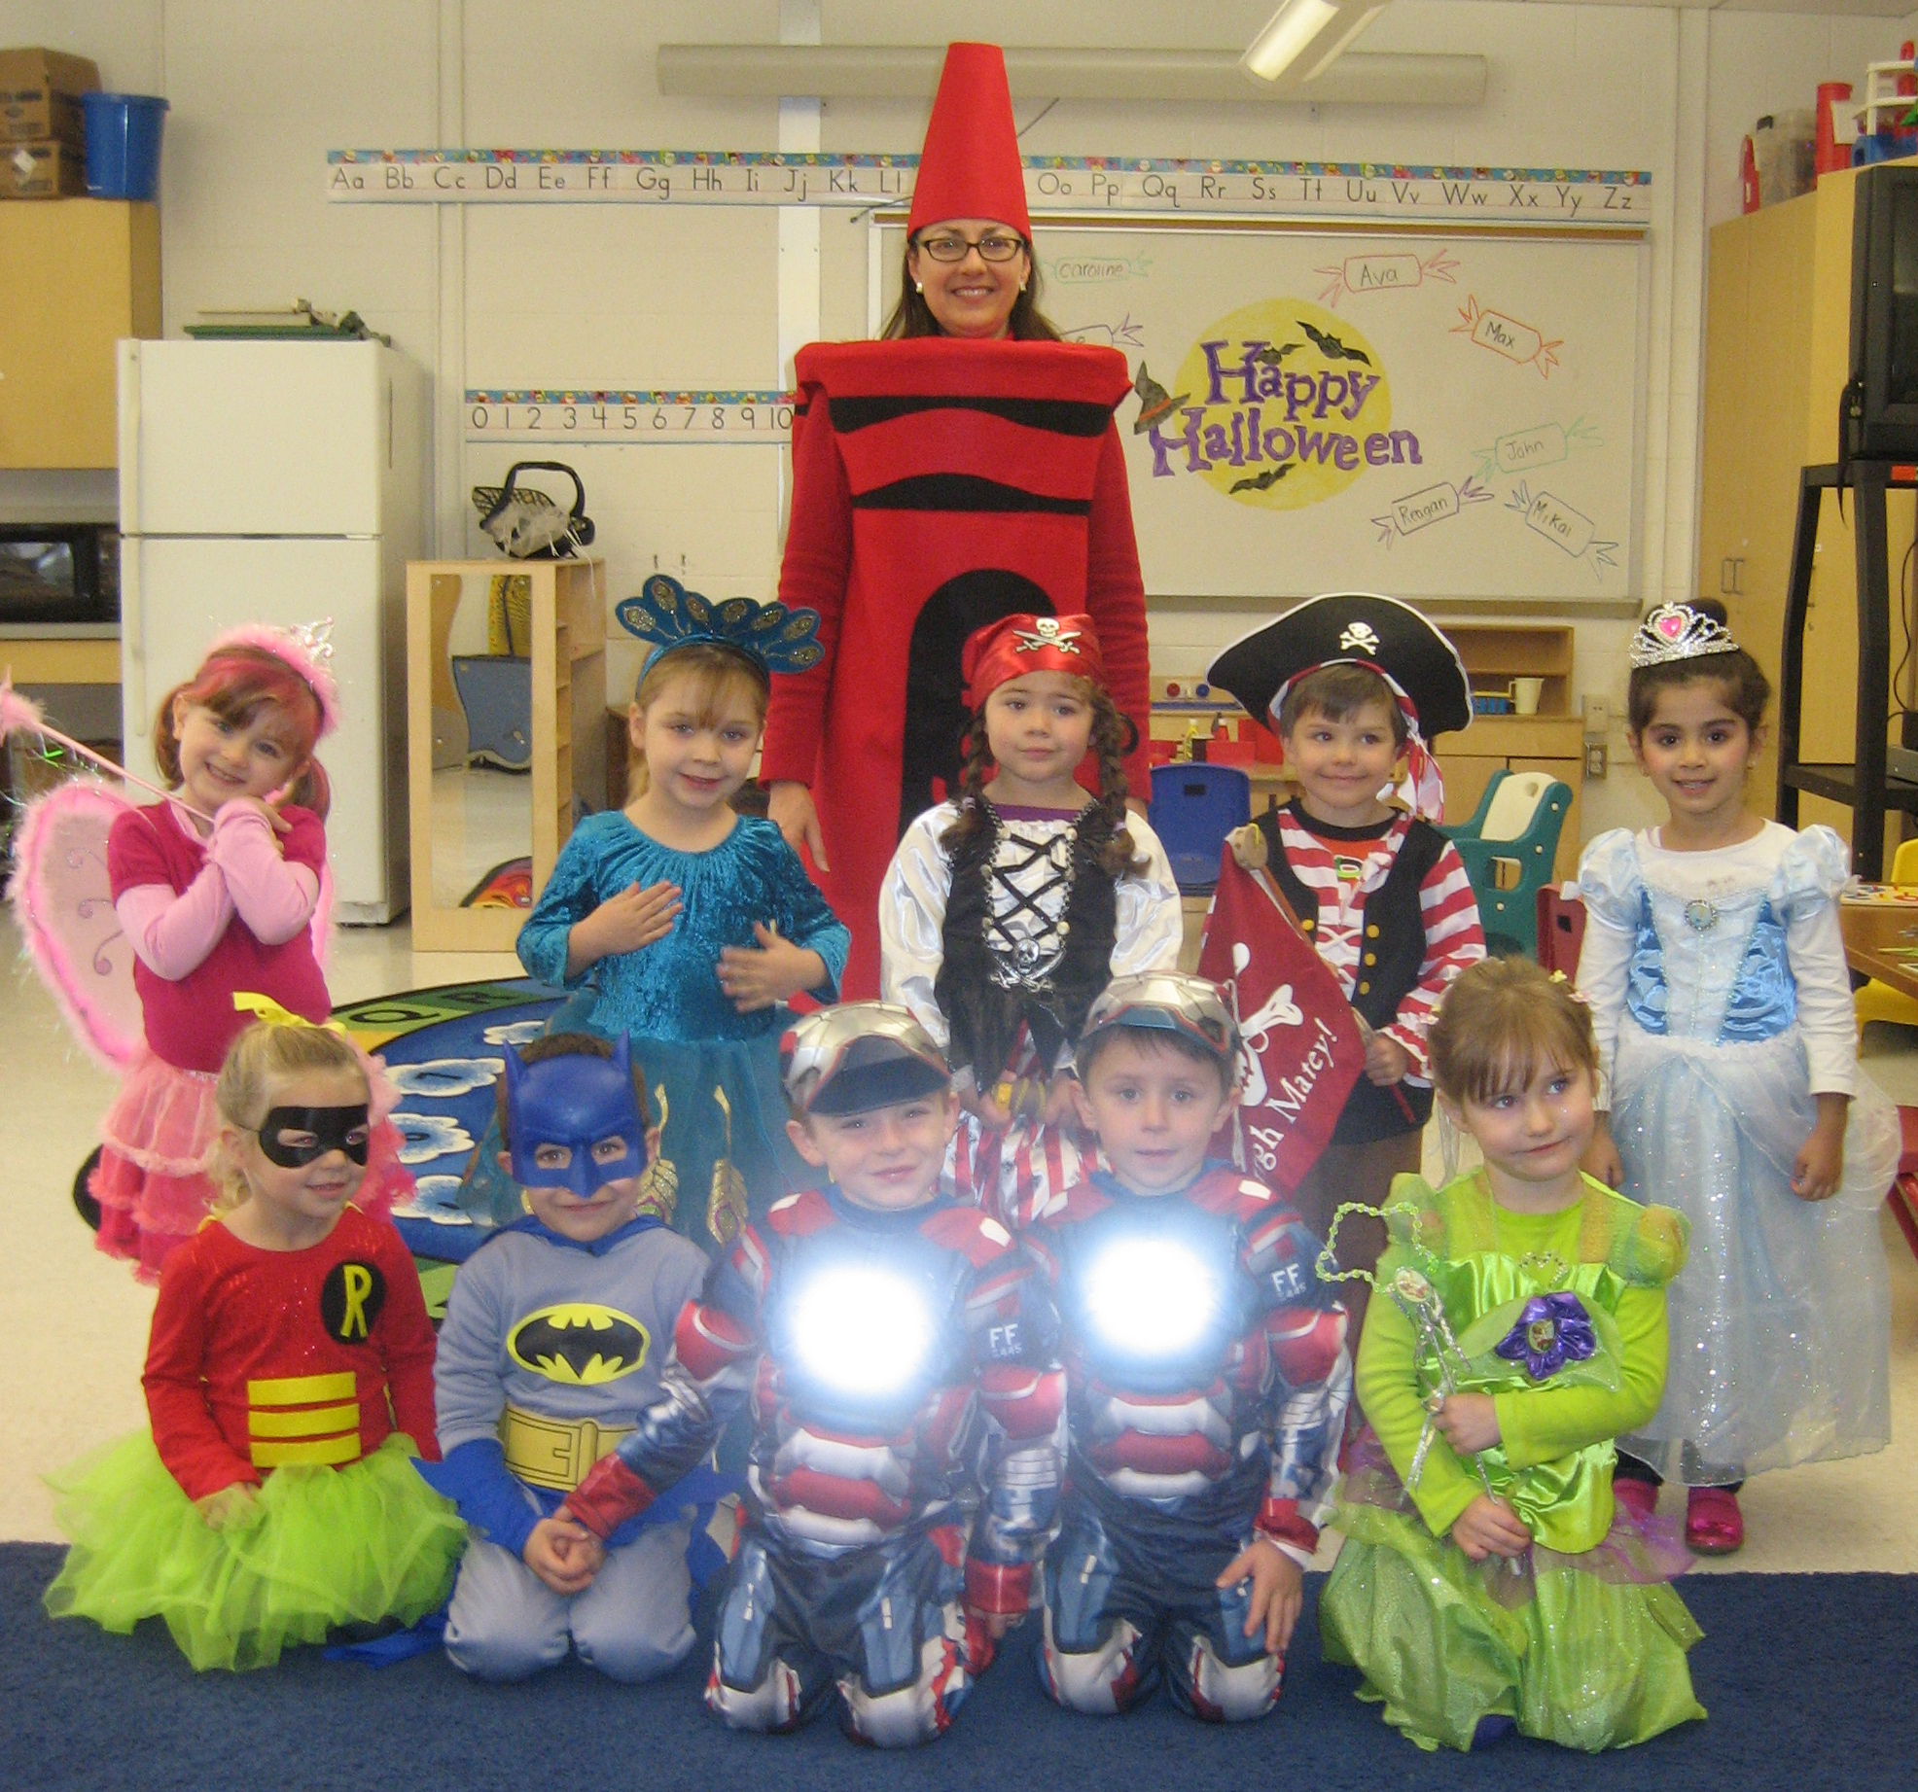

Slide 14
Multiple Births

Slide 15
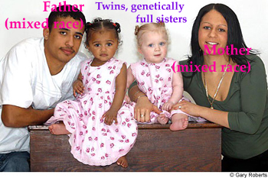
Fraternal Twins
When two eggs are released from the ovaries at the same time and become fertilized by two different sperm. These twins are like any other siblings. Boy/Boy, Girl/Boy, Girl/Girl
chances: 23 out of 1,000

Slide 16
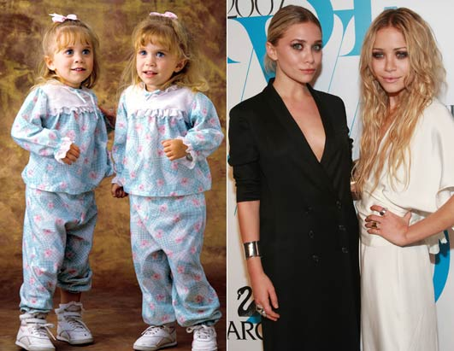
Identical Twins
The zygote (early mass of cells) splits in two. Since the two new cell masses came from one fertilized egg, the DNA is identical.
Chances: 4 out of 1,000

Slide 17
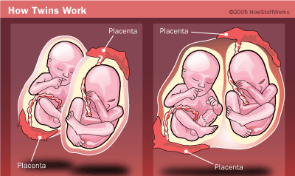
Twins in the Uterus
identical or fraternal identical

Slide 18
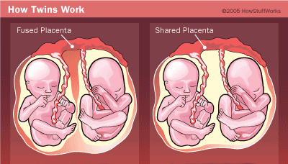
identical identical

Slide 20
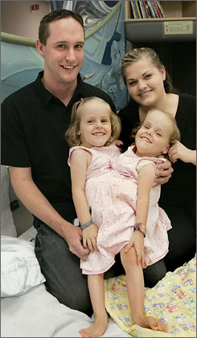
Conjoined Twins
This occurs when a
zygote partially splits.
Very rare - One in
200,000

Slide 21
Family Planning (Birth Control)
Only one sure way to prevent pregnancy
Abstinence
Most methods do not prevent STD’s.
Each method has a percentage of effectiveness
Some have possible side effects

Slide 22
Infertility
The inability to become pregnant.
Couples may question their fertility if they have been trying for 12 months to get pregnant without success.
40 % male infertility
40% female infertility
20 % unknown or both

Slide 23
Options for Infertile Couples
Adoption
Artificial Insemination: Doctors inject sperm into the woman’s uterus. The sperm could be from her partner OR a donor.
In vitro fertilization: Doctors fertilize the woman’s ovum with the man’s sperm in the lab. If fertilization occurs, the zygote is placed in the woman’s uterus

Slide 24
Ovum transfer: Same as “in vitro”, except that the ovum has been donated.
Surrogate Mother: A woman who becomes pregnant in order to have the baby for another woman.

