Slide 1
Preparing for Birth
A Healthy Pregnancy

Slide 2
Early Signs of Pregnancy
Missed period (usually first sign)
Full feeling or ache in lower abdomen
Frequent urination
Swollen breasts/discomfort
Nausea and vomiting (morning sickness)
Pregnancy test should be taken ASAP

Slide 3
Medical Care During Pregnancy (Prenatal Care)
Schedule a visit with an obstetrician
A doctor who specializes in pregnancy and childbirth
These doctors schedule regular checkups, assist during birth and examine the newborn
***Nothing is more important
to the health of the baby
than regular medical
care.

Slide 4
The First Exam
BP, pulse, respiration & weight
Medical history & medications
Pelvic measurement
Urine analysis (check for infections or diabetes)
Check for immunity to Rubella

Slide 5
The First Exam (continued)
Blood tests (check for anemia, RH factor)
Anemia – low iron or red blood cells
causes fatigue, weakness
Rh factor – a protein found in blood. If the baby has it and the mom does not, it could be a problem in future pregnancies.

Slide 6
Approximate Date of Birth
Nine months & one week from the first day of the last period

Slide 7
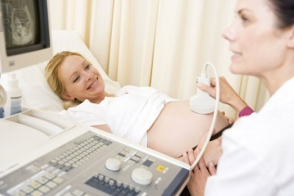
Regular Checkups
Monthly until 6th or 7th month
Twice monthly until 8th month
Weekly in 9th month

Slide 8
24th – 28th week: Glucose test
To test for gestational diabetes
a form of diabetes that occurs only during pregnancy
Preeclampsia: very high blood pressure. Bed rest is often required.

Slide 9
Discomforts of Pregnancy - Normal
Nausea & vomiting – usually in 1st trimester
Sleepiness – early in
pregnancy – due to
hormone changes
Heartburn – later in pregnancy – due to limited space in abdomen

Slide 10
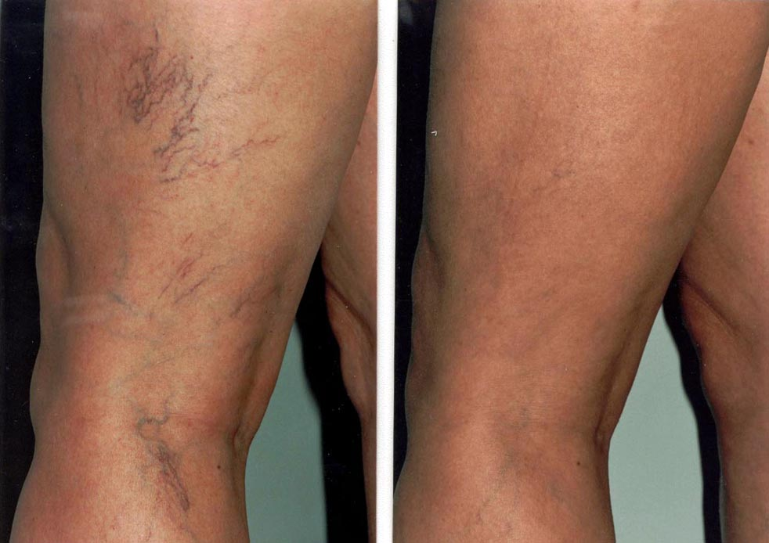
Discomforts of Pregnancy (continued)
Shortness of breath –
pressure on lungs from baby
Varicose veins – due to
increased pressure on
blood vessels in legs

Slide 12
Discomforts of Pregnancy (Continued)
Muscle cramps in legs
Lower back pain

Slide 13
Possible Serious Complications
Vaginal bleeding
Extreme weight changes
Severe abdominal pain
Fever
Swelling of face, hands, ankles
Blurred vision or dizziness

Slide 14
Nutrition During Pregnancy The single most important requirement during pregnancy.
Protein – Baby needs it for
bones & teeth
Carbohydrates & Fats –
Provide energy

Slide 15
Vitamins – some birth defects are linked to vitamin deficiency. Mom’s need for folic acid increases. All other vitamins help with the baby’s development.
Minerals – for strong bones & teeth. To help get waste products out of the body. Iron, calcium & phosphorous are very important.

Slide 16
Teens must be extra careful to eat right. Their own bodies are still developing as well as the baby’s. Teens typically eat more junk food.

Slide 17
Weight Gain
Women usually gain 24 – 30 pounds during pregnancy. Only about 7 – 8 pounds is the baby. The rest is:
Placenta
Amniotic fluid
Increased size of uterus
Increase in breast tissue
Increase in mom’s blood & fluid volume
Increase in mom’s fat stores

Slide 18
Weight Gain Distribution

Slide 19
Personal Care & Activities
Rest
Exercise
Good Hygiene

Slide 20
Emotional Health During Pregnancy
Couples should talk things out and spend time alone together.

Slide 21
Understand that hormones will cause mood swings
Try to reduce stress

Slide 22
Depression
Pregnant women who feel overwhelmed need to seek help

