Slide 1
Preparing for Parenthood

Slide 2
Other Children in the Family
Prepare your children for the arrival of a new baby.
Children’s reactions partly depend on how well prepared they were.

Slide 3
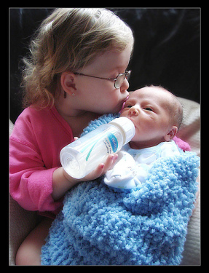
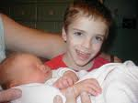
Children can have a variety of reactions
Jealousy
Confusion
Excitement
Love
Adjusting takes time. Talk about the child’s feelings.

Slide 4
Decisions about Feeding
Breast Feeding vs. Bottle feeding

Slide 5
Formula:
A mixture of milk or milk substitute, water
and nutrients

Slide 6
Choosing a Pediatrician
Pediatrician: a doctor who specializes in treating
children

Slide 7
Making a Budget
Budget: A spending plan that people use to help estimate their present and future income and expenses.
Identify sources of income and amount
Identify expenses

Slide 8
Identify expenses
Fixed expenses: expenses that can’t easily be changed.
ex. Car payments, rent, taxes
Flexible expenses: expenses that can vary.
ex. Food, clothing, entertainment, household items.

Slide 9
Estimating Health Care Costs
Doctors fees, hospital fees
Many working women have insurance. Some have it through their spouse
Some do not have any. There are government programs that offer insurance at low costs.
For example, HUSKY

Slide 10
Other Costs
Child Care
Maternity clothes

Slide 11
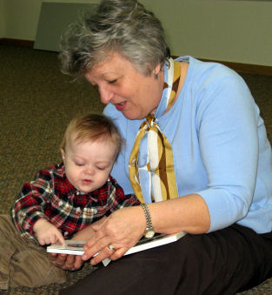
Balancing Work and Family
Decide on Child Care
Relatives
Home child care
Child care center

Slide 12
Maternity or paternity leave
Absence from work following the birth of a baby. Can be paid or unpaid – or a combination

Slide 13
Family and Medical Leave act
Employers with more than 50 workers must offer up to 12 weeks of unpaid medical leave to new mothers and fathers.

