Slide 1
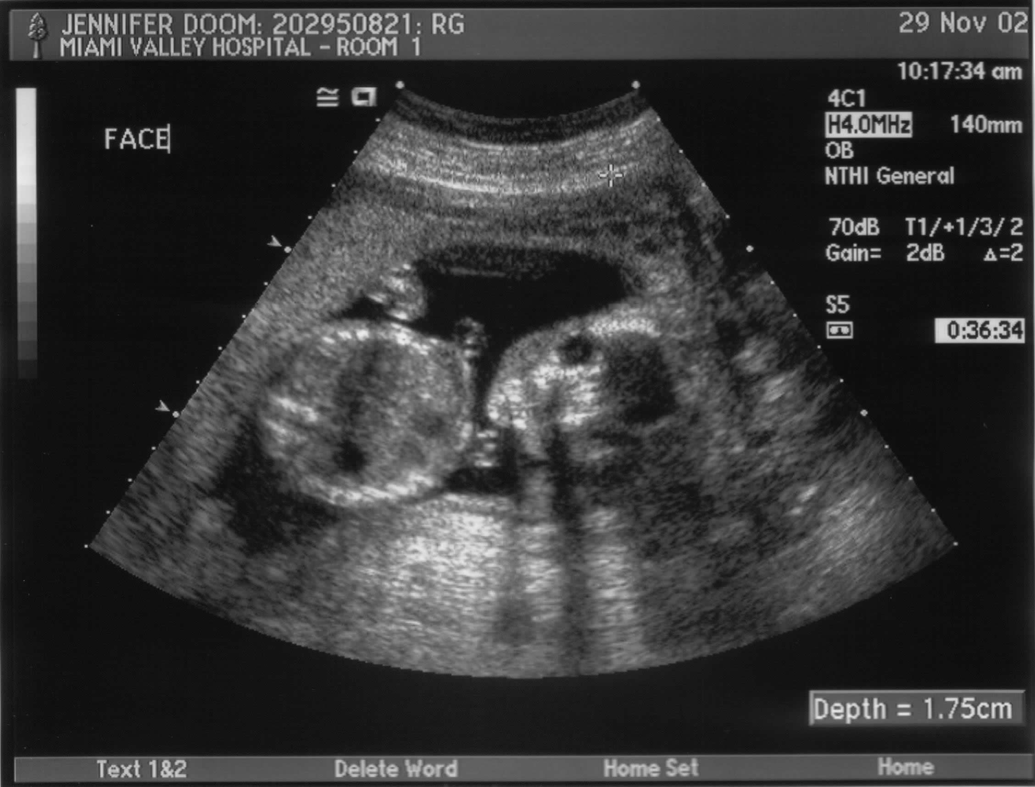
Chapter 4 Prenatal Development
(The baby’s development during pregnancy)

Slide 2
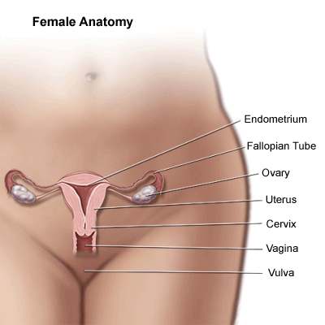
4-1 The Developing Baby
Female Reproductive System

Slide 4
Female Reproductive System
Uterus: The organ in which a baby develops.
Pear-shaped and muscular
Ovary: One of the two female reproductive organs. They produce egg cells (ova)
Fallopian Tube: Thin tube connecting the ovary to the uterus.

Slide 5
Vagina: Muscular tube that leads to the uterus. (where the tampon goes)
Cervix: The bottom portion of the uterus that leads to the vagina.
Ovum: The egg cell. Females are born with all they will ever have. Each month, one of a woman’s ovaries will release one.

Slide 6
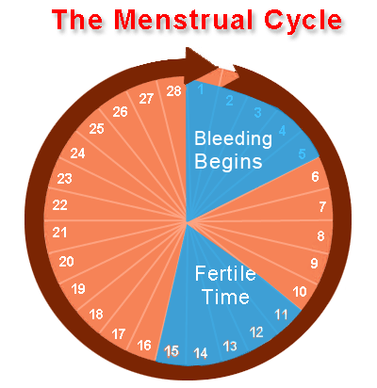
The Menstrual Cycle
The first day of the cycle is
when bleeding begins. Usually lasts about 5 days.
Ovulation occurs on day 14.
Days 11 – 15: Intercourse may lead to pregnancy
If a fertilized ovum does not implant itself into the uterine wall, the cycle will repeat

Slide 7
The Menstrual Process

Slide 8
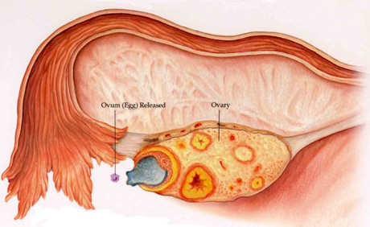
Ovulation: When one of the ovaries releases a mature ovum into the fallopian tube. This usually happens every 28 days.

Slide 9
Male Reproductive System

Slide 10
Penis: used to pass urine out of the man's body and to pass semen into the vagina of a woman during sexual intercourse.
Urethra: This is the tube inside the penis that carries urine or semen. It is connected to the sperm duct and the bladder.
Testes: There are two testes. The job of the testes is to produce millions of male sperm cells. They are connected to the sperm duct.

Slide 11
Sperm duct: Carries sperm from the testes to the urethra.
Seminal vesicles: attached to the sperm duct. They produce a sticky fluid that makes up most of a male’s semen.
Semen: fluid which contains sperm cells. It is expelled from the penis during sexual intercourse.

Slide 12
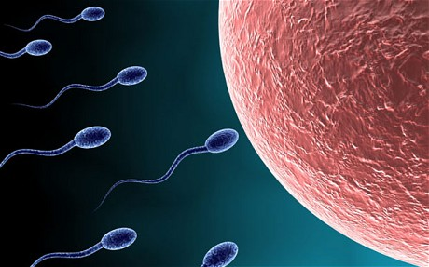
Sperm: Male reproductive cells. They are produced in the testes. During sexual intercourse, millions are expelled from the penis in the semen.

Slide 13
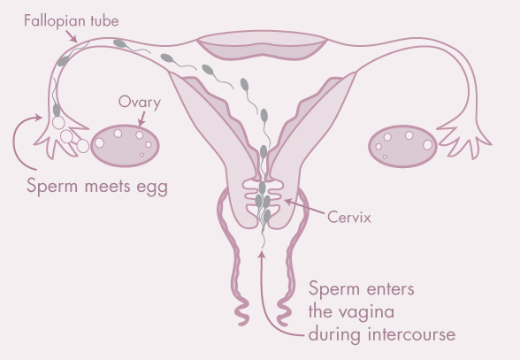
Fertilization: When a sperm cell (male reproductive cell) penetrates the ovum.
Also called conception. This occurs in the fallopian tube.

Slide 14
Fertilization

Slide 15
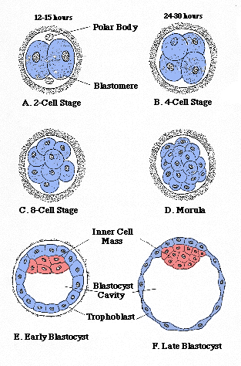
The Germinal Stage
The first stage in a baby’s
development.
Zygote: The fertilized egg.
This lasts for about two weeks.
Cell Division: The single cell
splits into two cell, then four,
etc.

Slide 16
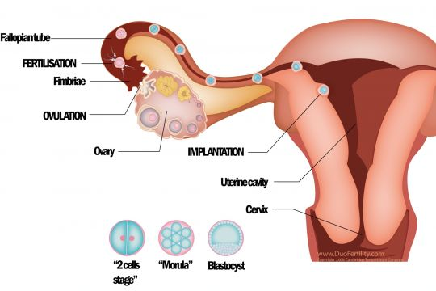
Implantation: After about 4 days, the zygote will reach the uterus. After 6 to 12 days, the zygote will attach to the lining of the uterus. This is called implantation.

Slide 17
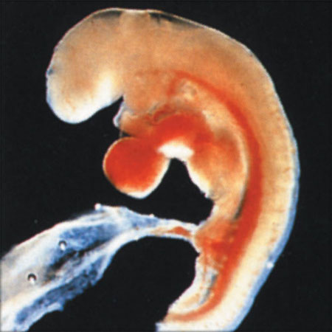
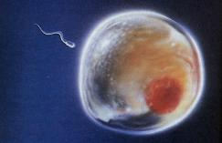
The Embryonic Stage
Embryo: From the third week until the eighth week of pregnancy. Much growth occurs.
Organs and body systems begin to develop.
Three Weeks Four Weeks

Slide 18
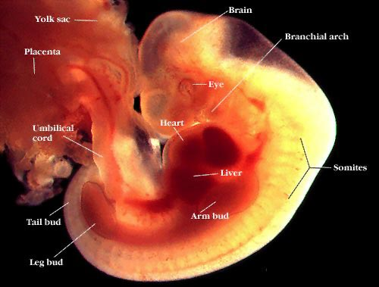
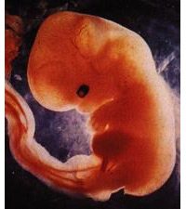
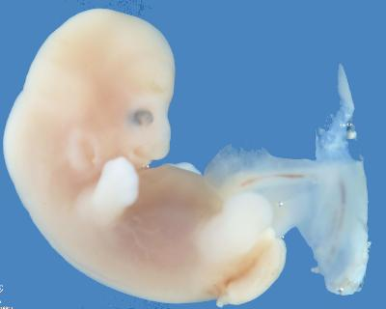
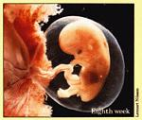
Five Weeks Six Weeks
Seven Weeks Eight Weeks

Slide 19
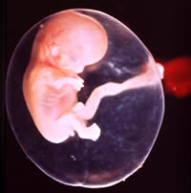
Amniotic sac: a fluid filled sac that forms around the embryo.
Amniotic fluid: the fluid within this sac. It protects and cushions the developing baby.

Slide 20
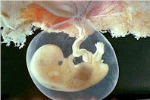
Placenta: blood-rich tissue that forms in the uterus. It is attached to the uterine wall.
Umbilical cord: cord that goes from the baby’s belly button (umbilicus) to the placenta. This cord takes oxygen & nutrients to the baby and removes carbon dioxide and wastes.

Slide 21
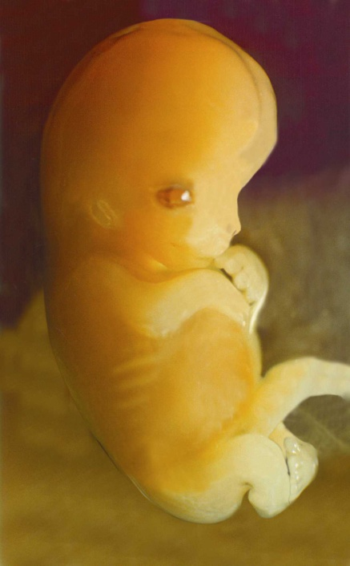
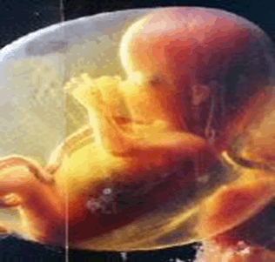
The Fetal Stage
From the eighth or ninth week until birth. The developing baby is called a fetus. It begins to look human.
Two Months Three Months

Slide 22
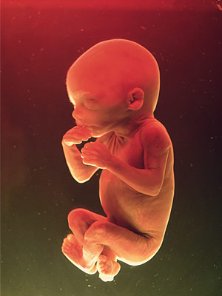
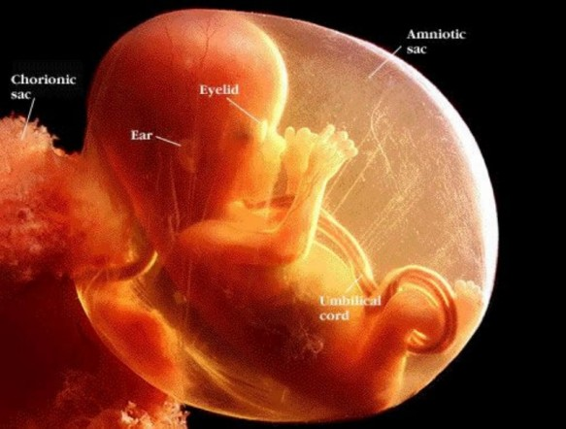
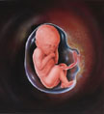
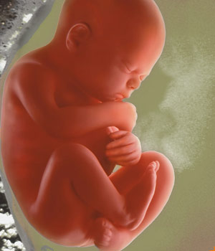
Four Months Five Months
Six Months Seven Months

Slide 23
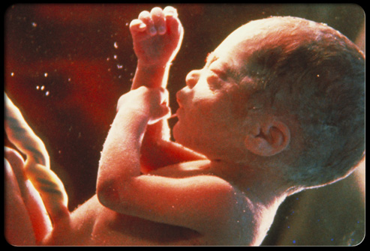
8 Months 9 Months

Slide 25
The Fetal Stage
Making Movements
Little kicks & other movements
Completing Development
Major organs develop & become ready to function
Staying Active
Thumb sucking, yawning, coughing, sneezing, etc.
Growing Bigger
Baby has to curl up to fit

Slide 26
Preparing for Birth
Full term is 37 – 42 weeks
Physical changes for mother:
Lightening: the baby “drops” down. Mom can breathe easier. Fetus is usually upside down.
If not upside down, it is called “breech”
Butt or legs are down

