Slide 1
Child Development - Chapter 8
Understanding the Emotional and Social
Development of Infants

Slide 2
What is Emotional Development and what is Social Development?

Slide 3
Emotional Development
Learning how to recognize and express your feelings and establish a personal identity.

Slide 4

Emotional Development helps us to:
Handle stress
Develop self-confidence
Be empathetic to feelings & concerns of others

Slide 5
Social Development
The process of learning self-expression and how to interact with others

Slide 6
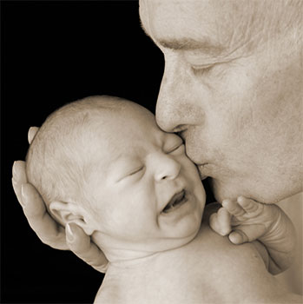
Social Development helps us learn how to:
Interact with others
Listen to other points of view before reacting
Show tolerance to others

Slide 7
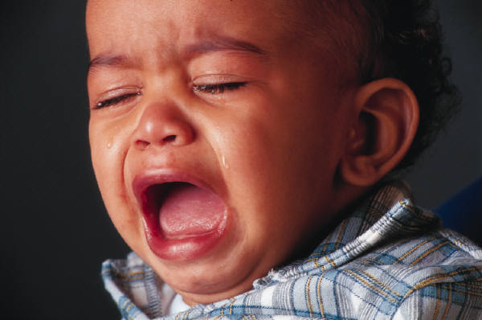
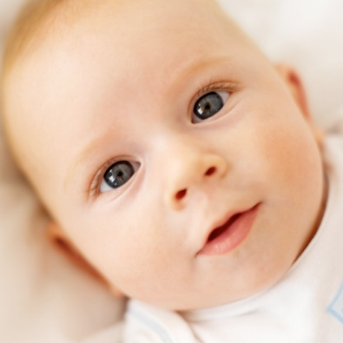

What emotions does an Infant Display?
Newborn: Pain or
Discomfort
Contentment
Delight

Slide 8
Other emotions that appear in first year: (5 Basic Emotions)
Interest Disgust Joy
Sadness Anger
Parents can distinguish different emotions through facial expression and different types of cries

Slide 9

Attachment: The bond between a child and a parent (or caregiver).
Infants need physical contact in order to learn how to trust and relate to others.

Slide 10

Harry Harlow Monkey Experiment

Slide 11
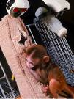

Slide 12
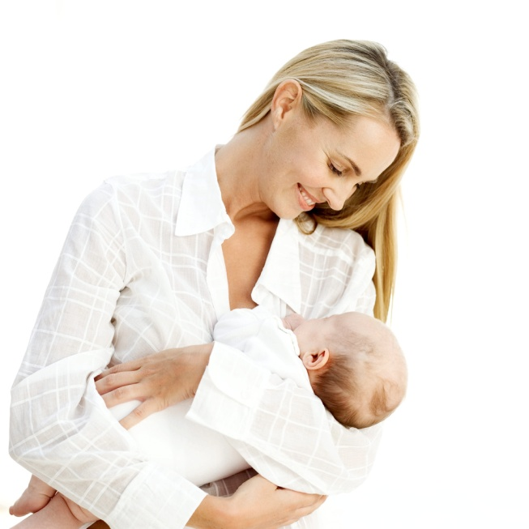
Communication is critical to building positive attachments.
Babies respond to
Vocal sounds
Facial expression
Eye contact
Touch
Infants thrive when their emotional & physical needs are met.

Slide 13
Erik Erikson: Psychologist (1950’s)
Trust vs. Mistrust
Infancy is critical to emotional & social development.
It is when babies learn to trust or mistrust the world around them.
The attitude newborns develop about their world depends on how their needs are met.

Slide 14
How to help a baby develop a sense of trust
Love and affection from parents - create the sense of trust.
Follow a predictable routine – regular feeding times
Get to know the baby – hold them and get to anticipate their needs
Bond with the baby – talk softly, positive, smiling, eye contact
Meet the baby’s needs – Physical, Social and emotional

Slide 15
What happens when infants needs are not met?
Failure to Thrive: a condition in which babies fail to grow and develop properly. Brains can be 20 - 30% smaller.
Problems can continue into adulthood if not addressed in childhood.

Slide 16
Temperament: A person’s unique nature. It determines how a baby reacts to its world. There are nine components to temperament. Everyone has each one to a degree.
Intensity – Strength or weakness of emotional responses to events and to other people.
Persistence – Determination to complete an action.
Sensitivity – Strength of reaction to a person’s own feelings

Slide 17
Perceptiveness – Awareness of surroundings and tendency to be distracted by new things.
Adaptability – Ability to adjust to changes
Regularity – Tendency to follow set patterns in daily life.
Energy – Level of physical activity - high level and squirm when sitting
First Reaction – Degree of comfort with new situations.
Mood – Positive or negative outlook. - cheerful or cranky

Slide 18
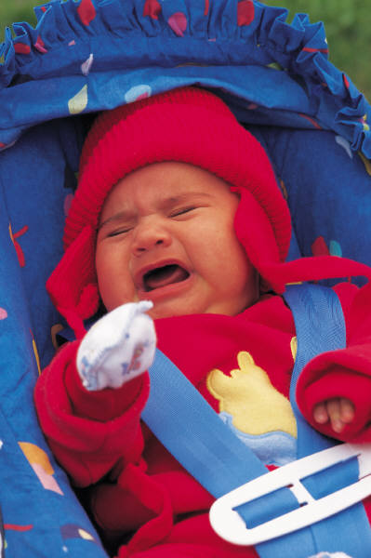

Crying and Comforting
A young baby that is crying needs attention and care.
What are the first things you should check for?
Is baby hungry?
Does diaper need changing?
Is burping needed?
Is baby hot or cold?

Slide 19
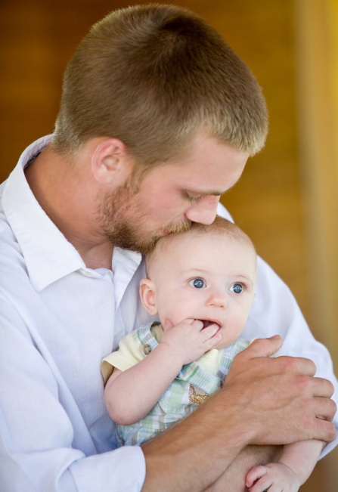
If you have check all the basic needs and nothing works…. Try:
Cuddling
Rocking
Walk around
Take outside for a breath of fresh air
Move to a new position like sitting up
Talk softly or sing – they love singing!
Offer a toy because sometimes they are bored.
Rub their backs

Slide 20
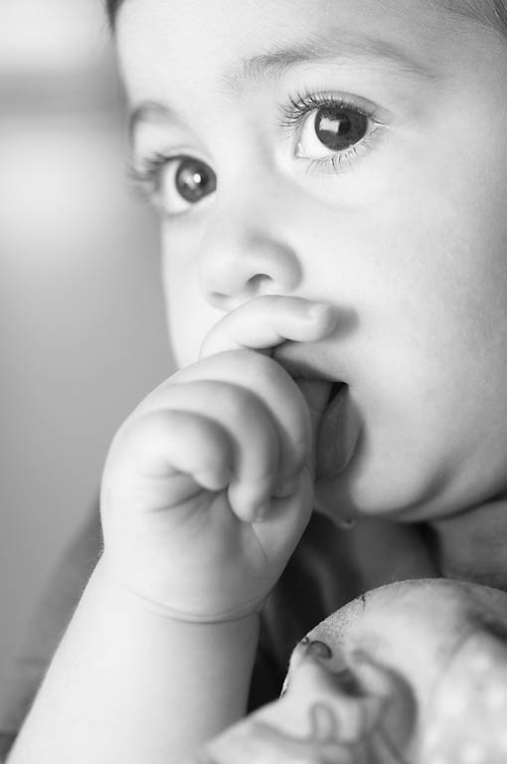
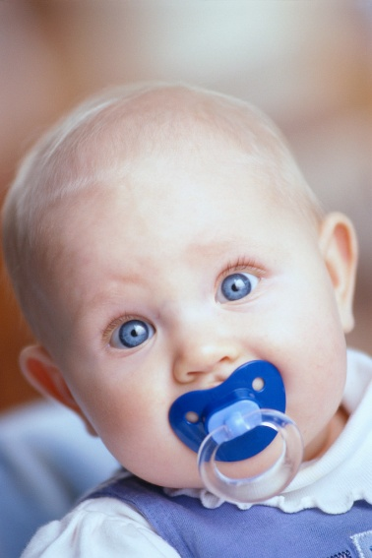
What is the most common self-comforting technique for an infant?
Thumb Sucking –
Is a basic urge for infants.
Pacifiers –
Pediatricians say it’s okay
to use, but wash frequently
and NEVER tie with a string
on their clothing.

Slide 21
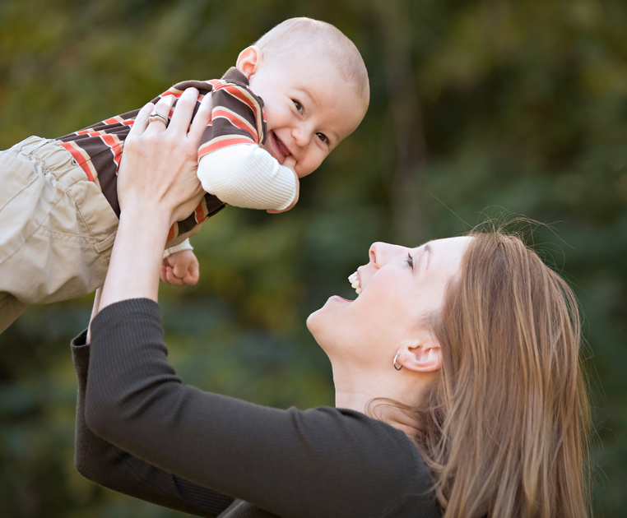
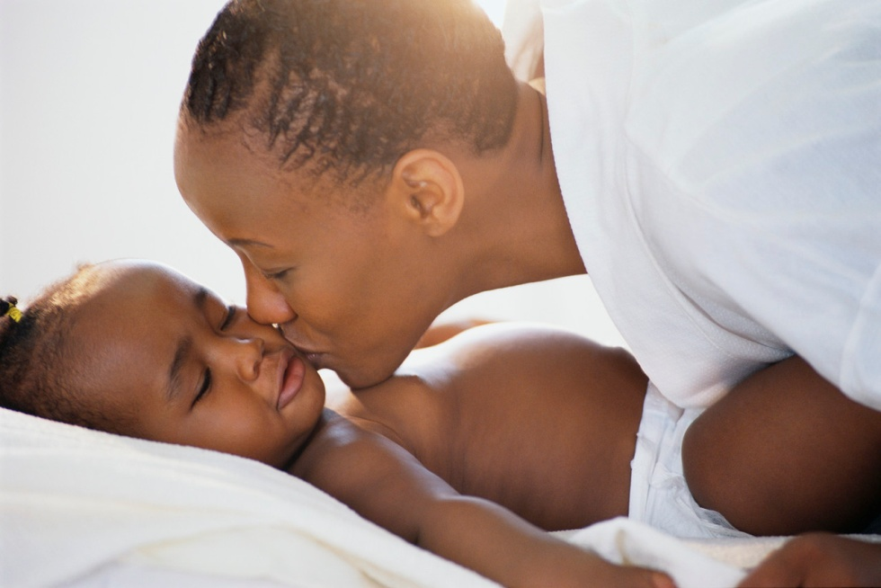
What is the importance of FACE-to-FACE time?
Builds Trust
Babies will learn Language

Slide 22

Colic – A condition in babies that results in extended periods of crying. The baby is inconsolable.
Reflux – When the baby has partially digested food stuck in their throat and can cause colic like symptoms – crying and spitting up.

Slide 23

Emotional Climate within the Home
Babies can pick up any negative emotions.
If you’re having a bad day and snap or you’re worried or feeling tense, the baby will react to this.
Bitterness and mistrust will affect the babies development.
If you are feeling overwhelmed go to a separate room and let it out in private – DO NOT ARGUE INFRONT OF CHILDREN – if at all possible.

Slide 24
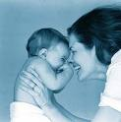
8 -2 Understanding Social Development of Infants
Children develop on their own timeline, but it’s nice to have a guideline of what to look for as a parent.

Slide 25

Developmental Milestones - Social
1 Month:
Coos and babbles
May cry a lot, but quiets down at the sight of the caregiver’s face or sound of voice, or when lifted or touched.

Slide 26

2-3 Months:
Begins to smile & show excitement
Eyes can follow moving objects
Wants companionship
Maintains brief eye contact while being fed
Makes different crying sounds for different needs
Can tell a smile from a frown

Slide 27

4 - 6 Months:
Turns to sound of familiar voices
Laughs, squeals
Can tell the difference between family members
Reaches out with hands and arms to play
May cry when left alone

Slide 28
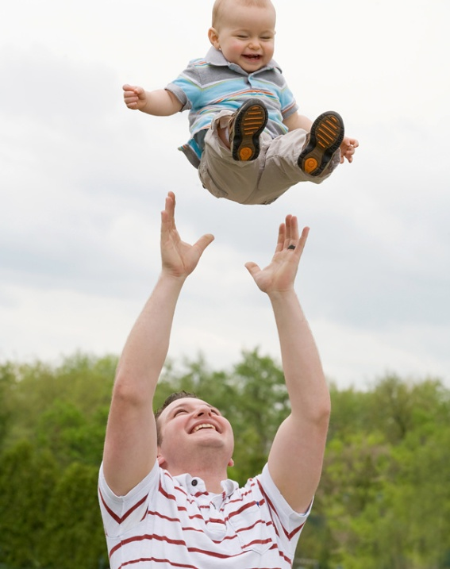
7 - 8 Months:
Tries to imitate sounds made by adults
Plays alone and plays longer with other people and toys
Enjoys other children
Begins to experience stranger anxiety and clings to familiar caregivers

Slide 29

9 - 10 Months
Responds to “no” and own name
Says simple words, such as “no”, “bye-bye”, “dada”, and “mama”
Objects if a toy is taken away
Crawls around to look for parents
Enjoys playing “peek-a-boo” and sound games

Slide 30
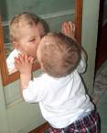
11 - 12 Months:
Uses the words “Dada” and “Mama” to refer to specific people
Uses gestures as well as simple body language
Shows stronger likes and dislikes
Spends time looking in mirrors

Slide 31

Stranger Anxiety – is the fear of unfamiliar people, usually expressed by crying.
This usually begins at about 8 months of age.

Slide 32



HOW TO COPE WITH STRANGER ANXIETY
Act welcoming toward the new person
Encourage friends and relatives to speak softly to the baby and let the baby get used to them.
Never force a baby to be held by an unfamiliar person.
Stay close to the baby
Let the baby set the timetable for adjusting to a stranger

Slide 33
How Behavior is Learned
Infants learn behavior through their relationships with others.
Babies learn that the same behavior brings about the same results every time.
Parents should be as positive as possible and be consistent with their responses.
Parents should model desirable behaviors.

Slide 34

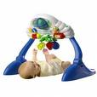
Social Development Through Play
Babies learn through play. It helps all areas of development.
First Six Months:
Play games with objects the baby can grasp.
Place colorful toys where baby can see & reach them.
Make noises with rattle or other toy
Gently shake & stretch baby’s arms & legs
Laugh and smile with baby.

Slide 35
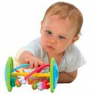

Six to twelve months
Peek-a-boo
Place toys just out of reach, so baby must crawl to it
Read from simple books
Give babies containers that they can fill and dump.

Slide 36
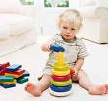
Play Environment: A comfortable space with no dangers and with toys that are safe.
Toys should be:
Safe
Age appropriate
Too big to fit in mouth
No small parts that can
fit into ears or nose
Sturdy
Clean

Slide 37

Exploration
Babies explore with all of their senses.
This is why toys go into their mouth.
By exploring, babies learn using cause and effect: learning that one event (the effect) is caused by another event.
Babies use play to explore their world and learn about it.

