Slide 1
Teen Parenthood

Slide 2
Sexuality: View of yourself as male or female – physical, intellectual, social, emotional
Hormones: Body chemicals that produce specific results
Some hormones become activated during puberty. They cause physical and emotional changes as teens become sexually mature
Abstinence: Completely avoiding sexual activity

Slide 3
Consequences of Sexual Activity
Sexually Transmitted Infections (STI’s)
spread from person to person by sexual contact
1 in 5 people have an STI
25% of new cases are teens
All are preventable
Some can be treated, some last a lifetime

Slide 4
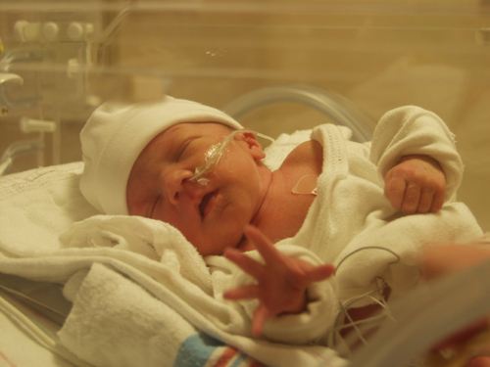
Teen Pregnancy
Health Risks: more likely to have medical complications
Iron deficiency – can cause premature birth
Nutritional deficiencies
Critical development occurs even before you know you’re pregnant
More premature babies – low birthweight

Slide 5
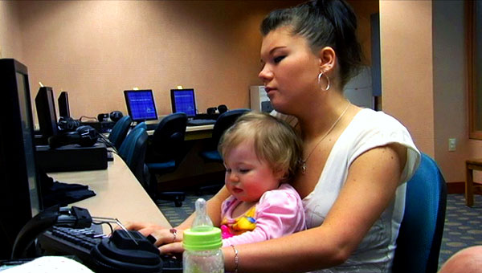
Education: It is very difficult to finish school while pregnant or a parent
Half of teen mothers never finish High School
Limits job options

Slide 6
Emotional and Social Stress:
Miss old friends & activities
Adjust to new relationships

Slide 7
Finances: Most teen parents have financial problems.
Childbirth is expensive. Good medical care for mom and baby is expensive. Food, clothing, housing, & healthcare are expensive
Both parents are responsible for finances
Paternity must be established

Slide 8
Teen Pregnancy
Sometimes teens ignore symptoms
Pregnancy should be confirmed as soon as possible
Father should be part of decision making

Slide 9
Weighing the Options
Single Parenthood:
Can be draining
Possible depression, burnout
Be realistic
Who will help you
Can you do it all alone?

Slide 10
Marriage: More stresses than later marriage
- Adjusting to parenthood at the same time as adjusting to marriage
+ Two people to share the responsibility for parenting

Slide 11
Adoption: legally gaining
permanent custody
of a child
Confidential Adoption
Birth parents don’t know who the adoptive parents are
Open Adoption
Birth parents and adoptive parents know something about each other

Slide 12
Abortion: Difficult decision
Currently legal
Should be done in first 3 months

