Slide 1
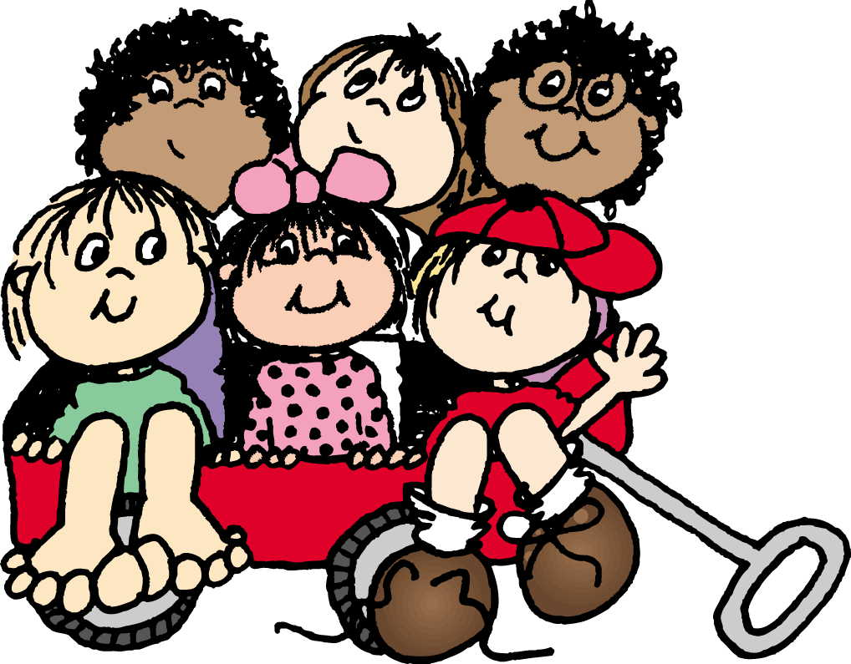
Emotional and Social Development from One to Three
Chapter 11

Slide 2
Temper Tantrums
Done to release anger
If you see it coming, try to head it off
If at home, try ignoring it
If in public, take to a quiet spot to cool down
Remain calm and quiet yourself

Slide 3
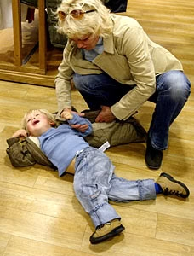
Acknowledge the child’s feelings while stating why their demands cannot be met
Adhere to the set limit. DO NOT GIVE IN!
Be sure to physically protect the child from harming him/herself
When the tantrum is over, praise child for calming down
Keep explanations short.
Remember they are normal. All children go through this.

Slide 4
Age 18 months
Children become self-centered. Say “NO”
Negativism – doing the opposite of what is asked
Desire for independence
Frustration
Realization of being a separate person

Slide 5
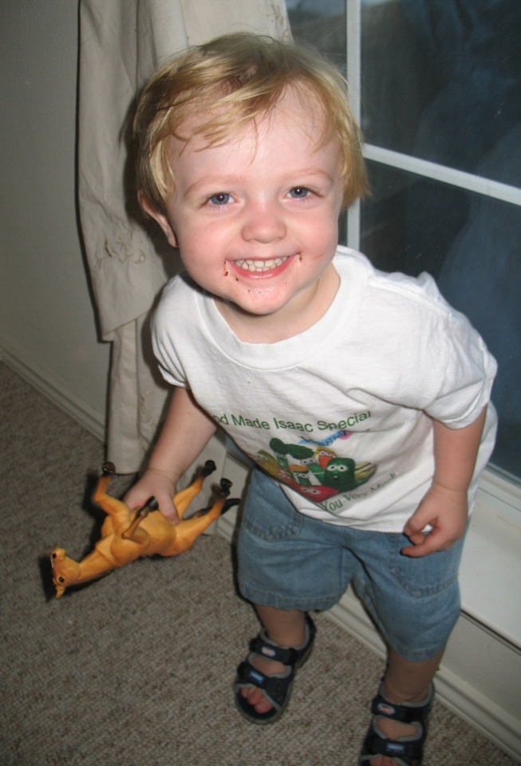
Age Two Years
Speech and motor skills have improved. Less frustration
Understands more
Can wait longer
Less self-centered

Slide 6
Age two and a half
Learning so much they get overwhelmed
Frustrations return – desires are greater than their abilities
Can be very stubborn and have mood swings
Consistency is important
Require lots of love and patience

Slide 7
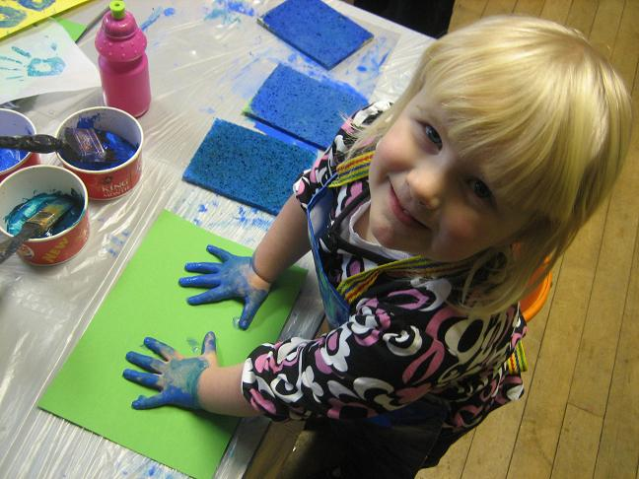
Age three years
Happier and more cooperative
More willing to take direction
Fewer tantrums
Usually ready for preschool

Slide 8
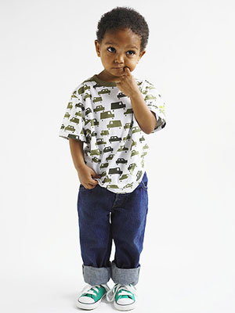
Age three and a half
Can become immature and seem to go “backward”
Fears and insecurities emerge
May try to control their environment and become “demanding”

Slide 9
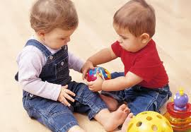
Social Development of Toddlers
Chapter 11-2

Slide 10
Socialization
The process by which young children learn to get along with other people.
First their own families, and then in other groups

Slide 11
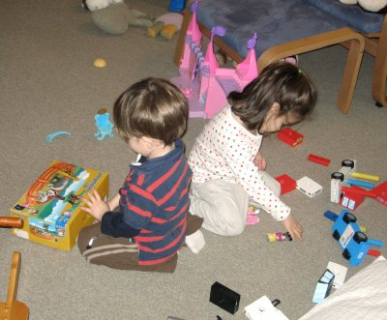
Parallel Play
When children play near each other, but not with each other.
Usually from 18 months – 3 years

Slide 12
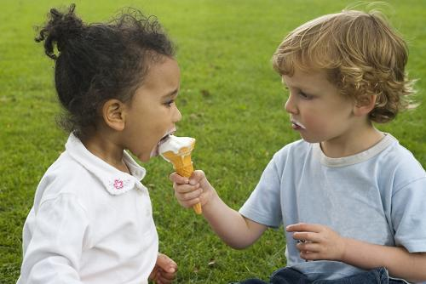
At this time, children don’t understand that other children have feelings.
They may take toys away, hit, bite, etc,
At about age 2, children begin to share.

Slide 13
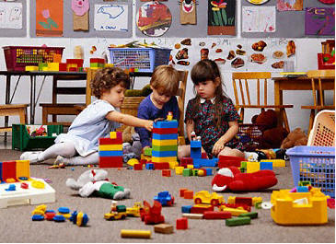
Cooperative Play
When children actually play with each other.
Usually starts at about age 3.
Children begin to learn how to solve conflicts (using words)

Slide 14
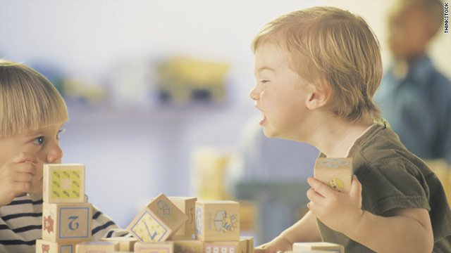
Children should have opportunities to play with other children at a young age. If not, it will be harder later.
Adults should not intervene all the time. Intervention is needed if a child may potentially be emotionally or physically harmed.

Slide 15
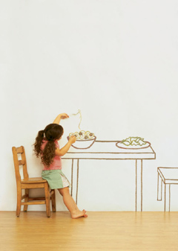
Imaginary friends
Very normal. Children can work out their feelings and conflicts with an imaginary friend (or animal)

Slide 16
Guiding Children’s Behavior
The goal is self-discipline: the ability of children to control their own behavior.
Guidance helps children learn to get along and handle feelings in an appropriate way. It helps with self-esteem and moral development.

Slide 17
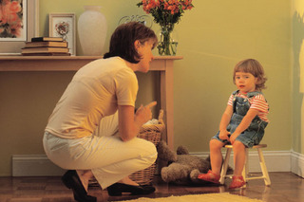
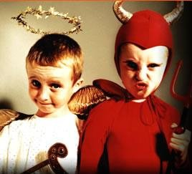
At first, right/wrong is determined by adults praising or scolding.
Later, children develop a conscience: an inner sense of right and wrong.
Guidance changes with age

Slide 18
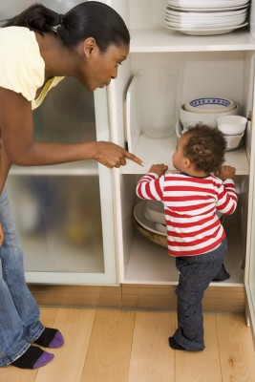
12 – 15 months
Children are unable to reason. Best to remove forbidden objects and distract children.

Slide 19
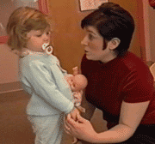
15- 24 months
These children need spoken restrictions, as well as removal and distraction.

Slide 20
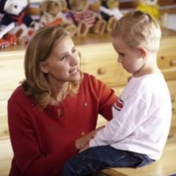
2 – 3 years
Spoken directions and simple explanations

Slide 21
3 year olds
Easier to guide. They like to please.
All ages – Be consistent

Slide 22
Setting limits
Keep it clear and simple
Show understanding of the child’s wants. Acknowledge the child’s feelings.
Give alternatives when possible.
Enforce limits once they are set.

Slide 23
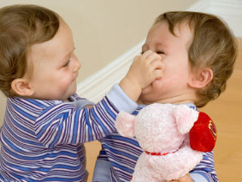
Behavioral Problems
Aggressive or inappropriate behavior signals a child is upset or not having his needs met. Children have trouble with words.
Try to find the cause of the problem behind the behavior

Slide 24
Biting
Figure out why the child is biting. Take steps to guide the child to a more appropriate behavior.

Slide 25
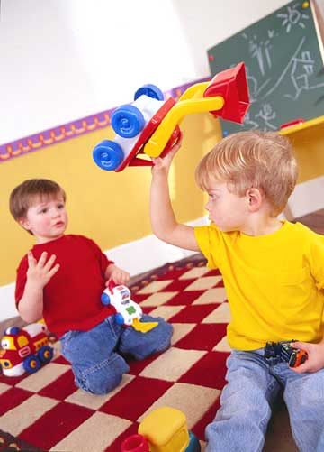
Hitting/Throwing
Usually impulsive and due to frustration or anger.
Encourage children to use words instead.
Time-outs can also be used.

