Slide 1
Intellectual Development from One to Three
Chapter 12

Slide 2
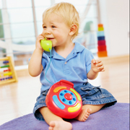
Methods of Learning
Incidental Learning
Unplanned learning
for example, pushing a button and getting music

Slide 3
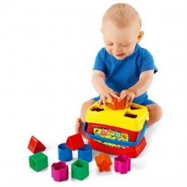
Trial and Error Learning
When a child tries several possible solutions before getting one that works
experimenting

Slide 4
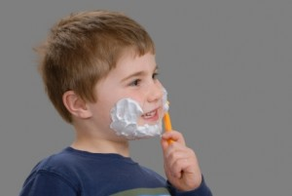
Imitation
Learning by watching and copying others

Slide 5
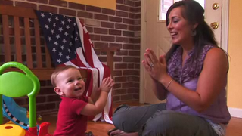
Directed Learning
Learning that results from being taught
You can be taught by:
Parents
Caregivers
Older siblings
Teachers

Slide 6
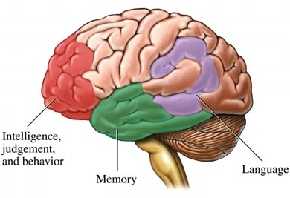
Intellectual Activity
7 areas:
Attention
Memory
Perception
Reasoning
Imagination
Creativity
curiosity

Slide 7
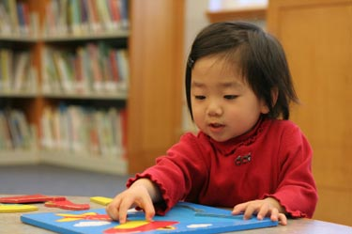
1. Attention
The ability to focus on the task at hand and block out other sensory information (screen out distractions).
Learning becomes more focused on one thing at a time
Attention span increases

Slide 8
2. Memory
Short term memory: remembering info just long enough to use it
Ex. Remembering a phone number in order to place a call.
Long term memory: info is first entered into short term memory and then stored in long-term memory. This begins at about age 3.

Slide 9
3. Perception
The interpretation of
information received
through the senses.
through the senses.
Use descriptive observations when talking to children.
Respond to questions such as “who?”, “what?”, “when?”, “where?” and “why?”

Slide 10
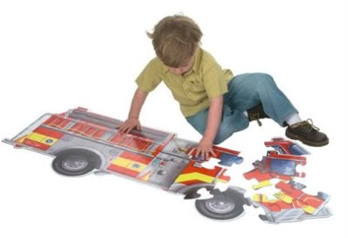
4. Reasoning
Needed to be able to solve problems, make decisions, form concepts & recognize relationships.
Provide children with many opportunities to practice problem solving in a safe way.

Slide 11
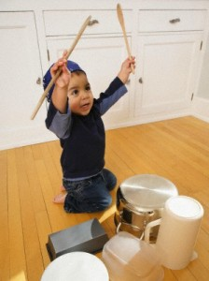
5. Imagination
Can be seen as early as two years old.
Allows a child to try new things and to act out a variety of roles.
Can help children cope with anxiety.
Until about age 5, children are not always sure what is real and what is not.

Slide 12
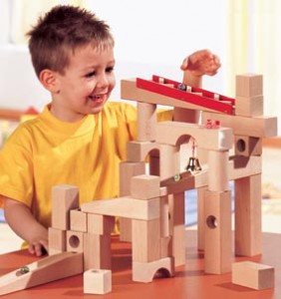
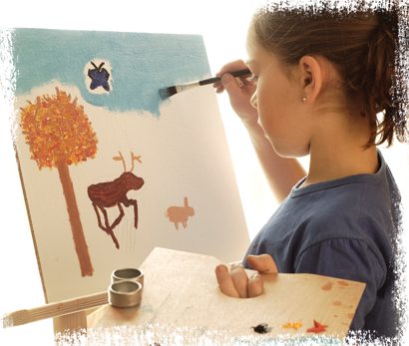
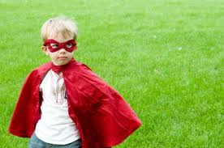
6. Creativity
The imagination is used to produce original ideas.
Artwork
Story
Dramatic Play
Building

Slide 13
7. Curiosity
Curiosity helps brain development.
Children need to be able to safely explore their environment.

Slide 14
Readiness for Learning
In order to learn a new skill, children must be physically and intellectually ready.

Slide 15
Reading Readiness
Learning the skills necessary for reading
Turn pages
Read from left to right
Know that written words
have meaning

Slide 16
Begins very early, as parents read to children
Be enthusiastic
Get child to participate
Later
Letter recognition and sounds
Letters form words

Slide 17
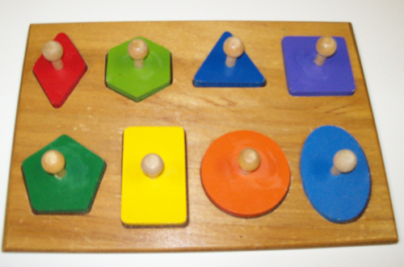
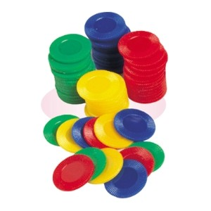
Math Readiness
Learning skills necessary for math
Shapes
Sizes
Amounts

Slide 18
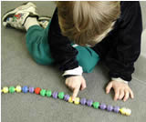
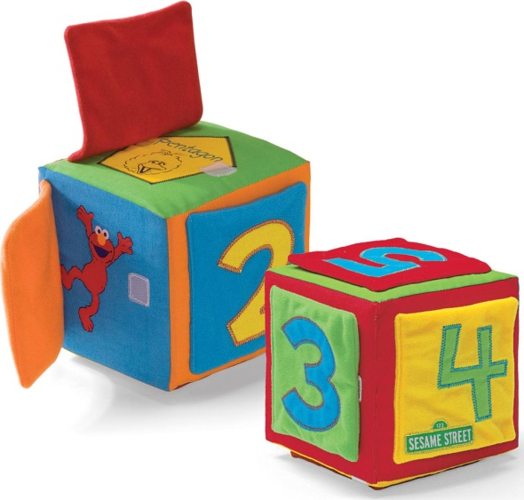
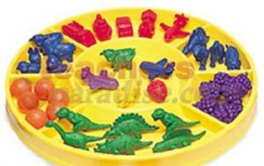
Count with children
Show them shapes
& numerals
Games
Sorting
Blocks,
puzzles

Slide 19
Guiding Learning
Give your time and attention
Allow time for thinking
Give only as much help as the child needs

Slide 20
Encourage children to draw their own conclusions
Demonstrate and model problem solving
Maintain a positive attitude
Keep explanations simple

Slide 21
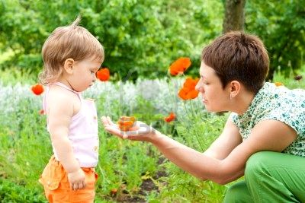
Let children explore and discover
Help children understand the world and how it works
Take breaks

Slide 22
Speech Development
Between one and two, children learn new words
They will use one word to mean an entire sentence
“Up” means “Pick me up.”
“Milk” means “I want milk.”
Talk to children often.
Speak clearly

Slide 23
Age Two
Children combine a few words and use pronouns
“Doggie eat”
“Me do it”

Slide 24
Age Two and a half
Some grammar is used, but not always correctly
Plurals
“My foots growed”
Past tense
“I eated my apple”
Pronouns
“What’s her doing?”

Slide 25
Speech Difficulties
If a child’s speech seems very delayed, get a speech examination
Speech/Language Pathologist:
Someone who is trained to detect and correct speech problems

Slide 26
Possible Speech Problems
Physical
Hearing
Mouth development
Learning disability

Slide 27
Stuttering
Most children outgrow it
Don’t tease

Slide 28
Many children have trouble with articulation:
The ability to speak clearly and distinctly
Trouble with first letters
Skipping syllables
Leaving off endings

Slide 29
Adults should set a good example
Avoid over-correcting

