Slide 1
Building Strong Families
Chapter 3

Slide 2
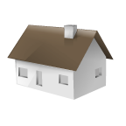
Functions of the Family
Meeting Basic Needs
  Physical Needs:
  Food
  Clothing
  Shelter
  Health & Safety

Slide 3
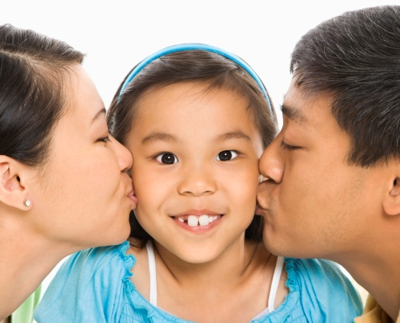
  Emotional needs:
    Love
    Care
    Help

Slide 4
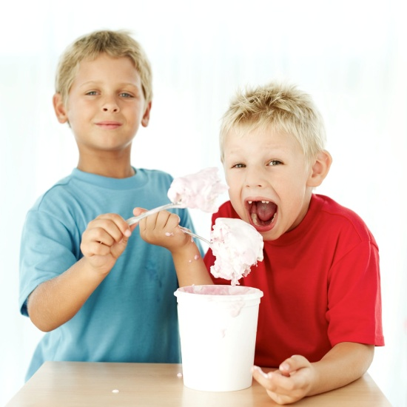

  Social Needs:
- Sharing
- taking turns
- work ethic

Slide 5
Intellectual Needs
    Language
    Numbers
    Schooling

Slide 6

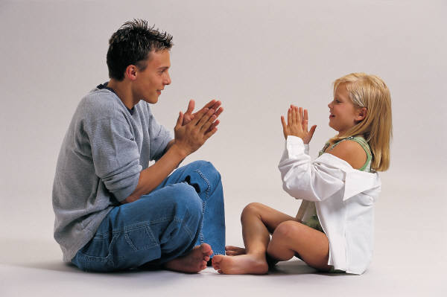
2. Preparing Children to Live in Society
Parents pass on values in several ways
  Through example
  Through Communication
  Through Religious Training
  Through Play

Slide 7
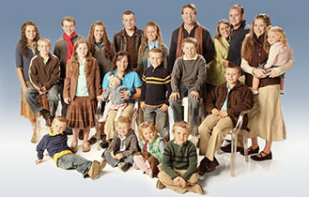
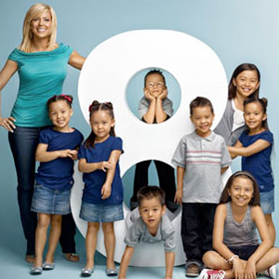
Family Structure
Nuclear Family
  Mother, Father, Child(ren)
Single Parent Family
Mother OR Father, Child(ren)
Custodial Parent: The parent with
whom the child resides

Slide 8
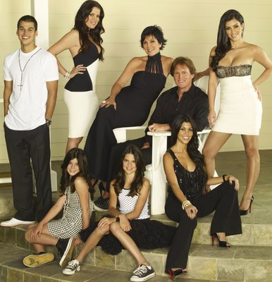
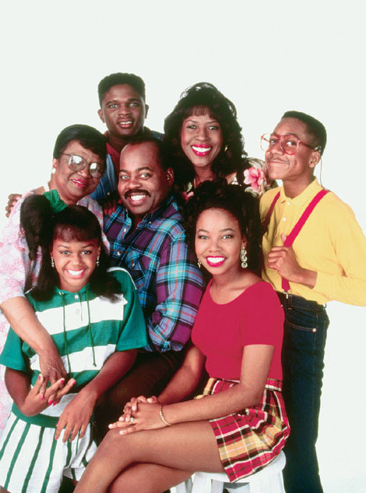
Blended Family
Single Parent with child(ren)
marries person (step parent)
with or without children.
Extended Family
at least one parent,
one child, and other
relative(s).
EX. grandparent

Slide 9

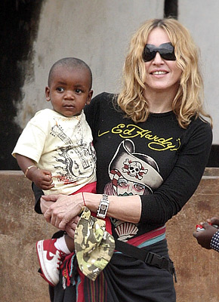

Joining a Family
Birth
Legal Processes:
  Adoption
    Permanent
  Foster Children
    Temporary: These
    Children come from families in difficult circumstances.
    They are placed in a foster home until their parents solve their problems or until a permanent adoptive home
    can be found.

Slide 10
The Family Life Cycle
Beginning Stage
  Establish Home & Relationship
Parental Stage 1
  Prepare for & Adjust to Parenthood

Slide 11

Parental Stage 2
  Parents work to meet children’s changing needs
Parental Stage 3
  Launching – Children leave home

Slide 12


Middle Age
  Couples renew relationships & prepare for retirement
Retirement
  Adjust to having more free time

Slide 13
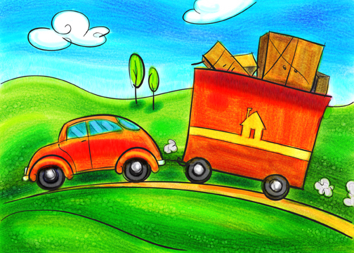
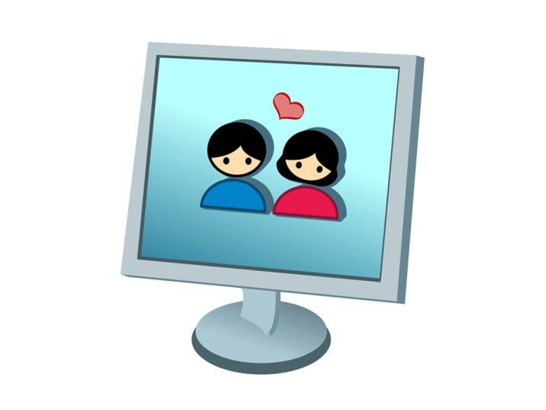
Trends Affecting Families
Mobility:
    Adults move away from
    their childhood
    community
Fewer close relatives
live nearby

Slide 14
Aging Population
  More people are caring for both children and aging parents.
  This allows for more intergenerational interaction

Slide 15
Economic Changes
More families need both parents to work outside the home
Families are smaller, parents are starting families later
More need for day care

Slide 16
Workplace Changes
Types of jobs are changing
Companies are hiring fewer people
Constant need to learn new skills
Possibility of working from home

Slide 17
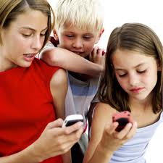

Technology
Makes family life both easier & more complicated
Need to teach children to use technology responsibly
Can cause more family isolation

Slide 18
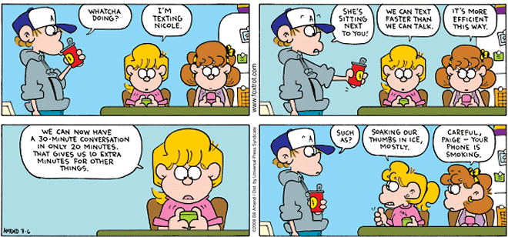

Slide 19
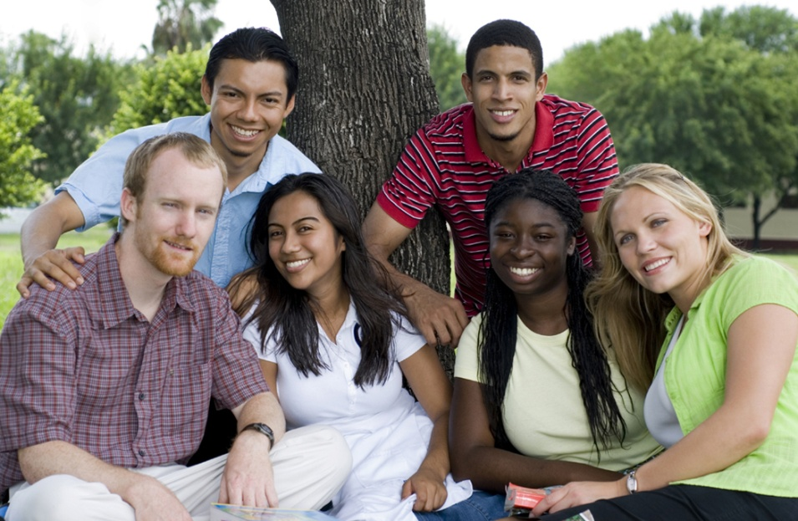
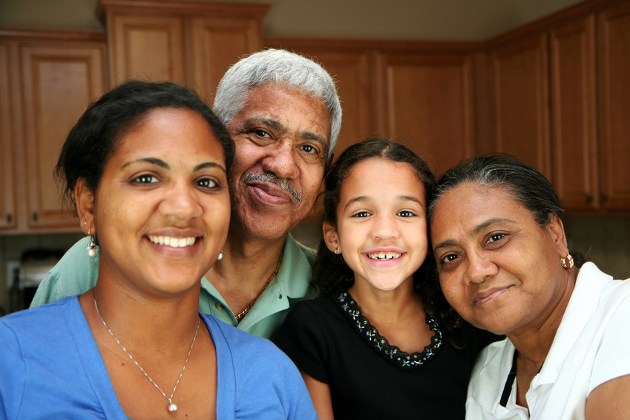
Sources of Family Support
Friends
Relatives
Neighbors
Co-workers

Slide 20
Professionals
  Doctor
  Counselor
  Social worker
  Teacher
  Religious Leader

Slide 21
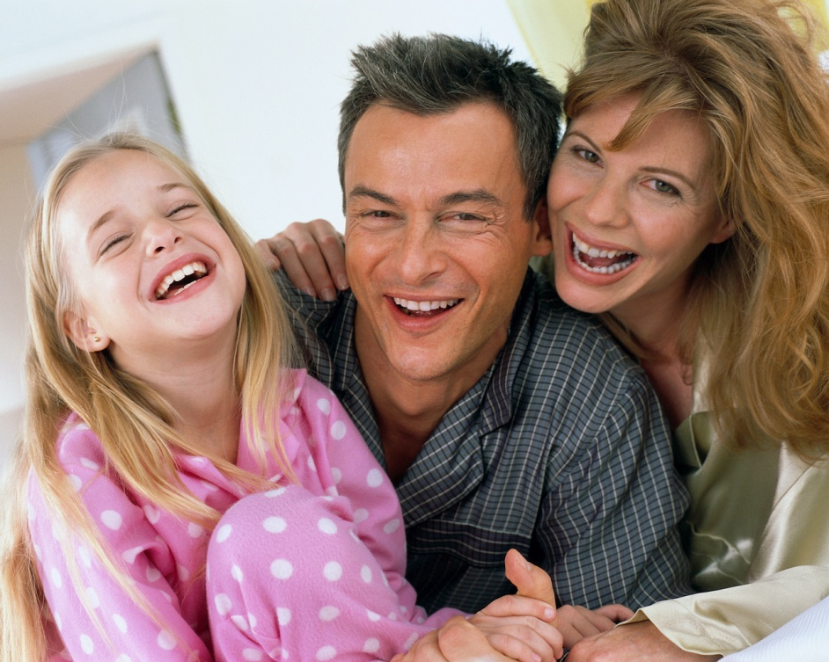
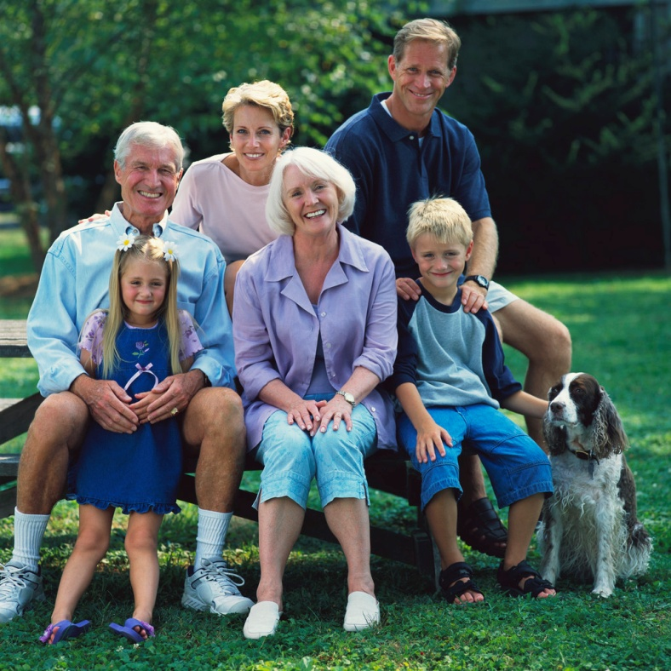
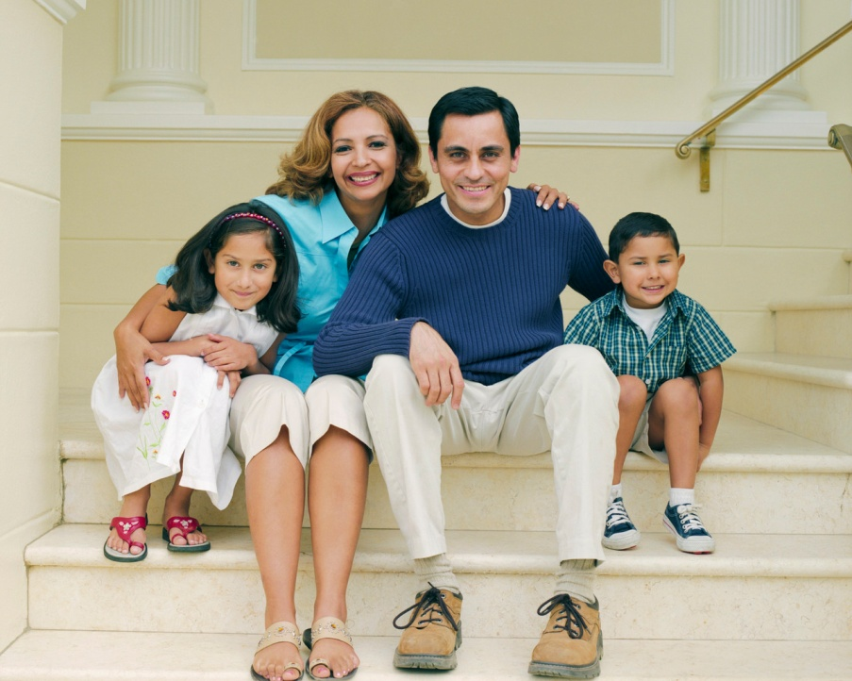
Strong Family: A group where all members feel:
  A sense of belonging
  Acceptance
  Nurtured
  Supported
  Protected

Slide 22
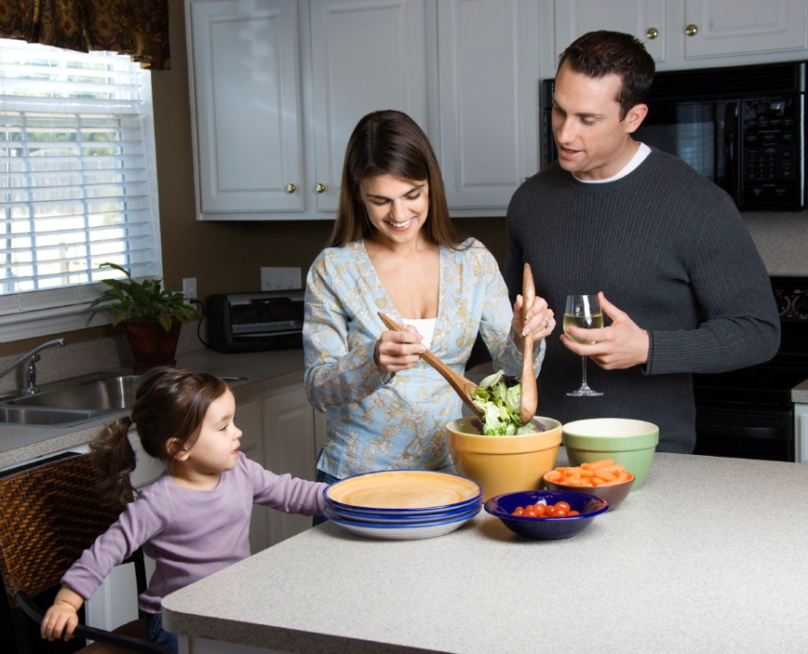
Characteristics of Strong Families
Spend time together
Share Responsibilities

Slide 23
Work together to solve problems
Listen, share goals & values

Slide 24
Forming Traditions
Spending time together is a foundation of a strong family
  There are three types of traditions
  Celebration traditions
  (holidays, birthdays)
  2. Family traditions
  (vacations, family meetings)
  Patterned family interactions:
  daily routines (dinner, bedtime)

Slide 25
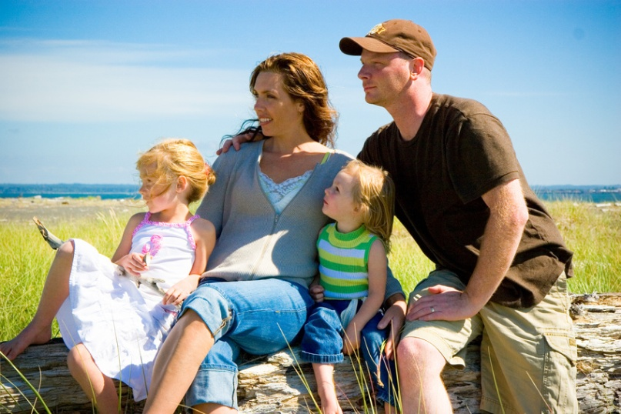
Shared Values
Beliefs held by individuals, family, community, or society
  For example: honesty, kindness, respect, etc.
  Commitment to one another and shared values build strong families

Slide 26
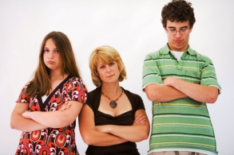
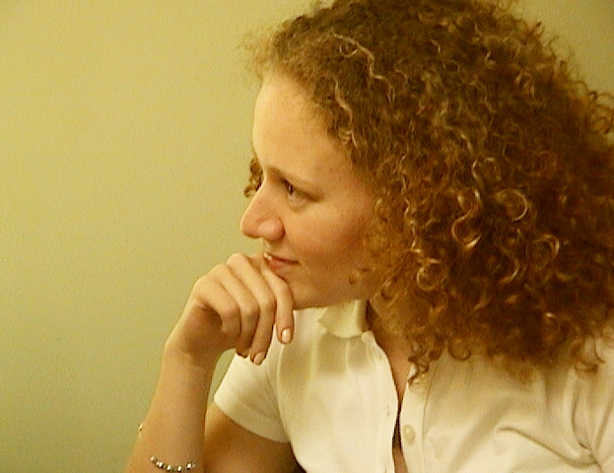

Handling Family Conflict
Keep cool
Be an active listener
Use positive body language

