Slide 1
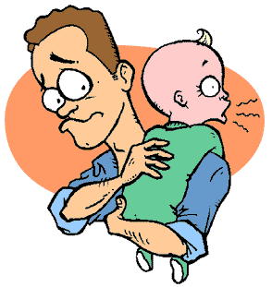
Infant Care Skills
Chapter 7-2 and 7-3

Slide 2
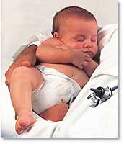
Handling Babies
Babies need to be handled for many reasons
Changing
bathing
feeding
dressing
Cuddling
Hugging
Safety, physical care, and bonding are all involved.

Slide 3
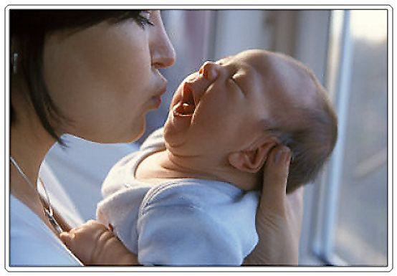
Support head and neck at all times
Babies cannot hold up their head for about 4 months.

Slide 4
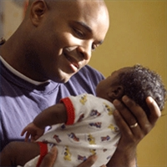
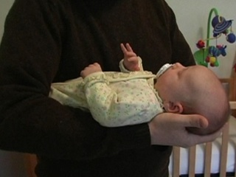
Holding an Infant

Slide 5
Sleep
Sleep is very important for growth and development.
The amount varies, but averages about 16 hours per day.
Place baby face up. Avoid pillows, stuffed toys and fluffy blankets to prevent suffocation.
Cribs slats must not be more than 2 3/8 inches apart!!

Slide 6
Bedtime Routines
Routines help babies get to sleep.
Baths
Fresh diaper
Rocking
Story
Lullaby

Slide 7
When Baby Cries
It is important to respond to baby’s cries. This will not spoil an infant.
One exception: Briefly let baby cry when establishing bedtime habits.
Reasons for crying:
Wet diaper
Hunger
Cold
Pain or Sickness

Slide 8
Responding to Crying Baby
First make sure baby is comfortable, fed, and dry.
Next, try comforting baby by :
rocking
talking
singing

Slide 9
Feeding Baby
Feeding schedule of infants is unpredictable. Feed as much as they want to eat. Infants often feed every 2 to three hours.

Slide 10
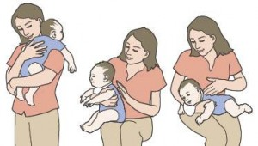
Burping Baby
Babies swallow air as they feed. This makes baby uncomfortable. Burping helps to expel the air. Try once during feeding and once after.
Gently tap baby’s back. Use a burp cloth, as liquid may come up with the air.

Slide 11
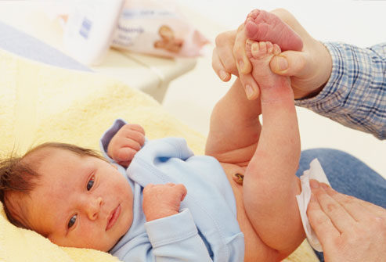
Diapering a Baby
Infants often need 10 or more diaper changes per day.
Remove the diaper and clean the baby. Use a soft cloth or disposable wipe.
Put on a fresh diaper. Hold baby’s ankles and lift body to slide the diaper underneath.
Dispose of used
supplies.
4. Watch out with little
boys. They may
squirt you!

Slide 12
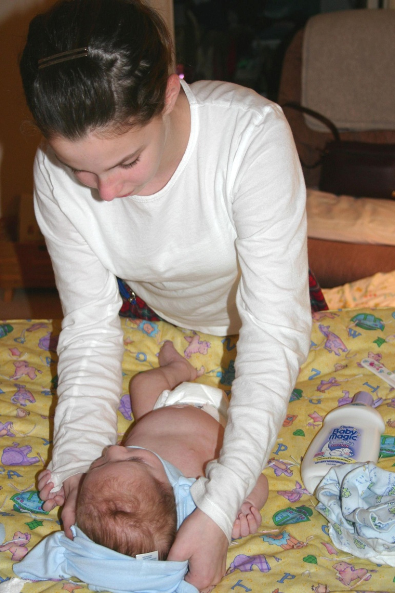
Dressing the Baby
Choose comfortable, stretchy
clothing that is not too tight.
For young infants, open clothing
with snaps is easiest to use.
Use care when pulling a shirt
over baby’s head.
Socks and hats help keep infant
warm.
Hand covers prevent baby from
scratching.

Slide 13
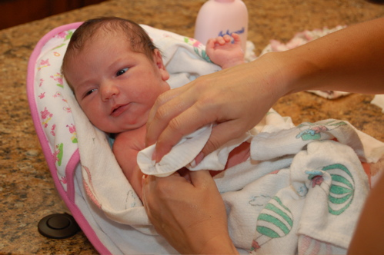
Bathing the Baby
Give baby a “sponge” bath for the first few weeks. (until the naval heals)
Infants only need full baths about twice a week, since you are always cleaning the diaper area.
Use a soft cloth, warm water and mild soap.

Slide 14
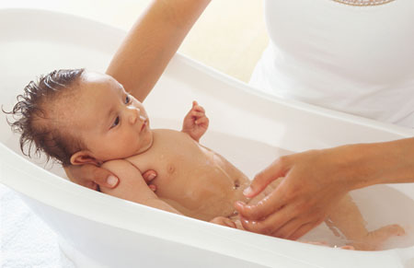
Tub Baths
Use a baby tub, large dishpan, or sink.
Use about 2 inches of warm water.
Use a soft cloth, baby soaps and shampoo.
Avoid getting water and soap in baby’s eyes.
Wrap and dry baby right away to avoid chills.
Try to make bath time fun for baby.

Slide 15
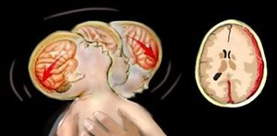
Shaken Baby Syndrome
Damage to baby’s brain caused by shaking the baby
Can cause: mental retardation
cerebral palsy
blindness
neck & spine injuries
death

Slide 16
Video: Never Shake a Baby
http://www.youtube.com/watch?feature=player_detailpage&v=M3xytsg6oDo
8 minutes

Slide 17
When you’re frustrated….
- Put baby down, go into
another room, calm down.
- Ask a friend or relative to
take care of the baby
for a few hours.
- Call someone and talk
about the problem.
- Call a parenting hotline.

Slide 18
Sudden Infant Death Syndrome
(SIDS)
The unexpected death of an infant with no obvious cause. The baby dies in its sleep.
No crying, no evidence of struggle.
The cause is unknown.

Slide 19
Reducing the risk of SIDS
Put babies to sleep on their backs.
Avoid smoking both before and after the baby is born.
Avoid exposing the baby to smoke.

Slide 20
Sudden Infant Death Syndrome
http://www.youtube.com/watch?v=29sLucYtvpA
10 minutes

Slide 21
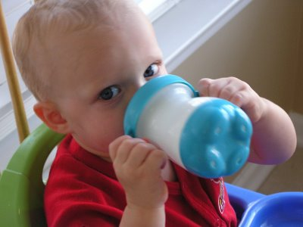
Weaning
Changing from the bottle or breast to a cup.
This usually occurs between 9 and 12 months.
This is best done gradually.
Use a small “sippy” cup that is easy for the baby to hold.

Slide 22
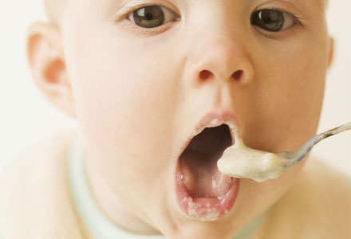
Introducing “solid” foods
Usually begins at about 4 - 6 months.
Start with a little baby cereal in the milk. You can gradually add more cereal.
After cereal, you can introduce new baby foods.
Introduce new foods one at a time and about four days apart in case of allergies.

Slide 23
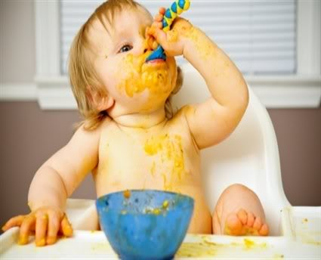
Self-feeding
Usually starts at 8 - 10 months, when baby can sit up in a high chair.
Babies reach out for food with their fingers and reach for a spoon.
Be patient! This is time-consuming and messy.

Slide 24
Small foods that can be eaten with the fingers is best
Start with small foods that can be broken down without chewing: soft fruits such as banana pieces, Cheerios, pasta pieces, cooked veggies, etc.

Slide 25
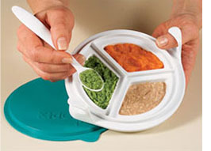
Nutrition
Babies can eat whenever they are hungry.
Calories are necessary for activity and rapid growth.
Include protein, dairy, fruits, veggies, & grains.
Foods should provide key nutrients: vitamins, minerals, etc.
Liquids are also important.

Slide 26
Malnutrition
Inadequate nutrition during infancy can cause lasting physical problems, including poor brain development.
Government programs are available to help prevent childhood malnutrition.
WIC - Women, infants, & children:
provides low income women with nutritious food for their babies.

Slide 27
Allergies
An oversensitivity to a particular substance that is harmless to most people. The body attacks the substance and the side effects are the symptoms of the allergy.
Symptoms may include:
- skin rash - fussiness
- puffy, itchy eyes - vomiting
- trouble breathing - watery stools

Slide 28
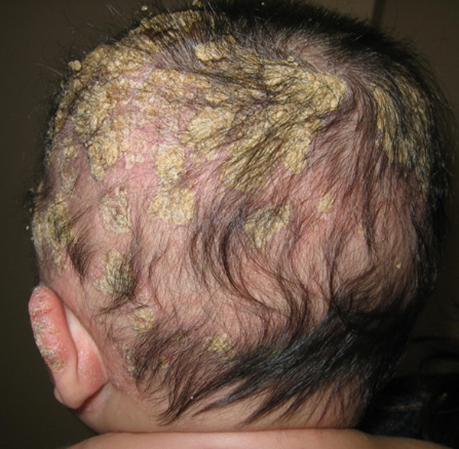
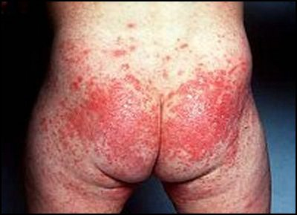
Skin Conditions
Cradle cap: yellowish, crusty patches on the scalp.
Diaper rash: patches of rough, irritated skin in the diaper area.

Slide 29
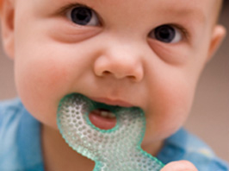
Teething
Usually begins at about 6 months. The teeth begin to push through the gums.
This can be painful.
Causes baby to become cranky, fussy, drool and develop a fever.
Provide something clean and safe for the baby to chew on.

Slide 30
Infant Safety Concerns
Choking
Suffocation
Water
Falls
Poisoning
Burns
Sun
Animals
clothing

Slide 31
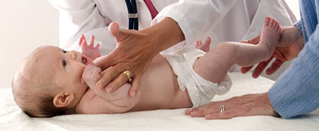
Checkups
The pediatrician will track the baby’s growth and development.
Immunizations: Shots to help prevent disease.
Vaccine: a dead or artificial virus is injected. The body thinks it is real and develops antibodies to destroy it. If you ever get the real, live virus, you already have the antibodies to destroy it. Example: chicken pox

