Slide 1
Chapter 9-3
Helping Infants Learn

Slide 2
Encouraging Learning
Provide Basic Care
The infant will make brain connections based on the relationship between his/her needs and the caregiver’s actions.

Slide 3
Learn about child development
This will help you provide age appropriate toys and experiences.

Slide 4
Provide time and attention
Talking and interacting

Slide 5
Provide positive feedback
This encourages the baby to keep trying new things

Slide 6
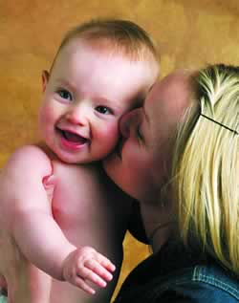
Express Love
This helps with self-confidence

Slide 7
Talk, talk, talk
This stimulates brain development

Slide 8
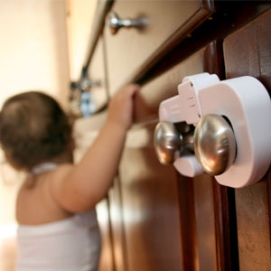
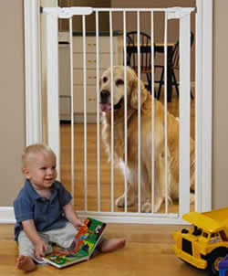
Safe Learning
Babies need as much freedom of movement as possible.
This requires a safe environment. Take measures to childproof your home.

Slide 9
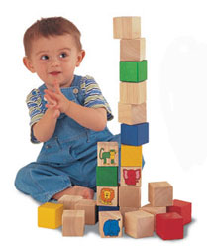
The Importance of Play
Toys are the tools of learning. Development of all types is enhanced by playing.

Slide 10
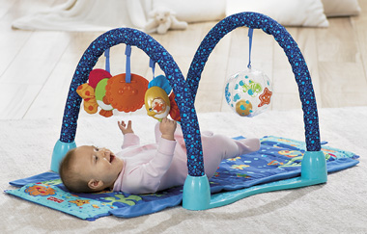
Age Appropriate Toys
Babies will need different toys as they age and develop
1 – 3 months
Simple toys to look at and listen to

Slide 11
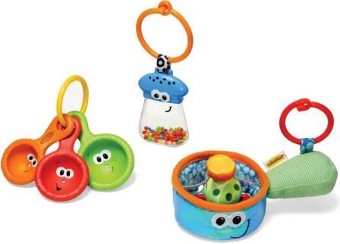
4 – 6 months
Toys to touch, handle, bang, shake, suck and chew.
Baby books

Slide 12
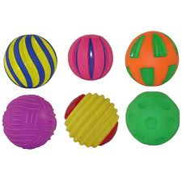
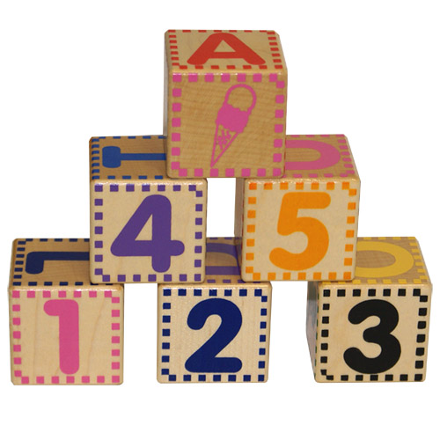
7 – 9 months
Still things to handle and that make noise
Also blocks, balls, and other large items
(pots and pans are good too)

Slide 13
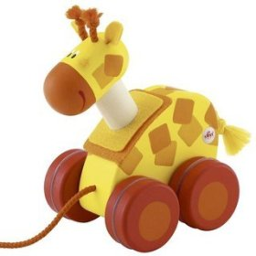
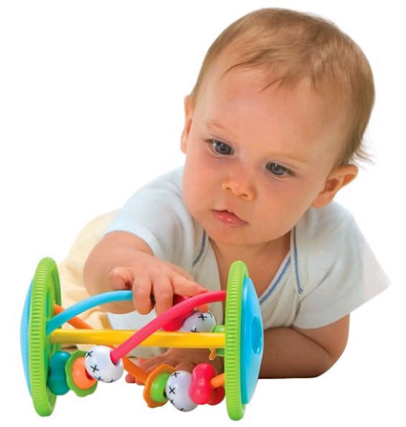
10 – 12 months
Toys that they can crawl after. Push or Pull toys
Toys that they can manipulate or work with their hands
Containers
Picture books

Slide 14
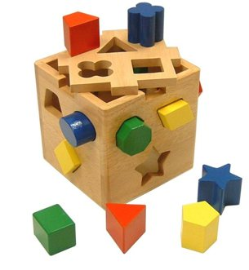
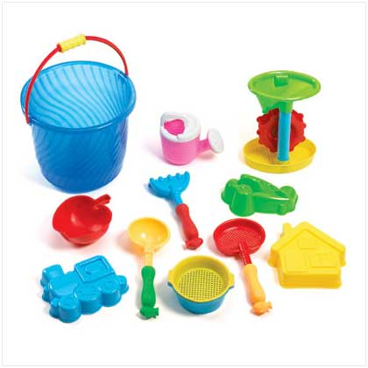
Choosing Toys
Encourage participation and use
Ones that will remain interesting and useful for a long time

Slide 15
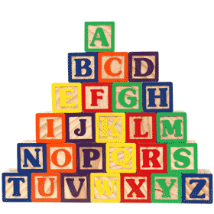
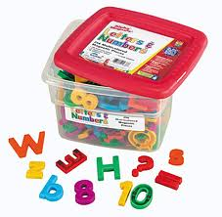
Toys that will last, have no small parts or lead paint
Toys that can be used in more than one way

Slide 16
Communication
Crying – different cries for different things

Slide 17
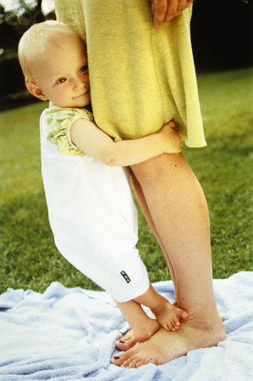
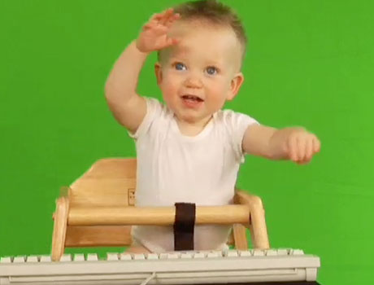
Body language
Wiggling
Clinging
Pushing away

Slide 18
Talking use simple clear speech
use repetition

