Slide 1
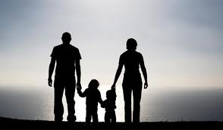
Chapter 1-1
Children and Parenting
Making a Difference in Children’s Lives

Slide 2
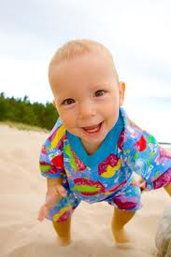
Benefits of Studying Children
Learn why children feel, think, and act the way they do.
Typical Behaviors:
Ways of acting or responding
that are common at each
stage of childhood.

Slide 3
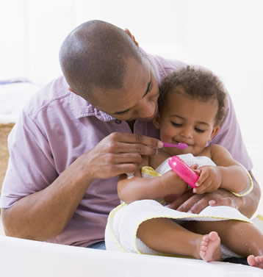
Discover Caregiver’s Importance.
Caregiver:
Parents and others who tend to young children

Slide 4
3. We will enjoy children more.

Slide 5
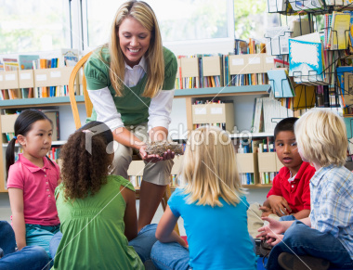
4. We will learn about career opportunities

Slide 6
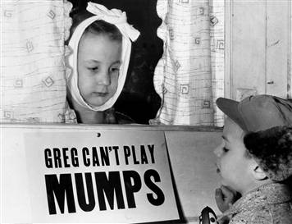
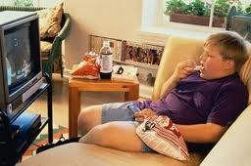
Comparing Childhood Past & Present
Health
Past Present
More childhood Better health care
diseases and death Poor food choices
Lack of exercise

Slide 7
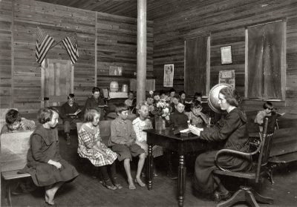
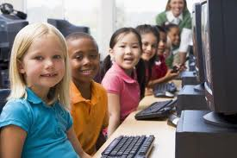
Education
Past Present
Not all children in school Most children in school
Small schools Larger schools
Different ages in same Students grouped by age
Class More technology

Slide 8
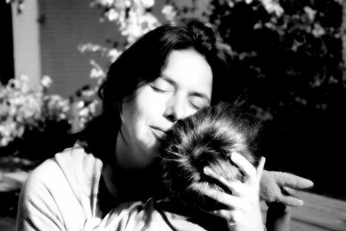
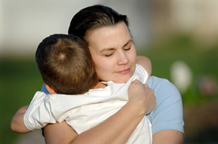
Love
The need for love has not changed.
Past Present

Slide 9
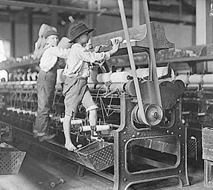
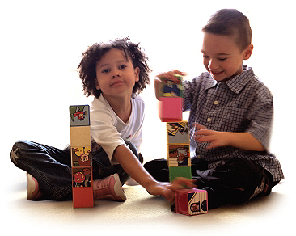
Work
Past Present
children worked at Children banned from early ages in adult jobs working in most places
Children work at learning
and playing

Slide 10
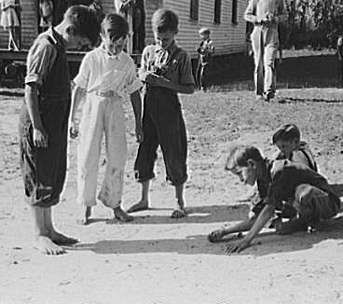
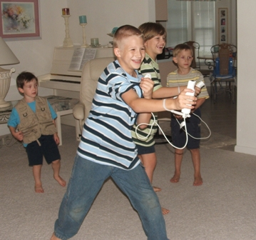
Play
Past Present
Fewer, simpler toys More high-tech toys

Slide 11
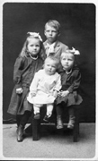
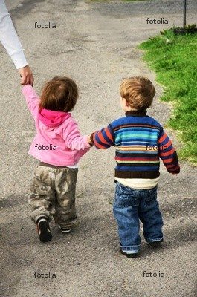
Dress
Past Present
More formal Less formal

Slide 12
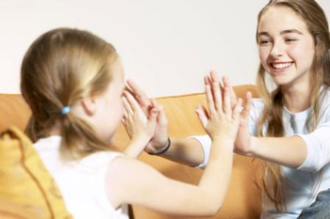
Living What You Learn
Gaining New Skills

Slide 13
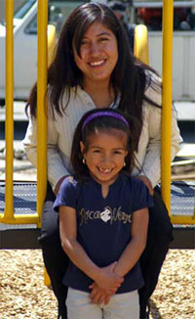
Understanding Yourself

Slide 14
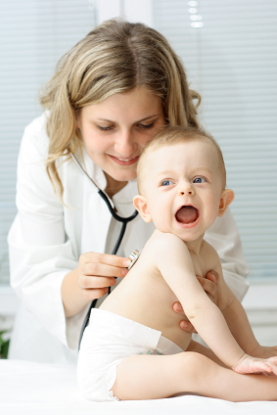
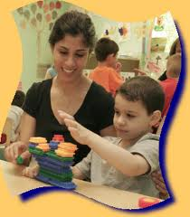
Building for the Future

