Slide 1
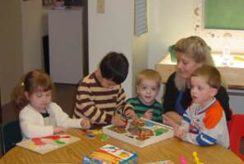
Observing and Interacting with Children
1-3

Slide 2
Why Observe Children
Lets you see children as individuals meeting the challenges of development in their own ways & in their own time.
Allows you to identify children who have a disability or require extra care
Lets caregivers know how successful their strategies are

Slide 3
How to Observe Young Children
Objective Versus Subjective Observations
Subjective: relies on personal opinions & feelings rather than facts
Objective: is factual. The observer leaves aside personal feelings and describes only what was seen or heard.

Slide 4
Types of Observations
Running Record: Write down everything you observe for a set period of time (ex. 15 min.)
Anecdotal Record: You concentrate on a specific area of development. No time limit.
Frequency Count: A tally of how often a certain behavior occurs.
Developmental Checklist: Observers check off skills or behaviors they see on a checklist.

Slide 5
How to Act While Observing
Formal: Set up with a child care center
Informal: You are less obvious, such as at the mall.
Try not to be noticed – your presence may affect the children’s behavior.
In some cases, you may have to interact with the child.

Slide 6
Using Observations
Once you have your observations written down, you need to analyze it. This is called interpretation.
Confidentiality: You must protect the privacy of the child and his/her family. Information may be shared only with the child’s parents or the child development teacher.

