Slide 1
Chapter 3-2
Meeting Children’s Needs

Slide 2

Meeting Children’s Needs
Physical, Emotional, Social, Intellectual
  Deprivation: a lack of the critical needs and an encouraging environment that are essential to meeting these needs
  Remember Danielle

Slide 3

Parenting Styles
The way that parents and other caregivers care for and discipline their children
3 Main Styles
Authoritarian: Parents believe that children should obey without question. When rules are broken, parents respond quickly and firmly.

Slide 4
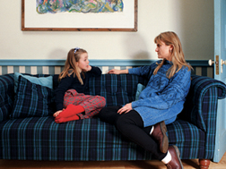
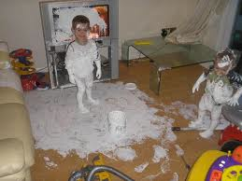
2. Assertive-Democratic: Children have some input into rules and limits. When rules are broken, child has some input into punishment.
3. Permissive: Parents give children much freedom. Children set their own rules. Rule-breaking is ignored.

Slide 5

Guiding Children’s Behavior
Guidance: Using firmness and understanding to help children learn right from wrong.
Can lead to:
Self-Discipline: The ability to control one’s own behavior
Gradually, children will develop a:
Conscience: An inner sense of
what is right and wrong.

Slide 6
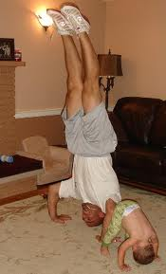
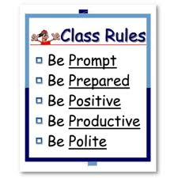
Ways to Guide Children
Being a Role Model: Children imitate.
They learn best by following the
example of those around them.
-Setting Limits: Limits include physical
restrictions and rules of behavior.

Slide 7
Guidelines for Setting Limits
Does the Limit allow the child to learn, explore, and grow? Too much restriction hinders development
Is the limit fair and age appropriate?
Does the limit benefit the child, or is it merely for the adult’s convenience?
  Be simple, clear, calm, and direct
  Repeat as needed
  Consistency is important

Slide 8
Positive Reinforcement
Giving children attention when their actions are appropriate
A response that encourages a particular behavior
Be Specific
Comment on the behavior as soon as possible
Recognize small steps
Help children take pride in their actions
Tailor the encouragement to the needs of the child
Use positive reinforcement wisely (not all the time)

Slide 9
Dealing with Inappropriate Behavior
Misbehavior happens
  Think about the following when deciding what to do:
    Is the child’s behavior age appropriate?
    Does the child know the behavior was wrong?
    Was the behavior deliberate, or beyond the child’s control?

Slide 10


Unintentional Misbehavior
Don’t punish a behavior that is unintentional.

Slide 11
Using Punishment Effectively
Can help remind children that appropriate behavior is expected and that there are consequences for poor choices.
Show that you disapprove of the behavior, but still love the child.
Warnings are a good first step.
Punishment must fit the behavior.

Slide 12
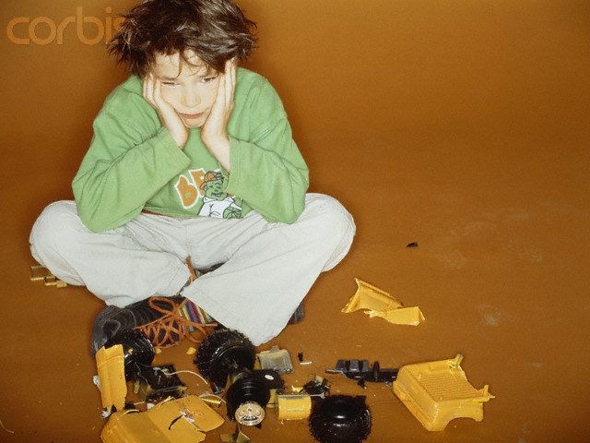
Negative Reinforcement
A response aimed at discouraging children from repeating an inappropriate behavior.
Natural Consequences: Children naturally suffer from the results of their actions.

Slide 13

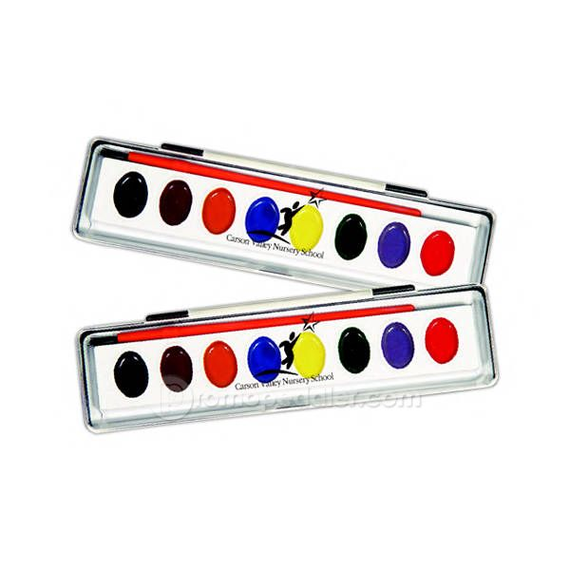

2. Logical Consequences: consequences that have a connection to the misbehavior.

Slide 14

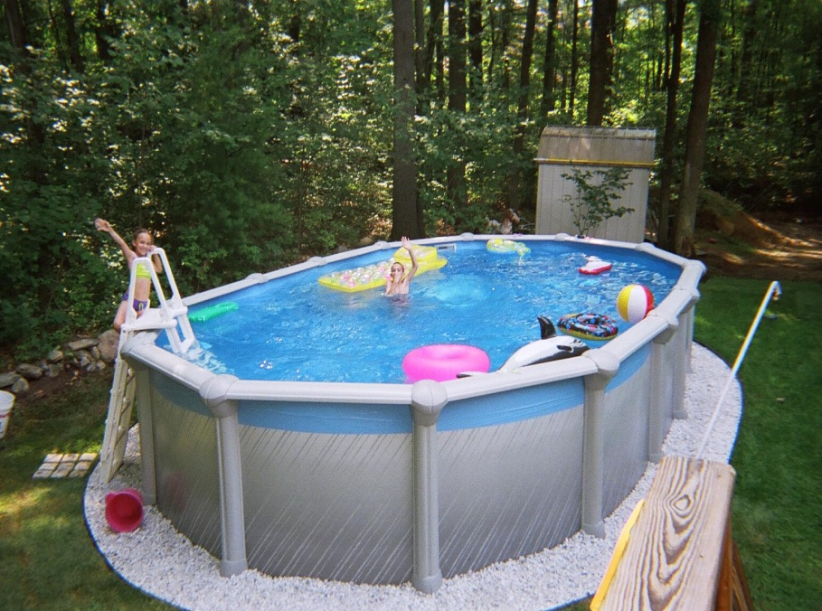
3. Loss of Privileges
Best used on children older than 5
Best if the privilege is related to the misbehavior
ex. No lifejacket, no swimming

Slide 15

4. Time Out
A short period of time when
the child sits away from
others and activity.
It gives the child a chance
to calm down and regain
self-control.
One minute per year of age.

Slide 16

Poor Disciplinary Measures
Bribing: Children learn to expect rewards for inappropriate behavior.

Slide 17


Making children promise to behave
Children may feel forced to lie about misbehavior, rather than disappointing someone they love.

Slide 18

Shouting or yelling
This can be very frightening to young children.
Older children learn to tune out yelling.
Not good modeling.

Slide 19

Shaming, Belittling, or Embarassing
Parents should not ridicule children’s mistakes.

Slide 20
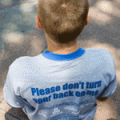
Threatening to Withhold Love
Telling children that you won’t love them anymore may make them fear rejection or abandonment.

Slide 21

Exaggerating the Consequences
Parents cannot follow through with some consequences, which will cause them to lose credibility.

