Slide 1
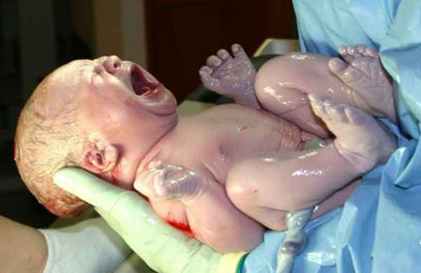
Chapter 6
The Baby’s Arrival

Slide 2
Labor & Birth
The Beginning of Labor
Lightening: The baby settles deep in the uterus
Less pressure on the upper abdomen
Can happen any time in the last few weeks

Slide 3
Early Signs of Labor
Bloody show: mucous that plugs the uterus during pregnancy dissolves, leaving a small pinkish or bloody stain. Can happen in the last few days.
Water breaks: A break in the amniotic sac. This causes amniotic fluid to leak out. Up to 48 hours before birth.

Slide 4
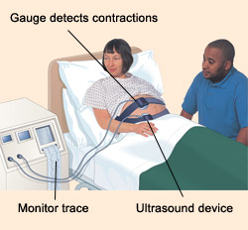
Contractions: Muscles of the uterus contract and relax. The contractions help to push the baby down. As you get closer to delivery, they become longer, stronger, and closer together.
Fetal Monitoring: Watching the baby’s heart rate, usually with an ultrasound device

Slide 5
Premature Labor: When labor begins before 37 weeks.
False Labor: Contractions, but not actual labor contractions (not regular, and don’t become stronger)
Inducing Labor: Starting labor by artificial means (usually medication)
Done for medical reasons or emergencies, or after 42 weeks.

Slide 6
Stages of Labor
Stage 1:
Contractions: They Increase in strength, length and frequency
(60 seconds in length, 5 – 6 minutes apart)
Dilation: The cervix dilates (opens and gets larger)
Transition: Cervix is fully dilated (10cm diameter)
Strong contractions, lasting 90 seconds & 2 – 3 minutes apart

Slide 7
Stage 2:
Contractions push the baby through the vagina (birth canal)
The baby’s head narrows and elongates to fit through.
Doctors support the head. The shoulders follow, one at a time.
The rest of the baby follows quickly

Slide 8
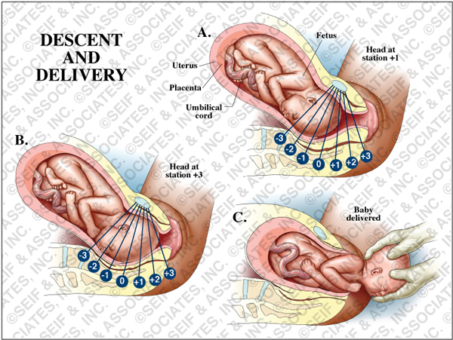
Stage 2

Slide 9
Stage 3:
Smaller contractions help to separate the placenta from the uterus and push it out.
The placenta and umbilical cord contain cord blood. Cord blood contains stem cells. These cells are capable of becoming any type of cell. They can be saved and stored for later use. They can be used to treat illnesses.

Slide 10
Cesarean Birth
When the baby is surgically delivered through an incision in the mother’s abdomen.
Reasons for this include:
Lack of progress during labor
Baby is in distress
Baby is in wrong position
Mother is having multiples
Requires up to 6 weeks for recovery

Slide 11
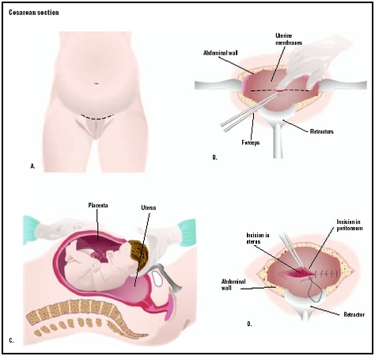
Cesarean Birth

Slide 12
Pain Relief
Epidural – a medication injected into the lower back that numbs the lower half of the body. It is the most commonly used pain reliever during childbirth.

Slide 13
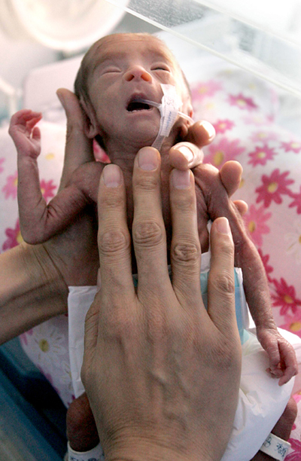
Premature Birth
Births before 37 weeks.
(5-6% of births)
Body systems are not
yet mature & ready
to live outside the womb

Slide 14
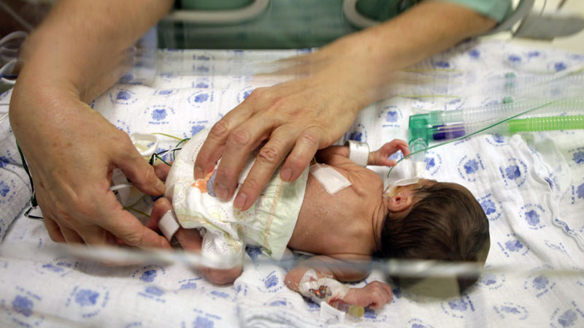
Premature babies often need to be placed in an incubator.
The incubator controls oxygen, temperature & humidity to help the baby develop.

