Slide 1
The Newborn

Slide 2
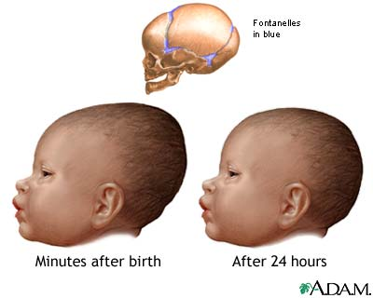
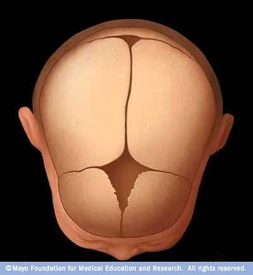
Appearance of the Newborn
Head is large for body
May be misshapen due
to birth
Fontanels: soft spots on
the baby’s head where the
bones of the skull have not
yet fused. These will join
together within 18 months.

Slide 3
Babies need to be kept warm
Blankets & caps are used
Some babies have lanugo - Fine downy hair This will soon
disappear.

Slide 4
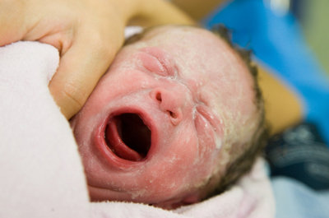
Some babies are covered in vernix. It is a white, pasty substance. It will wash off during the baby’s first bath.

Slide 5
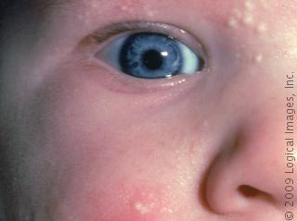
Many babies have milia on their nose and cheeks. These little bumps are plugged oil ducts, similar to acne. It will disappear in a week or so.

Slide 6
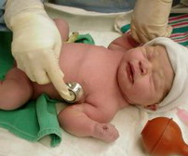
The Apgar Scale
When the baby is one minute old, and five minutes, old, doctors evaluate the baby’s physical condition using the APGAR scale.
Five factors are rated on a scale of 0 – 2
Heart rate
Breathing
Muscle tone
Color
Response to stimulation

Slide 7
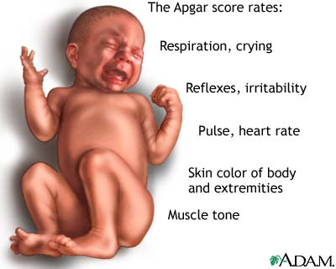

Slide 8
Apgar Scale, Continued
A 10 would be a perfect score.
6 – 10 is normal after 5 minutes.
Lower than this means the baby needs medical attention

Slide 9
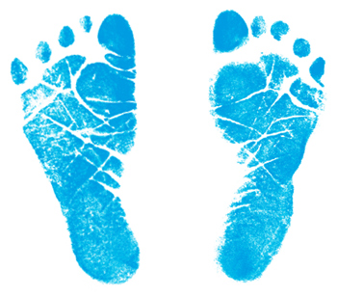
Babies are then weighed, measured, cleaned up and dried.
A footprint is taken
Blood is taken from the umbilical cord and tested for certain diseases

