Slide 1
6-3 The Postnatal Period

Slide 2
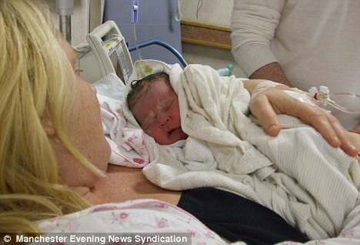
Bonding
Forming emotional ties between parents and baby.
Research shows that this is vital for a baby’s development (including brain development)
Newborns are placed with their parents as soon as possible. Baby’s learn their parents smells, voices, & touch.

Slide 3
Nursing can begin right away.
This helps the uterus contract & stop bleeding.
Colostrum: Early breast milk that is high in calories & protein. It helps protect the baby against illness.

Slide 4
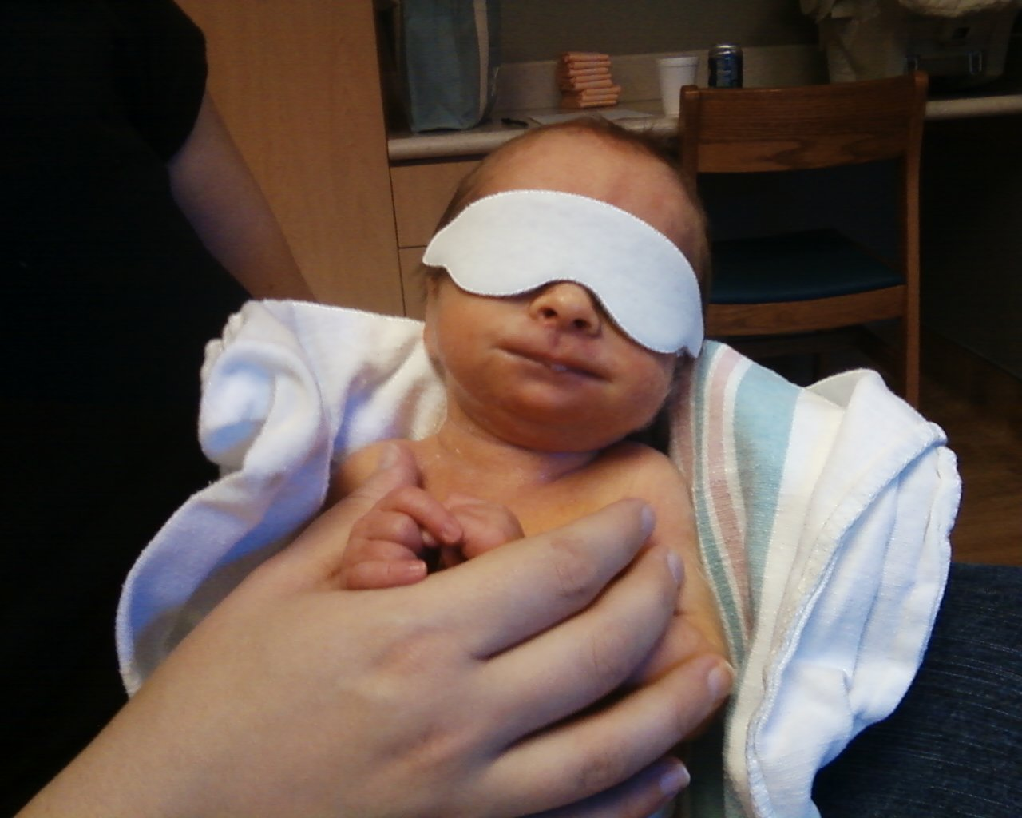
The Neonatal Period The baby’s first month of Life
Jaundice: common in newborns. Baby’s eyes & skin will look yellowish. The liver can’t remove bilirubin, a substance produced by the breakdown of red blood cells.

Slide 5
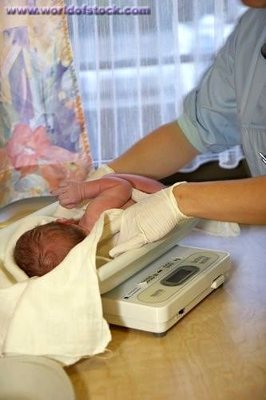
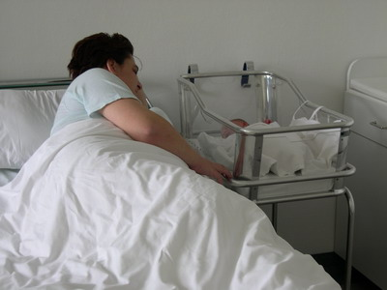
Weight loss is common in first few days,
but then weight gain will begin.
Lactation Consultants: can help moms
learn to breastfeed.
Rooming in: when the newborn can stay in the room with mom

Slide 6
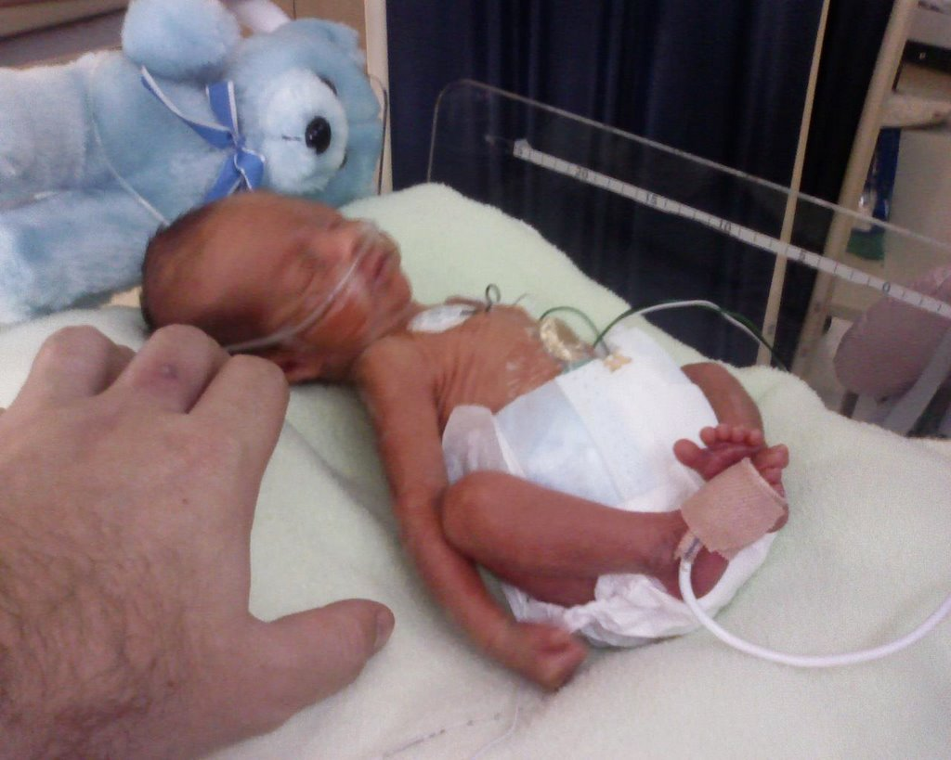
Premature Babies
Born before 37 weeks
Need a longer hospital stay
Often fed through a tube in the stomach
Breathing machines help babies with immature lungs
Many are placed in incubators for warmth

Slide 7
Postnatal Care of Mom
Mom’s Physical Needs:
Rest
Exercise – gentle at first
Good nutrition – especially if breast feeding
Medical checkups
Mom’s emotions
Confusion
Mood swings
Irritability
“Baby Blues”

Slide 8
Postpartum Depression
About 10% of new moms have “the blues” that don’t go away and worsen. It can get to the point where the moms are not interested in the baby and may think about causing harm. Women who experience this need to get treatment. It is more common in teen moms.

