Slide 1

The Challenges of Parenting
Section 2-1 Parenting and Families

Slide 2

Parenting: Caring for children.
Helping them grow and develop

Slide 3
Parenting is complicated -
It requires understanding children & good judgment.
- Times to help, times not to
  (children must learn from setbacks)
  - Encourage children to try new things
  (without being too pushy)
  Parents must change/adapt as children grow
  Parents need to have reasonable expectations

Slide 4




How to Build Parenting Skills
Books, magazines,
on-line information
Experience working with children
Advice from experienced parents
Observation

Slide 5
Stages of Parenthood
Parents develop & change just as their children do.
When they’re aware of the stages, they can be more prepared and effective.

Slide 6
Galinsky’s Stages of Parenting
Stage | Time Period | Parents’ Tasks
Image-Making | Pregnancy | Begin to imagine themselves as parents
Nurturing | Birth to Age 2 | Become emotionally attached to child May question relative worth of other priorities
Authority | Age 2 to Ages 4-5 | Determine rules Clarify role as authority figure
Interpretive | Ages 4-5 to Age 13 | Rethink their role as parents Decide what knowledge, skills, and values child needs
Interdependent | Adolescence | Establish boundaries Find disciplinary methods appropriate for teens
Departure | Child Leaves Home | Evaluate their parenting

Slide 7


Changes that Parenthood Brings
New Responsibilities:
  Put someone else first
  More financial costs
  Time needed to care for child
Changes in Lifestyle:
  Sleep loss
  Less time for yourself
  personal freedom
  Less energy
  Making arrangements for child care, Dr. visits, etc.

Slide 8


Emotional Adjustments:
  Fear
  Frustration
  Worry
  Jealousy
  Depression
Relationship Adjustments:
  Arguments between parents
  Changes in relationships between
  the new parents and their parents.
  (grandparents)

Slide 9

Employment:
  Stop working or cut back
  Can change family income
  Child care is expensive
Rewards:
  Happiness, pride, love, joy
  Sense of accomplishment
  See the world with new eyes

Slide 10
Making Decisions About Parenthood
What does it involve?
Emotional Maturity:
The ability to put someone else’s
needs before your own.
  Don’t expect anything in return
  Ability to control your temper
  Can handle a non-stop job

Slide 11
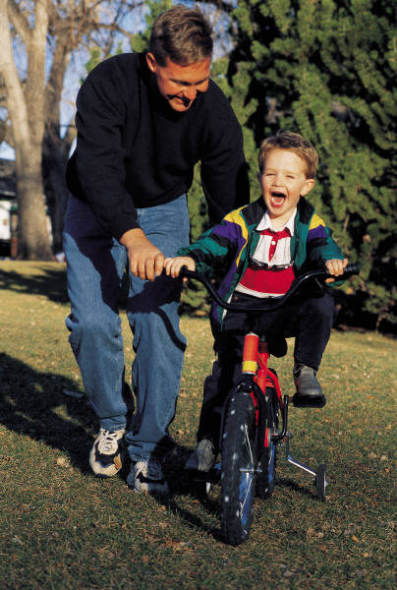

Desire for Parenthood:
  You really want to have a child
  You aren’t using it to solve a
  personal problem
  (low self-esteem, relationship
  problems, etc.)
Health:
  Good health is important
  Age: Under 17 & over 35 is more risky
    Teens: less likely to get prenatal care
    Older moms: higher chance of diabetes, high blood pressure and birth defects

Slide 12
Finances:
  Expensive – must be able to afford it
  Be willing to change your lifestyle
    For example:
      Will you stop working?
      Can you afford child care?

Slide 13
Resource Management Skills
Set Goals: Decide what is most important
        Prioritize
Identify Resources: sources of money or other help
Make a Plan: Decide how you’ll use the resources
Put the plan into action
Reevaluate from time to time: when resources change
Set new goals: when existing goals have been reached.

