Slide 1
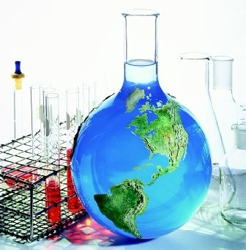
CHEMICAL ANALYSIS
OF LIS WATER

Slide 2
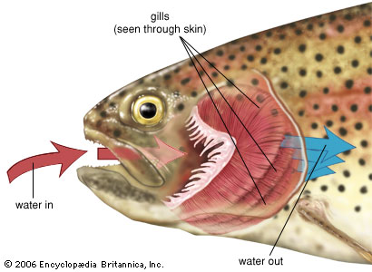
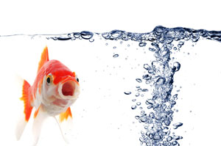
DISSOLVED OXYGEN
What do organisms need oxygen for?
How do organisms get oxygen out of the water?

Slide 3
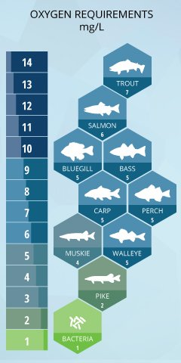

Slide 4
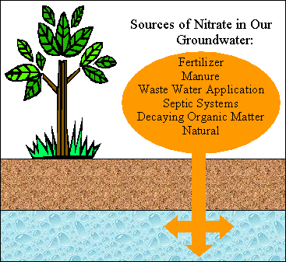
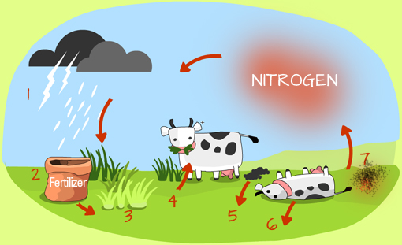
NITRATES/NITRITES
Where does nitrogen come from?
How are nitrates (& nitrogen) pass through an ecosystem?

Slide 5
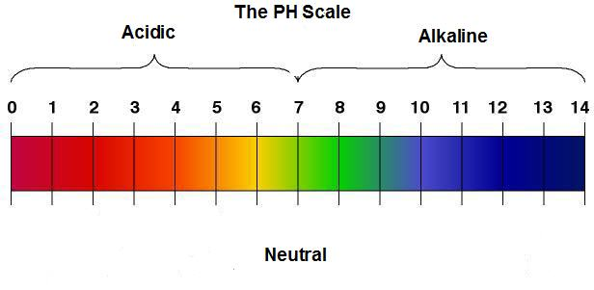
pH
What does pH measure?
High or low pH?

Slide 6
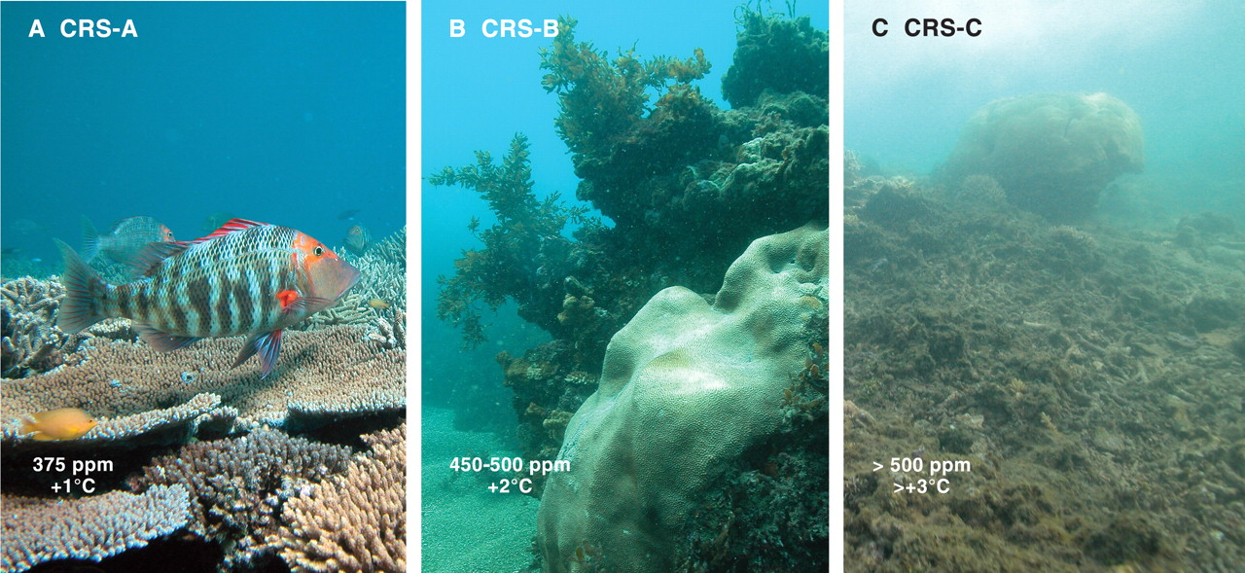
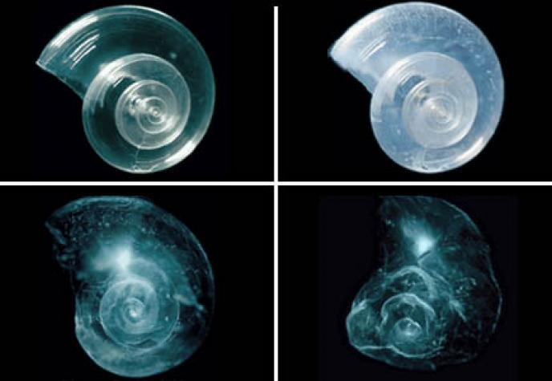

Slide 7
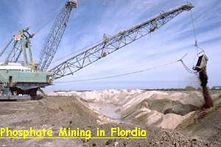
PHOSPHORUS
Where does P come from?
Ideal levels: <0.03 ppm
http://reefkeeping.com/issues/2004-05/rhf/

Slide 8
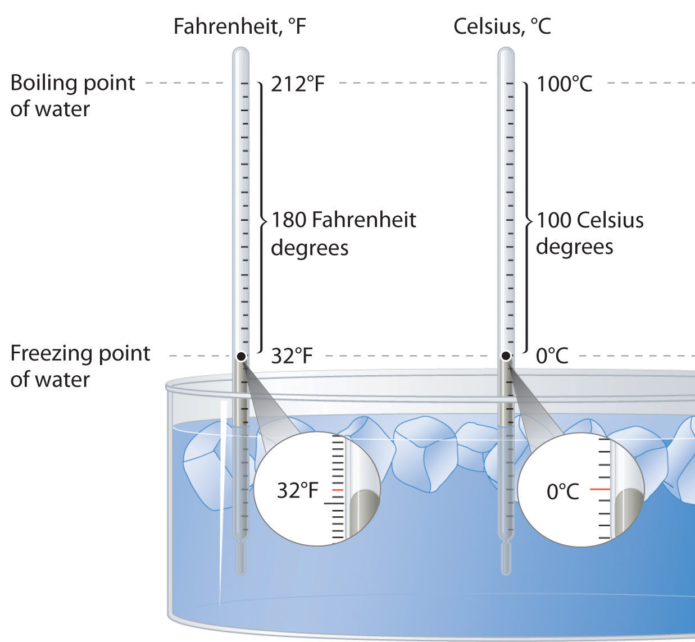
BOILING POINT/FREEZING POINT
Water vs. Salt water?
Boiling point is lowered
Freezing point is increased

Slide 9
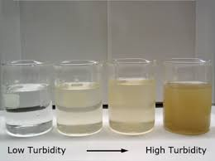
TURBIDITY
What causes an increased turbidity?
What happens to fish in high turbidity?

Slide 10
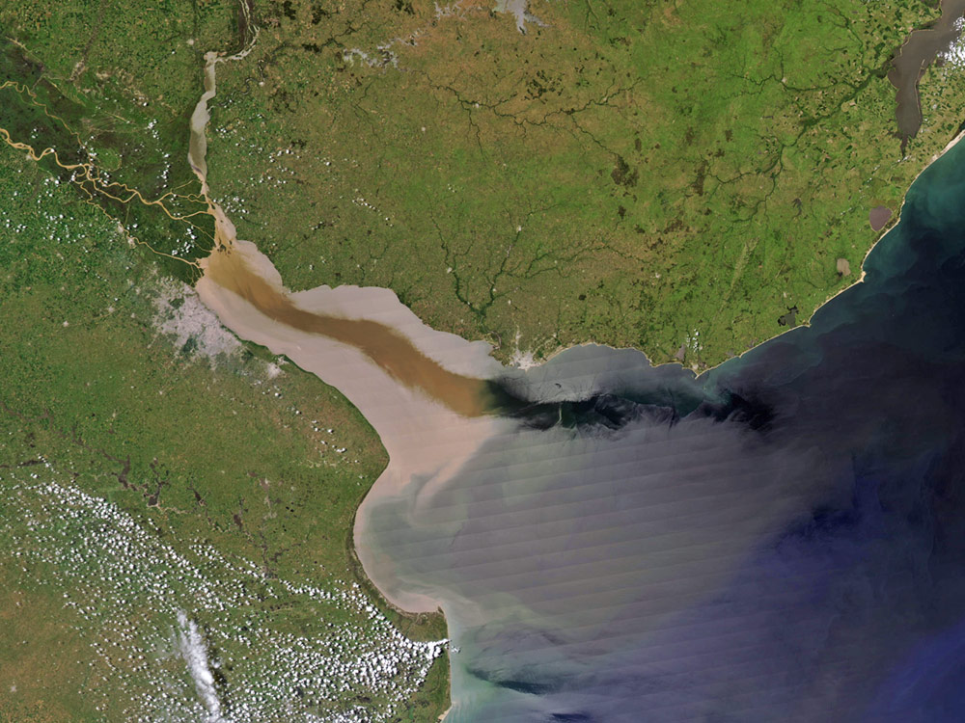
SALINITY
Where does salt come from?

Slide 11
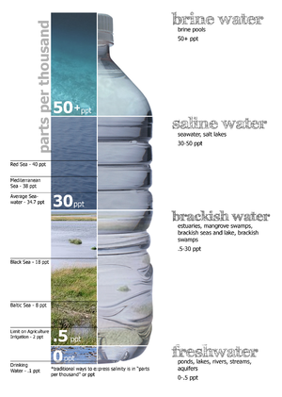
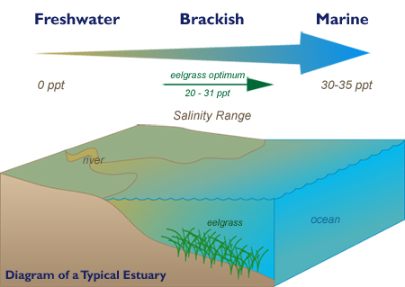
What is ppt, ppm?

