Slide 1
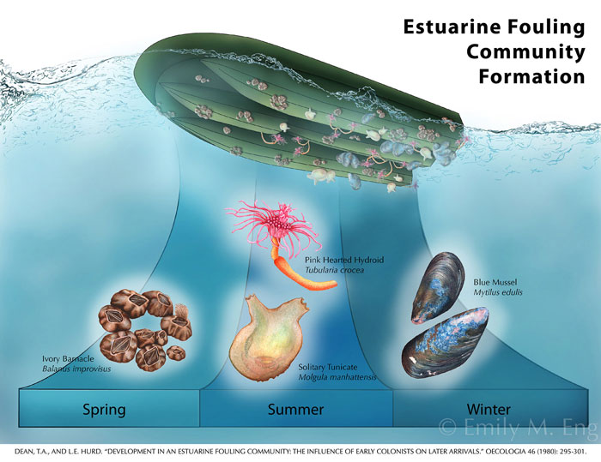
Groups of organism that settle on man-made structures

Slide 3
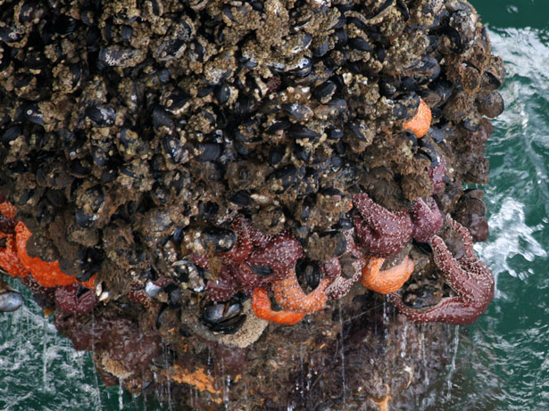
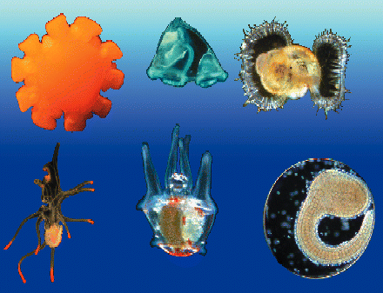
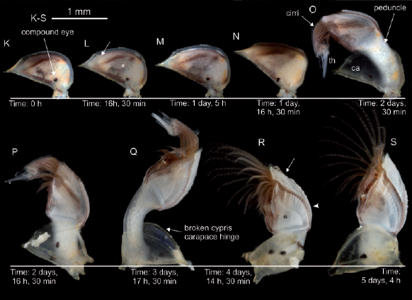
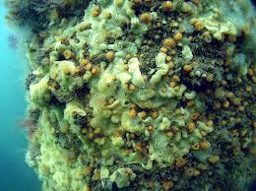
How are they formed?

Slide 4
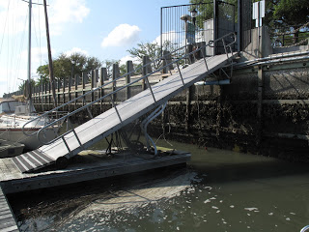
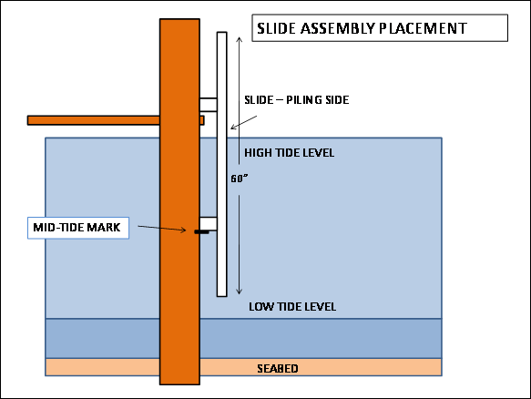
INTERTIDAL
Sometimes under water
SUBTIDAL
Always under water

Slide 5
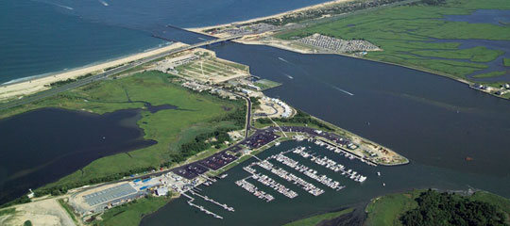
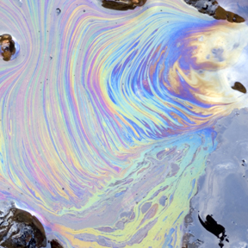
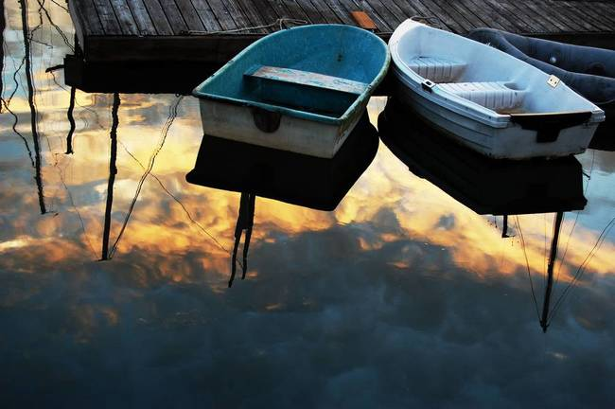
STRESSORS under the dock
Always submerged
Low salinity
No waves
High pollution

Slide 6
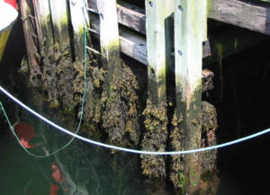
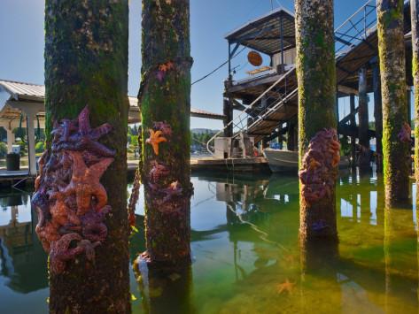
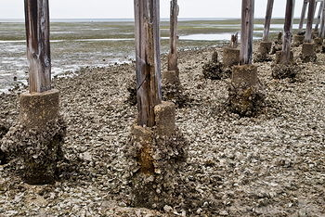
STRESSORS on the piling.
INTERTIDAL:
EXPOSURE TO AIR
Exposure to predators
Desiccation: drying out, getting oxygen, heat

Slide 7
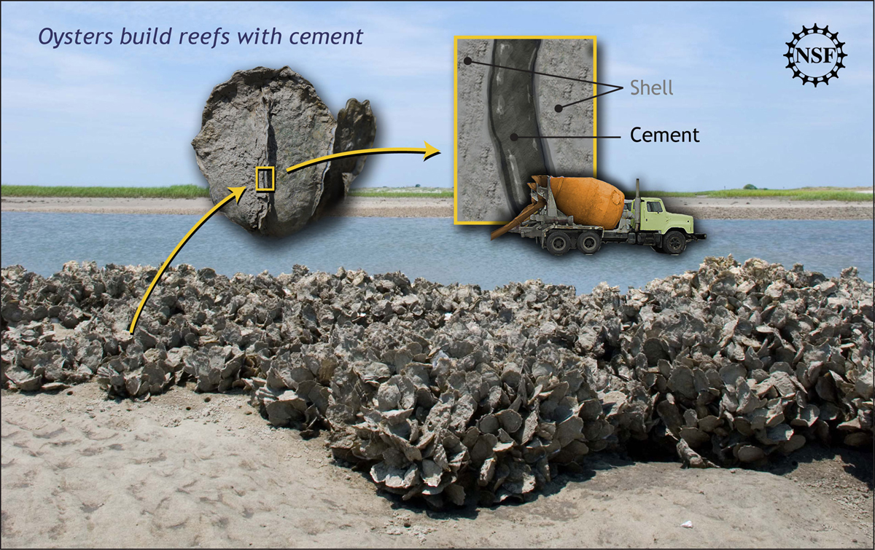
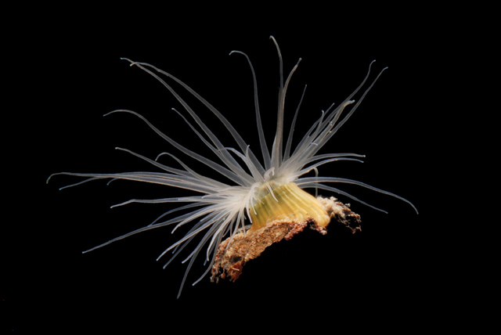
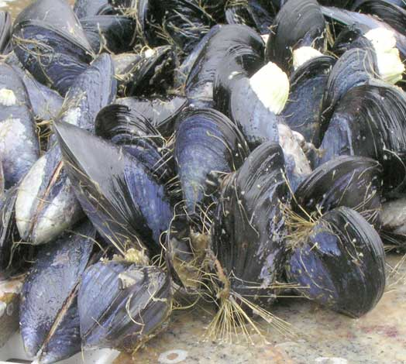
How to Attach?
CEMENT
FOOT & GLUE
BYSSAL THREADS: beard

Slide 8
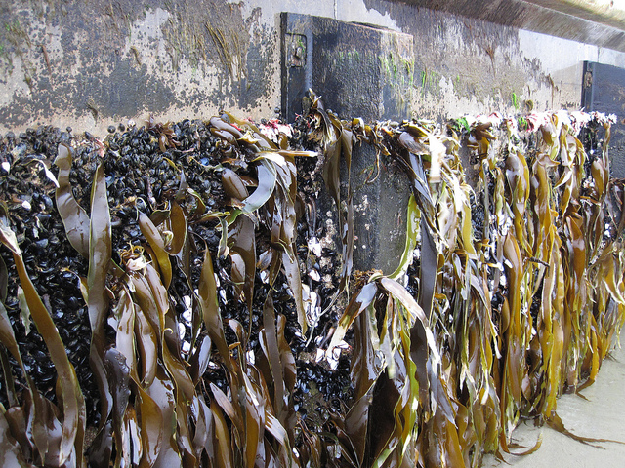
Why must there be lots of algae/plant life?

Slide 9
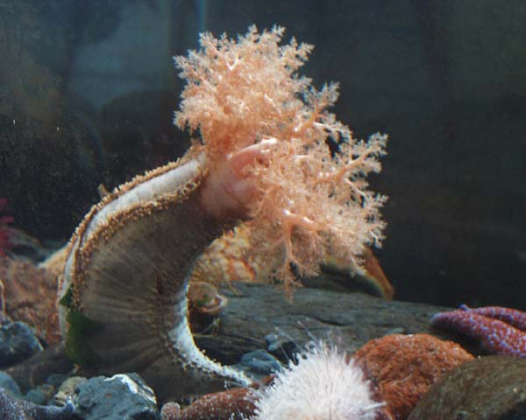
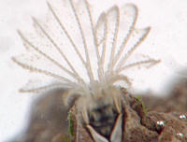
How do organisms feed at the docks?
Suspension feeders: eating particles
http://www.youtube.com/watch?v=VKhY-gLGPCk

Slide 10
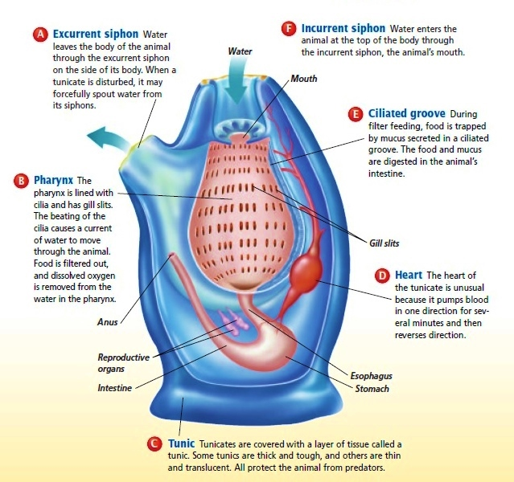
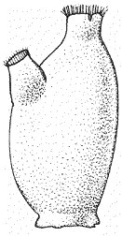
How do organisms feed at the docks?
Filter feeders: eating particles

Slide 11
INTERTIDAL
Sometimes under water
SUBTIDAL
Always under water

