Slide 1
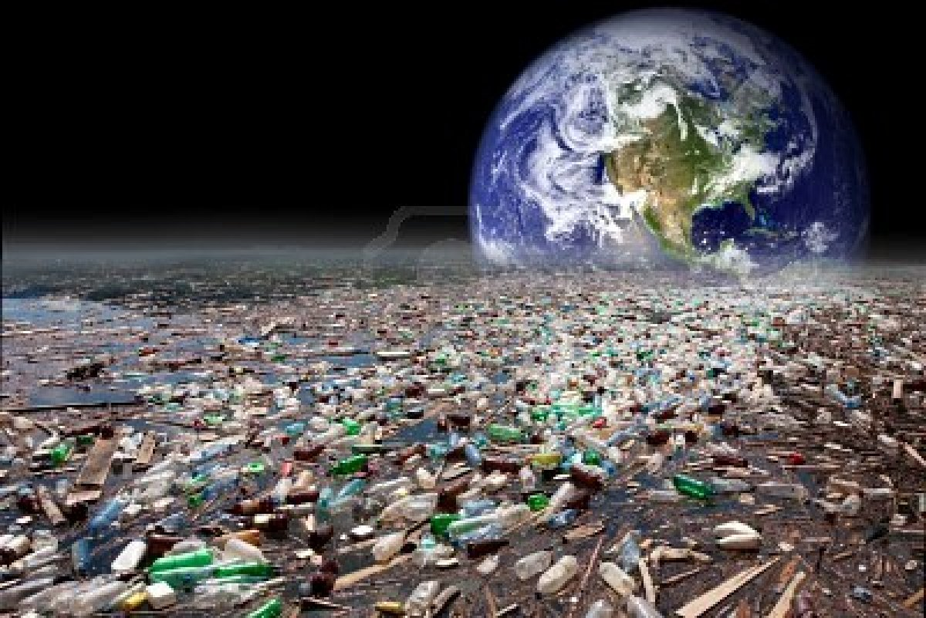
WATER POLLUTION

Slide 2
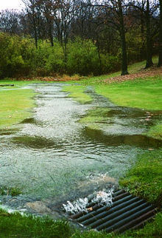
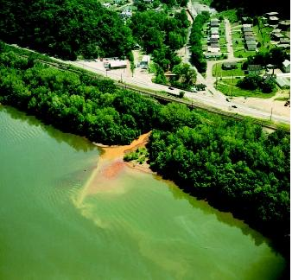
Point &
Non-point Source

Slide 3
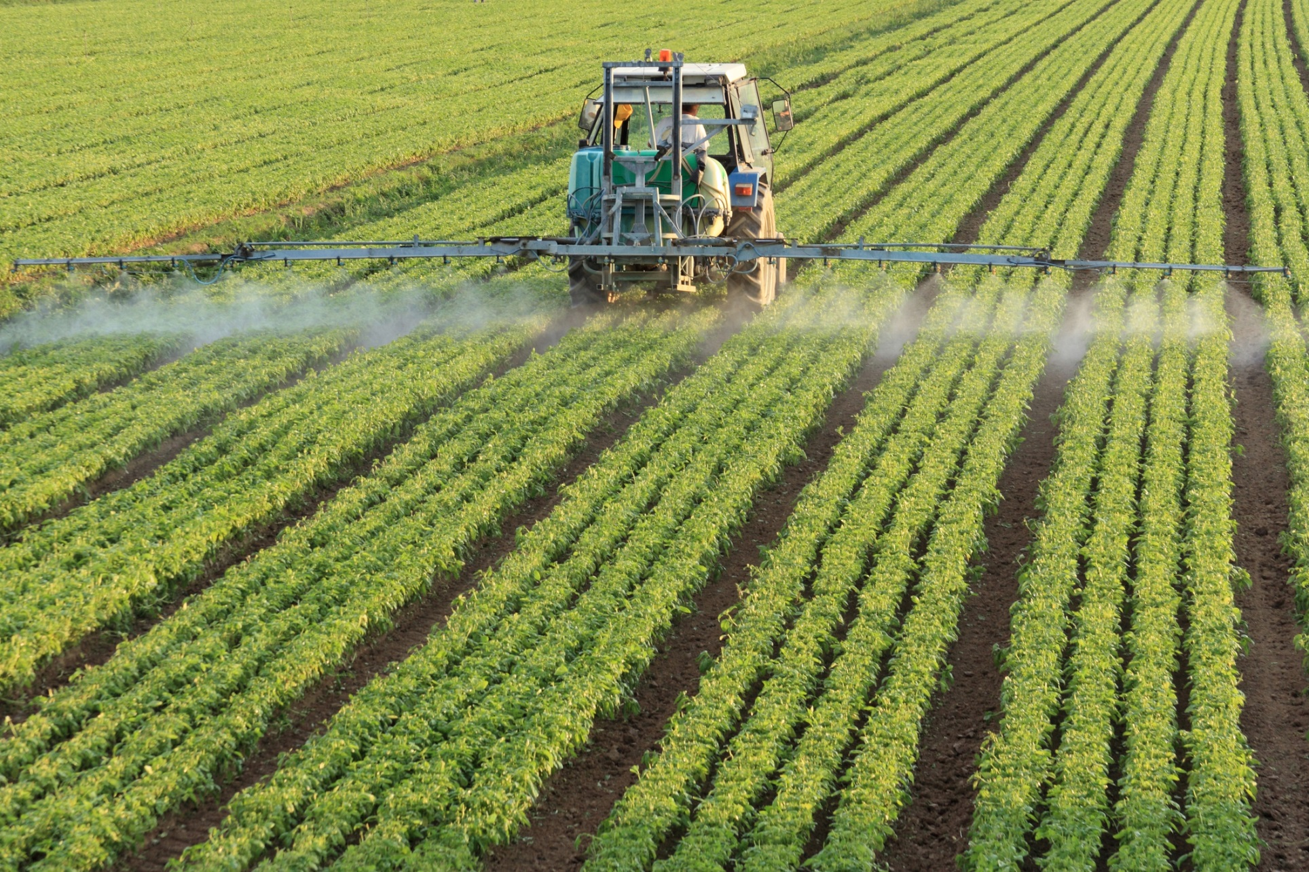
Abundance of fertility (N and P)
Algae blooms - hypoxia

Slide 4
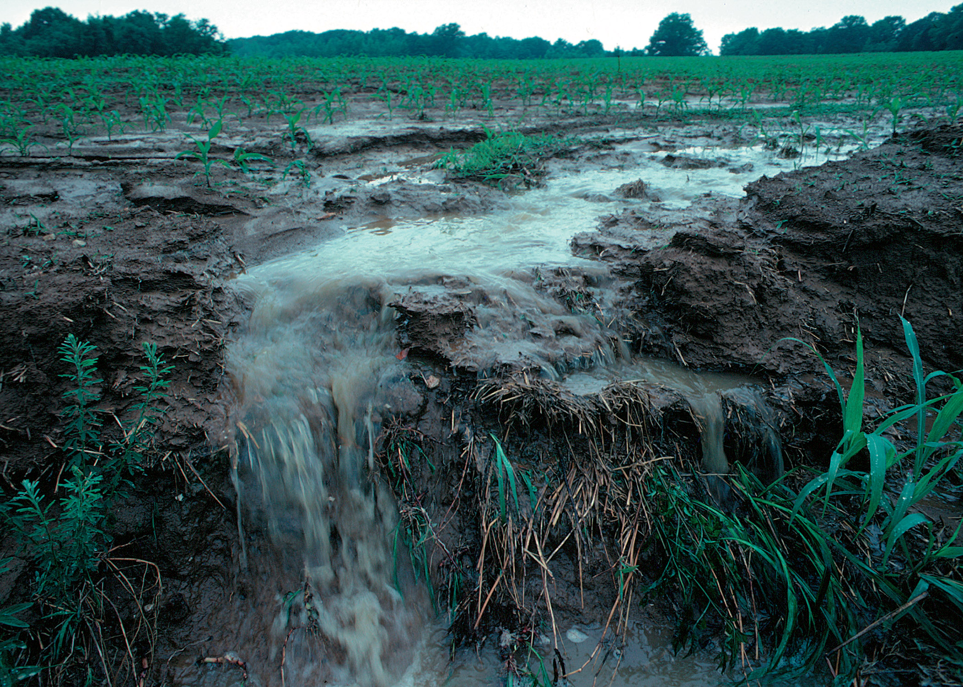
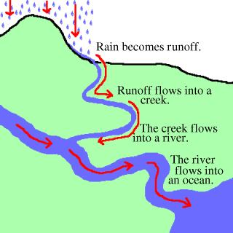
Where do all the fertilizers go?

Slide 5
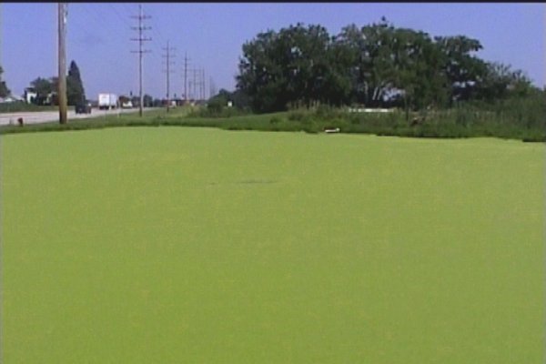
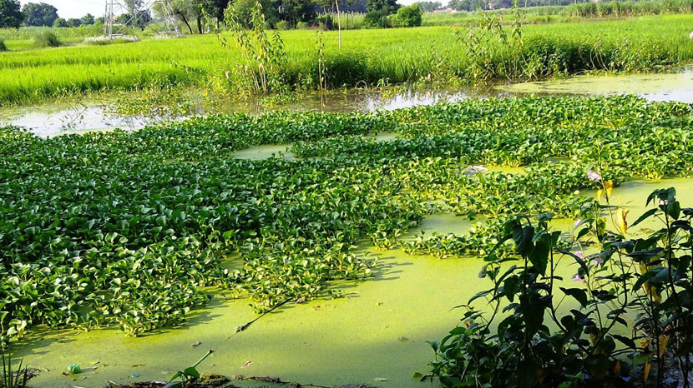
What happens when the fertilizers reach the Sound?
Algae blooms - hypoxia

Slide 6
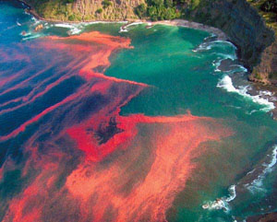
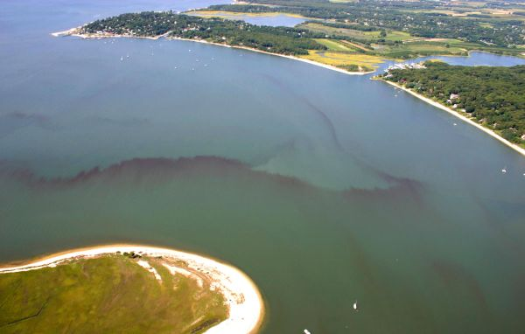
Some just reproduce like crazy.
Some are toxic Protists

Slide 7
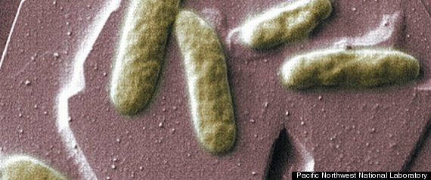
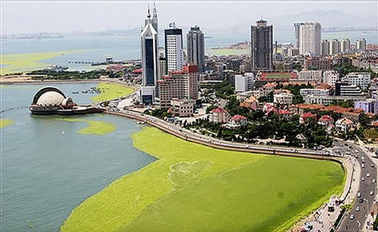
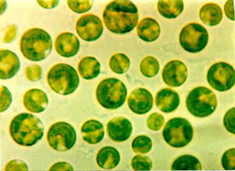
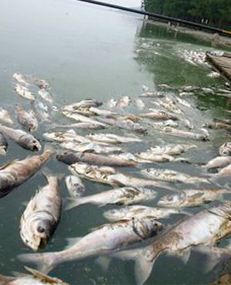
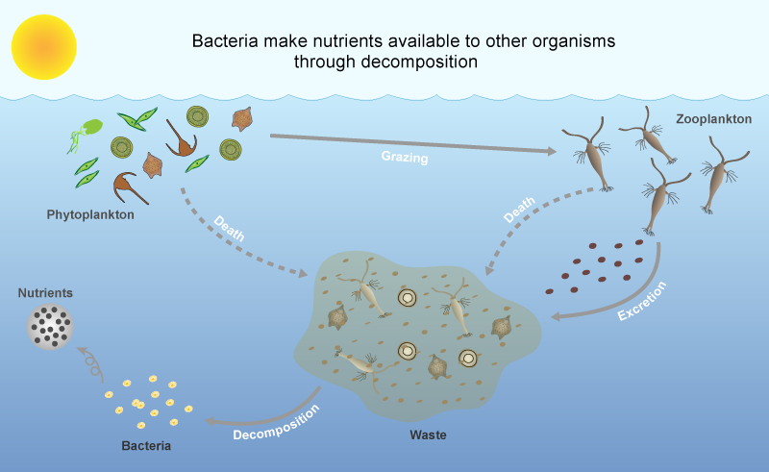
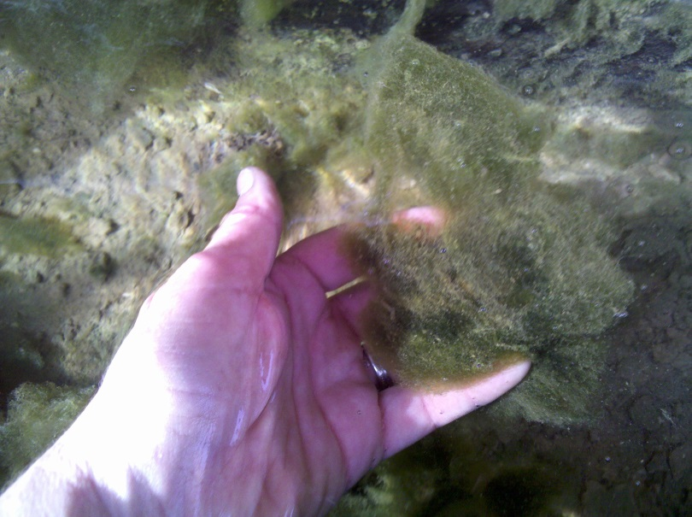
1. Algae reproduce
6. No OXYGEN, fish die
5. Bacteria Respiration uses OXYGEN
2. Algae bloom
3. Algae die
4. Bacterial Decomposition

Slide 8
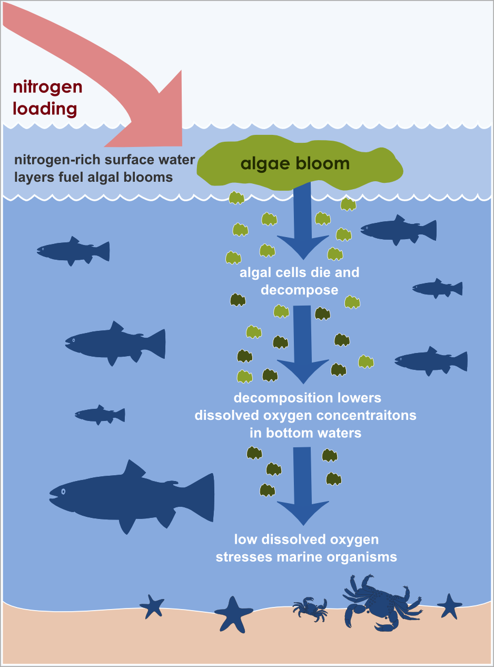

Slide 9
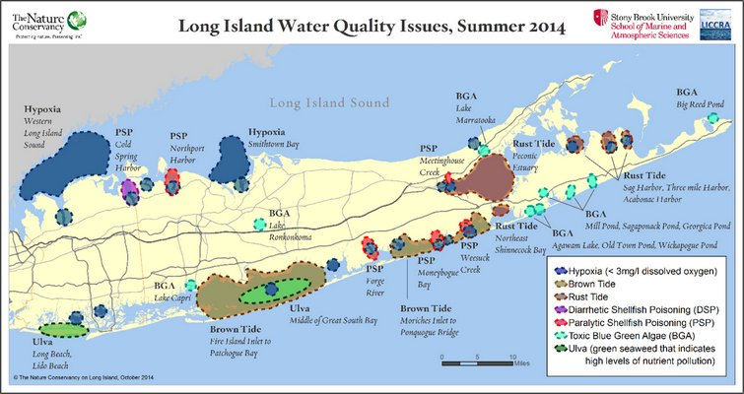
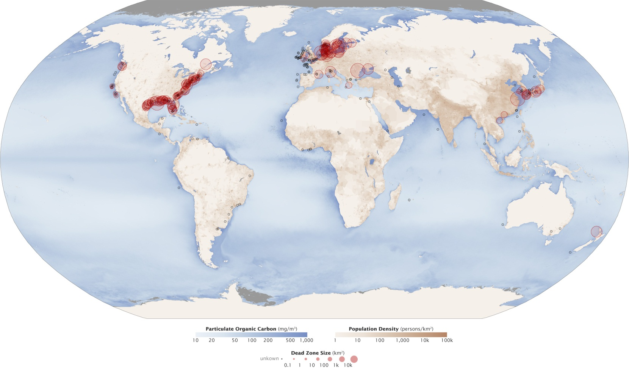
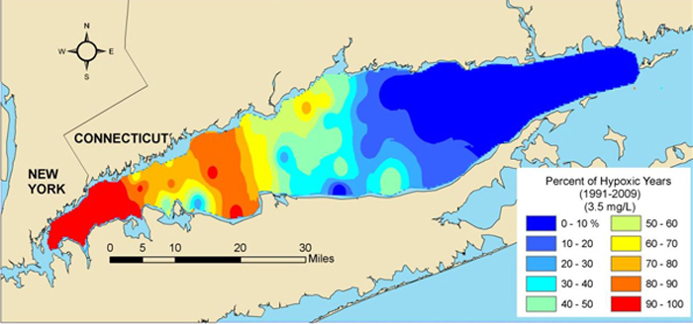
Human Wastewater
Decomposition (hypoxia)
Nutrients increase (hypoxia)
Disease causing organisms
Dead Zones
UN states 200 dead zones world wide

Slide 10
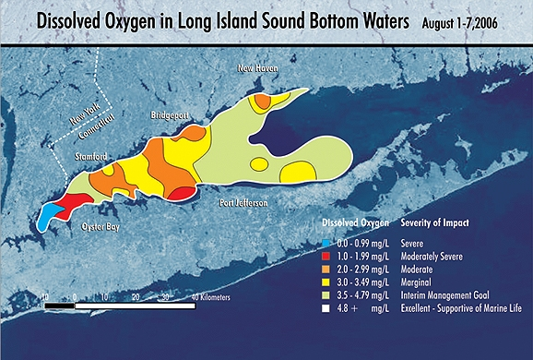

Slide 11
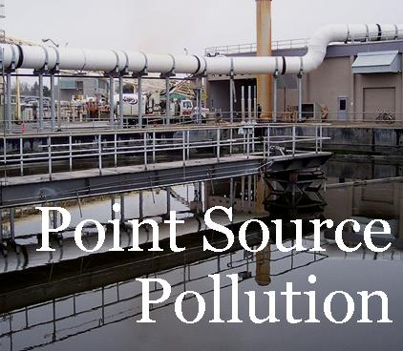
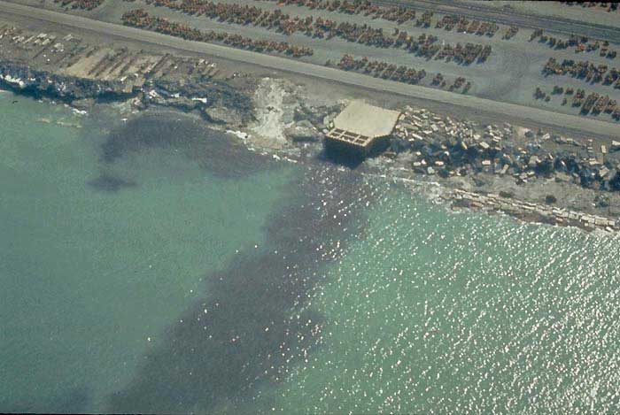
Any other sources of nutrients?

Slide 12
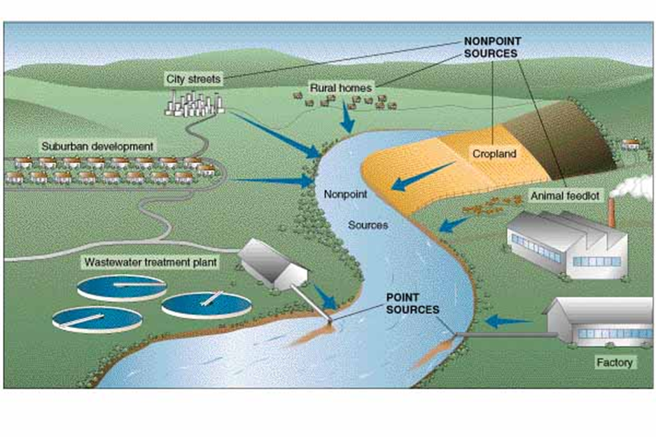

Slide 13
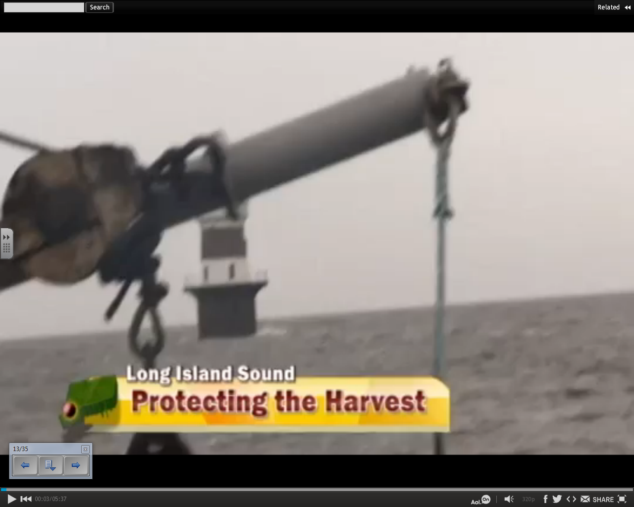
http://www.cambio.com/videos/cambio-on-aol/protecting-the-long-island-sound--516987329/

Slide 15
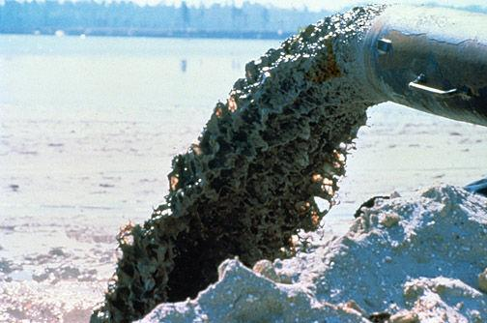
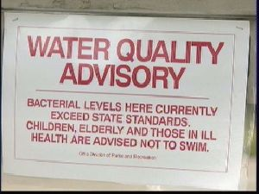

Slide 16
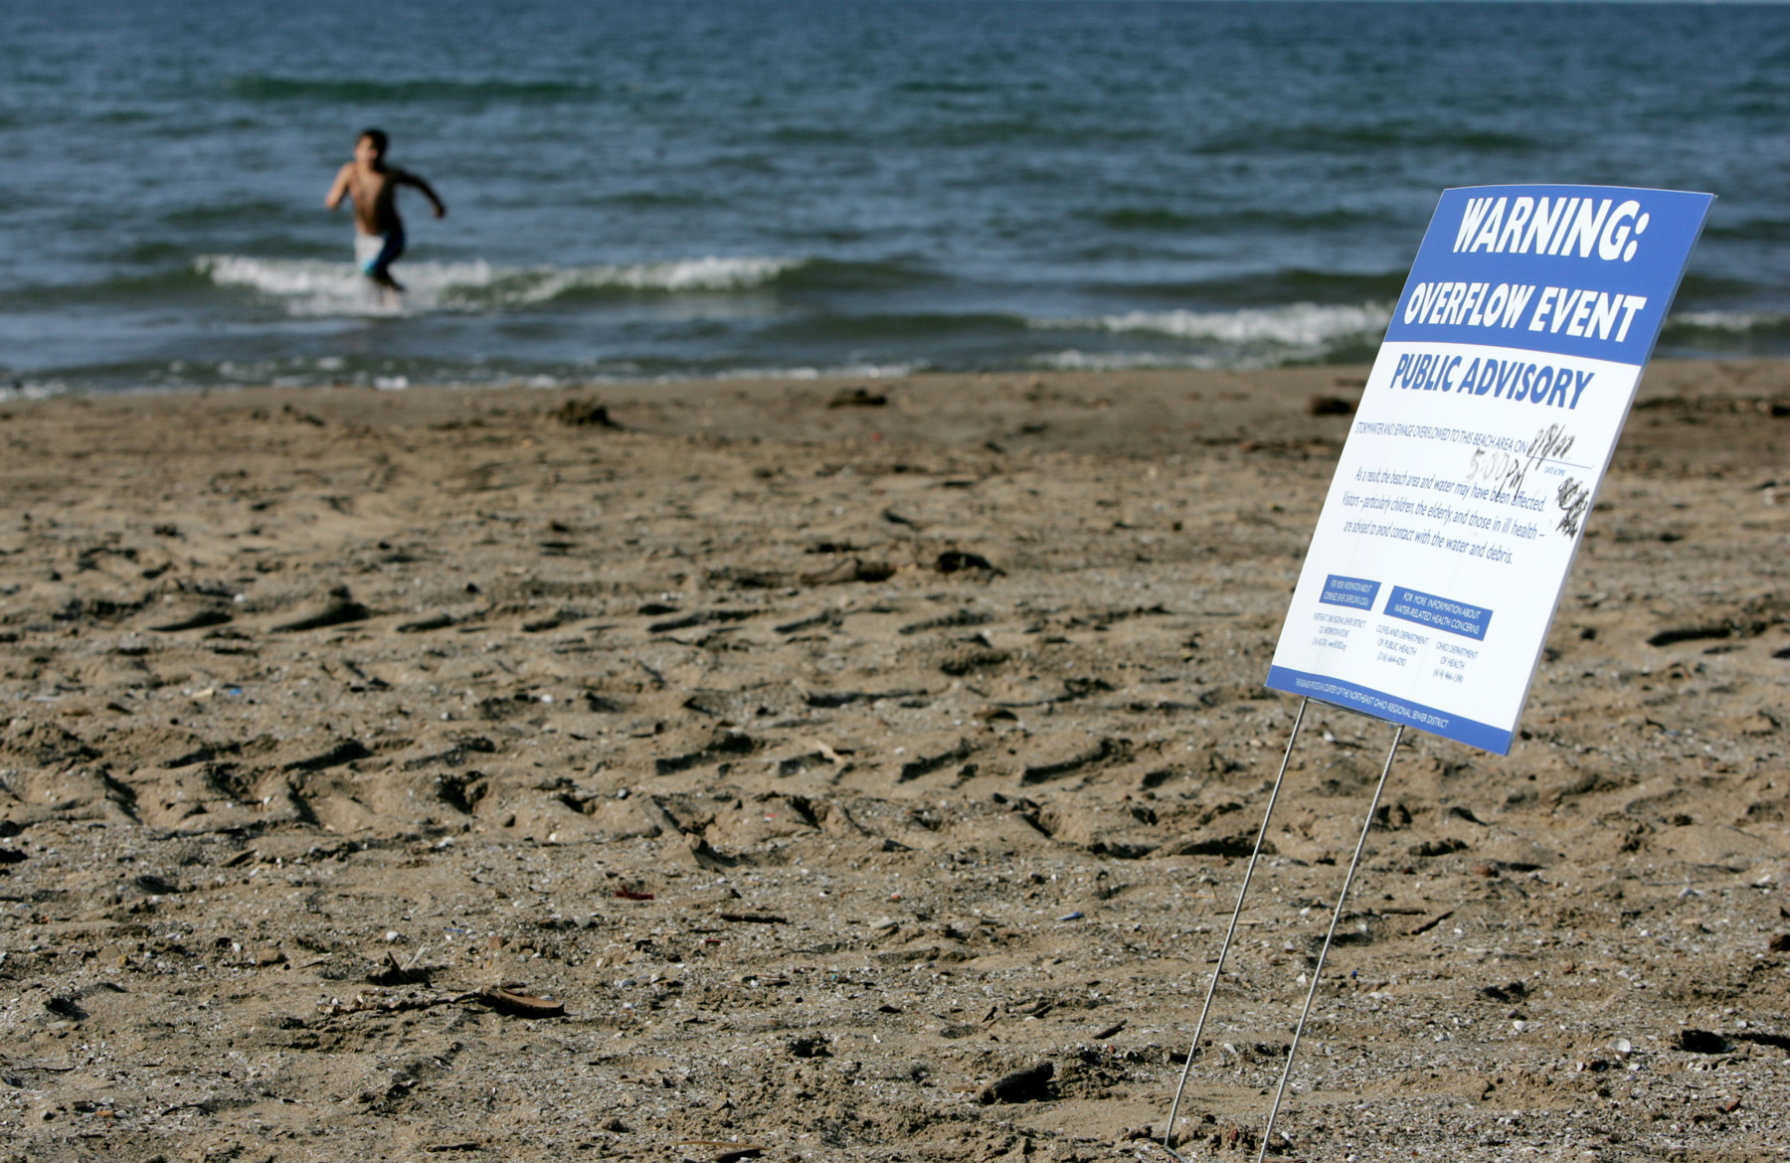
Overflows 40,000 times per year
Close beaches, shellfish contamination

Slide 17
https://www.youtube.com/watch?v=S-jvoOZGq8I

Slide 18
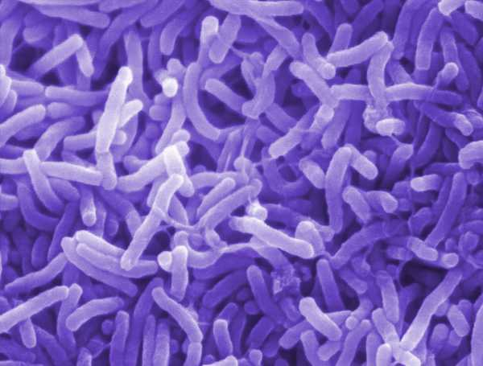
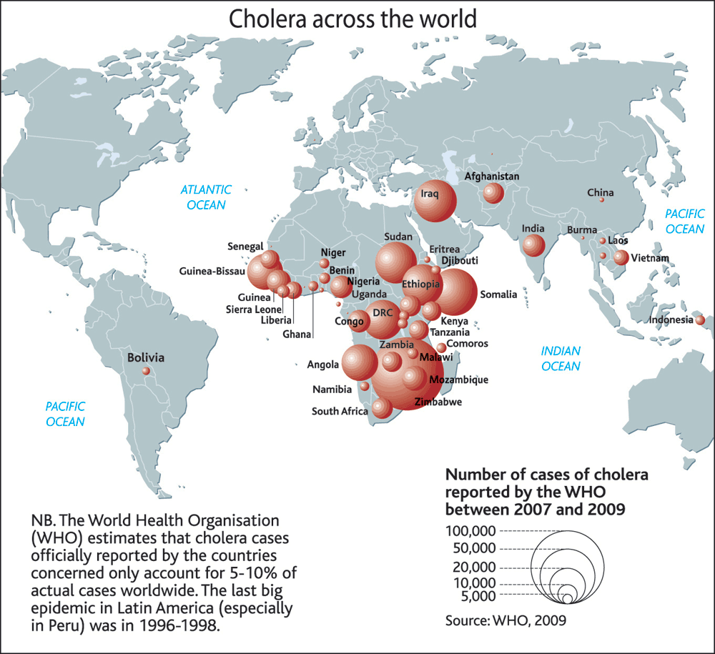
Disease Causing Organisms
Pathogens: viruses, bacteria, parasites
Cholera:
Hepatitis (A is becoming more frequent) due to bacterium Cryptosporidium
typhoid fever, stomach flu & diarrhea

Slide 19
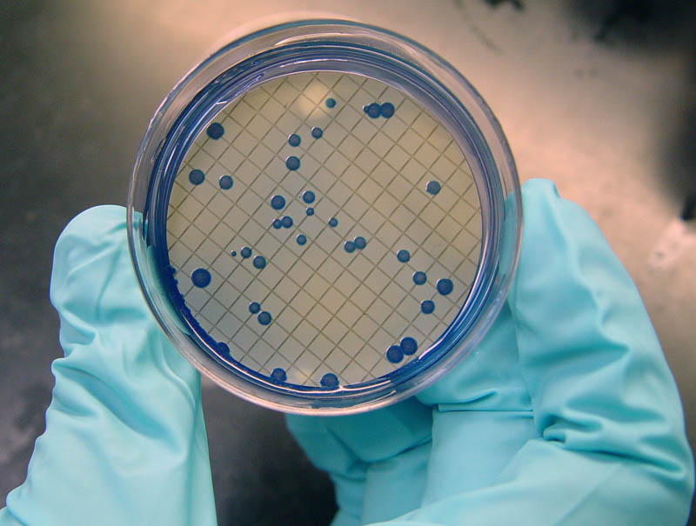
Using indicator species
Fecal coliform
Escherichia coli
Acceptable levels: less than 500 to 10,000 colonies per 100mL of water

Slide 21
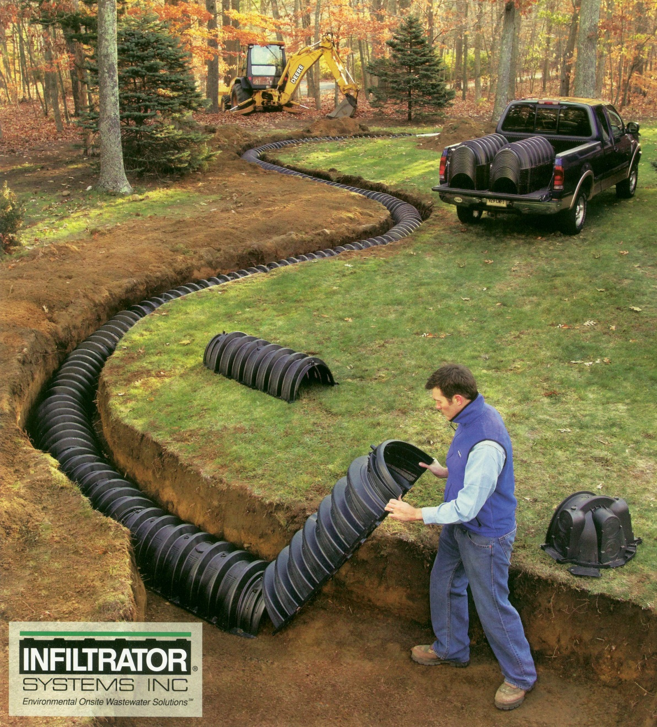
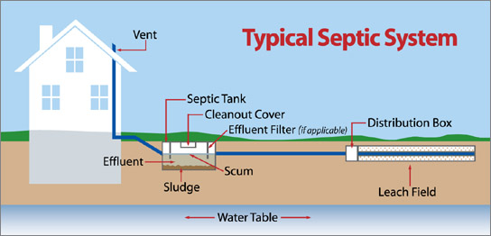
CLEANING WASTE WATER
Septic systems
Leach field and tank
3 layers: scum layer (floats to top), septage (middle, clearer layer), sludge (bottom, heavy layer)
Organisms are outcompeted, water into leach field, absorbed by plants
No electricity, uses gravity and natural bacteria
Sludge pumped out every 5-10 years

Slide 22
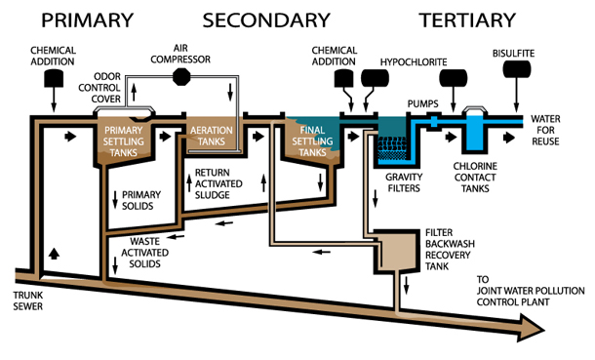
SEWAGE TREATMENT PLANTS

Slide 23
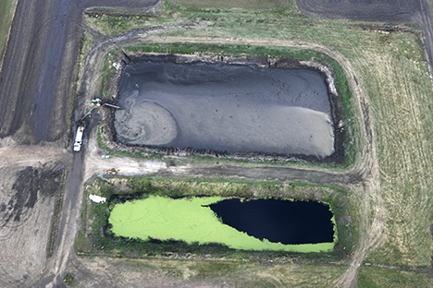
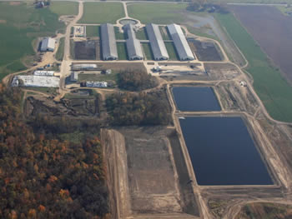
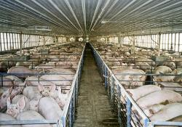
FEED LOTS/MANURE LAGOONS
CFO’s: manure, hormones, antibiotics
Manure lagoon
Lined with rubber
Bacteria break down manure: then can be used
LEAKING?

Slide 25
HEAVY METALS
Lead
Arsenic
Mercury
Acids
Synthetics (pesticides, pharmaceuticals, hormones. PCB)

Slide 26
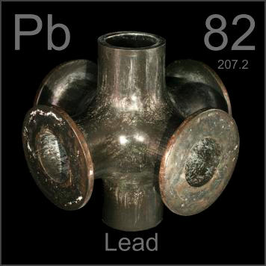
Old lead pipes, brass fittings, solder
Fetuses and infants most affected
Brain damage, nervous system and kidneys

Slide 27
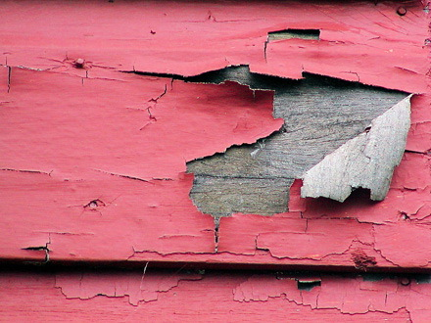
Lead used to be in gasoline and paint

Slide 28
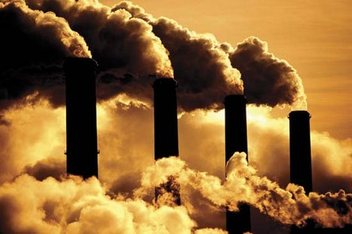
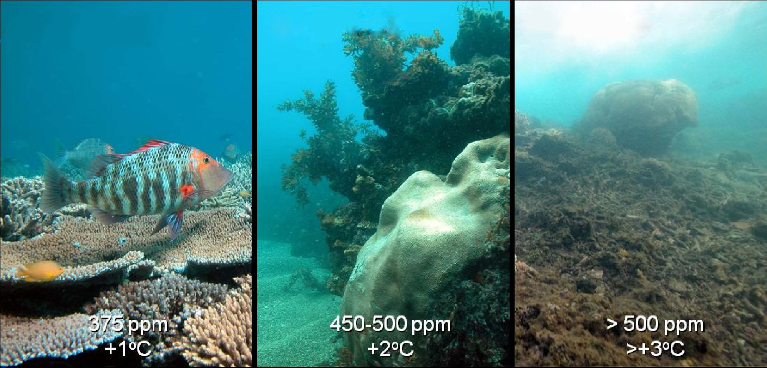
Acid Deposition
Coal burning power plants produce CO2
CO2 becomes acidic in solution

Slide 29
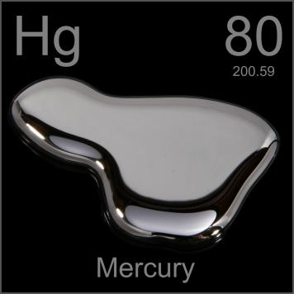
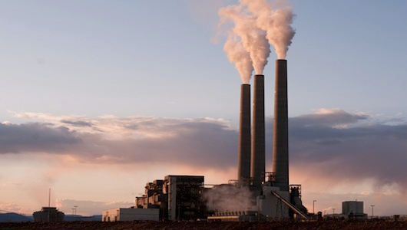
2/3rd of mercury comes from burning fossil fuels (especially coal)

Slide 30
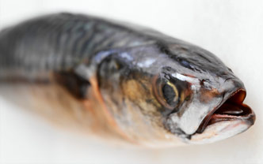
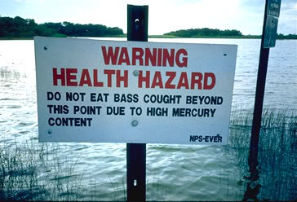
Methyl-mercury in humans comes from eating contaminated fish
NY Times reporter 2008
Purchased tuna sushi from 20 locations
Most restaurants: diet of 6 pieces of sushi per week would exceed EPA standards

Slide 31
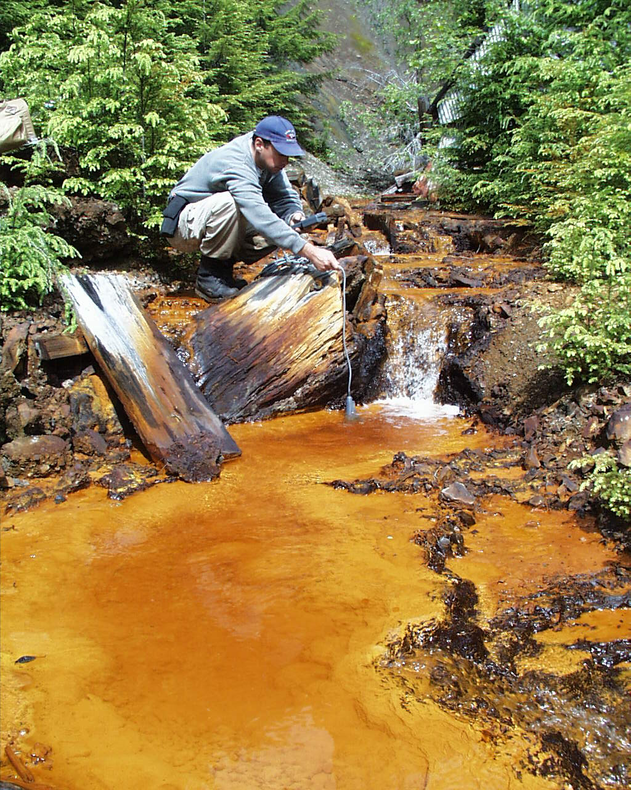
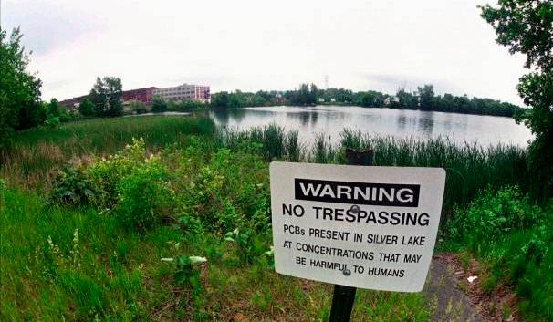
Used in plastics & insulation

Slide 32
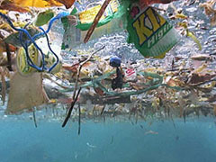
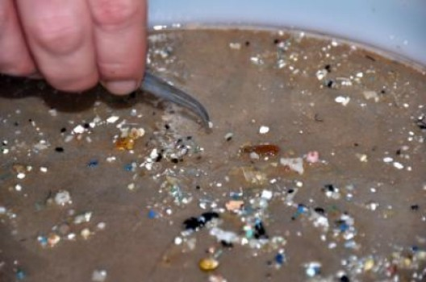
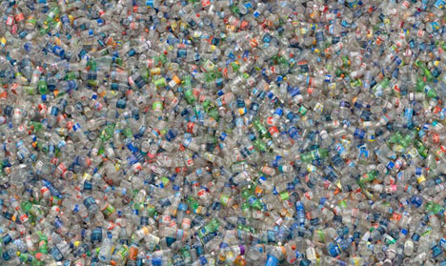
SOLID WASTE POLLUTION

Slide 33
https://www.youtube.com/watch?v=2VrrxMIiwgQ

Slide 34
Clean Air Act
Clean Water Act
Safe Drinking Water Act
MCL (maximum contaminant levels)

Slide 35
Type of Pollution | Source of Pollution | Effects on Ecosystem
Fertilizers (N, P) | Farms, agriculture | Algae bloom, hypoxia
Sewage overflow | Sewers/septic | Algae bloom, hypoxia Pathogens
Heavy Metals (Pb, Hg) | Paint, gas, burning fossil fuels | Toxins/pollutants Bioaccumulation
CO2 | Burning fossil fuels | Acidification
Trash/plastic | Trash | Death, estrogen disrupters

Slide 36
Ways to Clean
Proper working septic system
Properly treat waste water
Buffers/scrubbers on burning fossil fuels
Prevent leaching of toxic chemical/dispose of properly

