Slide 1
The Extraordinary Properties of Water

Slide 2
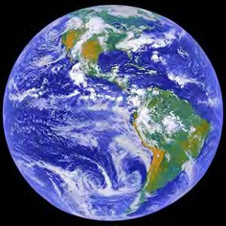

Slide 3
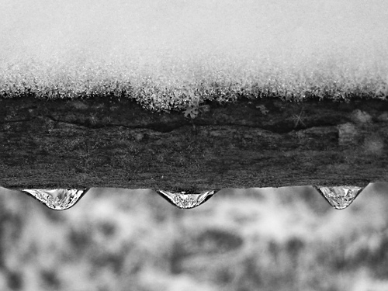
This shows 2 phases of water.
http://farm1.static.flickr.com/179/469960481_d98f6680ac.jpg?v=0

Slide 4
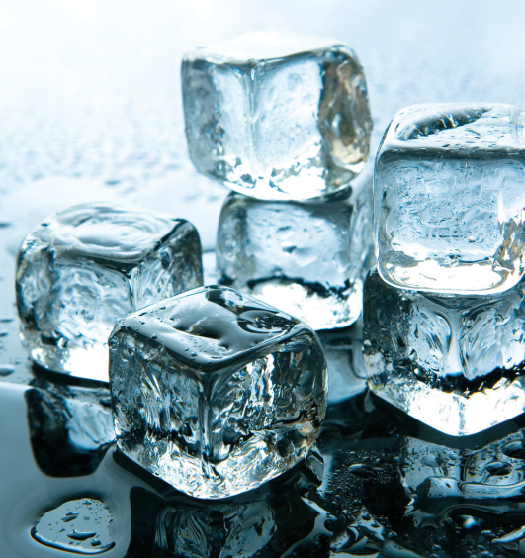
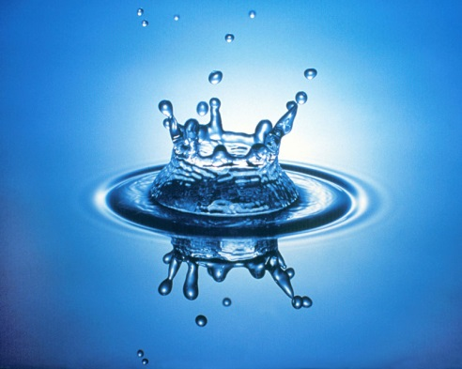
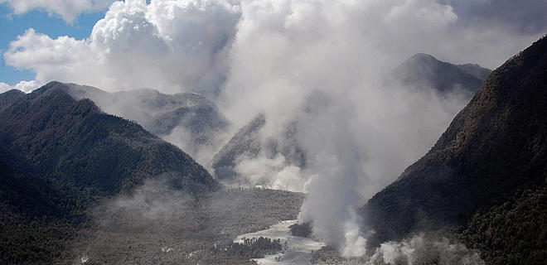

Slide 5
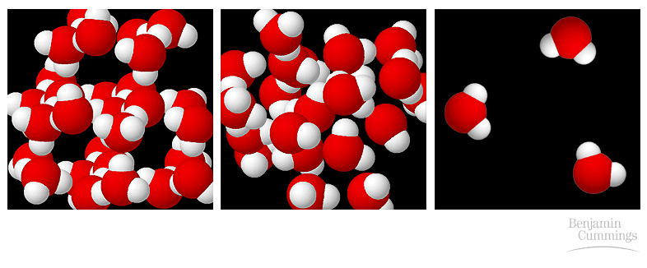
Ice, water, vapor

Slide 6
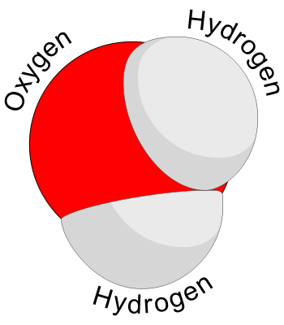
What is this?
Water
What is the molecular formula for these molecules?
H₂O
http://www.sinap.ac.cn/water08/pic/350px-Water_molecule_svg.png

Slide 7
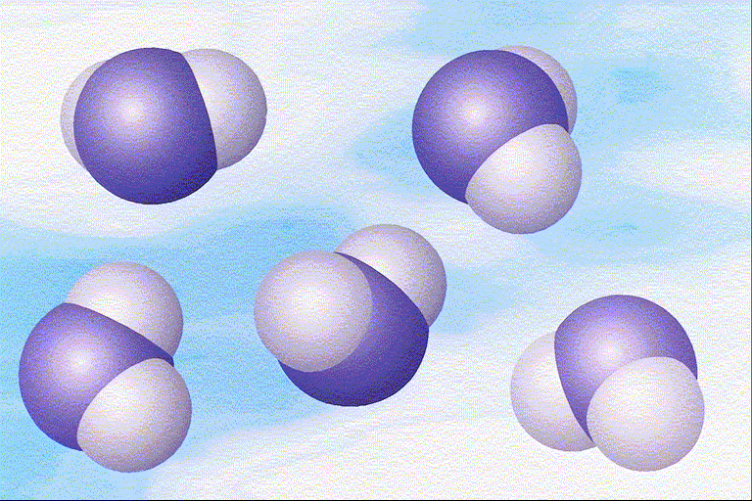
How many water molecules?
5 Waters = 5H₂O
http://www.windows.ucar.edu/earth/geology/images/water_molecules_lg.gif

Slide 8
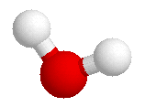
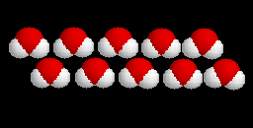
H
WATER
2H
1O
H
O
Notes:
1

Slide 9
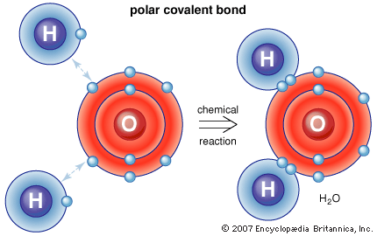
Covalent Bond

Slide 10
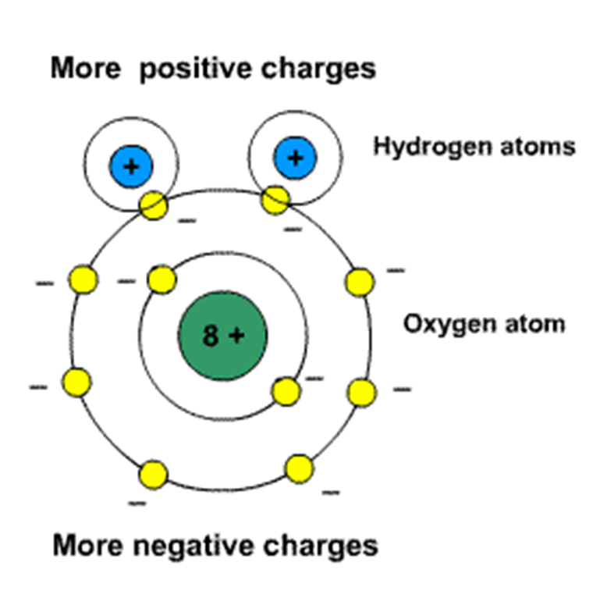
Structure of Water
Polar
Unequal sharing of electrons
Opposite charges on opposite ends
Water Molecules have a slight charge.

Slide 11
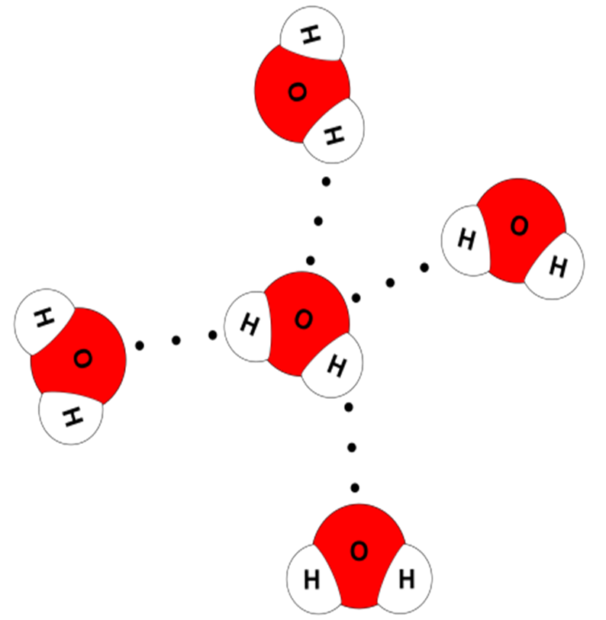
Structure of Water
Hydrogen bonds
Weak attractions

Slide 12
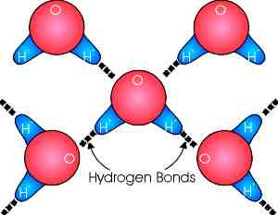
Cohesion – Same molecules that stick together

Slide 13
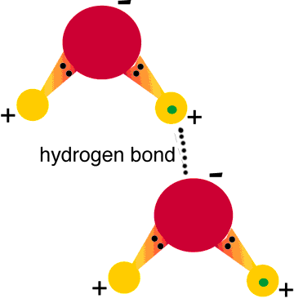

Slide 14
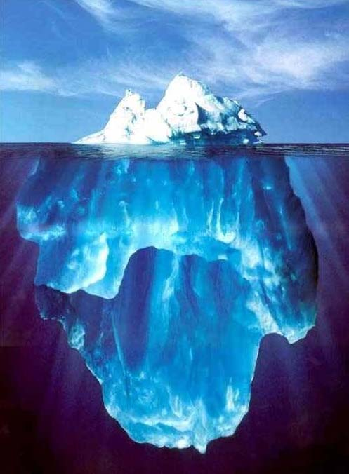
What are the Properties of Water?
Notes:
1

Slide 15
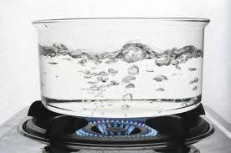
Pure water boils at 100 °C
100 °C
Freezes
0 °C
Notes:
1

Slide 16
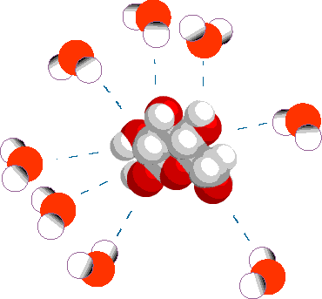
Cohesion
Attraction between particles of the same substance
Results in Surface tension
Notes:
1

Slide 17
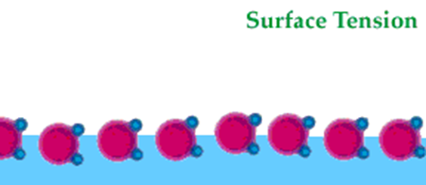
Produces a surface film on water that allows insects to walk on the surface of water

Slide 18
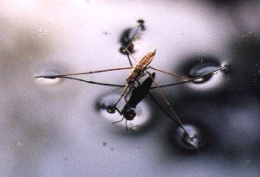
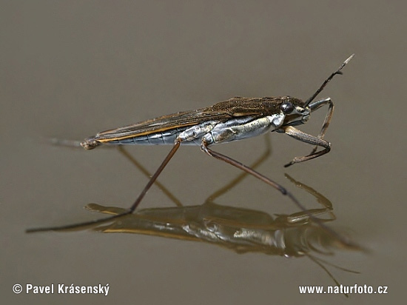
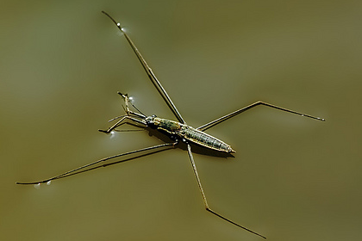
Cohesion …
Helps insects walk across water

Slide 19
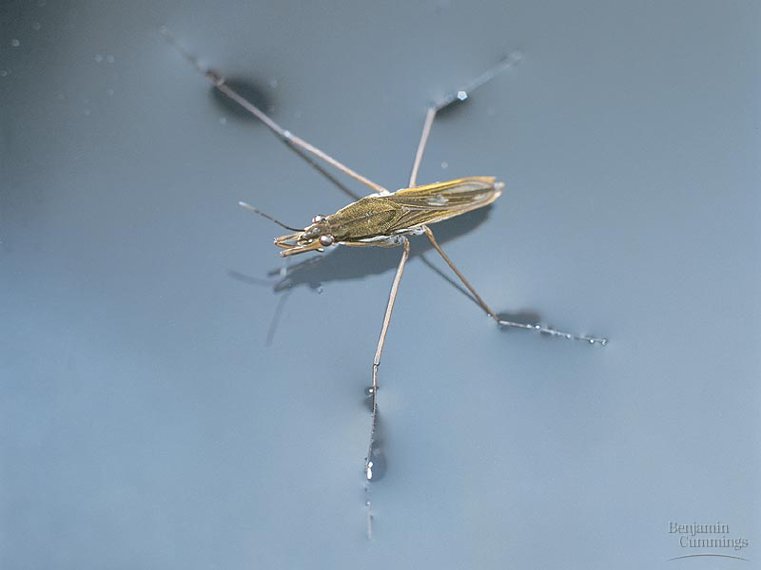
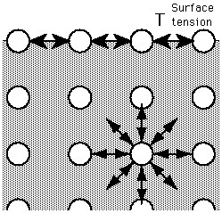
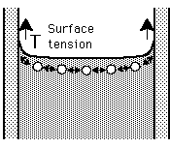
Surface tension

Slide 20
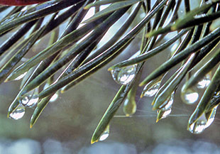
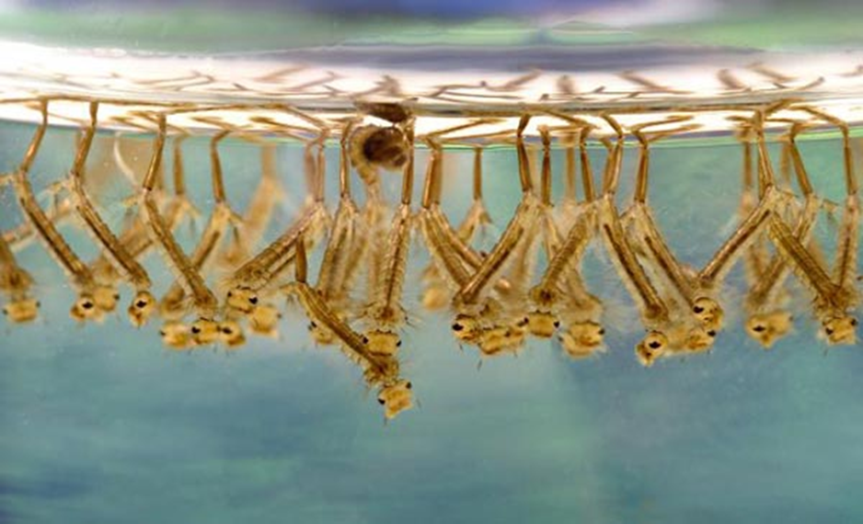
Adhesion
Different molecules that stick together

Slide 21
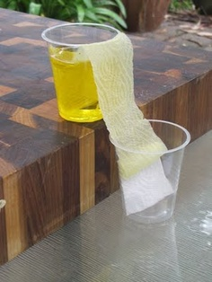
Other surfaces such as glass, soil, plant tissues, and cotton.
Notes:
1

Slide 22
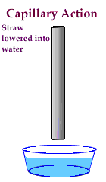
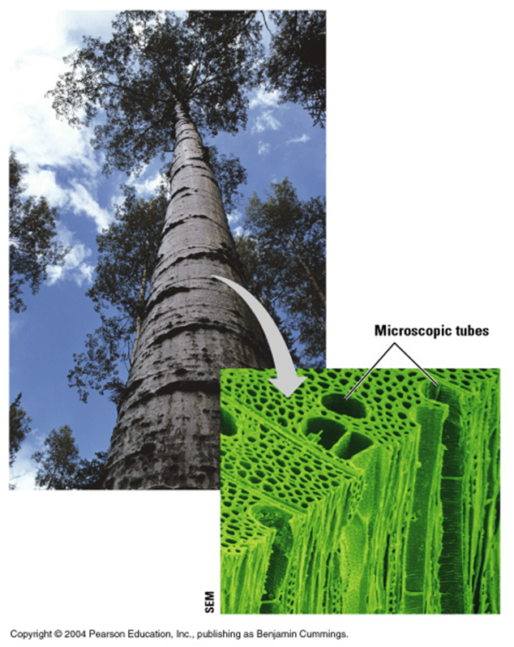
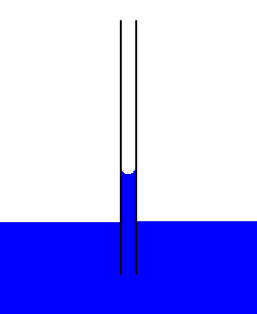
Adhesion Causes Capillary Action
Which gives water the ability to “climb” structures

Slide 23
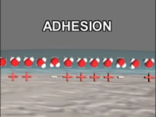
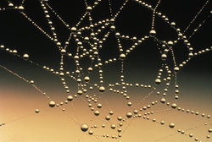
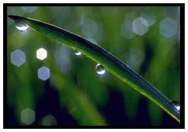
Adhesion Also Causes Water to …
Attach to a silken spider web
Form spheres & hold onto plant leaves

Slide 24
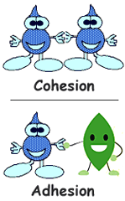

Slide 25
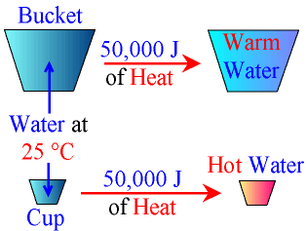
High Specific Heat
Water can absorb or release large amounts of heat energy with little change in actual temperature.
Notes:
1

Slide 26
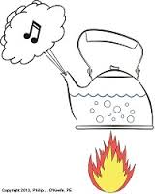
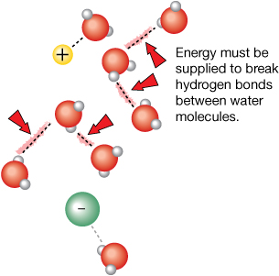
High Heat of Vaporization
Amount of energy to convert 1g or a substance from a liquid to a gas
In order for water to evaporate, hydrogen bonds must be broken.
Notes:
1

Slide 27
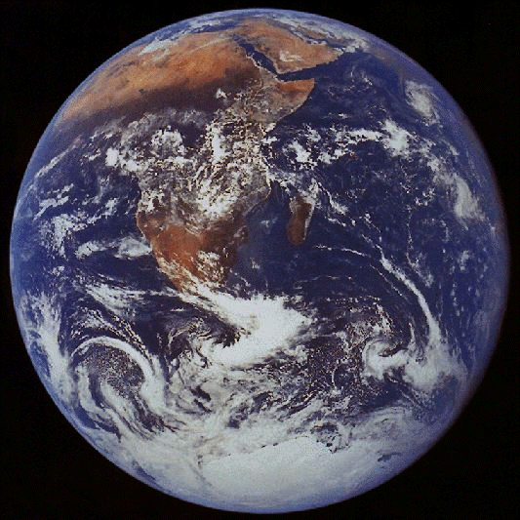
Water vapor forms a kind of global ‘‘blanket” which helps to keep the Earth warm.
Notes:
1

Slide 28
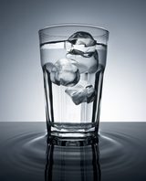
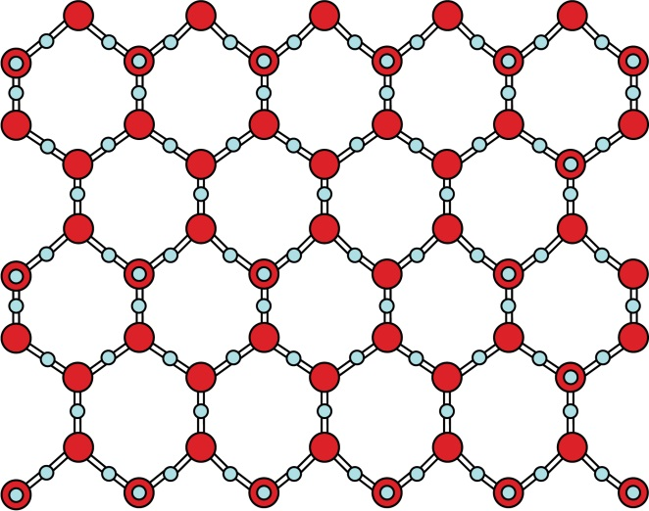
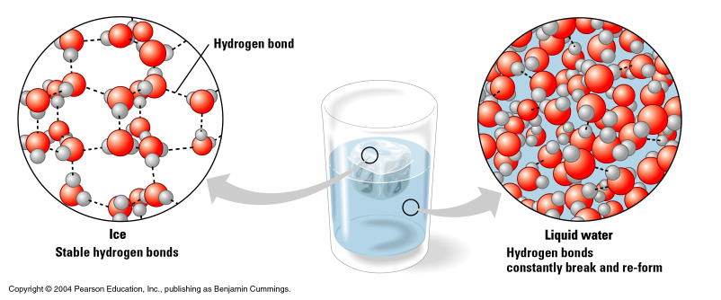
DENSITY
Notes:
1

Slide 29
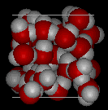
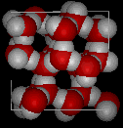
Water is Less Dense as a Solid
Which is ice and which is water?
Notes:
1

Slide 30
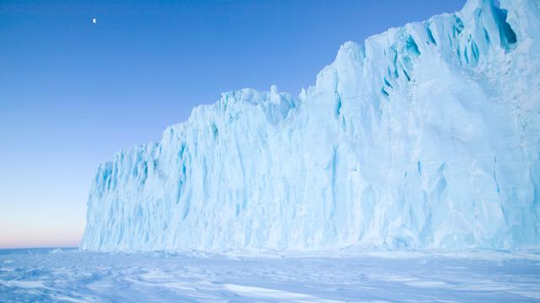
Why does ice floating matter?
Ice sheets
control weather patterns
currents
hold 69% of fresh water
http://www.bbc.co.uk/science/earth/water_and_ice

Slide 31
Polarity and Ice
If frozen water sank, what would happen to the climate on earth?
Warm up, ice sheets keep it cooling on surface
Insulate water below

Slide 32
Water’s Life-Supporting Properties
Why is this important?

Slide 33
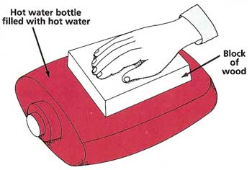
Homeostasis
Makes a good insulator
Resists temperature change
Universal solvent
Notes:
4

Slide 34
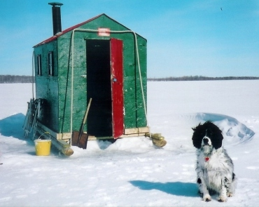
Ice protects against temperature extremes (insulates frozen lakes)

Slide 35
Water’s Life-Supporting Properties
Moderates temperature
Evaporative cooling

Slide 36
What happens to the milk?

Slide 37
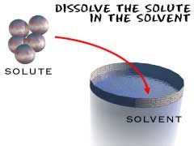
http://www.chem4kids.com/files/matter_solution.html

Slide 38
http://www.lcc.ukf.net/KS3Chem/mixtur3.jpg

Slide 39
Water’s Life-Supporting Properties
Water as a solvent

Slide 40
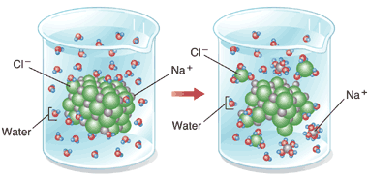
Solution

Slide 41
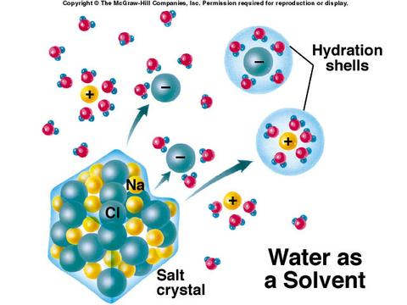

Slide 42
How does salt change the properties of water?

Slide 43
Suspensions
Substances that don’t dissolve but separate into tiny pieces.
Water keeps the pieces suspended so they don’t settle out.

Slide 45
pH
Potential Hydrogen
Measures amount of H ions in a solution
Amount of acid or base.

Slide 46
Acids
Produce lots of H+ ions

Slide 47
Bases
Contain lots of OH-ions and fewer H+ ions

Slide 48
Acids, Bases & pH
pH scale
Measurement of H⁺ ions
Acid:
Neutral:
Base:

Slide 49
Each pH unit represents a 10 fold change.
http://www.ec.gc.ca/WATER/images/manage/qual/a3p7e-sm-rev.gif

Slide 50
Buffers
Weak acids or bases that react with strong acids or bases to prevent sharp, sudden changes in pH (neutralization).
Produced naturally by the body to maintain homeostasis
Weak Acid
Weak Base

