Slide 1
FAIRFIELD WARDE HIGH SCHOOL follow us on twitter at @fwhsmustangs
COURSE SELECTIOn
David Ebling, HeadMaster
Caryn Campbell, director of student services

Slide 2
FAIRFIELD WARDE
MISSION STATEMENT

Slide 3
Fairfield Warde High School Belief Statements
Students are most successful when there are positive collaborative relationships among all members of the school community, diversity is valued and opportunities enable all to be a part of a nurturing school community.
Students benefit from a comprehensive, rigorous educational experience where authentic, creative and self-directed learning takes place and critical thinking yields imaginative and meaningful products.
Students develop an altruistic sense of community when they understand, respect, and take responsibility to promote expected and ethical standards of behavior.
Students prepare for global citizenship when held accountable for their own analytical problem solving skills, and demonstrate flexibility, adaptability and perseverance to address current challenges.
Endorsed by the FWHS Faculty on June 18, 2017

Slide 4
Academic Expectations

Slide 5
2019-2020 GPA Scale
GRADE | AP | Honors | Elective | College Prep
A+ | 5.00 | 4.67 | 4.67 | 4.33
A | 4.67 | 4.33 | 4.33 | 4.00
A- | 4.33 | 4.00 | 4.00 | 3.67
B+ | 4.00 | 3.67 | 3.67 | 3.33
B | 3.67 | 3.33 | 3.33 | 3.00
B- | 3.33 | 3.00 | 3.00 | 2.67
C+ | 3.00 | 2.67 | 2.67 | 2.33
C | 2.67 | 2.33 | 2.33 | 2.00
C- | 2.33 | 2.00 | 1.67 | 1.67
D+ | 2.00 | 1.67 | 1.33 | 1.33
D | 1.67 | 1.33 | 1.00 | 1.00
D- | 1.33 | 1.00 | 0.67 | 0.67
F | 0.00 | 0.00 | 0.00 | 0.00

Slide 6
2020-2021 and beyond GPA Scale
GRADE | AP | H | CP
A+ | 5.00 | 4.67 | 4.33
A | 4.67 | 4.33 | 4.00
A- | 4.33 | 4.00 | 3.67
B+ | 4.00 | 3.67 | 3.33
B | 3.67 | 3.33 | 3.00
B- | 3.33 | 3.00 | 2.67
C+ | 3.00 | 2.67 | 2.33
C | 2.67 | 2.33 | 2.00
C- | 2.33 | 2.00 | 1.67
D+ | 2.00 | 1.67 | 1.33
D | 1.67 | 1.33 | 1.00
D- | 1.33 | 1.00 | 0.67
F | 0.00 | 0.00 | 0.00

Slide 7
Expectations for Each Level
College Preparatory
  Reading material at grade level
  Complexity of the material and work expectation at grade level
Honors
  Reading material above grade level
  Complexity of the material and work expectation above grade level
  Accelerated pace
Advanced Placement
  Equivalent to a freshman college course in a major
  Reading material at the college/university level
  Significant volume of independent work
  Level of synthesis, critical thinking and problem solving significantly above that of a high school course
  Very rapid pace

Slide 8
Work Load Comparison Across Levels
AP classes
  6-10 hrs per week (average) outside of class time
  **Most courses have summer assignments
Level 1 courses (Honors)
  3-6 hrs per week (average) outside of class time
Level 2 courses (College Prep)
  3-5 hrs per week (average) outside of class time

Slide 9
MATHEMATICS

Slide 10
Core Concepts in Mathematics
Standards of Mathematical Practice
Make sense of problems and persevere in solving them.
Reason abstractly and quantitatively.
Construct viable arguments and critique the reasoning of others.
Model with mathematics.
Use appropriate tools strategically.
Attend to precision.
Look for and make use of structure.
Look for and express regularity in repeated reasoning.

Slide 11
ENGLISH
Ninth Grade
English 9 or 9H
Tenth Grade
English 10 or 10H
Eleventh Grade
English 11 or 11H
AP Language and Composition
AP American Studies
Twelfth Grade
English 12 or 12H
AP Literature and Composition
English Electives*
*Available to all seniors as the required English courses or in addition to other English courses. If taken as the required English courses, must take one writing and one literature course. Also available to juniors in addition to their required full-year course.

Slide 12
Core Concepts in English
Critical Reading of Literary Texts
Students actively engage and interact with texts and apply certain processes, models, questions, and theories that result in enhanced clarity and comprehension.
Creative and Analytical Writing
Students write in a variety of modes for distinct purposes and audiences to communicate ideas in response to the world around them.
Academic Discussions - Respond to Opinions and Theories
Students discuss tasks or ideas and question one another, negotiate meaning, clarify their own understanding, and make their ideas comprehensible.
Conventions of Standard English Grammar and Usage
Students demonstrate increasing sophistication in all aspects of language use, from grammar, usage, mechanics, vocabulary and syntax, to the development and organization of ideas.

Slide 13
Senior English Electives
Two categories: Literature Courses & Writing Courses
Literature | Writing
Contemporary Global Literature | Creative Writing Workshop
Call of the Wild | Poetry
Gender Perspectives in Literature | Satire
The Supernatural in Literature | Film Analysis and Criticism
Dramatic Literature & Performance | Journalism
*Literature of Well-Being: Exploring Ideas of Health and Happiness

Slide 14
SOCIAL STUDIES
Three and one-half years of Social Studies is required. The course sequence is described below:
(7 Credit Requirement)
Global Studies
9 or 9H
9th
Modern Global Studies
10 or 10H
10th
United States History
AP, H, or CP
AP American Studies
11th
11th or 12th *
Civics*
Civics – International Relations AP Comparative Government and Politics
Civics – Contemporary Issues AP US Government and Politics
Civics – Youth & the Law
11th or 12th
Elective Courses
AP Comparative Government and Politics Contemporary United States History
AP Modern European History Economics
AP Psychology Humanities
AP US Government and Politics Psychology
Sociology
*One Civics course is a requirement for graduation

Slide 15
Core Concepts in Social Studies
Disciplinary Concepts (Content Knowledge)
  Knowledge of concepts and information from social studies is necessary to promote understanding of our nation and our world, and to foster citizenship.
Social Studies Literacy Skills
  Competence in literacy (reading and writing), inquiry, and research skills is necessary to analyze, evaluate, and apply social studies concepts.
Academic Expectations
  Critical and Creative Thinking
  Communicating and Collaborating

Slide 16
SCIENCE
SUGGESTED COURSE SEQUENCE
Grade 9 | Grades 10, 11 or 12 | Grades 11 or 12
Biology 9H (L) OR Biology 9 (L) Courses in addition to Biology may be taken with permission of the Director of Science (pre-requisites must be met) | Dangerous Planet (E)* Cosmos (E)* Dynamic Environment(E)* Earth’s Waters (E/L)* Marine Science(E/L)* Chemistry H (P) Chemistry (P) Physics (P) Forensics I: Without a Trace (L/P)* Forensics II: Fake the Prints (L/P)* AP Physics 1 (P) AP Chemistry (P) AP Environmental Science(E) | HAP – Blood, Guts, Senses & Defenses (L)* HAP – Brains, Bones & Brawn (L)* Chemistry of Nutrition (P)* Chemistry of Medicine (P)* AP Biology (L) AP Physics 2 (P)

Slide 17
Science
EXAMPLES OF POSSIBLE PATHS
GRADE | ALL OF THESE EXAMPLES PROVIDE FOR 3-4 YEARS OF SCIENCE IN BIOLOGY, EARTH/SPACE SCIENCE, AND PHYSICAL SCIENCE
9th | Biology | Biology | Biology
10th | Earth Science electives | Chemistry | Chemistry H
11th | Chemistry or Physics electives | Earth Science or Physics Electives | AP Science
12th | Chemistry or Physics Electives | AP, Physics or electives | AP Science

Slide 18
Core Concepts in Science
Disciplinary Core Ideas
  Define what students should know about the most essential ideas in the major science disciplines.
Science & Engineering Practices
  Skills of practicing scientists and engineers to explain phenomena and solve real world problems
Cross Cutting Concepts
  Broad concepts tie together the influence of engineering, technology, and science on society and the natural world.
Academic Expectations
  Critical and Creative Thinking
  Communicating and Collaborating

Slide 19
World Language
Course Sequence
Language | Level
French | I – II – III H – IV, IV H – V,V H – VI H – AP
Spanish | I – II – III H– IV, IV H – V, V H – VI H – AP
Latin | I – II – III H – IV H – AP
Italian | I – II – III H– IV H
Mandarin | I – II– III H – IV H
New course | Introduction to Culture and Communication

Slide 20
Core Concepts in World Languages
Interpersonal Communication
  Learners interact and negotiate meaning in spoken, signed, or written conversations to share information, reactions, feelings and opinions.
Interpretive Communication
  Learners understand, interpret and analyze what is heard, read or viewed on a variety of topics.
Presentational Communication
  Learners present information, concepts and ideas to inform, explain, persuade, and narrate on a variety of topics using appropriate media and adapting to various audiences of listeners, readers or viewers.
Cultures
  Learners use the language to investigate, explain, and reflect on the relationship between the products, practices and perspectives of the cultures studied.

Slide 21
HEALTH - Units of Study Grades 9-12
9th Grade Social Media CPR Nutrition Influential factors in decision-making | 10th Grade Distracted Driving Influential factors in decision-making
11th grade Stress Management Human Growth and Development | 12th Grade Life After High School

Slide 22
Courses that meet the Graduation Requirement for Computer Systems Proficiency
Business
Computer Information Systems
Web Design
Computer Games Programming
AP Computer Science
Robotic Programming
AP Computing Science Principles
Art
Introduction to and Intermediate Digital Design
Introduction, Intermediate, or Advanced Digital Photography
Technology Education
CAD & 3D Animation (all)
Computer engineering III & IV
Graphic Communications (all)
Music
Music Technology I or II

Slide 23
ACADEMIC SUPPORTS
Available to ALL students
  Academic Center
  Math Center
  After school homework help
Classes by recommendation
  Reading Strategies
  Math workshop
For students who receive special education services
  Learning Center support
  Collaborative classes in the major academic areas

Slide 24
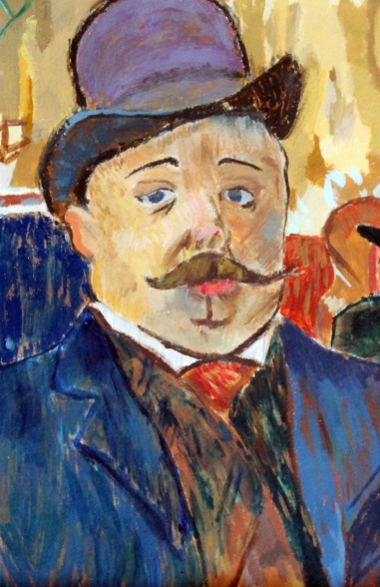
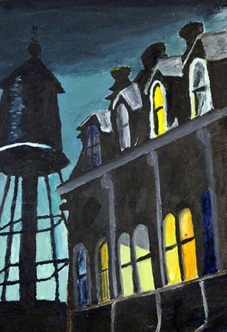

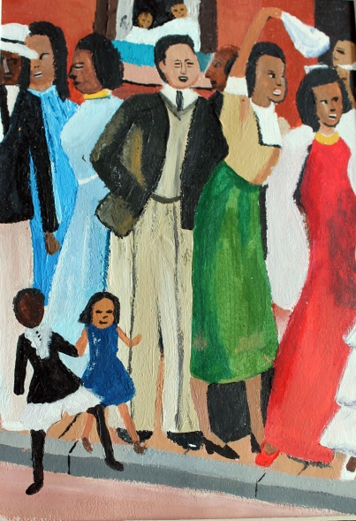
Elective Courses
https://www.wevideo.com/view/1292745624

Slide 25
Art Course Sequence Options
All Electives are 1 Semester Courses
Foundations 2-D Foundations 3-D
Introduction to, Intermediate, Advanced Drawing and Painting
Introduction to, Intermediate Digital Design
Introduction to Digital Photo
Intermediate, Advanced Photo
Introduction to Darkroom Photo
*AP Studio Art 2D
Introduction to, Intermediate Pottery
Introduction to Sculpture
Advanced Pottery and Sculpture
3-Dimensional Design
*AP Studio 3D

Slide 26

Business Education
Do something today that your future self will thank you for.
Top 5 College Majors
The Business Department offers courses in 4 out of the 5 top majors in college!
1. Computer Science
2. Communications
3. Government/Political Science
4. Business
5. Economics

Slide 27
21 Business Courses Offered!
Accounting
Accounting II
Advertising
AP Computer Science
AP Computer Science Principles
AP Macro Economics
AP Micro Economics
Business Law
Business Management
Computer Game Design & Programming
Computer Information Systems
Entrepreneurship
Financial Literacy
Introduction to Business
Investing
Marketing
Robotic Programming
Sports & Entertainment
Web Design

Slide 28
Family & Consumer Sciences
Culinary |  | Human Development & Family Studies | Fashion
Intro to Culinary | Regional American Foods |  | Fashion & Design I
Baking & Pastry |  | Child Development | Fashion & Design II | Fashion Merchandising I
Food Services I |  | Early Childhood Education | Fashion & Design III | Fashion Merchandising II
Food Services II |  | Individual & Family Development | Fashion & Design IV | Interior Design
Food Services III
Notes:
Child Development- Learn about the birth of child and how to take care of them through school age. Reproduction, fetal development and birth will be covered. Take care of electronic baby.
Early Childhood- You become the teacher’s in our student-run preschool. Plan and operate preschool for 3-4 year olds from the community.
Individual Family Develop UCONN ECE- Human Development over the course a life span. Family system and the changes that occur in the family systems over time.

Slide 29
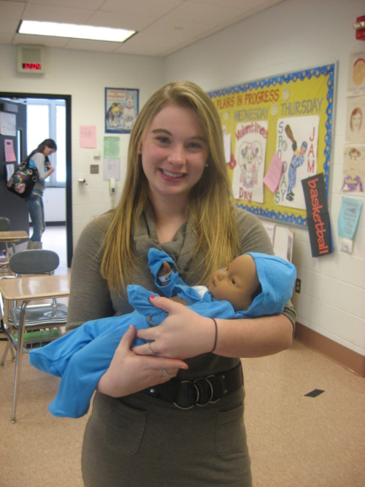
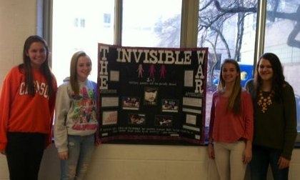
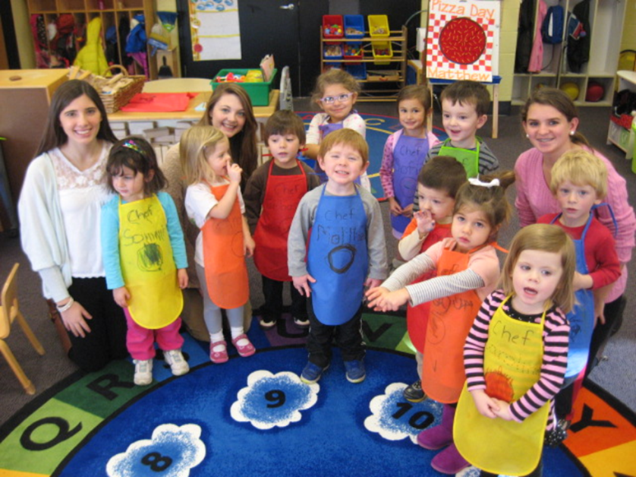
Child Development/Early Childhood Education
Individual and Family Development
3 College Credits
Child Development
Early Childhood Education
Possible Career Pathways:
Pediatrician
Psychologist
Teacher
Speech Pathologist

Slide 30
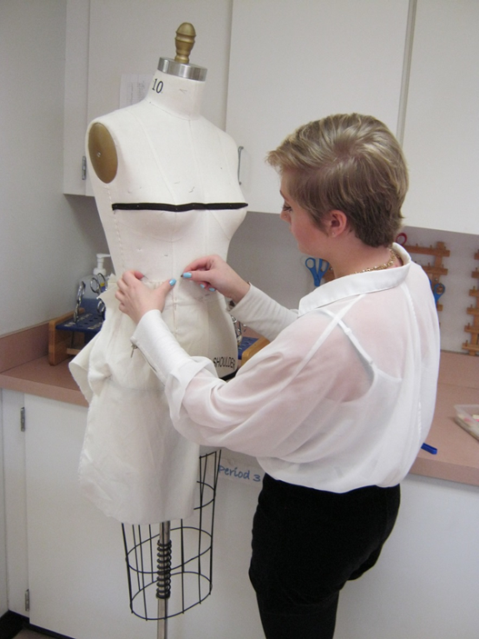
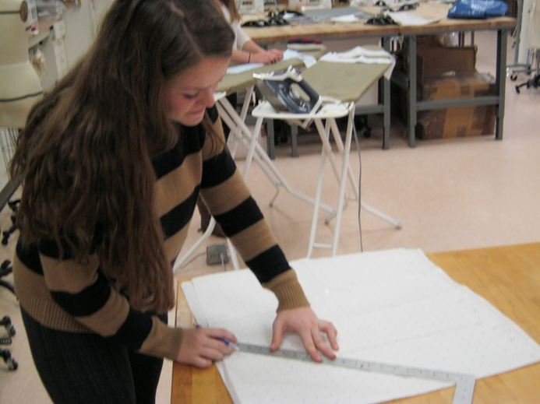
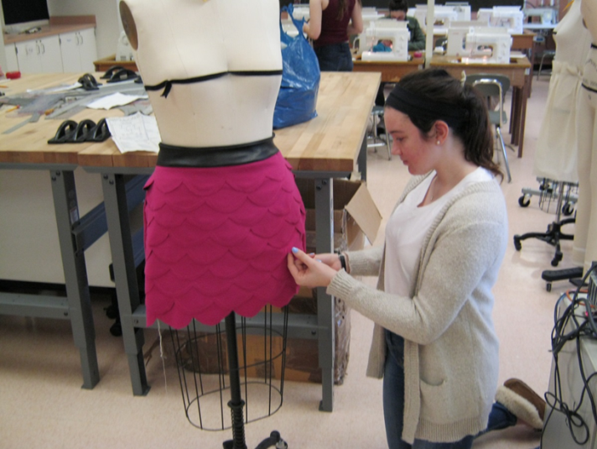
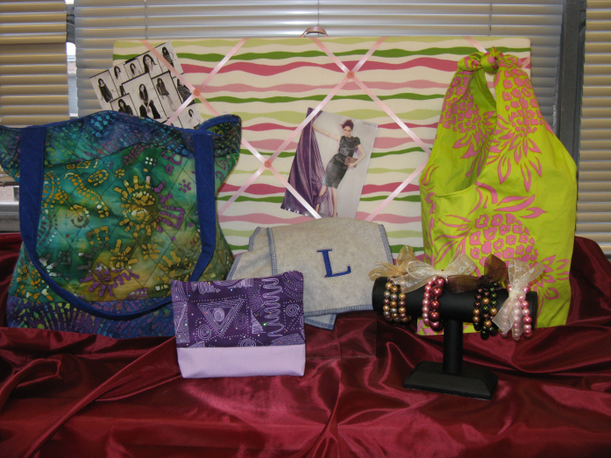
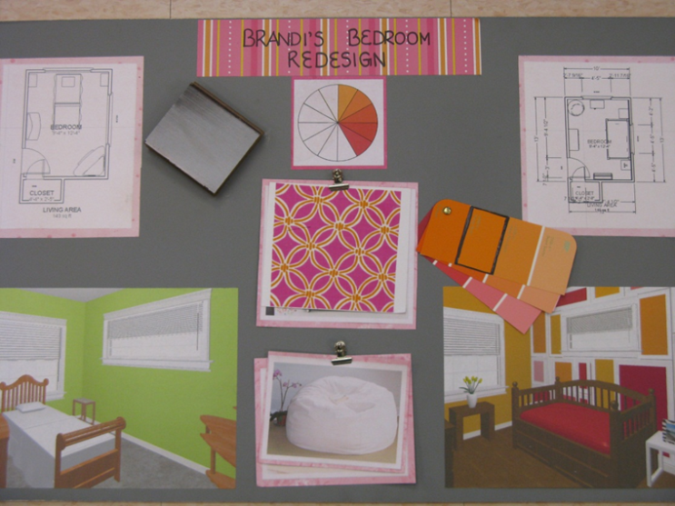
Fashion and Design
Fashion and Design
Possible Career Pathways:
Retail Buyer or Merchandiser
Showroom Sales
Visual Merchandiser
Store Planning Designer
Fabric or Clothing Designer
Trend Forecaster
Interior Designer
Fashion Merchandising and Interior Design

Slide 31
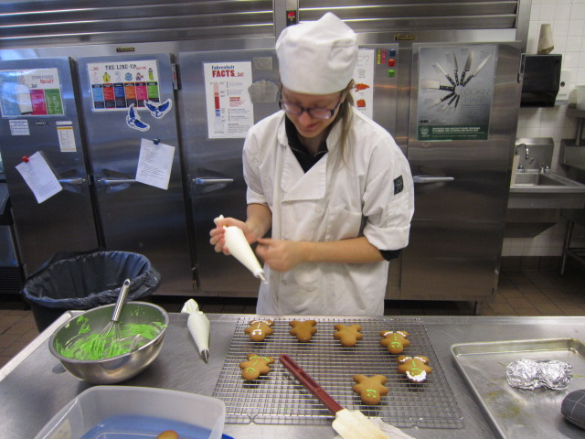
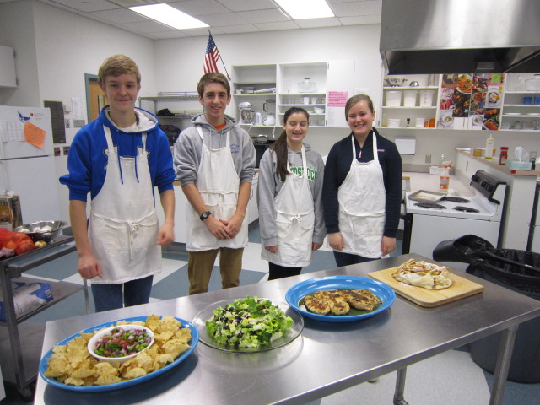
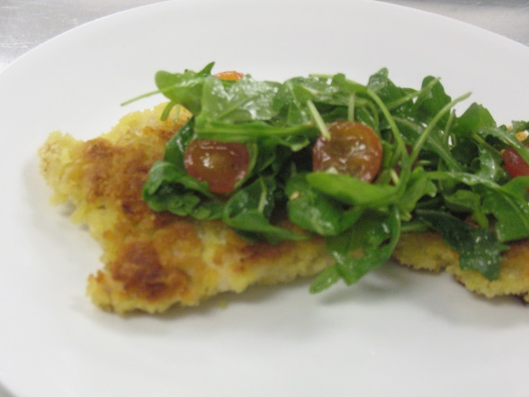
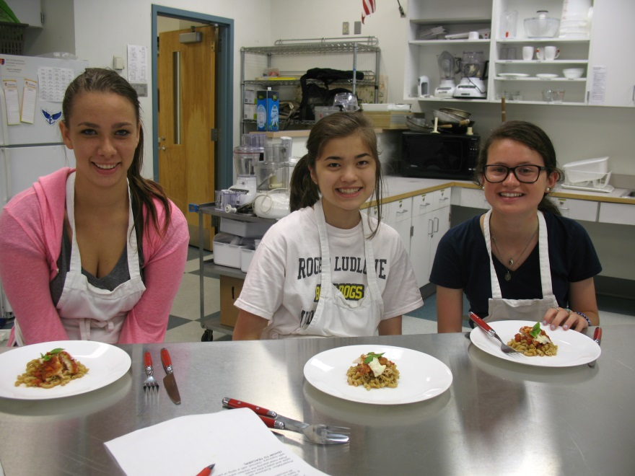
Culinary Arts & Food Service
Possible Career Pathways:
Professional Chef
Nutritionist
Food Photographer or Stylist
Hotel Management
Food Science & Research

Slide 32
Media Production:
Telling Real and Imagined Visual Stories
Library Media Department
Broadcast Journalism
Documentary Production
Movie Production
Video Production

Slide 33
Technology
Education
.
CAD and 3D Animation I and II
Computer Engineering I, II, III, IV
Graphic design technology I,II,III,IV
Robotics
Transportation/Technology I,II,III
Wood technology I,II,III,IV,V

Slide 34
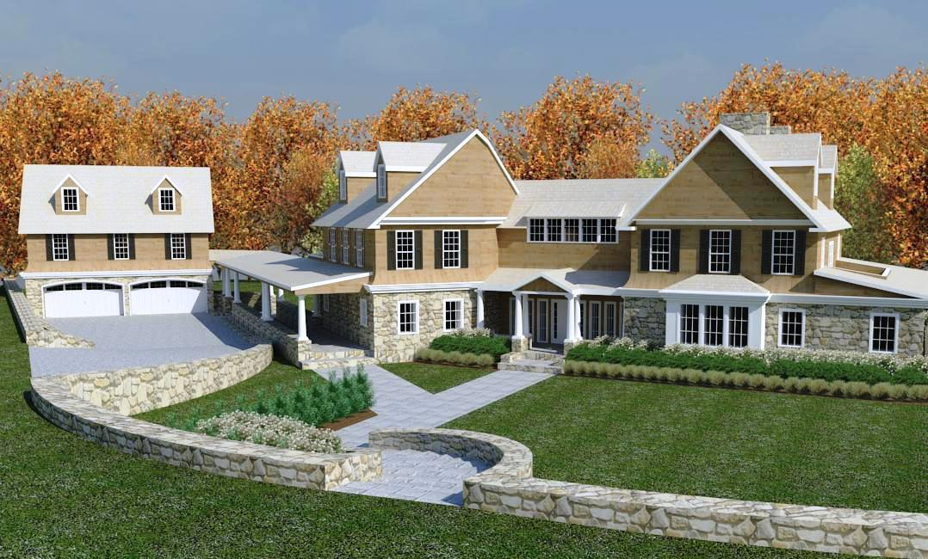
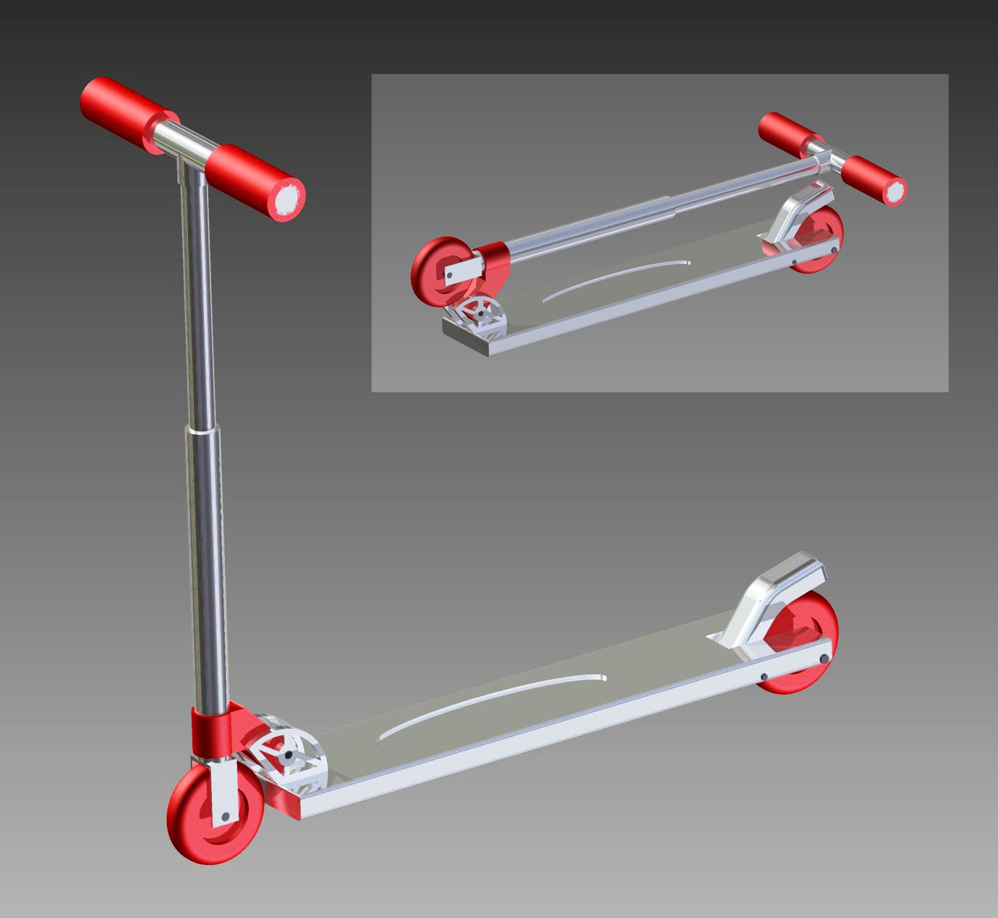

Architecture
Computer
Aided design
Engineering
And 3D Animation

Slide 35

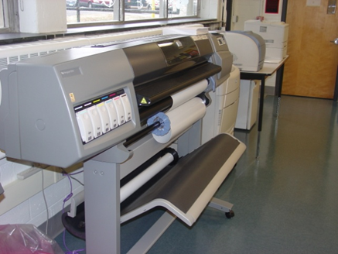
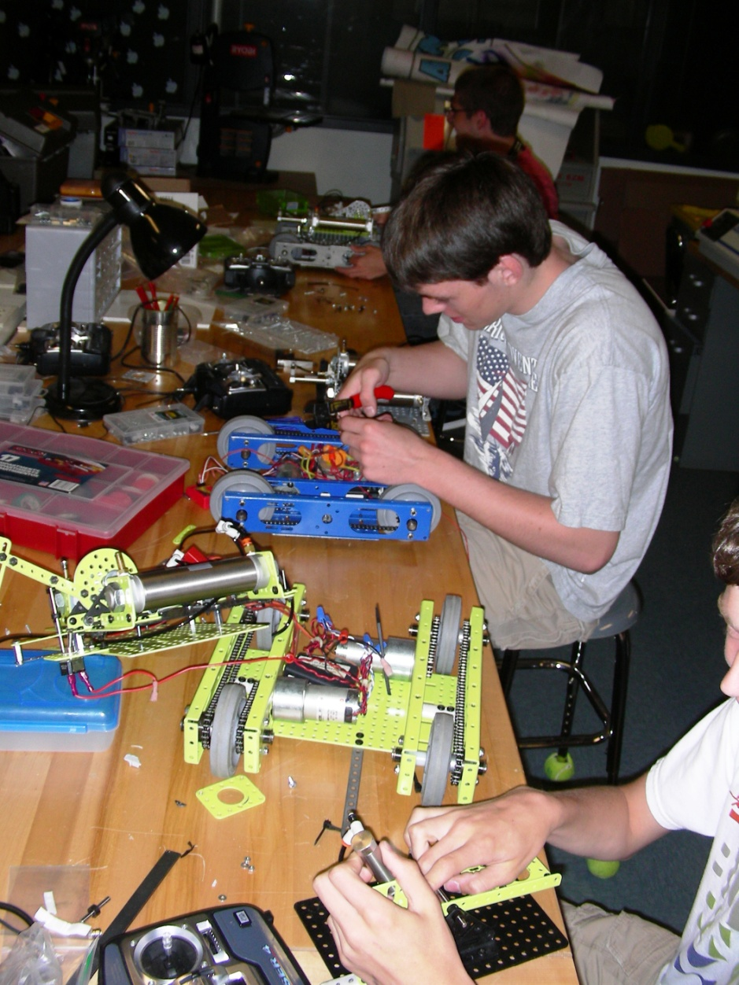
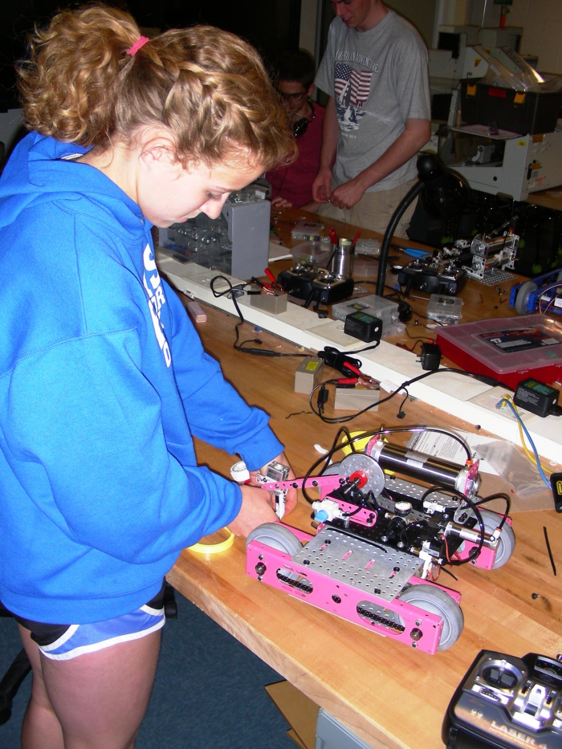
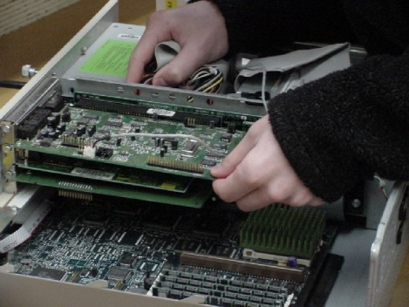
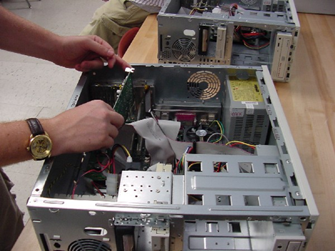



Computer Technology
Robotics Engineering
Graphic Design Technology
Hardware
Software
Networking
Diagnostics
Repair

Slide 36
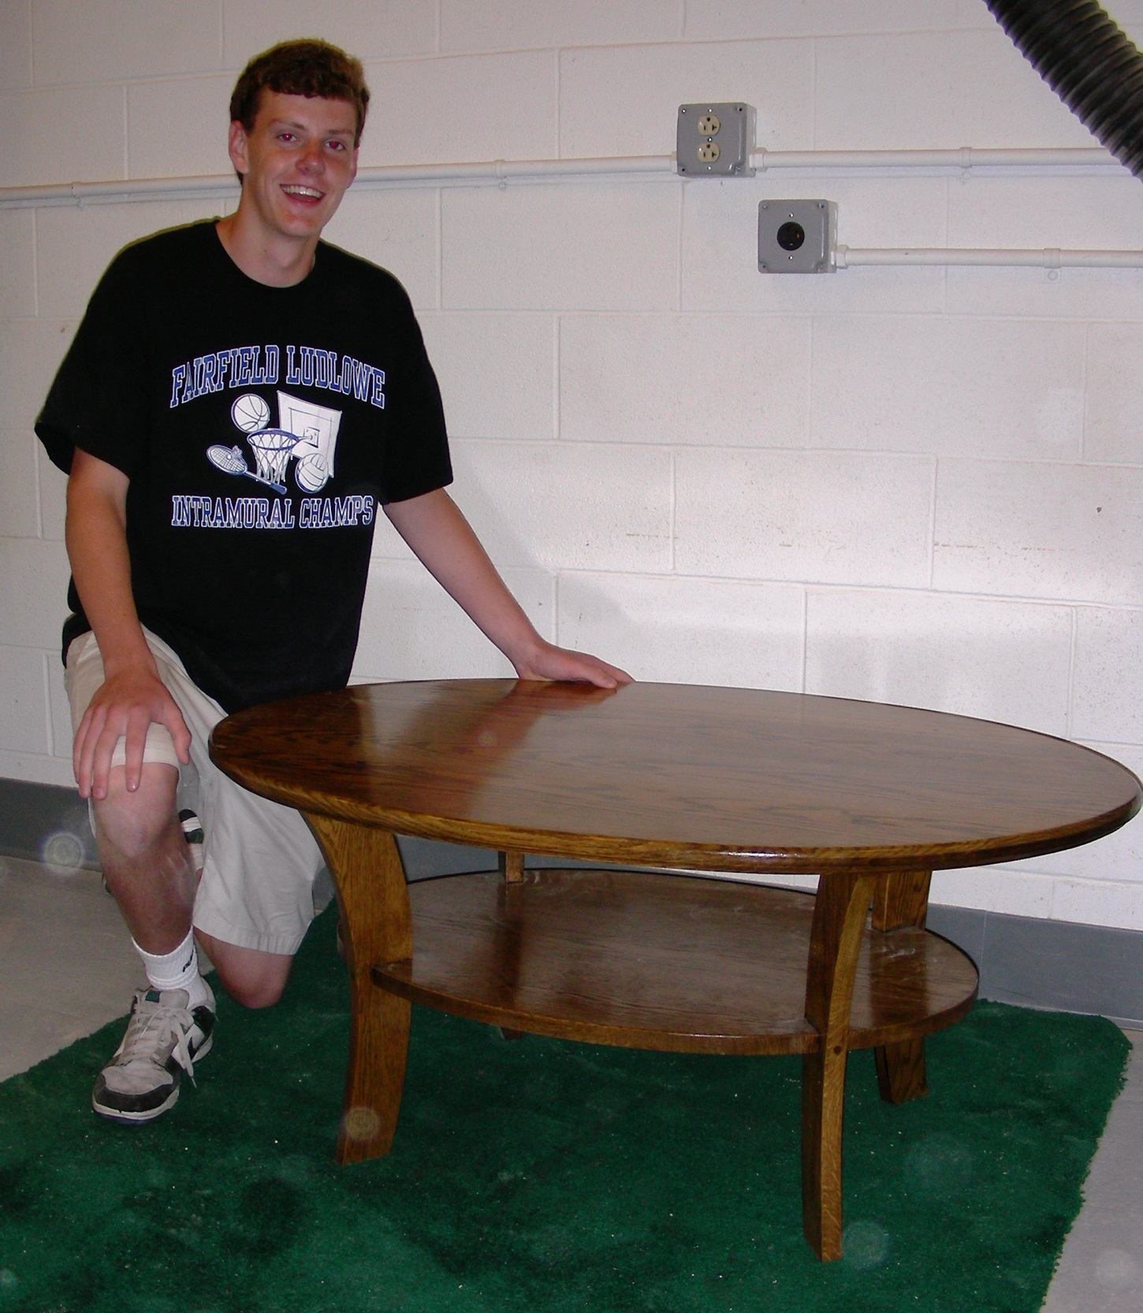
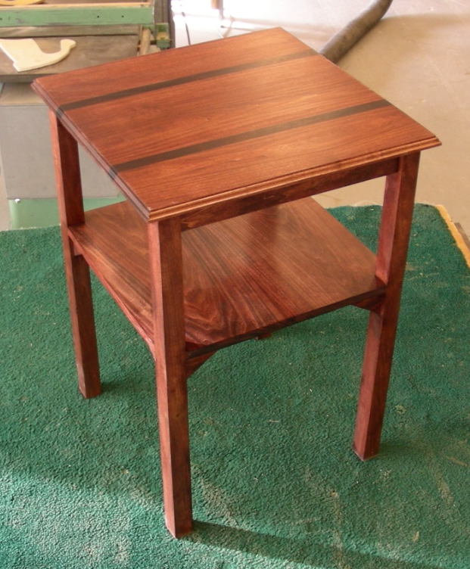
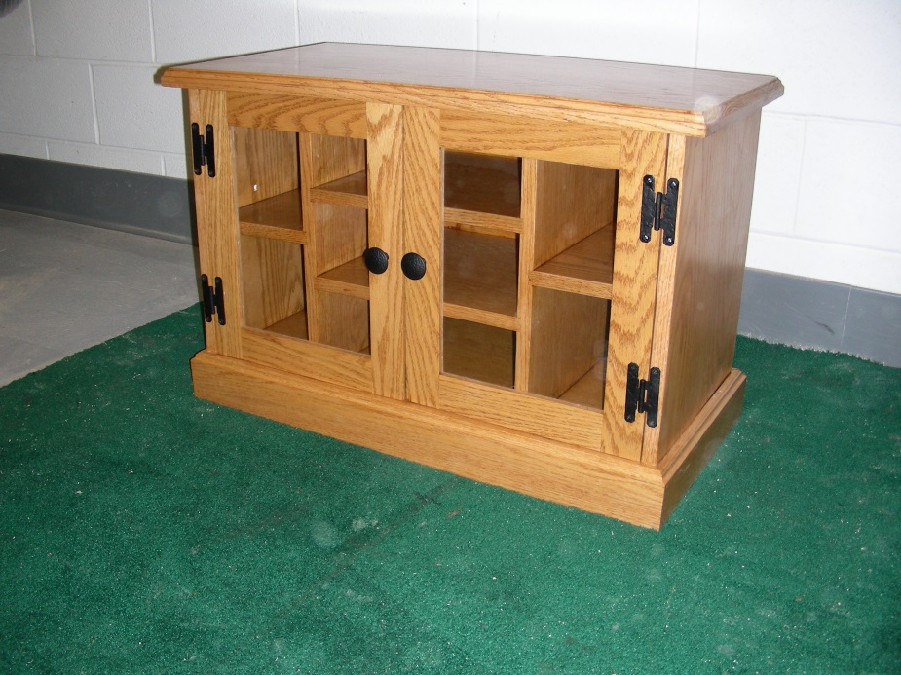
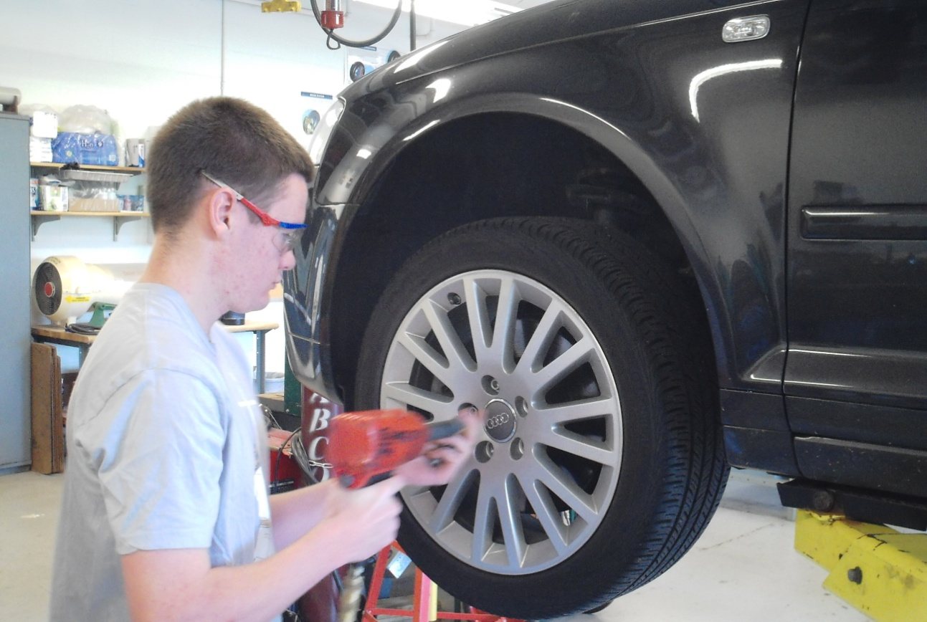
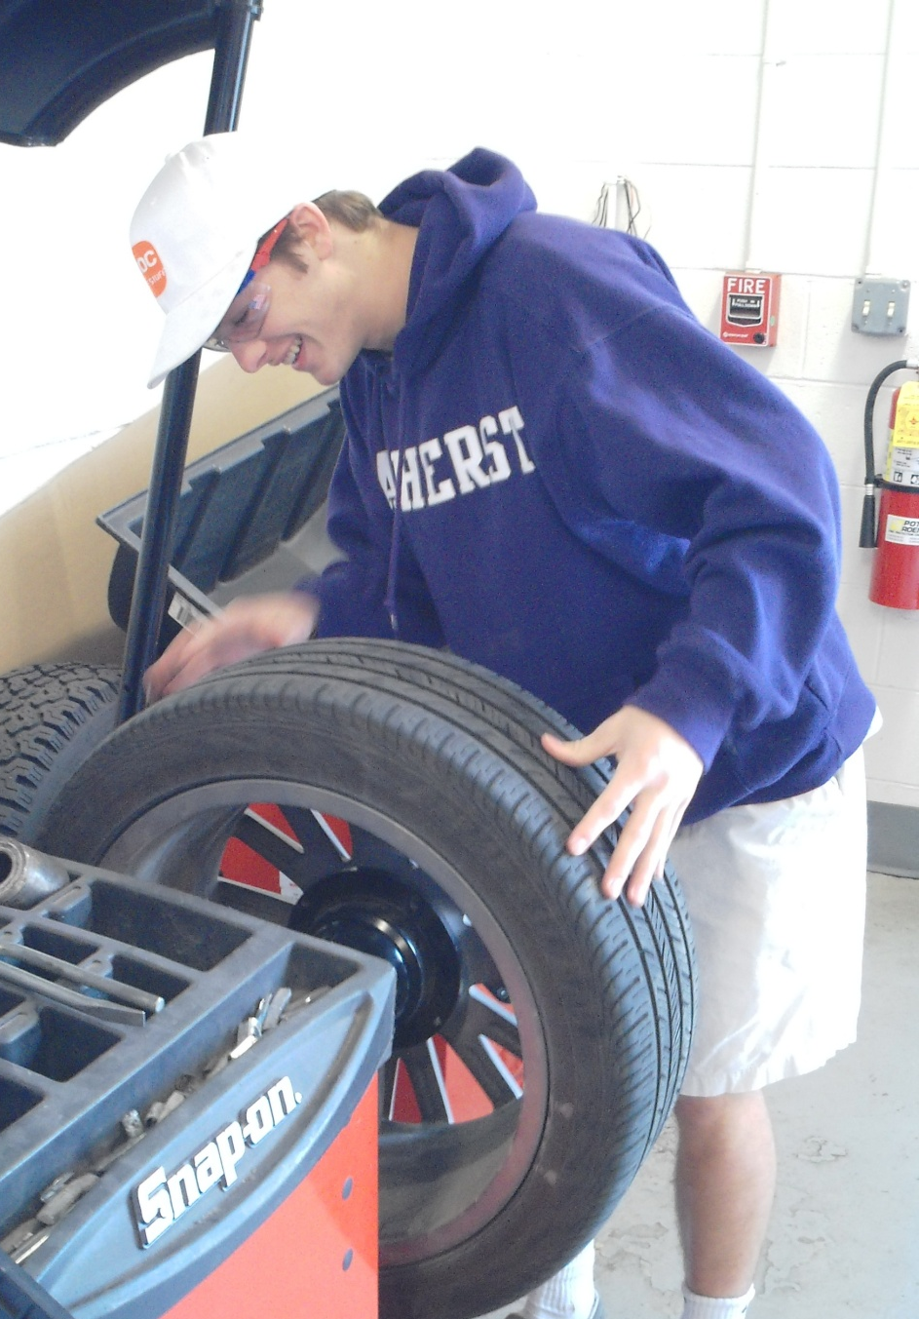
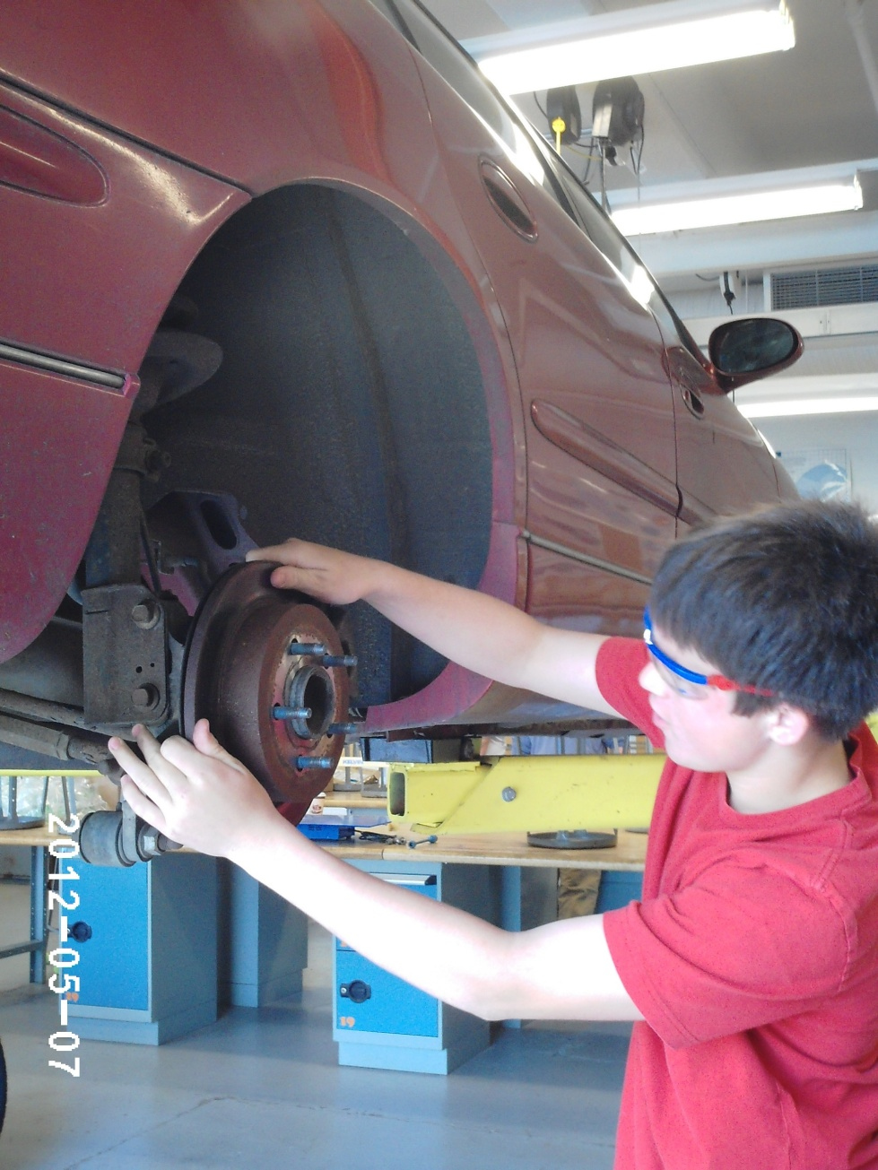
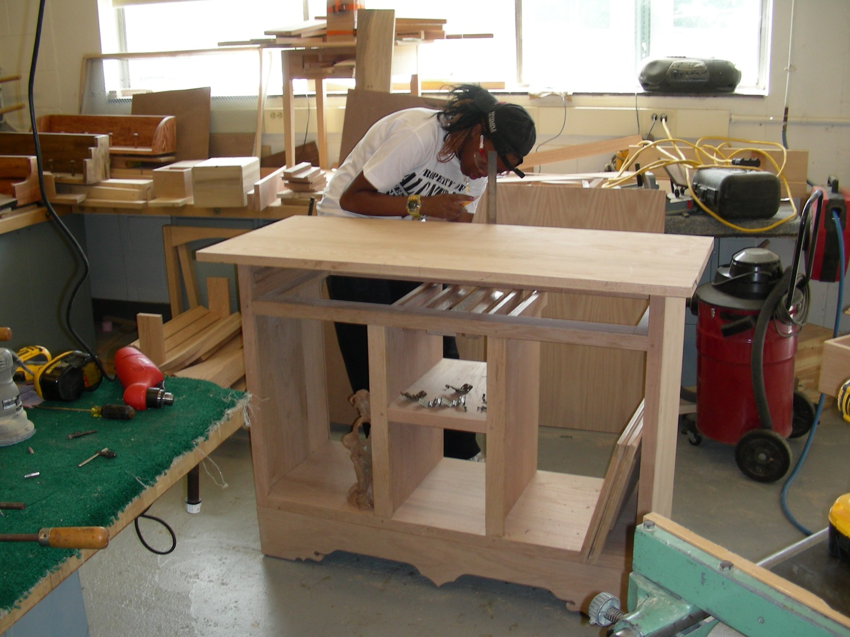
Transportation/Auto Technology
Wood Technology
.

Slide 37

Music
Instrumental:
Vocal and Classroom:
Concert Choir
Women’s Choir
Chamber Singers
Music Technology I
Music Technology II
Music Theory I
Music Theory II
Piano Skills
Concert Band
Symphonic Band
Wind Ensemble
Jazz Ensemble
Concert Orchestra
Symphonic Orchestra
Chamber Orchestra

Slide 38
The Schedule
 | DAY 1/3 | DAY 2/4
7:30—8:55 | Period 1 | Period 1
9:00—10:25 | Period 2 | Period 2
10:30—10:37 | Homeroom | Homeroom
 | Period 3 | Period 3
12:45—2:10 | Period 4 | Period 4
Lunch 10:39 – 11:09 | Class 10:42 – 11:25 | Class 10:42 – 12:08
Class 11:14 – 12:40 | Lunch 11:25 – 11:55
 | Class 11:58 – 12:40 | Lunch 12:10 – 12:40

Slide 39
Sample Weekly Schedule
Times |  | Mon DAY 1 | Tue Day 2 | Wed Day 3 | Thurs Day 4 | Fri Day 1
7:30 8:55 | Period 1 | Science | PE and Health | Science | PE and Health | Science
9:00 10:25 | Period 2 | English | Elective II OR STUDY HALL | English | Elective II OR STUDY HALL | English
10:30 10:37 | HR | Homeroom | Homeroom | Homeroom | Homeroom | Homeroom
 | Period 3 | Elective I | World Language | Elective I | World Language | Elective I
12:45 2:10 | Period 4 | Social Studies | Math | Social Studies | Math | Social Studies
Lunch 10:39 11:09 | Class 10:42 11:25 | Class 10:42 12:08
Class 11:14 12:40 | Lunch 11:25 11:55
 | Class 11:58 12:40 | Lunch 12:10 12:40

Slide 40
Changing/Dropping Courses
Once schedules are finalized, schedules cannot be changed! counselors will make changes for the following reasons only:
An incomplete schedule or insufficient credits
A course scheduled in error by the school
Changes needed as the result of courses failed
Changes needed as the result of summer school work
Changes needed to meet a particular college or post-secondary program entry requirement.
As always, students with concerns regarding their academic progress should speak to their teacher and school counselor.

Slide 41
Calendar for
Changing/Dropping Courses
Course changes will not be approved during the first two weeks of any course (except for reasons posted on previous slide).
After the first quarter of any course, any approved changes will result in a grade of “W” (withdrawn) which will appear on your transcript—this applies even to level changes. This will not impact GPA. After the 1st semester, any student dropping a full year course which they are failing will receive a grade of “WF”.

Slide 42
Rationale for Change/Drop Policy
Our process provides students with more opportunity and responsibility to build their schedule – and we are looking to foster commitment to original requests.
We build the master schedule from student course requests, so it is important to have solid numbers.
Our goal is to provide students and teachers with balanced classes (avoids large class sizes).
Even a single change can affect enrollment in multiple courses, increasing disruption.
Multiple changes to a schedule causes students to miss critical information shared in the initial days the course meets.

Slide 43
The Process
1. Get Informed
Course Selection night tonight, January 3oth
friday, January 31^{st-}students receive POS and course selection sheets in Homeroom
Read the Program Of Studies and course information posted online, speak with your teachers and school counselor
2. Complete the Course Selection Worksheet with your requests
February 1st-8th - Teachers will spend class time discussing department courses and their recommendations, and signing Course Selection Worksheets
Be sure all information is accurate and complete
Sign your form when completed
Obtain your parent’s signature
Enter your Requests into Infinite Campus

Slide 44
The Process
3. Review your requests with your school counselor
Schedule an appointment between February 11th and Feb. 28th (appointments are scheduled through Google, go to your House Google classroom page for the link)
Enter your final selections into Infinite Campus (with counselor assistance)
Print out Final Course Request Form from Infinite Campus
4. Final Step
Sign and obtain your parent’s signature on the Final Course Request Form
Return the Final Course Request Form to your school counselor on or before MARCH 4TH

Slide 45
Resources for Students/Parents
Course Selection Night, January 30th
Program of Studies – the most thorough resource you have (it’s on our website too!)
Conversations with teachers, school counselors, curriculum leaders, administrators
Informational website:
www.fairfieldschools.org/highschoolcourse_selection.html
(Includes: Course descriptions, AP syllabi, AP sample tasks and exemplary student work samples, table of time commitment expectations for each class)

Slide 46
Questions about Curriculum, Course Requirements, Expectations?
English – Jennifer Swingler, Curriculum Director Music-Sara Hoefer, Coordinator
jswingler@fairfieldschools.org 203-255-8286 shoefer@fairfieldschools.org 203-255-8454
Math – Paul Rasmussen, Curriculum Director Physical Education-Dave Abraham, Coordinator
prasmussen@fairfieldschools.org 203-255-7359 dabraham@fairfieldschools.org 203-255-8472
Science-Patrice Faggella, Curriculum Director Art-Michele Hermsen, Liaison
pfaggella@fairfieldschools.org 203-255-8282 mhermsen@fairfieldschools.org 203-255-7240
Social Studies-Gregg Pugliese, Curriculum Director Business-Robin Terwilliger, Liaison
gpugliese@fairfieldschools.org 203-255-8281 rterwilliger@fairfieldschools.org 203-255-8362
World Language-Eileen Frankel, Coordinator Family & Consumer Science-Rachel Keleher, Liaison
efrandel@fairfieldschools.org 203-255-7361 rkeleher@fairfieldschools.org 203-255-7236
Health-Lori Mediate, Coordinator Technology Education- John McCandless, Liason
lmediate@fairfieldschools.org 203-255-8472 jmccandless@fairfieldschools.org 203-255-7236
Director of Student Services, Caryn Campbell
ccampbell2@fairfieldschools.org 203-255-8388

Slide 47


Fairfield Warde High School PTA

Slide 48

Fairfield Cares Coalition, established in 2009, is a town-wide organization including parents, school representatives, local business leaders, law enforcement personnel, clergy, counseling professionals and youth services organizations.
Fairfield Cares is dedicated to:
Preventing underage drinking and substance abuse in Fairfield
Increasing awareness of the risks of various forms of addiction
Promoting healthy choices and behaviors to increase personal wellness
Strengthening community well-being and resilience
Contact:
fairfieldcaresct@gmail.com
Visit our website: Fairfieldcaresct.org
Like us on Facebook! Facebook.com/fairfieldcares

