Slide 2
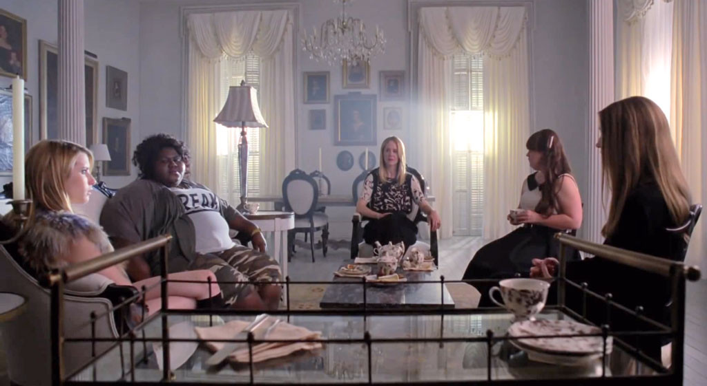
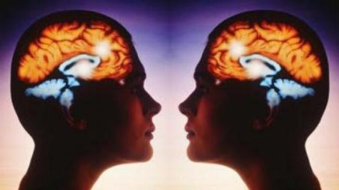
.
Table of Contents
Characters 1
Characters 2
Summary 1
Summary 2
Science
Myth or Fact?
The Brain
Mirror Neurons
How do Scientists know?
How does this impact us?
Negative Effects
We Deal with Mirror Neurons all the time!
Recap
Conclusion

Slide 3
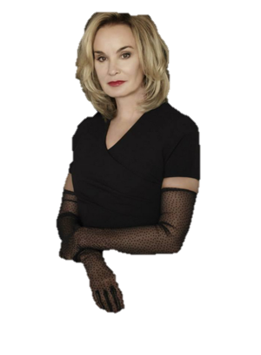
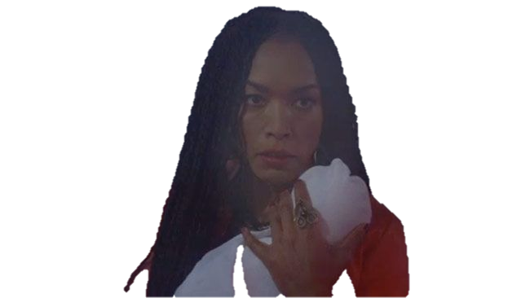
CHARACTERS
WARNING: SPOLIER ALERT
Witch that all the others underestimate because disability
Power is to read others minds by learning things about them that they don’t want others to know
Dies towards end of season
Supreme of Coven
Obsessed with looking young
As the next supreme rises, her cancer gets stronger
Kills all witches who she believes will be next supreme
Daughter of Fiona
Headmistress of Coven
Very protective of witches
Dies but comes back immediately
Next Supreme
Part of the Voodoo Coven
Rivals with Witchcraft Coven
Made truce that broke
Lives forever

Slide 4
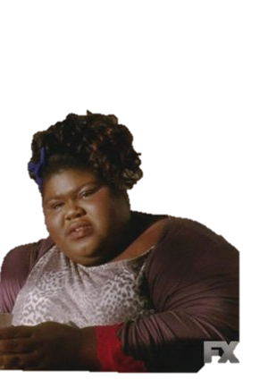
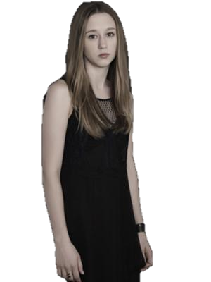
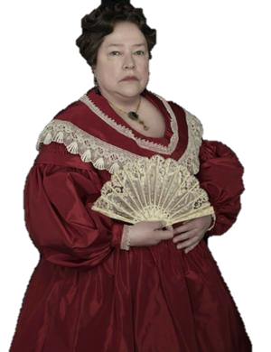
CHARACTERS
New witch of Coven
Inherits curse of being a witch from grandmother
Hard for her to adjust to things
Power to hurt people by hurting herself
Tries to join Voodoo Coven
1830’s high society, always throwing elegant parties
Brutally hurt slaves (all black)
Marie LaVeau cursed her with forever lifetime
Marie LaVeau buried her alive
Meaner witch of Coven
Believes she is better than anyone else
Can do almost anything with her powers
Uses powers to harm

Slide 5
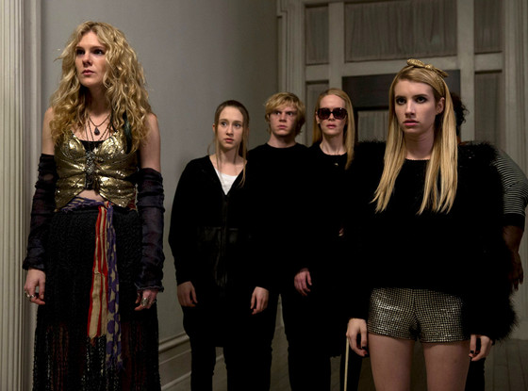
.
Summary
300 years after Salem witch trials witches who managed to escape starts to go extinct
Remaining witches put in Coven to learn how to protect themselves
Zoe is new girl at Coven in New Orleans
Meets Queenie, Nan and Madison
Nan discovers Delphine LaLaurie
Upsets Marie LaVeau

Slide 6
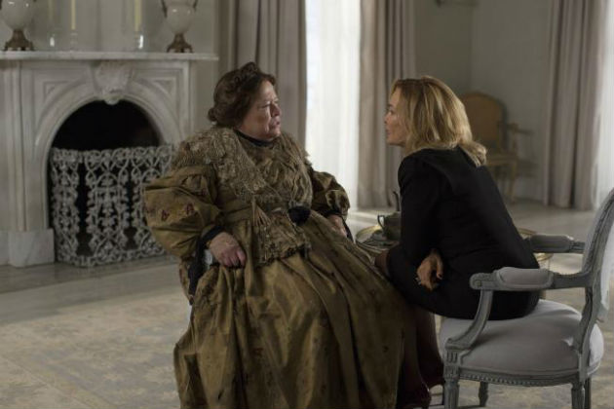
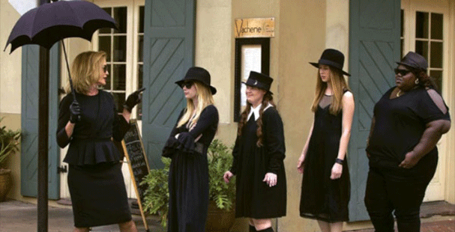
.
WARNING: SPOLIER ALERT
Summary
Rivalry between two different Covens: Voodoo, and Witchcraft
New Supreme starts to rise, Fiona starts to die
Fiona attempts to kill witches that she believes are next supreme
Practices Seven Wonders to see who next supreme is
Cordelia rises as new supreme
Broadcasts live about Coven, many witches come

Slide 7
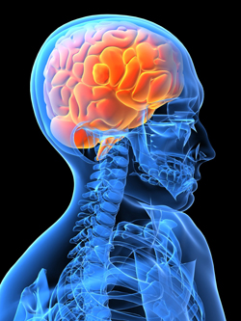
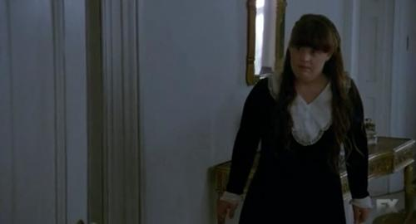
.
Science
Nans power is to read minds
Finds out things that others don’t want her knowing
Finding Delphine LaLaurie
Madison Montgomery killed a director
Can humans read minds?

Slide 8
.
Myth or Fact?
Is it possible for humans to read minds?
Possible
Cells called Mirror Neurons
Cells reflect actions of others
Cells reflect sensations and emotions
Cells respond same way as another
Found in Premotor Cortex

Slide 9
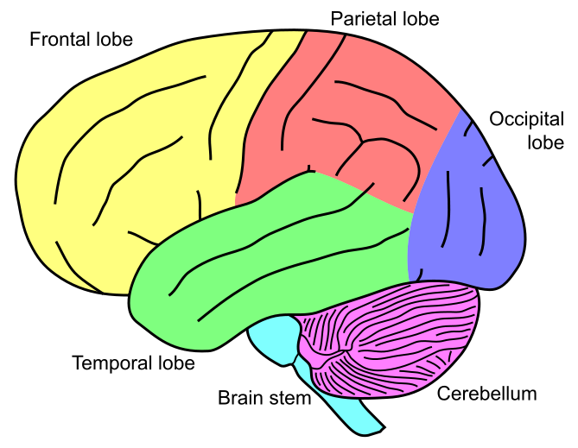
.
The Brain
Premotor Cortex
Responsible for planning movements
Responsible for motor control
Preparation of movement
Sensory guidance of movement
Spatial guidance of reaching
Direct control of proximal and trunk muscles
Cerebellum controls balance, coordination, and movement
Contains cluster of cells called mirror neurons
Mirror neurons: reflect actions, sensations, emotions
Cerebellum

Slide 10
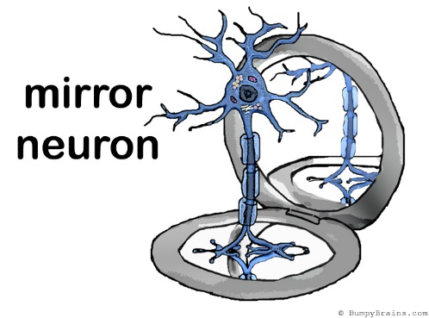
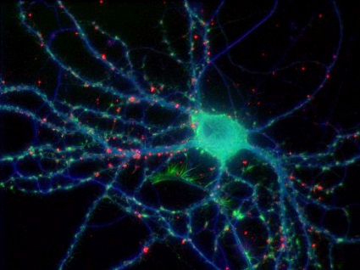
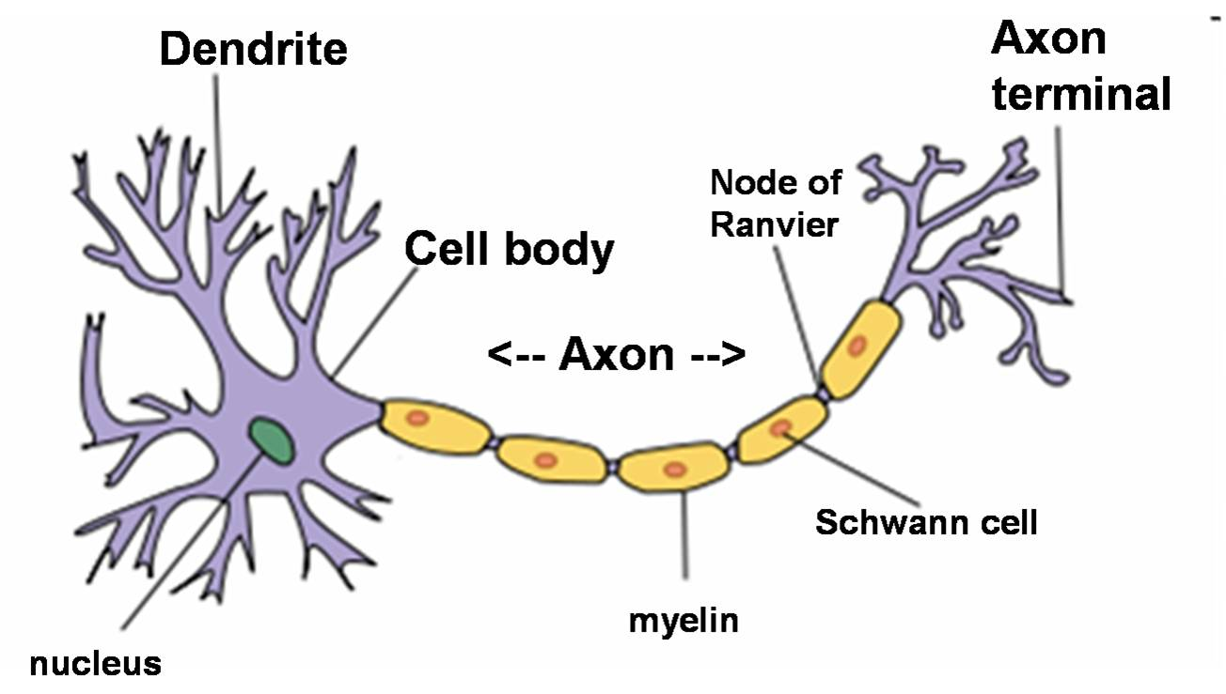
.
Mirror Neurons
Ability to instinctively and immediately understand what other’s experiencing
Mimics what others do after spending long time with them
Someone stubs toe, you flinch in sympathy
Most important neuroscientific breakthrough of recent history
Found in Premotor Cortex
Scientists thought brain used logical thought process to predict peoples’ actions
Allows us to receive and interpret facial expressions
scientific study of the nervous system

Slide 11
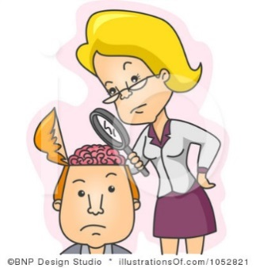
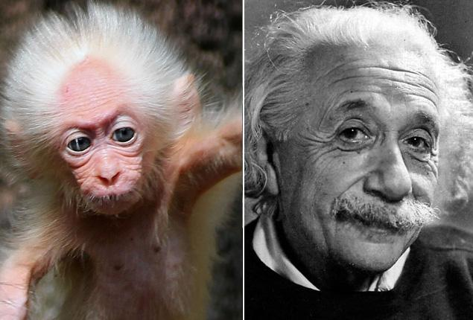
.
How Do Scientists Know?
1996 neuroscientists implanted electrodes in brain of macaque monkey to explore
Stumbled across curious cluster of cells in premotor cortex
Cluster of cells fired when monkey performed and saw action
Cells responded same with monkey when human reached for a peanut
Cells responded same with different actions taken
Experiments confirmed that mirror neurons exist in humans
Revealed that cells reflect sensation and emotion

Slide 12
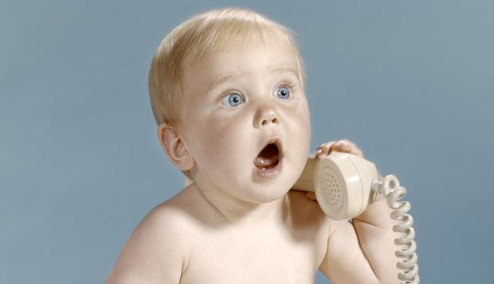
.
How does this impact us?
New understanding of how and why we develop empathy for others
More knowledge about autism, schizophrenia, other brain disorders characterized by poor social interactions
New theory about the development of language
Baby talking stages
New therapies helping stroke victims regain lost movement

Slide 13
.
Negative Effects
Spend time with nervous, anxious person, you find yourself mimicking anxiousness
Surrounded with anger, you become angry
With an angry friend, mood changes
Depends on vibes you are surrounded by

Slide 14
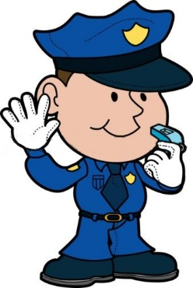
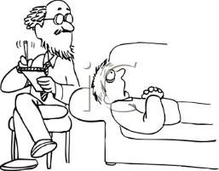
.
We Deal with Mirror Neurons
all the time!
We chose to help others we don’t want to mirror
Calming down a friend
Nurses
Cops
Mental health workers
Social workers
Psychiartrists
Higher risk of mirroring emotions, actions, etc.

Slide 15
.
Recap
Where can you find the mirror neuron?
Premotor Cortex
What is a mirror neuron?
A neuron in the Premotor Cortex that reflects actions, sensations and emotions
What is one negative and positive impact of mirror neurons?
Negative: Can mirror negative vibes such as anxiousness and anger
Positive: Improves knowledge on autism, schizophrenia, and other mental diseases
How did scientists find the mirror neuron?
Implanted electrodes in brain of macaque monkey and stumbled across curious cluster of cells

Slide 16
.
Conclusion
We can read minds
We can’t read minds like Nan ( look into others minds)
We understand what others experience
We mimic others
All happens in premotor cortex through mirror neurons
Scientists discovered this through macaque monkeys
Impacts us in positive and negative ways
We deal with mirror neurons all the time
Thanks For Watching!

