Slide 1

The Mystery of the Na’vi

Slide 2

Movie Trailer

Slide 3
Summary of the Movie
When his brother is killed in a robbery, paraplegic Marine Jake Sully decides to take his place in a mission on the distant world of Pandora. There he learns of greedy corporate figurehead Parker Selfridge's intentions of driving off the native humanoid "Na'vi" in order to mine for the precious material scattered throughout their rich woodland. In exchange for the spinal surgery that will fix his legs, Jake gathers intel for the cooperating military unit spearheaded by gung-ho Colonel Quaritch, while simultaneously attempting to infiltrate the Na'vi people with the use of an "avatar" identity. While Jake begins to bond with the native tribe and quickly falls in love with the beautiful alien Neytiri, the restless Colonel moves forward with his ruthless extermination tactics, forcing the soldier to take a stand - and fight back in an epic battle for the fate of Pandora.
From the IMDB (Internet Movie Database)
http://www.imdb.com/title/tt0499549/plotsummary

Slide 4
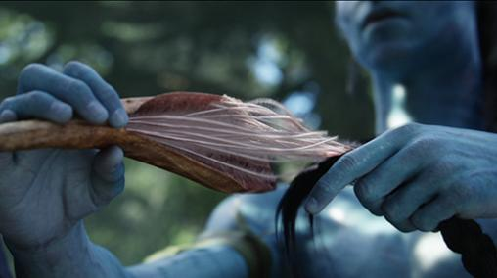
The Possibility of the Na’vi’s ‘Queue’
The Link to Eywa:
  The ability of the Na’vi to mentally and spiritually communicate to animals of Pandora and the planet itself. IS THIS POSSIBLE???
We Will Discuss:
  Our personal theory
  Review the CNS and PNS
  Real life examples

Slide 5
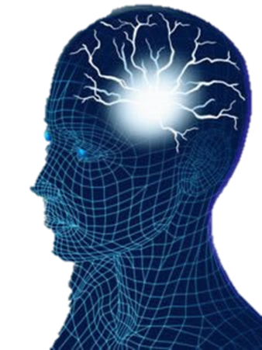
Personal Theory:
Based on research thus far:
  “The Na’vi are able to link with the other organisms of Pandora through an extension of their cerebellum, cerebrum, and spinal cord and are then able to control the muscles and bodily functions of that organism by sending messages from their own CNS.”
  Note: This is all based on the notion that the Na’vi share some similar biological characteristics with humans and other primates of Earth

Slide 6
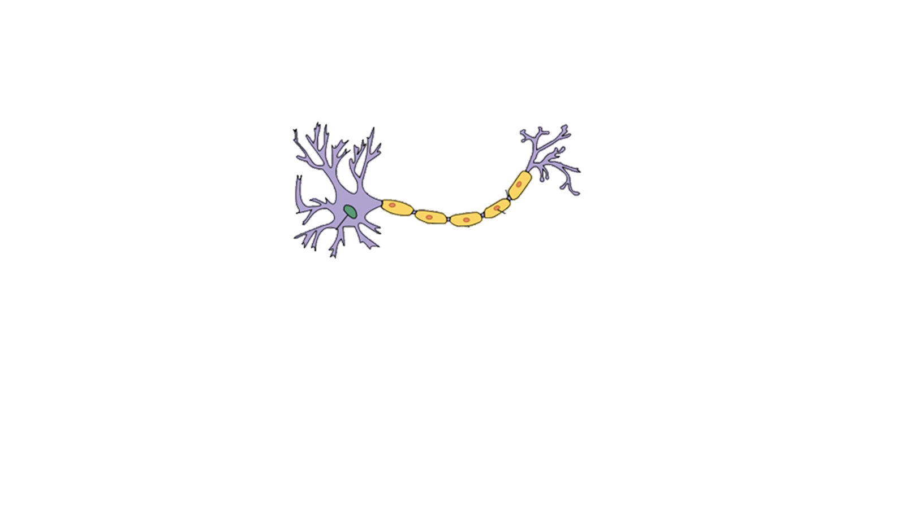
The Nervous System
Two main section:
  Central Nervous System
    Brain
    Spinal Cord
  Peripheral Nervous System
    Consists of nerves outside the CNS
Dendrites
Axon Terminal
Synapse
Cell Body
Axon
Nucleus

Slide 7
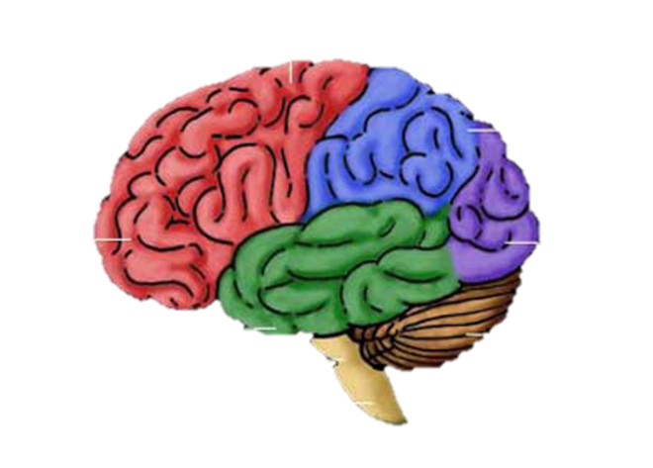
The Brain (Human)
Cerebrum
Sections:
  Cerebrum
  Brain Stem
  Cerebellum
Cerebellum
Brain Stem
Cerebrum | Brain Stem | Cerebellum
Movement (Voluntary Actions) | Controls involuntary actions: Heart Rate Digestion Blood pressure | Coordination
Problem Solving | Connects brain to spinal cord | Balance
Memory
Notes:
Functions: Cerebellum Voluntary Action
Cerebrum “memory”
Brain stem involuntary actions
Millions of nerurons

Slide 8
Nerves and Neurons
Nerves
  Take information from the five senses and send them to the CNS through links of neurons. Consists of many neurons bundled together.
Neurons
  Transmit and process messages through chemical and electrical signals
Neuron | Nerve
Single Cell | Made of the fibers of many neurons
Passes messages to other muscles, glands, or neurons. | Nerves carrying messages to the brain are considered sensory nerves
Sends neurotransmitter molecules from axon terminals which diffuse across the synapse and into the dendrites of another neuron | Nerves carrying messages away from brain are considered motor nerves

Slide 9
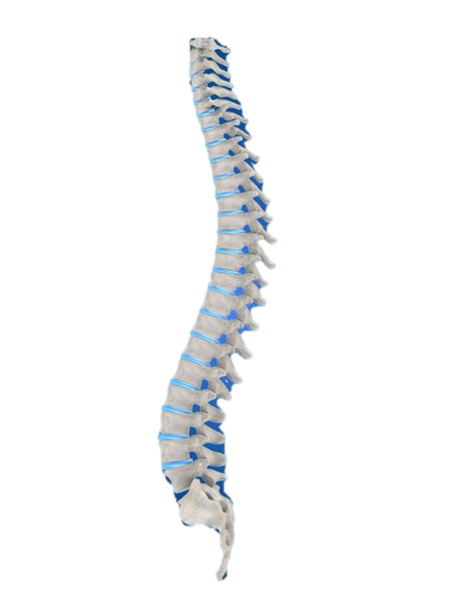

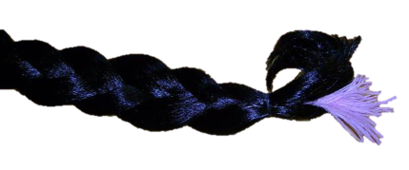
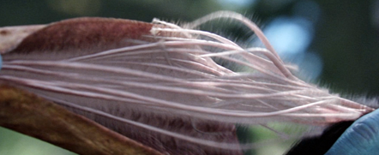
Our Proposed Anatomy of the ‘Queue’
Messages are sent from the brain
The messages travel down the spinal cord then branch off into another extension of the spinal cord. This extension stretches upwards toward the top of the head. This includes sensory and motor nerves.
The messages from the brain cross the synapse and are transferred to motor nerve cells
The spinal extension continues within a thick braid of hair. There are no vertebrae at this stage.
Thick bundles of nerve cells connect with the other organism’s strands

Slide 10
1st Method of Physical Connection
Upon contact with an input, the cells on both ends enter mitosis.
Upon entering mitosis the cells at the end of the braid rapidly multiply, creating a single connected strand of tissue.
The nerves come close enough with nerves on the input of the other organism to allow messages to cross the synapse.
The motor nerves can now carry messages from the Na’vi’s CNS and relay them to the motor nerves of the other organism

Slide 11
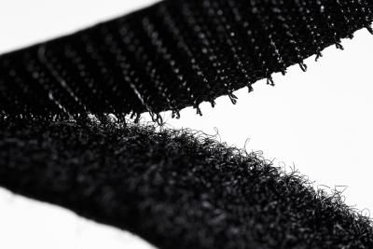
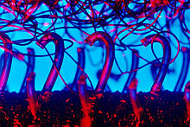
2nd theory of connection
The Queues from the Na’vi have little microscopic hair-like structures at the end of the worm-like structures in their queues. These connect with the other hair-like structures on the animals queues, and they connect with a velcro-like idea, with one animals queue being the hook, and the other animals queue being the loop. This is as equally possible as our theory, and there are small problems that face this, because as with velcro, if you open and close it too many times, it doesn’t work or it breaks. So my personal solution to this, is that since the Na’vi are living creatures, and so are their animal companions, the hair-like structures will grow back as they break. This bond will have to be so close that they are almost touching on a microscopic level. This allows the axon terminal to send the message across the synapse to the other animals dendrites.

Slide 12
Why this does not function in reverse:
Axon terminals and dendrites are one-way circuits
  This does not allow motor nerve cells to transfer messages from the “lesser” organism's CNS to the muscles and glands of the Na’vi

Slide 13
The Current Science on the Topic
There has been research done and experiments performed to study neural communication between animals. The Duke University Medical School experimented with two rats.
The brains of the rats were connected electronically allowing them communicate to one another and solve puzzles.
Official web page for the experiment

Slide 14
Conclusion
Through the use of an extension of the spinal cord, the Na’vi are able to send messages from their own central nervous system and gain access to the motor neurons of the controlled organism and control its motions. As quoted from Avatar Wiki it states that queues (long braid, hair-like figure that has pink worm-like tendrils at the end) are used for a neural-level connection between the Na’vi and the animal. [These queues are] in fact an extension of the nervous system. This connection is total, so both partners have control of the connected beings. [The Na’vi] enables him/her to use the mount’s sensory organ. This also means that the rider will feel pain when his/her connected animal is hurt.
This unique gift led to many advancements for the Na’vi as a people, and helped them against the humans in many ways…

Slide 15

Except when humans destroy their home tree.

Slide 16
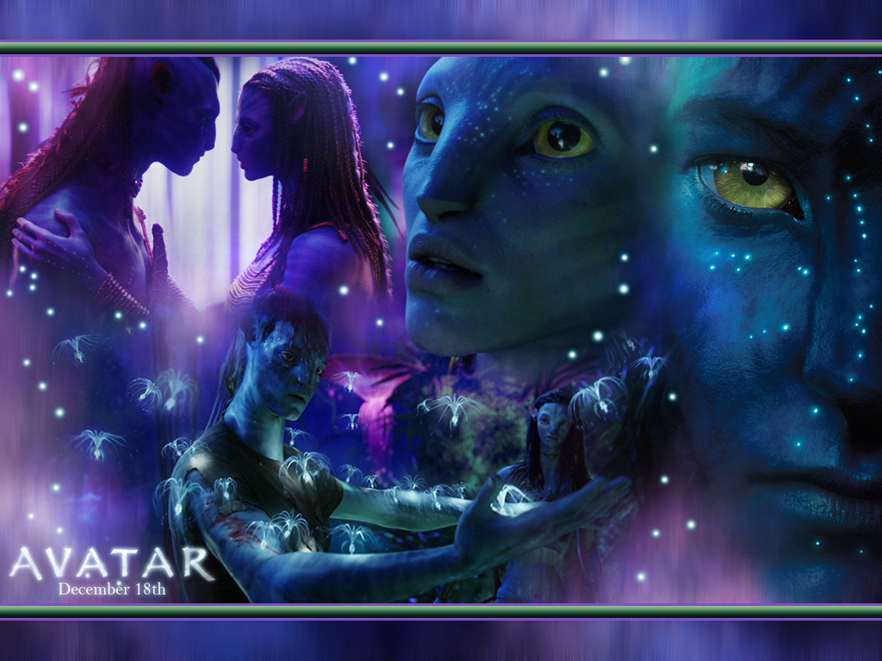
Work Cited
http://webpath.follettsoftware.com/resource/viewurl?encodedUrl=plo2j1Ikxcj5uQozTp-kxdcCs-jjZiMH5Sm5K80ON3k&version=1&appsignature=Destiny&appversion=10.5.6.0+%28RC6%29
http://blaberize.com/wp-content/uploads/2009/11/Avatar_movie-desktop-Wallpaper.jpg
http://webpath.follettsoftware.com/resource/viewurl?encodedUrl=q_rO5p7-EdwTrLQWtutQRHeFAys35RgGXwHfJH8fSKE&version=1&appsignature=Destiny&appversion=10.5.6.0+%28RC6%29
http://james-camerons-avatar.wikia.com/wiki/Queue

Slide 17
Works Cited Continued
Online Articles:
  http://school.eb.com/eb/article-9110704?query=central%20nervous%20system&ct=null
  http://www.pandorapedia.com/navi/life_society/the_navi
  http://www.dukehealth.org/health_library/news/brain-to-brain-interface-allows-transmission-of-tactile-and-motor-information-between-rats
Books:
  Gilbert, Scott F., and David Epel. Ecological Developmental Biology: Integrating Epigenetics, Medicine, and Evolution. Sunderland, MA: Sinauer Associates, 2009. Print.
  Silverstein, Alvin, Virginia B. Silverstein, and Robert A. Silverstein. The Nervous System. New York: Twenty-First Century, 1994. Print.
  Human Body I. Chicago: Encyclopaedia Britannica, 2009. Print.
Images:
  http://www.avatar.matthewclose.co.uk/Media/Pandora_in_front_of_Polyphemus.jpg
  http://3.bp.blogspot.com/_4hQRYdLXpqM/SzLbWEhmWhI/AAAAAAAAKAI/_M_ro9qgejk/s400/thanator.JPG
  http://jerrygarrett.files.wordpress.com/2010/03/direhorse.jpg
  http://media.moddb.com/images/mods/1/16/15199/ikran10.jpg
  http://www.pandorapedia.com/sites/default/files/imagecache/508x284/navi_queue_1.jpg
  http://images4.wikia.nocookie.net/__cb20100126230711/jamescameronsavatar/images/3/37/Tsutey.png
Images not noted here are Microsoft Office clip-art

