Slide 7
By Bari Lipper and Bridget Walsh

Slide 8
Summary
In dystopian Chicago, you are forced to choose between 5 factions that are based on beliefs.
The main character, Tris, is divergent and fits into more than one faction. She tries to overthrow the controlling government.
Each faction has serums, which do different things.
Truth serum: prevents lying; used in Candor
Memory serum: erases memory; used in Abnegation

Slide 9
Can the truth serum be recreated in real life?
In the book, the truth serum is used on everybody in the Candor faction when they are initiates, but is it really possible to guarantee the truth from a drug…?

Slide 10
Barbiturates
Depress nerve and muscle activity
Previously used as anesthetics in surgery
Dissolves into fat easily so they can cross the blood brain barrier quickly
Affect the Gamma Amino Butric Acid (GABA_{A}) receptor, which decreases neuronal activity

Slide 11
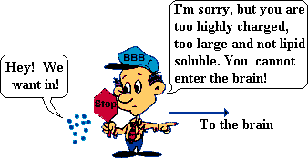
Sodium Pentothal/Thiopental
Barbiturate known as the “truth serum”
Induces hypnosis or anesthesia within 30-40 seconds of IV injection
Easily crosses the blood brain barrier

Slide 12
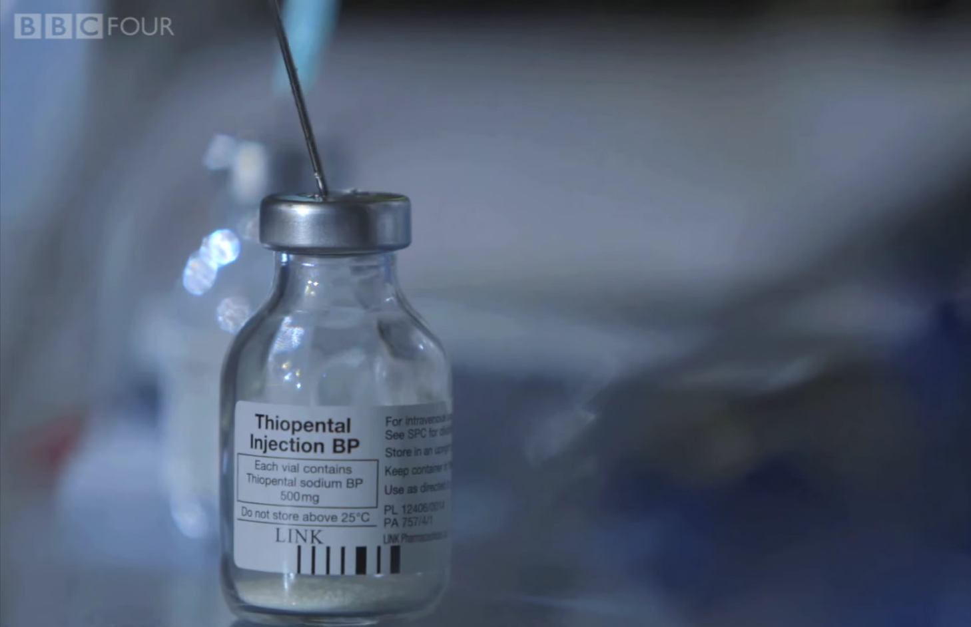
“Truth Serum” In Action
Lowers inhibitions and makes people more talkative
Makes it harder to fabricate lies due to decreased neuronal activity
Sodium Thiopental-BBC NEWS

Slide 13
The Truth About Truth Serum
Although certain barbiturates (such as Sodium Thiopental) may decrease likeliness to lie due to decreased neurological function, it cannot 100% prevent lying.

Slide 14
Can the memory serum be recreated in real life?
In Abnegation, they posses a serum that wipes the memory after they experience something traumatic or that can never be known of. But, is it really possible to erase select memories with a drug…?

Slide 15
Metyrapone
Decreases levels of cortisol
Decreases negative emotions associated with memories
Can be used to dampen old, negative memories for a period of time

Slide 16
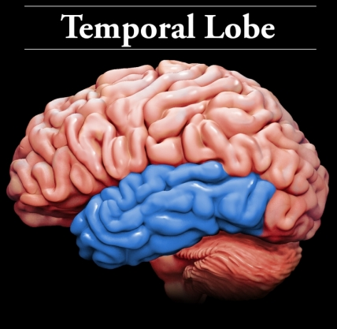
Hippocampus
Part of limbic system
Located in medial temporal lobe
Responsible for turning short term memories into long term memories

Slide 17
Cortisol
Corticosteroid hormone released by adrenal gland during stressful situations
Usually goes away quickly in mildly stressful situations
In highly stressful situations, cortisol remains in brain and causes damage to the hippocampus

Slide 18
Connection
High levels of cortisol causes damage to the hippocampus and causes long term bad memories
Metyrapone reduces high levels of cortisol in the brain
“Erases” or reduces negative emotions associated with such memory

Slide 19
Not possible
Although there have been advances in dulling negative memories by using drugs such as Metyrapone for PTSD patients, there is currently no way to recreate the memory serum.

Slide 20
Truth Serum
Memory Serum

Slide 21
Works cited
http://www.bbc.com/news/magazine-24371140
http://www.cbsnews.com/news/truth-serum-a-possible-weapon/
https://faculty.washington.edu/chudler/barb.htm
http://www.huffingtonpost.ca/2011/05/26/metyrapone-memory-drug_n_867792.html
http://www.livestrong.com/article/18695-effects-cortisol-brain/

