Slide 1
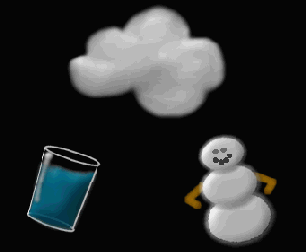
Change of State

Slide 2
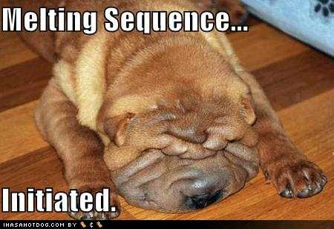
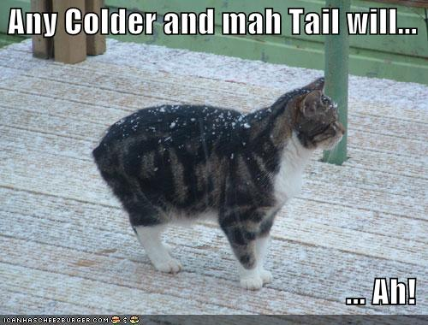
Change of State The change of a substance from one physical form to another.
All changes of states are physical ones
Substance doesn’t change its identity
Must add or remove energy (heat) in order to change its state.

Slide 3
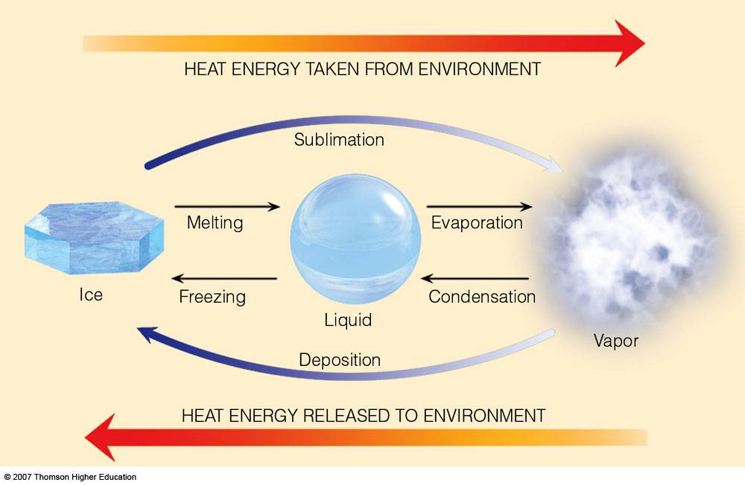
Solid
Liquid
Gas

Slide 4
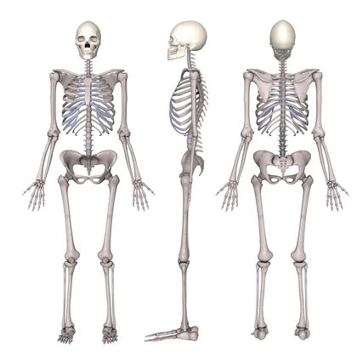
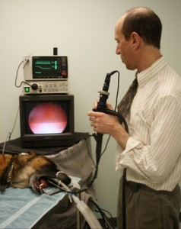
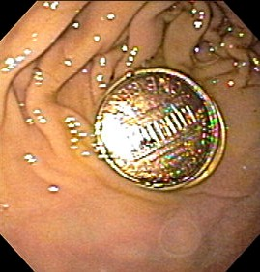
Endothermic Change
Endothermic change- energy is gained, or goes into the material. (Endo=Enter)
Endoscopy
Endoskeleton

Slide 5
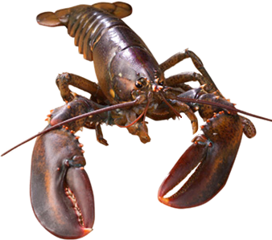
Exothermic Change
Exothermic change- Energy is lost, or goes out of the material. (Exo=Exit)
Exoskeleton

Slide 6
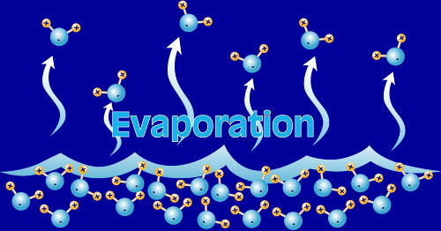
Evaporation: Liquid to Gas
Evaporation is the change of a substance from a liquid to a gas.
Evaporation happens when molecules at the liquids surface gain enough heat energy to overcome the attraction to one another and break away from the liquid to become a gas
Happens at the liquid’s surface.
Happens at any
temperature
(warmer liquid
evaporated faster)

Slide 7
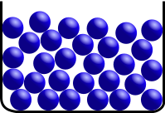
Boiling
A substances boiling point is the highest temperature as which it can exist as a liquid
Heat energy added, particles move faster and faster.
They have enough energy to break away from each other and fly away!
Boiling happens throughout the liquid.
Boiling happens at the temperature of liquid’s boiling point.
Boiling is an endothermic change

Slide 8
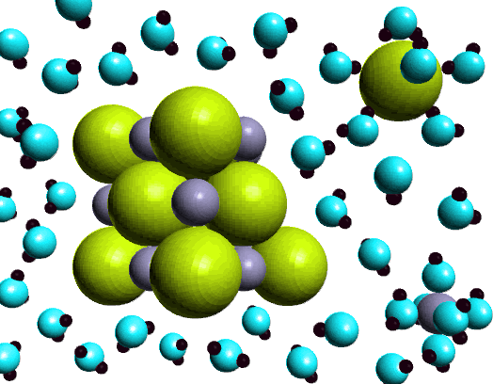
Salt dissolving in water
Na
Cl

Slide 9
Salt dissolving animation
http://www.youtube.com/watch?v=xdedxfhcpWo

Slide 10
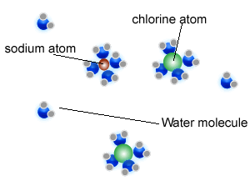
Boiling salt water
Water molecules need extra energy (heat) to “let go” of the salt particles BEFORE they can fly off as a gas.
More energy (heat) is needed to boil salt water!
Boiling is endothermic – “heat goes in”

Slide 11
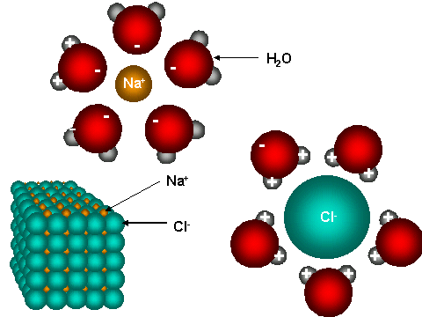
Freezing Salt Water
Salt particles get in the way of the water molecules as they are trying to freeze.
So water
Heat energy must be extra-low for salt water to freeze!
Freezing is exothermic – “heat comes out”

Slide 12
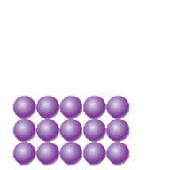
How does salt melt ice??
Thin water layer
Ice
Molecules on the surface of ice escaping into the water (melting)
Molecules of water being captured onto the surface of ice (freezing)
=
So…amount of ice remains constant.

Slide 13
Now add salt:
Dissolved salt particle
Thin water layer
Ice
Because of the salt, there fewer free water molecules to be captured on the ice’s surface.
So there are more molecules ESCAPING the ice than being CAPTURED by it.
So…the amount of ice decreases!

Slide 14
Evaporative Cooling
Evaporation is an endothermic change
Molecules that leave the liquid take away some of the heat energy from the liquid as they go.
Since liquid had lost some heat energy, it has a lower temperature!

