Slide 1
Chemical change
or
Physical change
?????

Slide 2
Elephant Toothpaste
Physical or Chemical?
The yeast acts as a catalyst to make the hydrogen peroxide break down really quickly.
Hydrogen peroxide breaks down into oxygen and water.
As the oxygen is released into the liquid, the detergent causes it to form bubbles of foam.
The foam is pushes out as more and more oxygen is released.

Slide 4
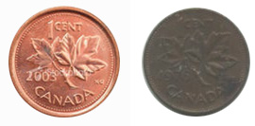
Copper Caper - Physical or Chemical?
1. Why did the pennies look dirty before you put them in the vinegar?
Copper atoms can combine with oxygen atoms from the air to make a blackish compound called copper oxide. The pennies looked dull and dirty because they were covered with copper oxide.

Slide 5
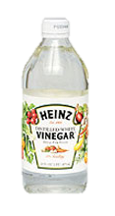
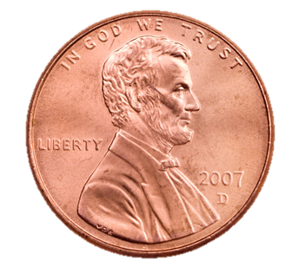
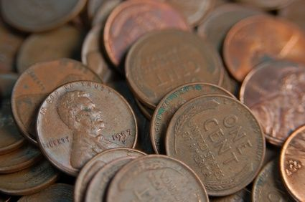
2. Why did the vinegar “clean” the pennies?
Copper oxide breaks down in a weak acid - and vinegar is an acid. You could also “clean” your pennies with lemon juice or orange juice, because those juices are acids, too.
+
=
Chemical Change!

Slide 6
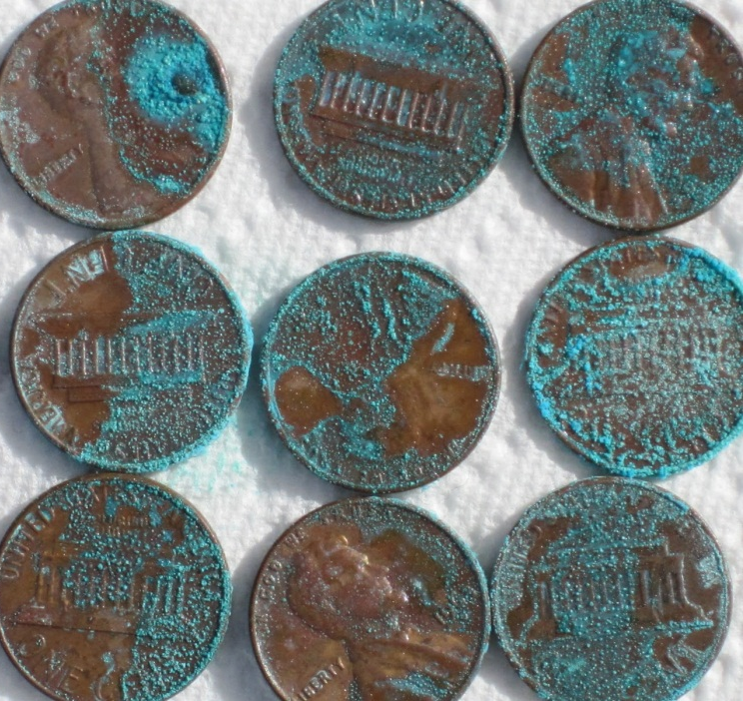
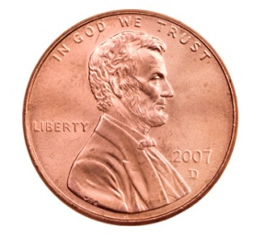
3. Why did the salted pennies turn blue-green?
After the vinegar dissolve the copper oxide layer, the copper was exposed to the air.
The copper then combined with oxygen and the salt to form a green compound called malachite.
+ oxygen + salt =
Chemical Change!

Slide 7
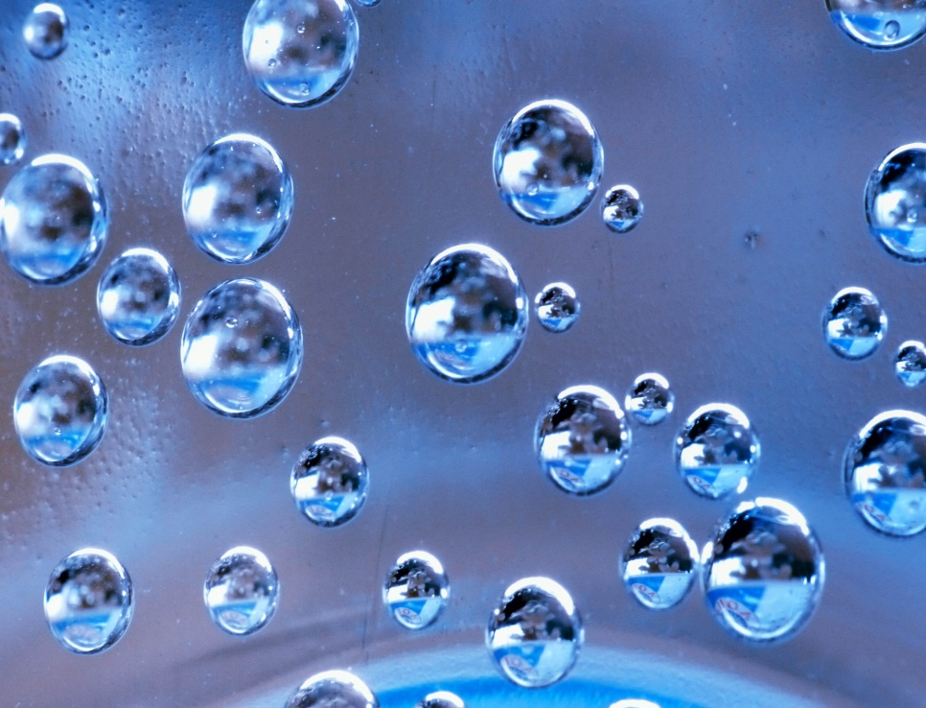
Dancing Raisins – Physical or Chemical?
Part 1 – The Bubbles
Carbonated soda is a solution of water with CO₂ dissolved in it.
When pressure is reduced by opening the bottle, the gas comes out of the solution, forming bubbles.
Physical Change

Slide 8
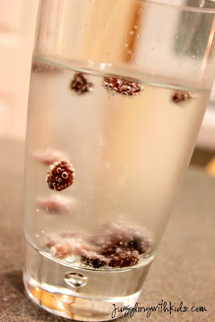
Part 2 – The Raisins
Going up!
CO₂ gas come out of solution best on surfaces, like sides of glass or......on the raisins.
These CO₂ bubbles increases the volume (but not really the mass).
When density (M/V) decreases to less than 1 g/mL, the raisins+bubbles float!
Coming down!
At the surface, some of the bubbles pop.
Volume of raisins/bubbles decreases.
When density (M/V) increases to more than 1 g/mL, raisins/bubbles sink.

Slide 10
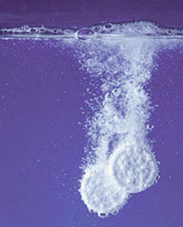
It’s a Gas! Physical or Chemical?
Effervescent antacid tablets contain an acid, similar to vinegar or lemon juice, and a base, similar to baking soda.
When the acid and base are dry like they are in the tablet, they do not react.
When they dissolve in the water, they react to produce carbon dioxide gas.
You cannot see this gas, but you can show that it is there by collecting it in the balloon.
Chemical Change!

Slide 11
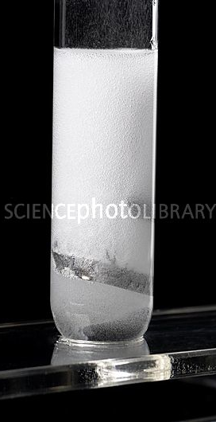
Magnesium and Hydrochloric Acid – Chemical or Physical?
When HCl is added to magnesium, it sizzles. This indicates a gas is being produced.
A new white substance is also produced: magnesium chloride (MgCl). It’s a type of salt.
Since the hydrogen (H) is not used to make the salt, it is given off into the air.
The reaction feels warm – it is an exothermic reaction

Slide 12
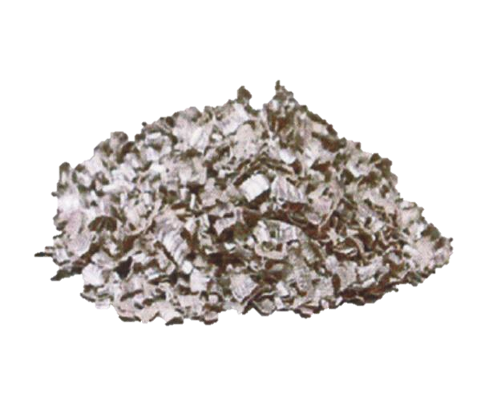
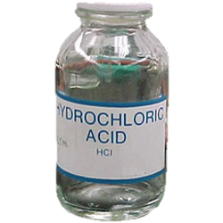
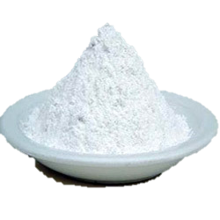
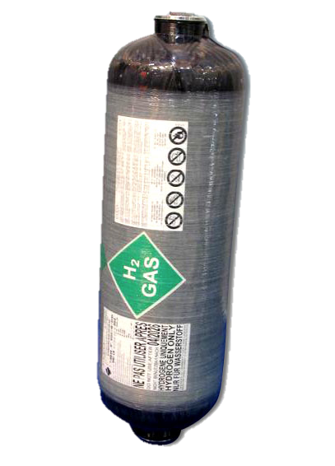
Hydrochloric
acid
Magnesium
Chloride (salt)
+ Hydrogen
(gas)
+ HEAT ENERGY
Magnesium +
➔
Mg + HCl ➔ MgCl + H₂
NEW substances were produced that weren’t there before!
Heat energy is released!
Chemical Change!

