Slide 1
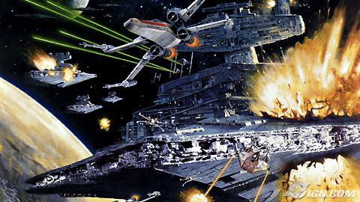
Energy

Slide 2
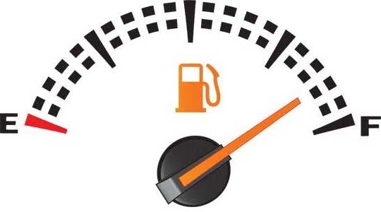
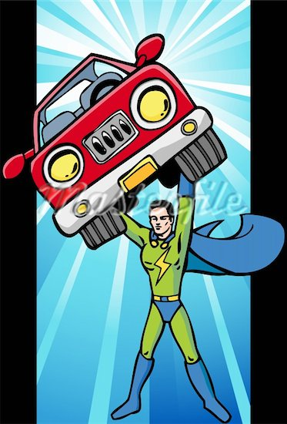
What is energy?
“The ability to do work”
You can think of Energy as the “universal fuel” needed to do work
….And when work is done on an object, that object gains energy.

Slide 3
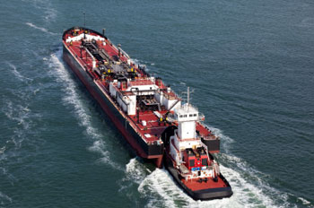
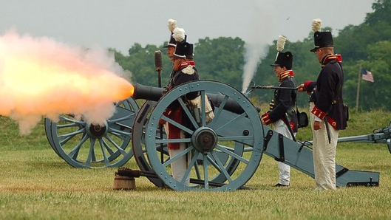
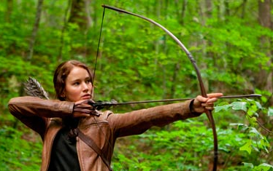
Examples:
You use energy when you do work to pick up your back-pack.
A tug boat uses energy when it does work to push a barge.
The gunpowder does work on the cannonball which gives the cannonball energy.
Katniss does work pulling back on the bowstring which gives the bowstring energy.

Slide 4
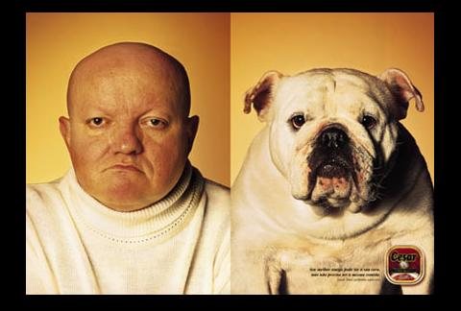
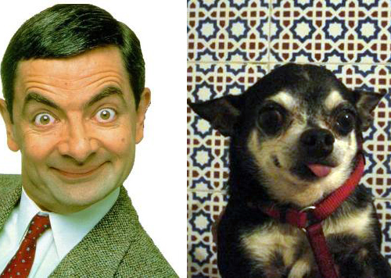
Important Concept:
Work and energy are VERY CLOSELY related…
The work done on an object is equal to the amount of energy the object gains
OR…
The amount of energy an object gains is equal to the amount of work done on the object.

Slide 5
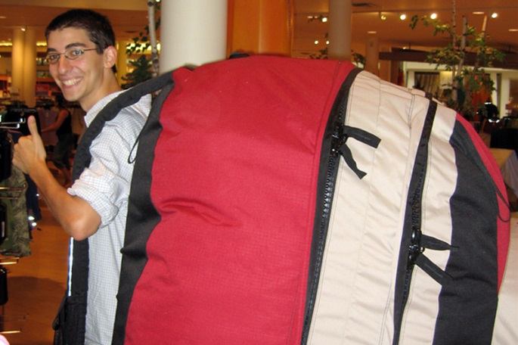
Examples:
If you do 100J of work to lift your backpack:
$→$ your backpack gains 100J of energy
If a tug boat uses 50,000J of energy to push a barge:
$→$the tug boat does 50,000J of work on the barge.
If Katniss does 80J of work pulling back on the bowstring,
$→$the bowstring gains 80J of energy.

Slide 6
So….
The work done on an object is equal to the amount of energy the object gains…
Work = Change in Energy
W = ⬇E
⬇ means “change in”

Slide 7
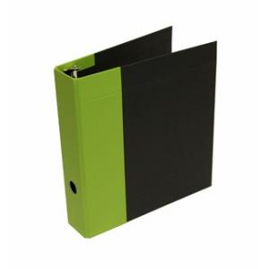
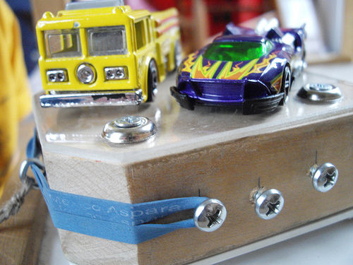
Understanding Check
If you do 150 J of work to lift your binder off the table, how much energy did your binder gain?
If you pull back the launcher block of the matchbox car launcher by doing 20 J of work on it, how much energy did you give the rubber band?

Slide 8
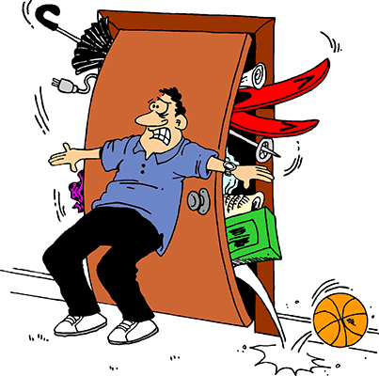
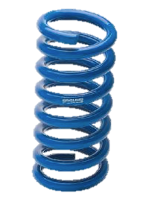
Potential Energy
Def: The energy an object has due to its position or condition.
It is energy that is stored and ready to use.
Elastic P.E.
Chemical P.E.
Gravitational P.E.

Slide 9
For us, the most common type of P.E. is gravitational potential energy
Def: The P.E. of an object due to its elevation above a surface.

Slide 10
Remember W = ΔE.
So the G.P.E. of each Grumpy Cat is equal to the work it took to lift him up on to his post:
G.P.E. = Work
G.P.E. = Force x Distance
More G.P.E.
Less G.P.E.
2m
1m
Weight of the cat
Height of cat above ground
G.P.E. = Weight x Height

Slide 11
Example
G.P.E. = Weight x Height
Calculate the GPE of each 5kg Grumpy Cat.
Step 1: We need the weight of the cats.
5kg x 9.8 m/s² = 49N
Step 2: Calculate GPE
Cat 1: GPE = W x H
GPE = 49N x 2m = 98J
Cat 2: GPE = W x H
GPE = 49N x 1m = 49J
2m
1m

Slide 12
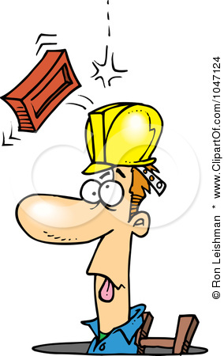
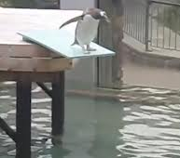
You Try It!
A brick with a weight of 20 N falls off a building from a height of 50 m. What is the gravitational potential energy of the brick before it falls?
GPE = weight x height
20 N x 50 m = 1000 J
A 100 kg diver is standing on a platform 7m above the surface of the water. What is the gravitational potential energy of the diver relative to the water’s surface?
Weight of diver: 100 kg x 9.8 = 980 N
GPE = weight x height
980 N x 7 m = 6,860 J

Slide 13
Work and GPE
Remember W = ⬇E
200 J
10m
4m
The bowling ball has a weight of 50N. The work done to lift it straight up to the top of the ramp is:
50N x 4m = 200J
200J is also the amount of GPE the ball will have at the top of the ramp.
So…how much work will you do pushing the same bowling ball up the ramp?
When the ball gets to the top it has to have 200J of GPE so you must have done 200J of work to get it there.

Slide 14
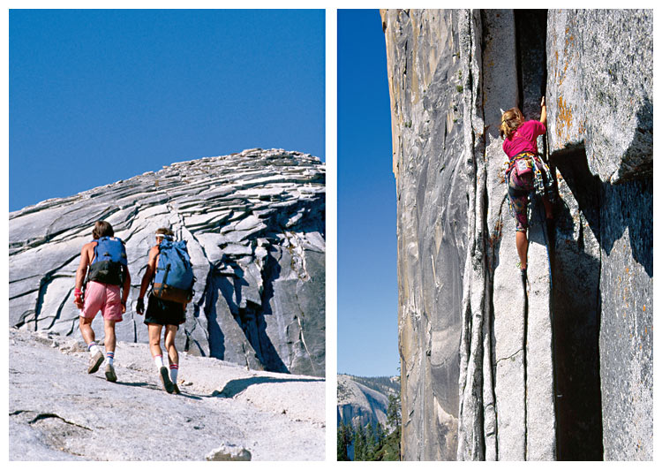
Lifting the same object the same vertical height requires the same amount of work, no matter the path.
Figure 4 Climbers going to the top of a mountain do the same amount of work whether they hike up a slope or go straight up a cliff.

Slide 15
Example
10m
4m
Work = Force x Distance
When lifting the object straight up it takes 50N of force:
50N x 4m = 200J (from previous slide)
Calculate how much force it would take to roll the ball up the incline plane:
Work = 200 J
Distance = 10 meters
200J = F x 10 meters
Solve for F
Force= 20N

