Slide 1
When Mr. Sgoutas drops two similar-sized objects that have different masses (thus different weights) from the same height, will they hit the ground at different times?
If so, which one will hit the ground first, the heavier one or the lighter one?
28.0g
8.3g
In your notebook, make a prediction and explain your reasoning.

Slide 2
Why did they land at the same time????
Explanation 1: The Math
Force
Mass
Acceleration =
28.0 g
28.0g
BIG force (of gravity), and BIG mass
8.3 g
SMALL force (of gravity), and SMALL mass
8.3g

Slide 3
So….since A = F / M...
28.0 g
8.3 g
28.0g
8.3g
BIG force
BIG mass
=
SMALL force
SMALL mass
Same acceleration!!!
But if you don’t like that explanation….

Slide 4
Explanation 2: Inertia
28.0 g
28.0g
BIGGER mass, MORE inertia
8.3 g
8.3g
SMALLER mass, LESS inertia

Slide 5
BIG
INERTIA
Small
Inertia
=
Small Force of Gravity
Big Force of Gravity
Same acceleration!!!

Slide 6
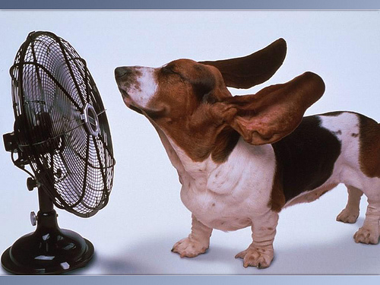
Note: air resistance affects the speed of falling objects, too!

Slide 8
Second-Law Problems
What is the acceleration of a 3 kg mass if a force of 14.4 N is used to move the mass? (Note: 1 N is equal to 1 kg•m/s²)
Second-Law Problems What is the acceleration of a 3 kg mass if a force of 14.4 N is used to move the mass? (Note: 1 N is equal to 1 kg•m/s²)
Step 1: | Write the equation for acceleration.
Step 2: | Replace F and m with the values given in the problem, and solve.

Slide 9
Now it’s your turn….
1. What is the acceleration of a 7 kg mass if a force of 68.6 N is used to move it toward Earth?
2. What force is necessary to accelerate a 1,250 kg car at a rate of 40 m/s²?
3. Zookeepers carry a stretcher that holds a sleeping lion. The total mass of the lion and the stretcher is 175 kg. The lion’s forward acceleration is 2 m/s². What is the force necessary to produce this acceleration?

