Slide 1
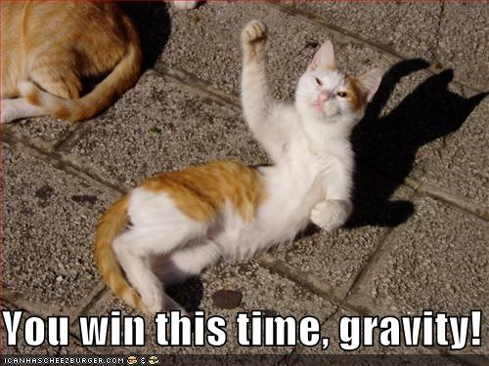
Gravity

Slide 2
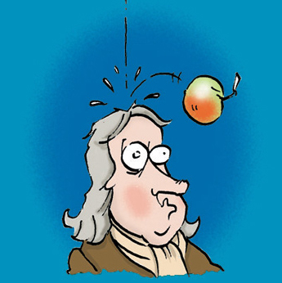
The famous legend:
The English scientist Sir Isaac Newton (1642-1727) developed the theory of gravity when an apple fell from a tree and hit him on the head.
But is it a true story?.....

Slide 3
According to a 1750 biography about Isaac Newton published 23 years after his death:
"After dinner, the weather being warm, we went into the garden and drank thea, under the shade of some apple trees...he told me, he was just in the same situation, as when formerly, the notion of gravitation came into his mind. It was occasion'd by the fall of an apple, as he sat in contemplative mood. Why should that apple always descend perpendicularly to the ground, thought he to himself, why should it not go sideways or upwards? but constantly to the earth’s center? "

Slide 4
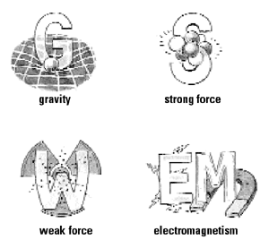
Force of Gravity
One of the 4 fundamental forces of nature
An attractive force – gravity pulls, never pushes.
Gravity is caused by matter – matter creates gravity!
Anything made of matter exerts a gravitational force, even you!

Slide 5
Every particle of matter exerts a gravitational pull on every other particle of matter:
More particles = more gravitational pull
That is, more MASS = more gravitational pull

Slide 6
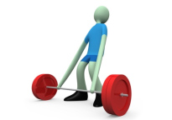
Gravity is a very weak force
The gravitational attraction between you and a car, a building, or tree, is miniscule!!
It takes something as massive as the Earth or the Moon for gravity to become an easily noticeable force!

Slide 7
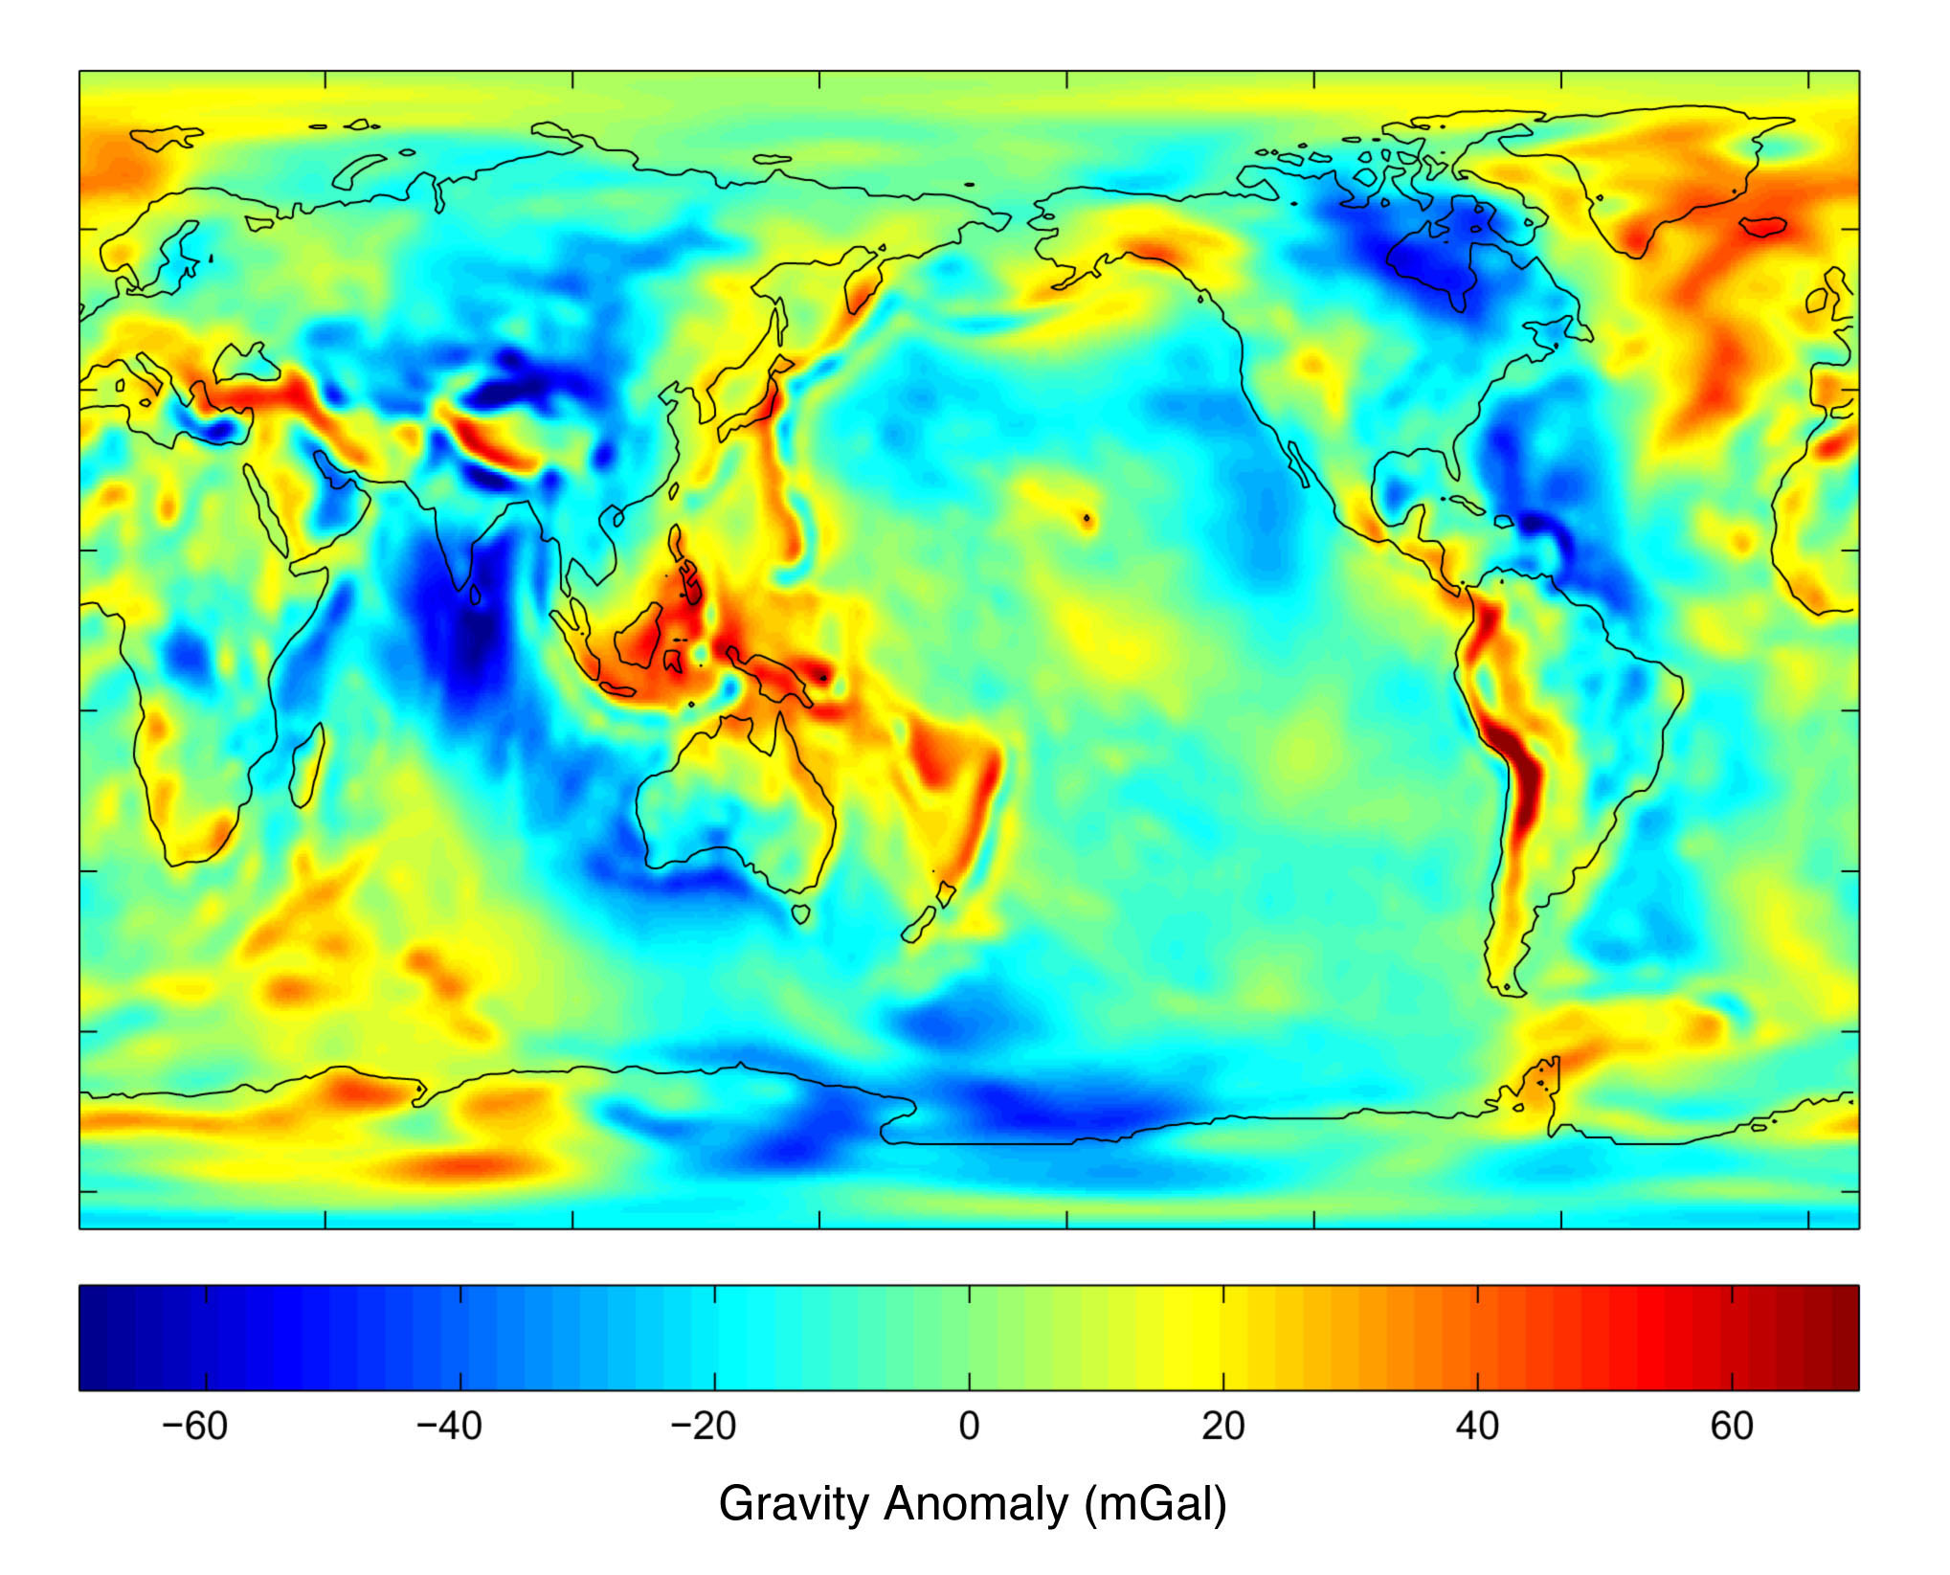
Some areas of the Earth have slightly more mass than others:
Note:
1 mGal is equal to about one millionth of the strength of earth’s gravity.

Slide 8
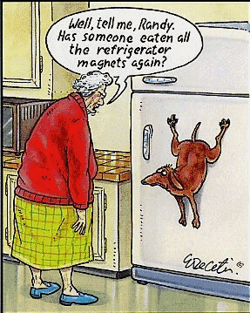
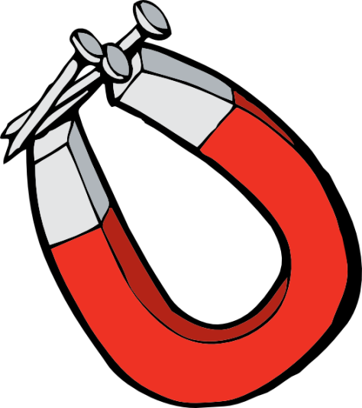
And just like with a magnet, the force of gravity gets weaker farther from the object.

Slide 9
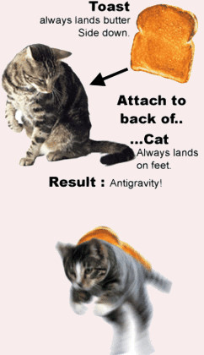
So the strength of gravitational attraction depends on two things…
MASS of the objects
DISTANCE between those objects

Slide 10
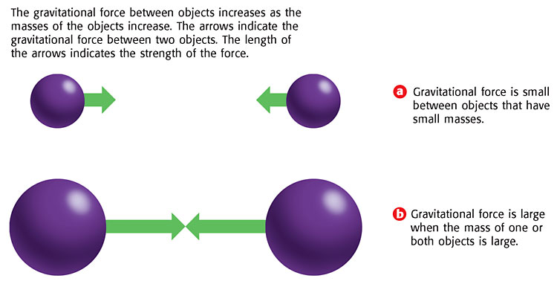
Gravity and Mass:
Direct relationship: M↑ then G↑ and M↓ then G↓

Slide 11
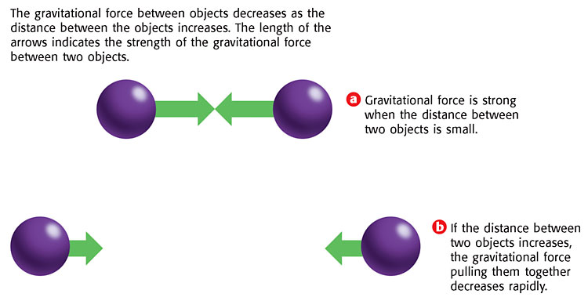
Gravity and Distance
Inverse relationship: D↑ then G↓ and D↓ then G↑

Slide 12
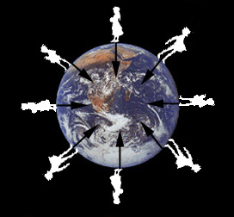
Gravitational Force and Distance
Interesting Fact
When you are standing on Earth with your toes buried in the dirt, it may seem like the distance between you and Earth is zero. But, the distance is measured between the centers of the two objects not the edges.
So the distance between you and Earth is the distance from the center of the Earth to your belly button.

Slide 13
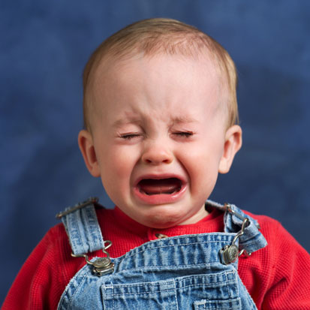
Gravity and Math
Mass ₁ x Mass ₂
(Distance)²
Force of Gravity =
G x
…and G = 6.67398 × 10⁻¹¹
But we don’t need to calculate gravitational force this year so…. let’s simplify…

Slide 14
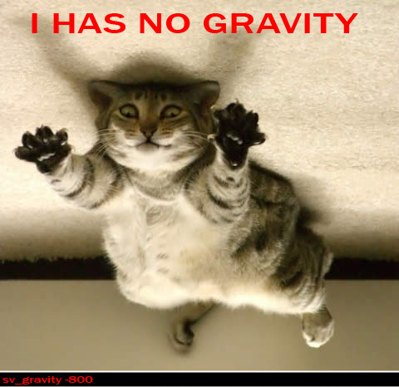
Gravity and Math
….But we will calculate what effect a change in mass or distance has on gravitational force.
Mass ₁ x Mass ₂
(Distance)²
Force of Gravity $\sim$
$\sim$ means “proportional to”

Slide 15
Gravity and Math
Force of Gravity $\sim$
(M₁ X M₂)
D²
If mass of one object is 2 times greater
then
Force of gravity will be 2 times greater
If mass of one object is 2 times less
then
Force of gravity will be 2 times less
G & M: Direct relationship!

Slide 16
Force of Gravity $\sim$
(M₁ X M₂)
D²
Objects
farther apart
If distance is 2 times greater
then
Force of gravity is 2² = 4 times less.
If distance 5 times less
then
Force of gravity is 5² = 25 times greater
.
Objects
closer together
G & D: Inverse square relationship!

Slide 17
Here’s the bottom line:
Gravity and mass:
However many times the mass of one of the objects increases, that’s the same number of times that gravity increases, and vice versa.
Gravity and distance:
However many times the distance between
the objects increases, the gravity decreases by
that amount squared, and vice-versa.

Slide 18
You try it:
Complete the following two charts in your notebook:
If the mass is: | Then the force of gravity will be:
3 times greater
6 times greater
4 times less
10 times less
If the distance between the objects is: | Then the force of gravity will be:
3 times greater
6 times greater
4 times less
10 times less
3 times greater
9 times less
6 times greater
36 times less
4 times less
16 times greater
10 times less
100 times greater

Slide 19
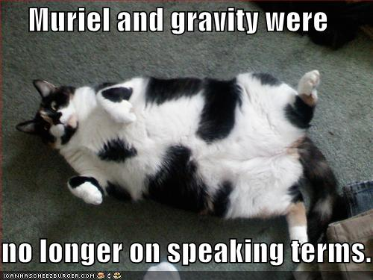

Slide 20
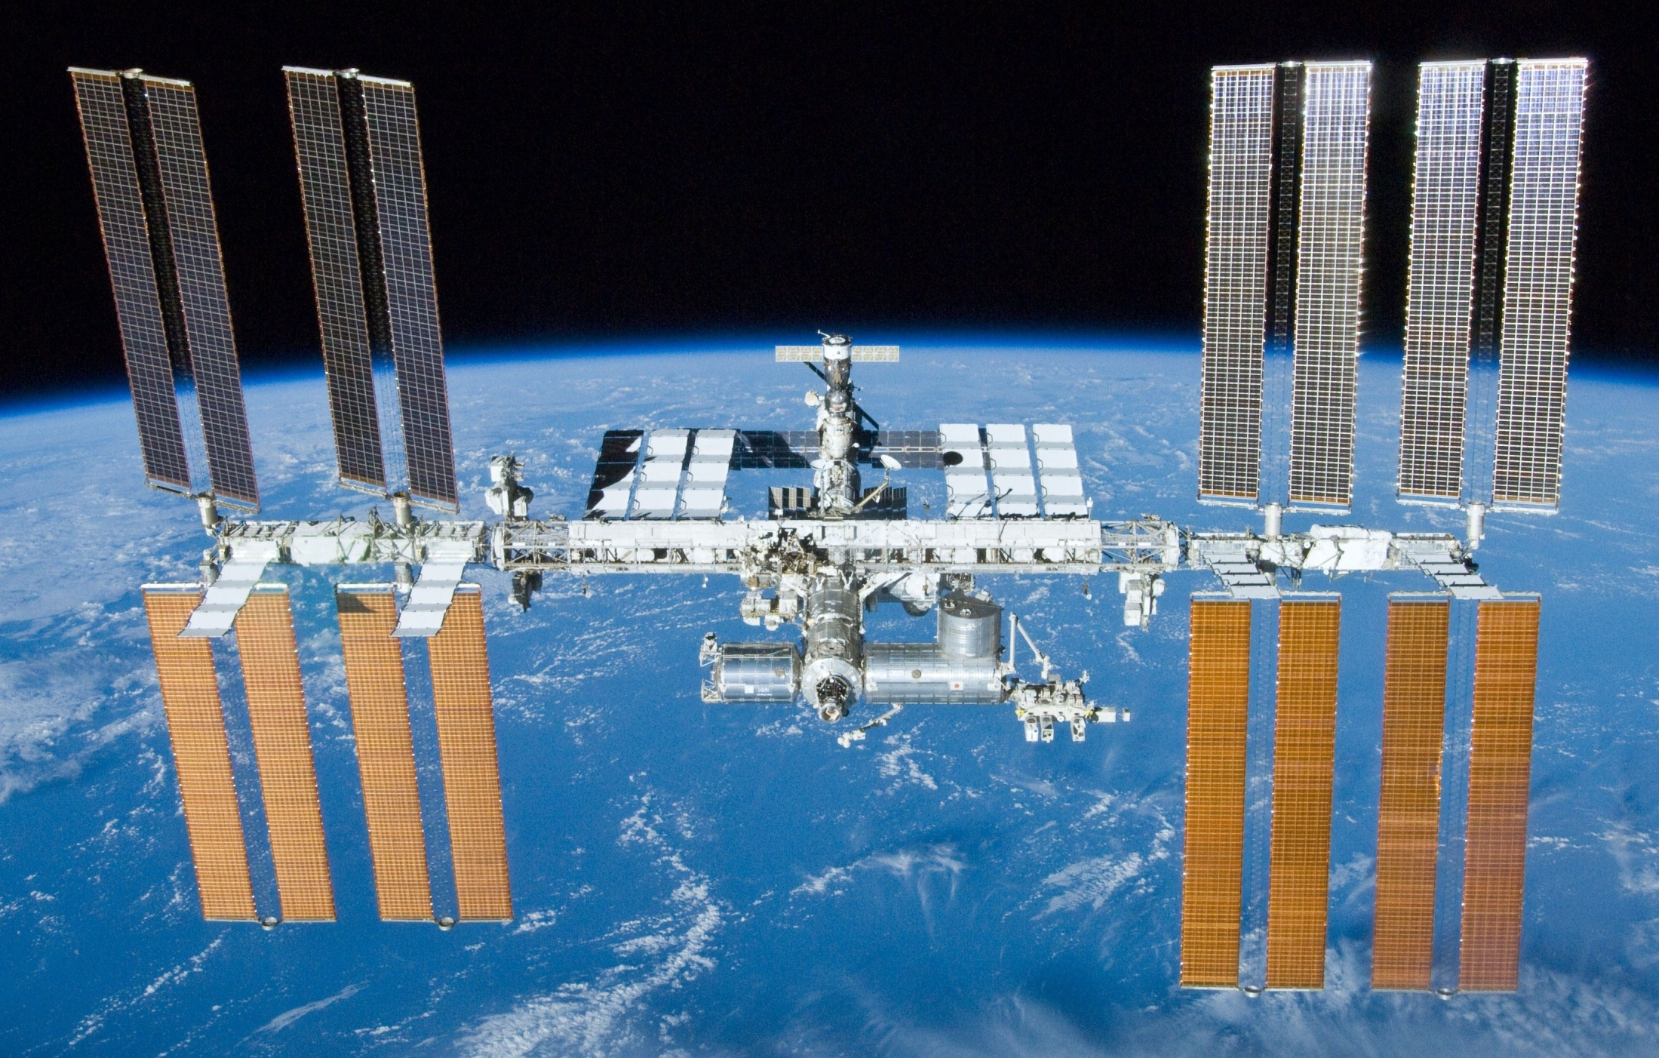
Objects in orbit:
Is there gravity in space?

Slide 21
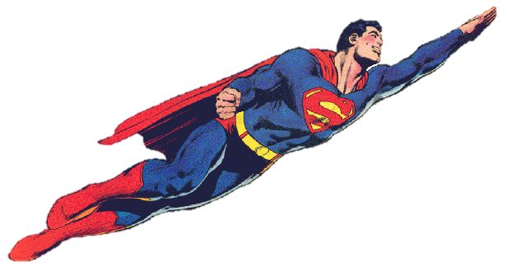
Imagine being in a elevator on Earth:
Elevator not moving:
Elevator in free-fall:
100 Pounds
0 Pounds
Girl will feel “weightless”!

Slide 22
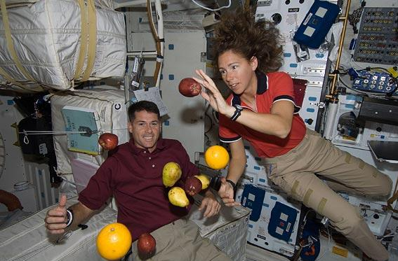
Orbiting objects are in free-fall

Slide 23
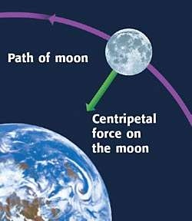
Centripetal force: the unbalanced force that causes objects to move in a circular path
“Centri-” = center
“Petere” = to seek
What is the centripetal force holding the moon in its orbit?
GRAVITY!!!

Slide 24
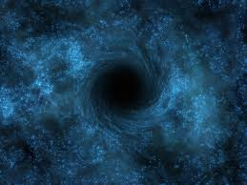
BLACK HOLE
M(black hole) x m(spaceship)
G!
=
d²
Average black hole has a mass 3000 times the mass of our sun (1,989,000,000,000,000,000,000,000,000,000 kg). Therefore, it has an ENOURMOUS gravitational force!!!

Slide 25
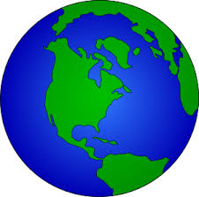
If the Earth were squashed to the size of a golf ball, it would become a black hole!
1. How many times smaller is the golf ball compared to the Earth? (don’t forget to convert units!)
6,000,000 m
.023 m
= 260,000,000
Or 2.6 x 10⁸
Radius = 6,000 km
2. How many times greater would the force of Gravity be on the golf-ball sized black hole compared to the earth? (hint: the distance to the center has changed, but the mass is the same)
D ↓ 2.6 X 10⁸ times, so G ↑ (2.6 X 10⁸)² times
Radius = 2.3 cm
= 2.6 x 10¹⁶ or 26,000,000,000,000,000 times!!!
(26 quadrillion)

