Slide 1
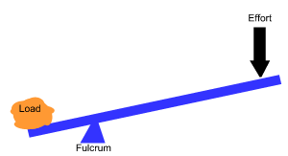
Simple machine force – distance trade-off:
A simple machine does not reduce the amount of Work you do.
A simple machine makes work easier by allowing you to apply a smaller force over a greater distance.
Greater distance, less force
W = F X D
W = F X D

Slide 2
Rank these levers in order by their mechanical advantage from greatest to least mechanical advantage.
Answer: C,A,B
A
The closer the fulcrum is to the load, the greater the mechanical advantage.
B
C

Slide 3
The mechanical advantage of a lever is the ratio of the distances of the 2 arms of the lever:
Length of Effort arm
Length of Load Arm
M.A. =
A
Calculate the M.A. of each of these levers
6 m
6 m
B
A: 6m/6m = 1
B: 3m/9m = .3
C: 10m/2m = 5
9 m
3 m
C
10 m
2 m

Slide 4
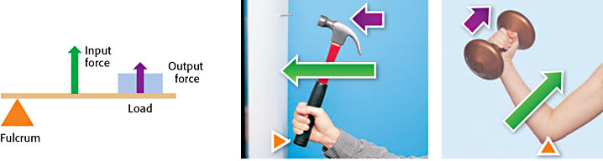
3 types of levers
1
2
3

Slide 5
Rank these inclined planes in order by their mechanical advantage from greatest to least mechanical advantage.
Answer: A,C,B
A
The less steep the slope of an inclined plane (ramp) is, the greater its mechanical advantage.
B
C

Slide 6
The mechanical advantage of an inclined plane is the ratio of its length to its height:
M.A. =
Length
Height
10 m
Calculate the M.A. of the inclined planes
2 m
A
3 m
B
2 m
A: 10m/2m = 5
B: 3m/2m = 1.5
C: 5m/2m = 2.5
5 m
2 m
C

Slide 7
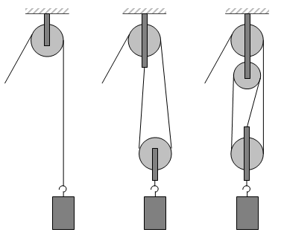
Rank these pulley systems in order by their mechanical advantage from greatest to least mechanical advantage.
Answer: C,B,A
The greater the number of rope segments pulling up on the object, the greater the mechanical advantage of the pulley system.
A
B
C

Slide 8
The mechanical advantage of a pulley system is equal to the number of rope segments supporting the weight.
What is the M.A. for each of these pulley systems?
A: 1
B: 2
C: 3
A
B
C

