Slide 1
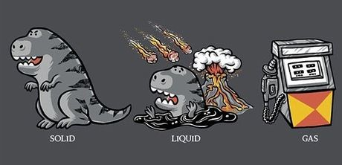
States of Matter

Slide 2
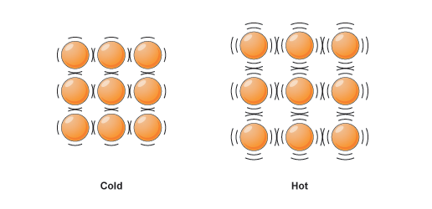
Solid
Particles “locked” in place, so a solid has:
Definite shape
Definite amount of space it occupies (volume)
Particles stuck in place, but they still vibrate

Slide 3
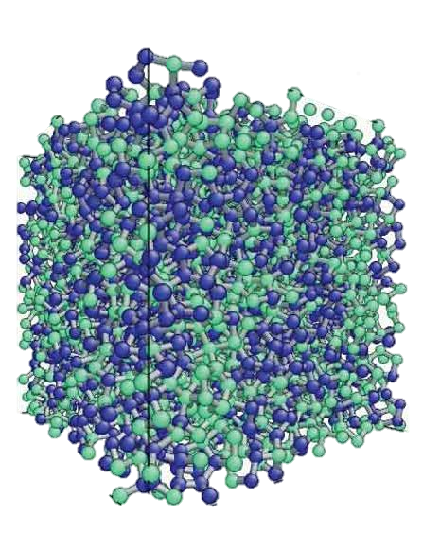
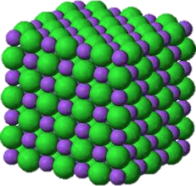
Solid…continued
Crystalline Solids
Amorphous Solids

Slide 4
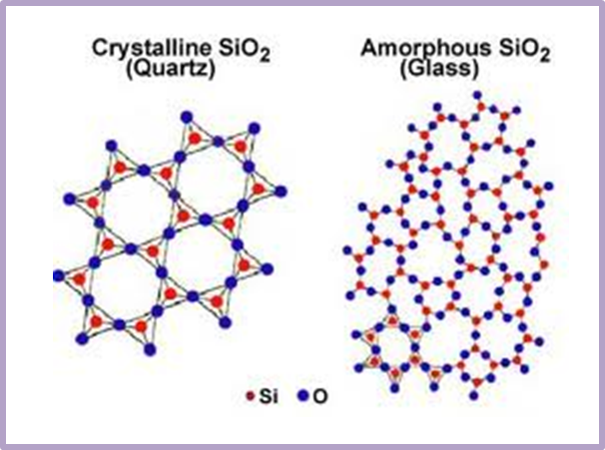
Solid…continued

Slide 5
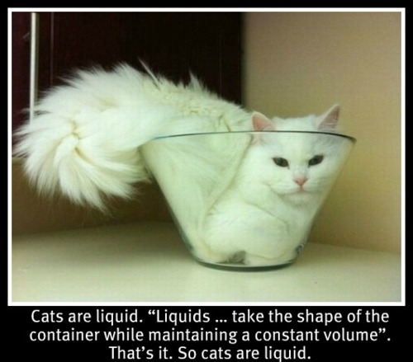
Liquid
Particles in close contact, but can easily slide past each other, so liquid has:
No definite shape – takes shape of its container
Definite amount of space it occupies (volume)

Slide 6
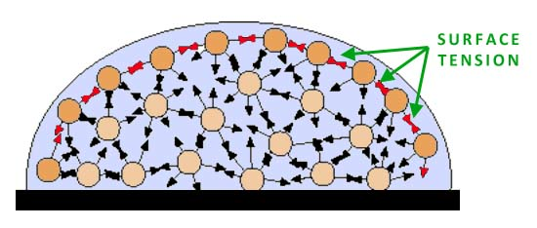
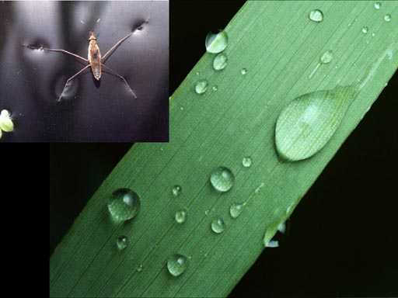
Liquid…continued
Surface tension
Attraction among particles creates a “skin” across the liquid’s surface.

Slide 7
Liquid…continued

Slide 8
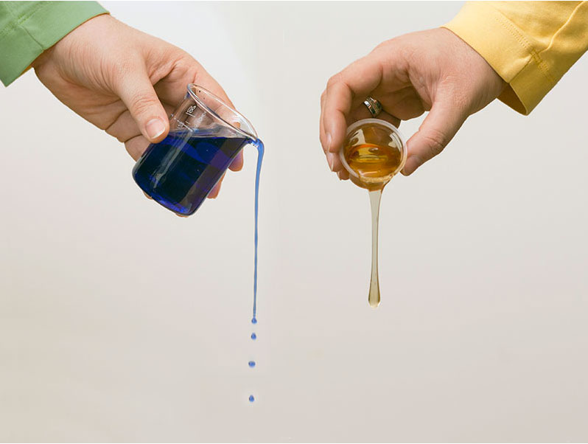
Liquid…continued
Viscosity: Liquid’s resistance to flow.
Honey has a higher viscosity than water.
Honey is more viscous than water.

Slide 9
Gas
Particles are far apart and moving very fast, so a gas has
No definite amount of space it occupies (volume) – gasses can be compressed.
No definite shape – it takes the shape of its container.

Slide 10
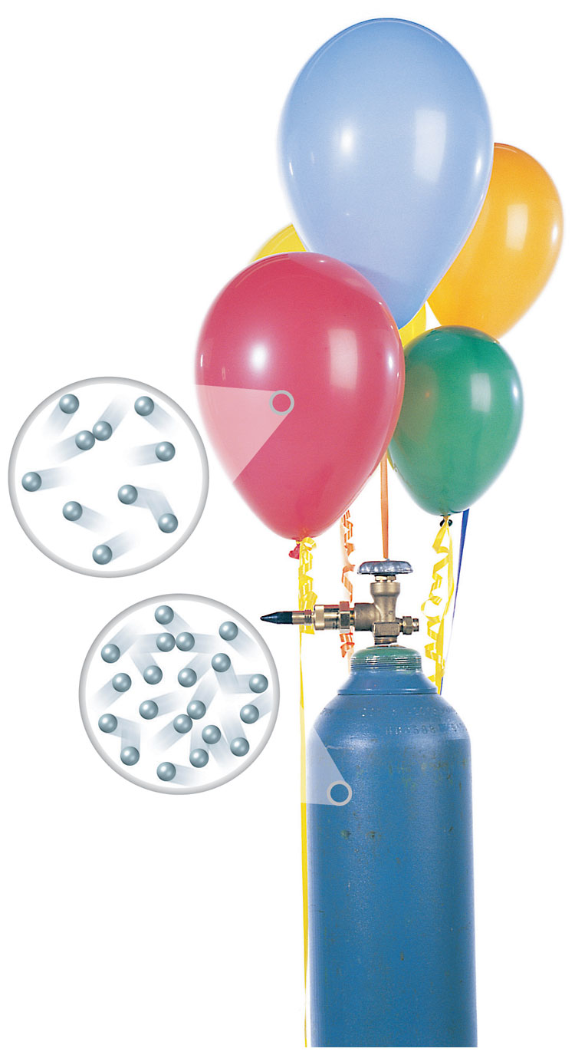
Gas…continued
Gas can be allowed to expand so it fills up more space (like in the balloon)
Gas can be compressed so it takes up less space (like in the tank)

Slide 11
Review
Crystalline solids
Amorphous solids
Surface tension
Viscosity
Compressible (volume can easily change)

