Slide 1
The Atom

Slide 2
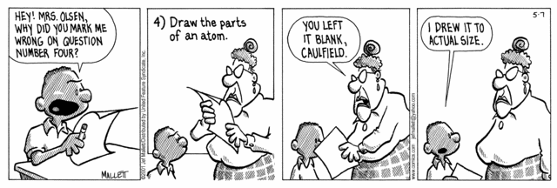
An Atom …
is the smallest particle into which
an element can be divided
and still be the same substance.

Slide 3
Protons- Positive charge and found in the nucleus
Neutrons- Neutral or NO CHARGE and found in the nucleus
Electrons- Negative charge and found in electron clouds outside the nucleus

Slide 4
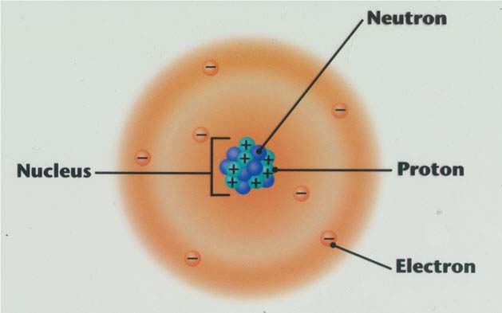
The Atom

Slide 5
“ELECTRON CLOUDS”
Regions where electrons are likely to be found

Slide 6
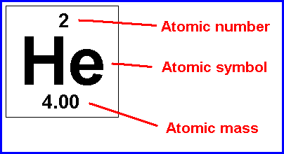
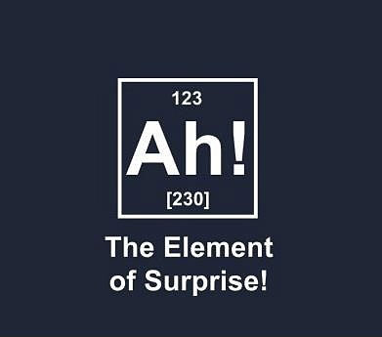
Atomic Number- the number of protons in the nucleus Atomic Mass- (AMU) – the weighted average of all the naturally occurring isotopes of that element Atomic Symbol- a standard chemical abbreviation used to show a specific element. Mass Number - sum of the protons and neutrons in an atom

Slide 7
Origins of Some Atomic Symbols
Name in English | Name in Latin | Chemical Symbol
Aluminum | Alumen | Al
Carbon | Carbo | C
Copper | Cuprum | Cu
Gold | Aurum | Au
Iron | Ferrum | Fe
Lead | Plumbum | Pb
Sodium | Natrium | Na

Slide 8
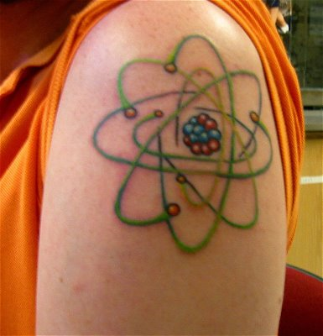
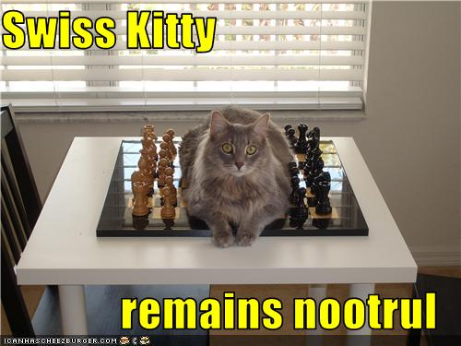
The charges of protons (+) and electrons (-) is opposite but equal so when there is the same number of protons and electrons they cancel each other out and an atom has no overall charge.
It is neutral!
Atoms have a net charge of zero (neutral). Therefore:
# of protons = # of electrons

Slide 9
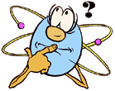
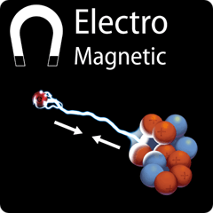
Why do the particles of atoms stay in place?
Protons are positive and electrons are negative. This means the are attracted to one another by electromagnetic force!

Slide 10
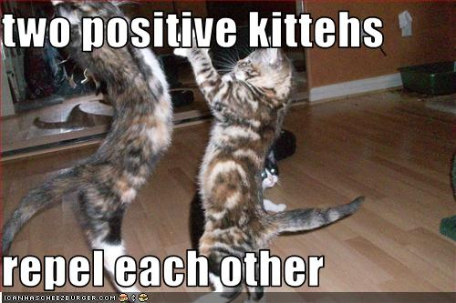
But what holds protons together?
Proton (+) and Proton (+)
YIKES! TWO POSITIVE CHARGES WILL REPEL EACH OTHER CAUSING THEM TO FLY APART!!

Slide 11
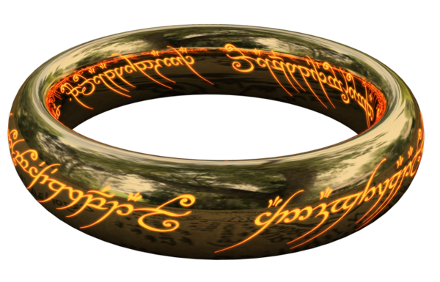
The STRONG force!
The Strong Force is more powerful than the electromagnetic force that repels the protons.
BUT…it has a VERY short range (like 10⁻¹³ cm…. smaller than the nucleus of an atom!!)
Acts among all the protons and neutrons in the nucleus, binding them together!

Slide 12
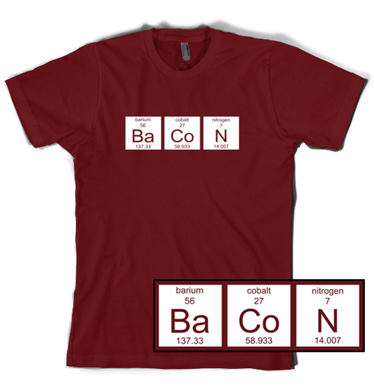
When trying to figure out the numbers...
Protons = Atomic Number
Electrons = Number of Protons = Atomic Number
Neutrons = Mass Number – Atomic Number
(Mass Number = Atomic Weight rounded
to the nearest whole number)

Slide 13
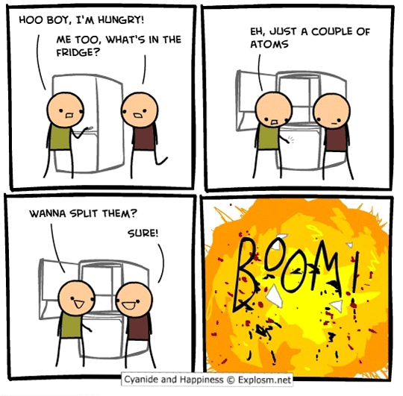
What is an ION?
What happens if the number of protons and electrons is not equal?
Atoms can lose or gain electrons!
If the number of protons and electrons in an atom are not equal it is called an ION.
Negatively charged ion- If there are MORE electrons than protons
Positively charged ion- if there are FEWER electrons than protons

Slide 14
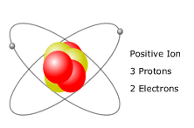
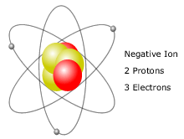
Positive Ion
Negative Ion

Slide 15
Calculate the numbers of protons, electrons, and neutrons for the following atoms:
14
Si
Silicon
28.1
12
Mg
Magnesium
24.3
29
Cu
Copper
63.5
P = 14
E = 14
N = 14
P = 12
E = 12
N = 12
P = 29
E = 29
N = 35

Slide 16
Quark Name | Charge
“Up” | + 2/3
“Down” | - 1/3
You know that the nucleus of an atom is made of protons and neutrons. But what are THEY made of ??? The answer is …quarks! A proton and a neutron is each made of 3 quarks. Look at the table and see if you can figure out which combination of 3 quarks make a proton and which 3 make a neutron.
?
?
?
?
?
?
Proton
(+1 charge)
Neutron
(0 charge)

Slide 18
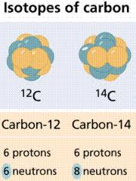
Isotopes
We have already learned that ions are atoms that are either missing or have extra electrons.
WHAT IF THERE IS A DIFFERENT NUMBER OF NEUTRONS?
An atom that has the same number of protons (as that of other atoms of the same element) but a different number of neutrons. Atomic masses will be different!
They are still the same element. They are just a little different from every other atom of the same element. CARBON-12
CARBON-14

Slide 19
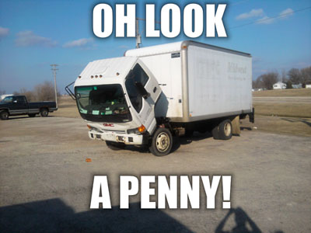
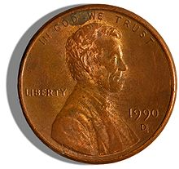
Most elements contain a mixture of 2 or more isotopes.
Therefore, the atomic mass of an element is a weighted average of the masses of the isotopes.
Example:
Copper, Cu = 69% Copper-63 and 31% Copper-65
So, the atomic mass of copper is 63.6 amu

Slide 20
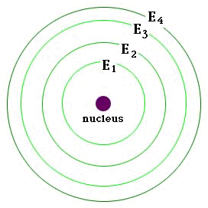
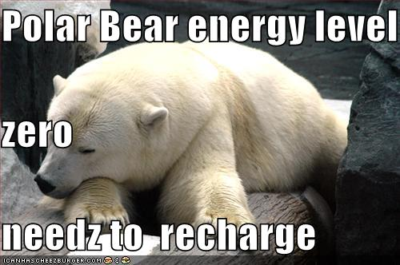
Electron cloud has different energy levels They are like the orbits/paths the electrons follow. Closer to nucleus - e’s have lower energy Farther from nucleus – e’s have higher energy!
The Electron Cloud

Slide 21
The Electron Cloud
Each energy level has a maximum # of electrons it can hold:
Nucleus
2
8
8

Slide 22
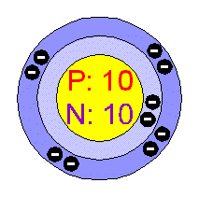
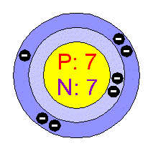
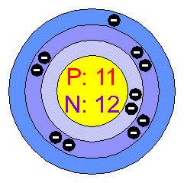
Some Examples:
NEON (10)
NITROGEN (7)
SODIUM (11)
Ne 2 8
N 2 5
Na 2 8 1

Slide 23
You Draw It:
Oxygen (8)
Hydrogen (1)
Aluminum (13)
Sulfur (16)
( ) = Atomic Number

Slide 24
Answers:
O 2 6
H 1
Al 2 8 3
S 2 8 6

Slide 25
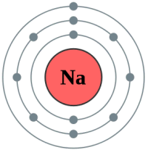
VALENCE LEVEL
VALENCE ELECTRON
The electrons in outer energy level of an atom are called valance electrons

Slide 26
