Slide 1
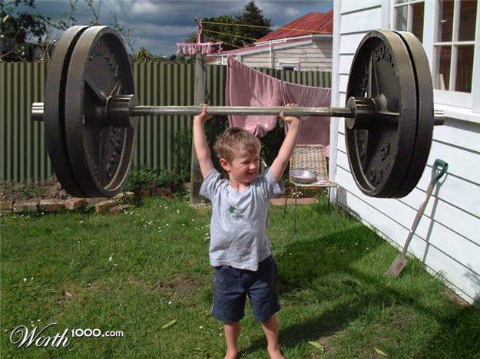
WORK

Slide 2
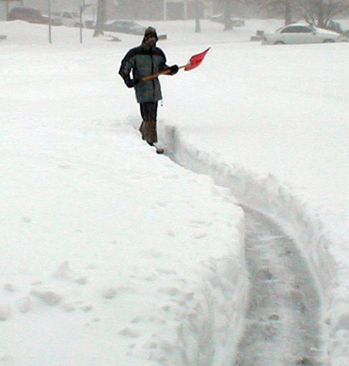
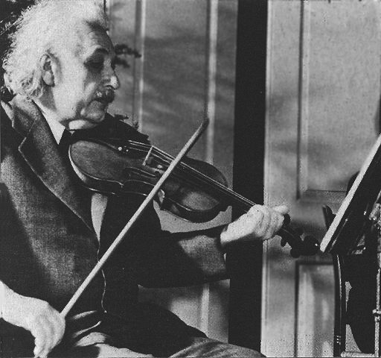
What is it?
Shoveling the walkway is hard work!
Writing this report is hard work!
What do you do for work?
Becoming good at the violin takes a lot of work.

Slide 3
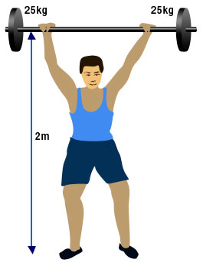
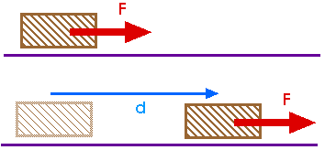
In science, WORK has a very specific meaning:
Work is done when a force causes an object to move in the direction of the force.

Slide 4
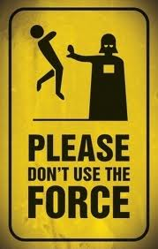
2 things determine if work is being done:
A FORCE is applied to the object.
2. The object MOVES in the direction of the force.

Slide 5
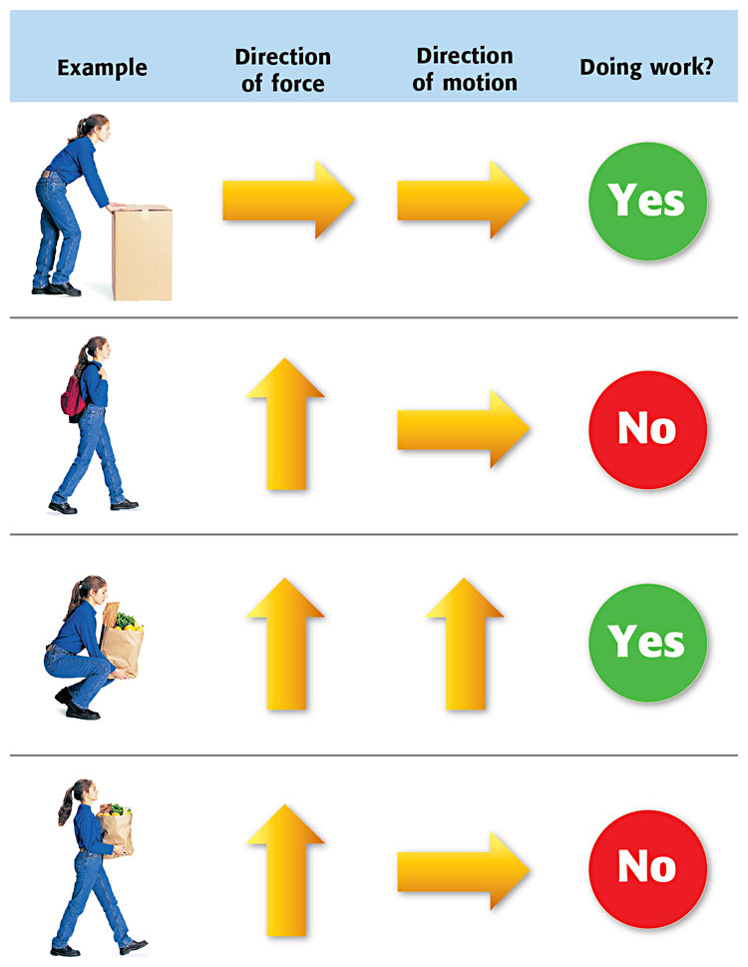
Work or Not Work?

Slide 6
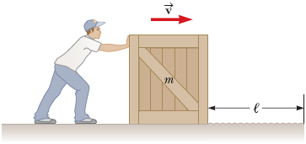
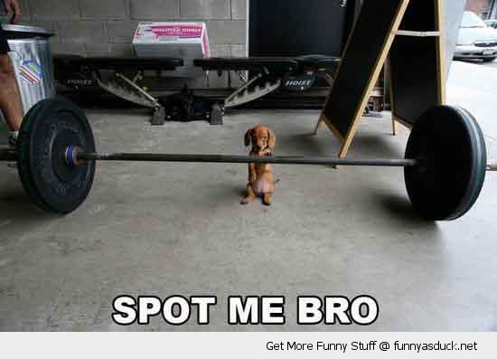
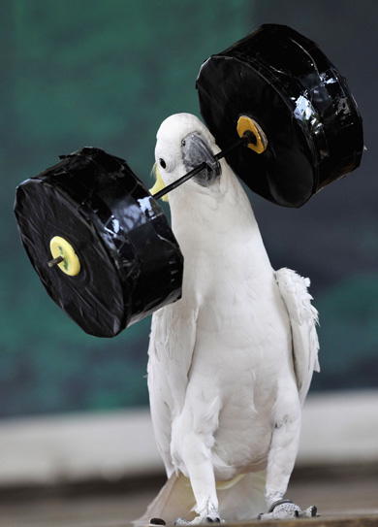
Work or not work???
☐Pushing one of Mr. Dingcrates’ crates across the floor.
☐Lifting a barbell off the ground.
☐Holding the barbell stationary over your head.

Slide 7
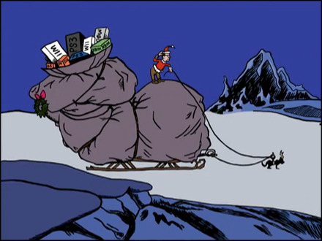
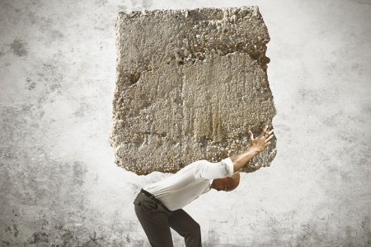
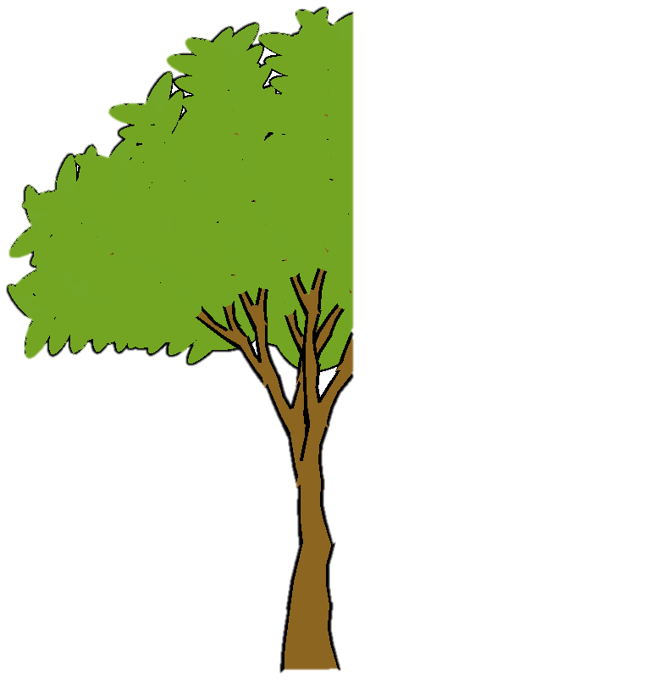
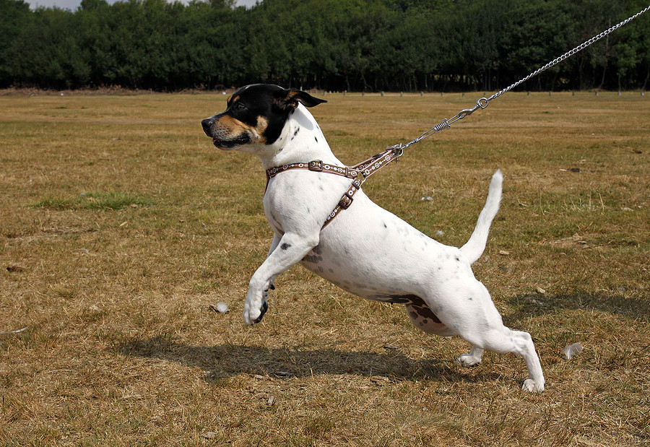
Work or not work???
☐ Max the dog pulling the Grinch’s sled across the snow.
☐ Carrying a rock across the yard.
☐ A dog pulling on his leash attached to a tree.

Slide 8
The Math…
The formula for work:
Work = Force x Distance
The force applied to the object (in Newtons)
The distance over which the force is applied (in meters)
The unit of work is a joule (rhymes with “cool”)
1 joule (J) is the work done pushing an object a distance of 1 meter with a force of 1 Newton.

Slide 9
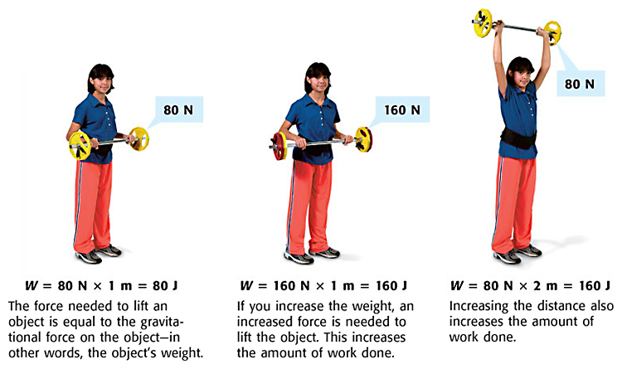
Example

Slide 10
You try it!
How much work is done if you push your little brother on his bicycle for 10 meters with a force of 50 Newtons?
2. How much work do you do on a bowling ball that weighs 80 N if you lift it 1.5 meters off the ground?
3. How much work do you do on that same bowling ball if you carry it 20 meters horizontally across the room?

Slide 11
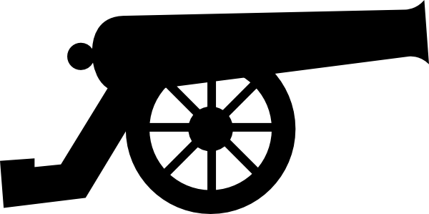
Newton’s Laws are only the beginning…
Question: If the force of the gun powder on the cannon ball is the same for both cannons:
Is the work done on each cannon ball the same?
Will one cannon ball go farther?
2m long
4m long
Hint: The force of the gunpowder pushes the cannon ball until it leaves the barrel of the cannon.

Slide 12
Force applied for a distance of 2 meters
Work = force x 2m
2m long
The longer cannon does 2x the work on the cannon ball since the force is applied over 2x the distance!
4m long
Force applied for a distance of 4 meters
Work = force x 4m

Slide 13
Newton tells us:
The force of the exploding gunpowder accelerates the ball. (a=f/m)
The concept of work tells us:
The force acting over a longer distance results in more work done on the ball.
So, Why is this important????

Slide 14
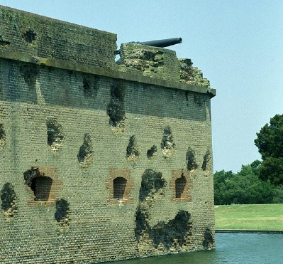
….Work is the transfer of energy to an object
So…since the longer cannon did 2x the work on the cannon ball, the cannon ball will have gained 2x the energy, and will:
leave the cannon barrel with a greater velocity
do more damage when it hits its target

Slide 15
Work Quick-Lab
Choose a few objects. Measure their mass in kg and convert it to weight in N. Then lift the object a certain distance and calculate the work you did on the object.
Object | Mass in Kg | Weight in Newtons | Distance Lifted (m) | Work done on object
Holt K textbook | 0.972 Kg | 9.5 N | 2m | 19 J
 |  |  | (Floor to lab table)
 |  |  | (Floor to top of cabinets)
 |  |  | E.S.B Obs. Deck: 370m
To convert Kilograms to Newtons:
1 kg = 9.8 N

