Slide 1
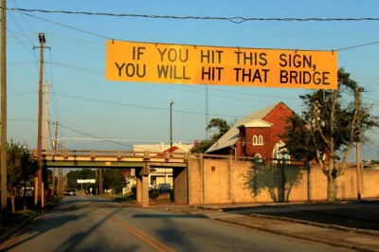
Bridges

Slide 2
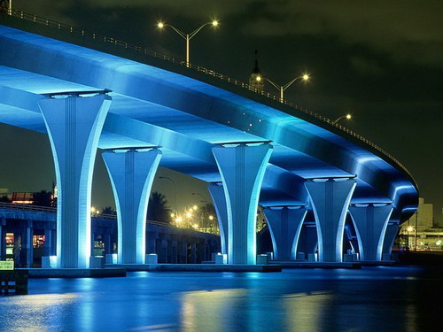
What is a bridge?
A bridge is an elevated structure designed to support the movement of objects over a span
Bridges are made of steel and pure awesomeness

Slide 3
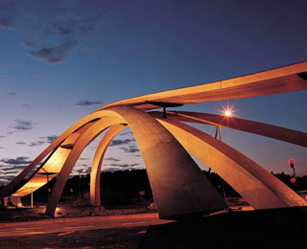
Bridge design depends on the function of the bridge and the nature of the terrain where it is constructed.
The world’s first bridge to use a tilting mechanism to open, forming a gateway for ships to pass. Pedestrian Bridge, England
Designed by Leonardo da Vinci
Bike Bridge, Norway

Slide 4
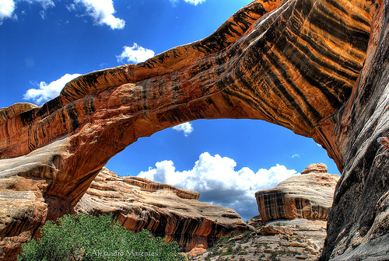
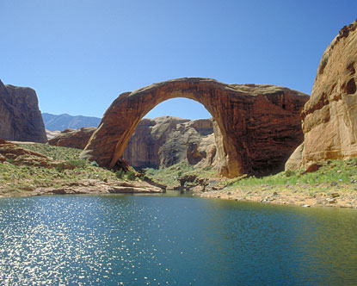
First Bridges-Natural Bridges

Slide 5
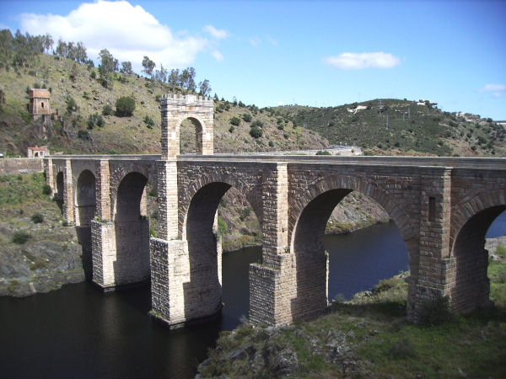
The greatest bridge builders were in ancient Rome!

Slide 6
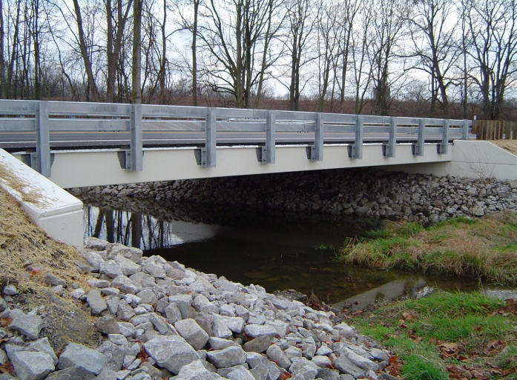
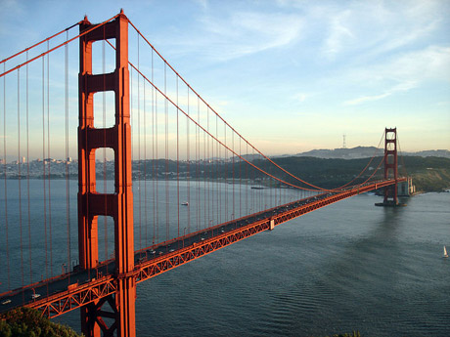
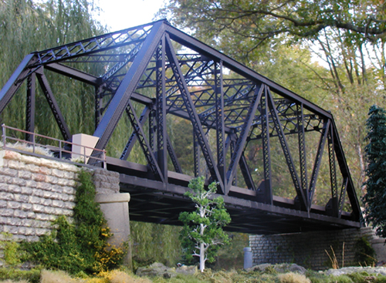
1. Beam 2. Suspension 2. Truss (type of beam)
Major Bridge Types

Slide 7
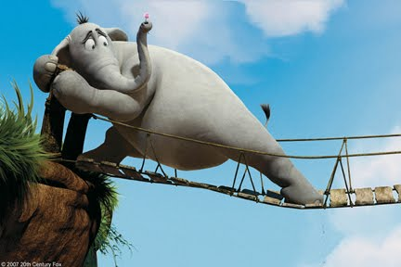
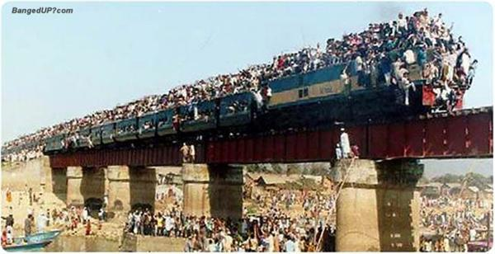
Loads and Forces
Load- The distribution of weights on a structure
Dead Load- The weight of the bridges structure
Live Load- The weight of the traffic on the bridge

Slide 8
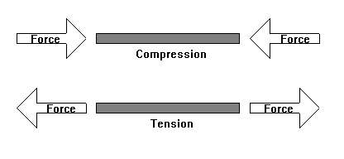
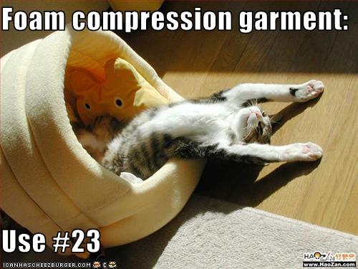
Forces on a Bridge (Push or Pull)
Bridges are kept stable by balancing the load forces with supporting forces of the structure
Tension
A pulling force that acts to stretch the structure
Compression
A force that acts to squeeze, push or shorten a structure

Slide 9
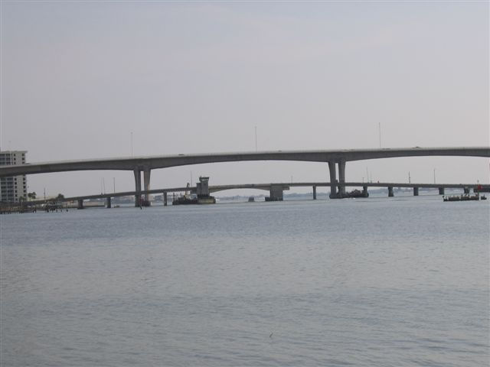
Shapes
Triangles and rectangles commonly used in bridge design
These shapes are strong and can handle large loads without tension and compression doing any damage
SPAN
The section of the bridge between two piers
Different types of bridges have different distances for each span

Slide 10
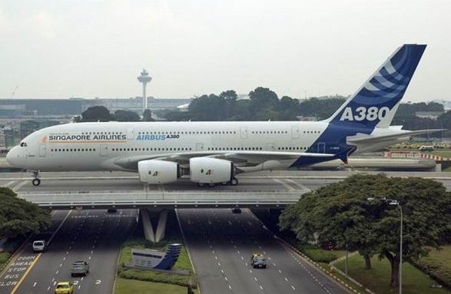
Materials
Materials are chosen for strength against tension and compression forces
Common Materials
Wood
Rope
Aluminum
Concrete
Steel

Slide 11
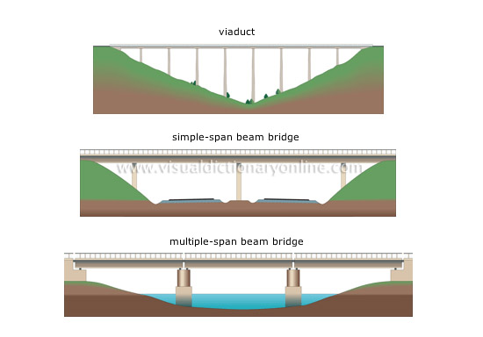
Beam Bridge
Simplest form of a bridge
The deck(roadway) is rigid and straight.
Supported at both ends by piers
The weight of the beam bridge pushes straight down on the piers
Amount it bends with a live load depends on length of beam

Slide 12
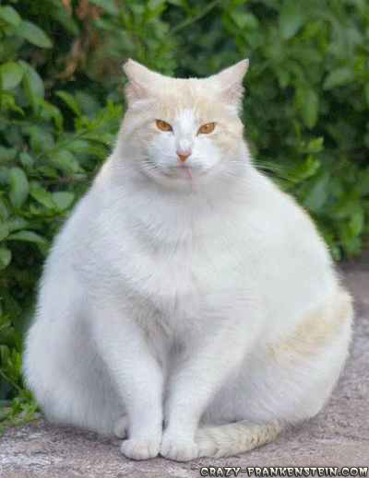
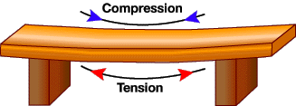
Beam Bridge Compression and Tension
Remember Forces act in pairs!
Compression
Compression force is on top of the bridge deck
Causes the upper portion of the deck to shorten
Tension
Tension force is on the bottom of the bridge deck
Causes lower part of deck to lengthen

Slide 13
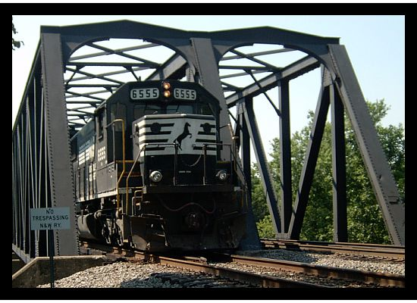
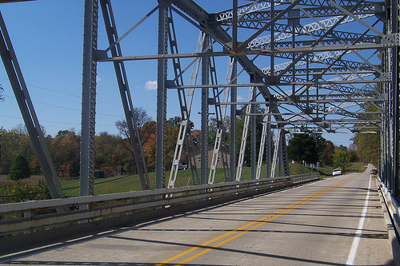
Truss Bridge
Uses triangles and interlocking joints to provide extra strength to bridge
Can carry heavier load because of shape

Slide 14
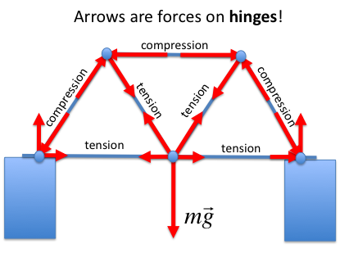
Truss Bridge Compression and Tension
Compression along outside of frame/triangles
Tension on the inside of triangles/frame and along deck
http://www.teachersdomain.org/asset/phy03_vid_bbtrussanim/

Slide 15
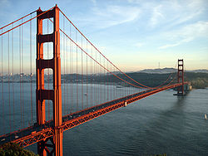
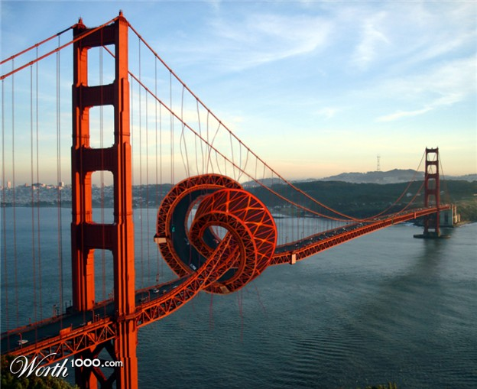
Suspension Bridge
Uses cables suspended from tall towers to hold up the deck and distribute the load

Slide 16
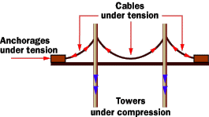
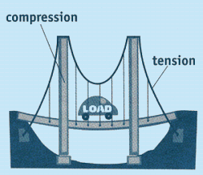
Suspension Bridge
Compression and Tension
Cables under tension and are stretched from the weight of the bridge and its traffic
Towers under compression from load crossing bridge/deck

Slide 17
Experiments
Scientists build model bridges to conduct controlled tests to see how they will withstand various stresses

Slide 18
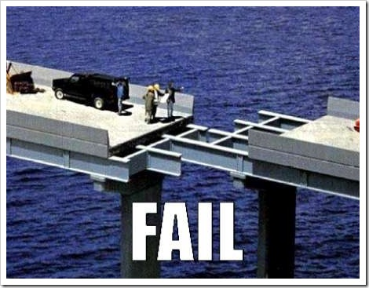
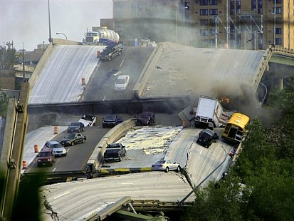
Bridge Failure
Faulty parts
Not used in way was designed
Poorly designed

Slide 19
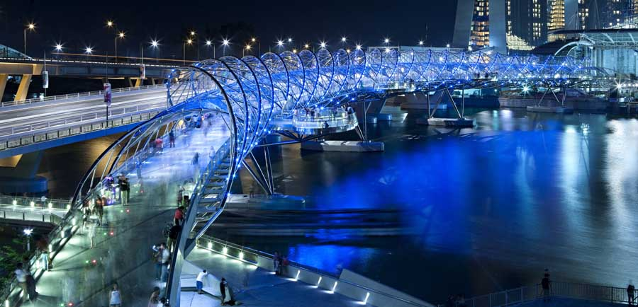
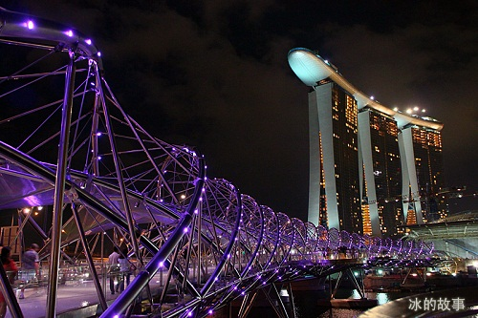
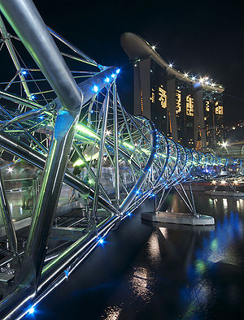
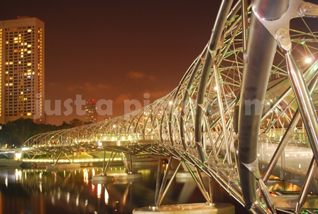

Slide 20
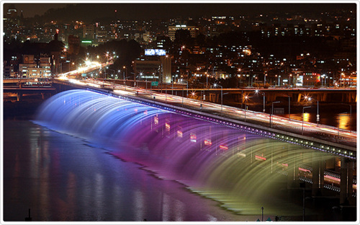
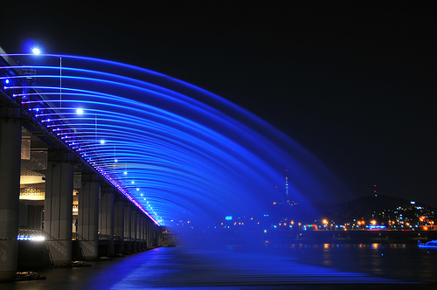
South Korea

Slide 21
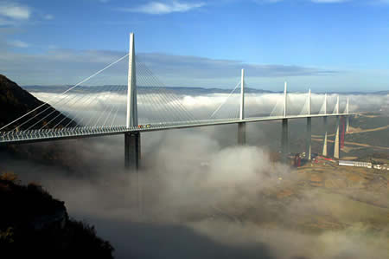
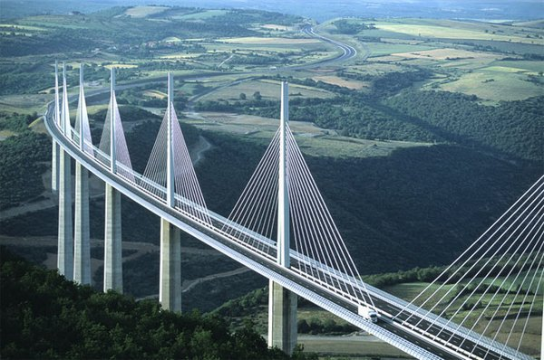
FRANCE

Slide 22
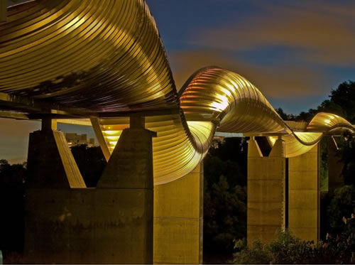
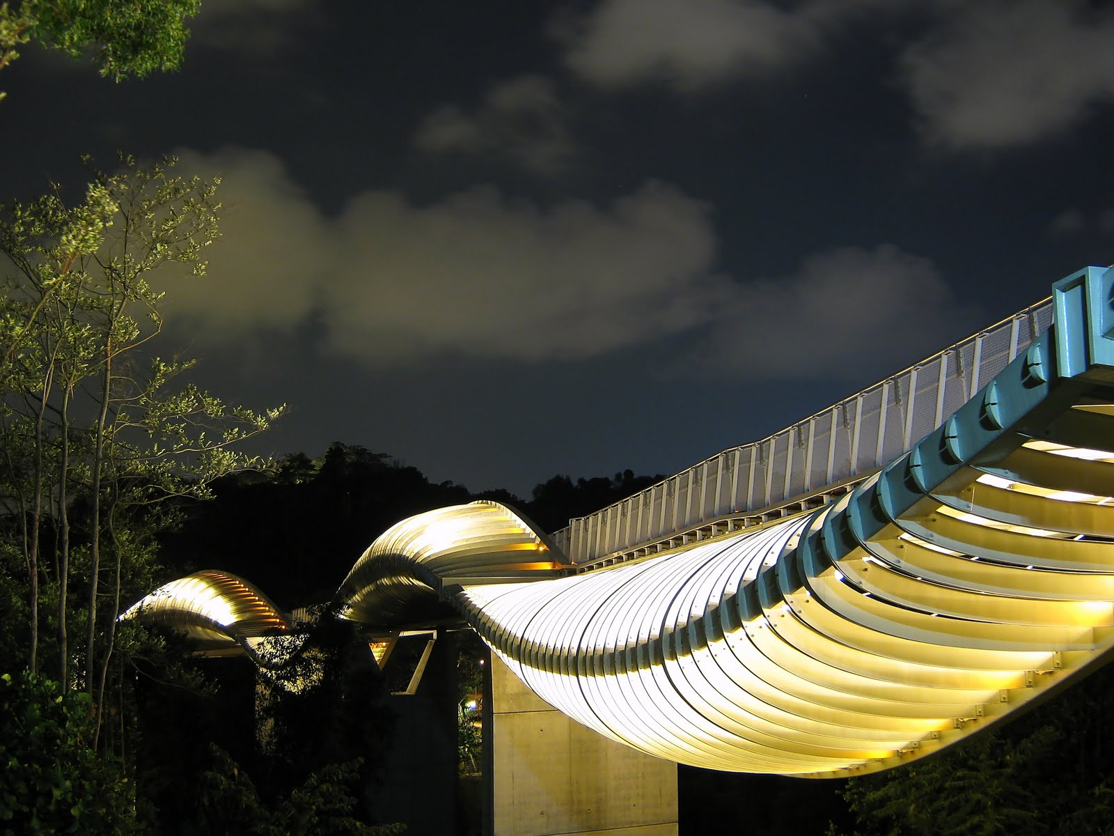
Singapore Pedestrian

Slide 23
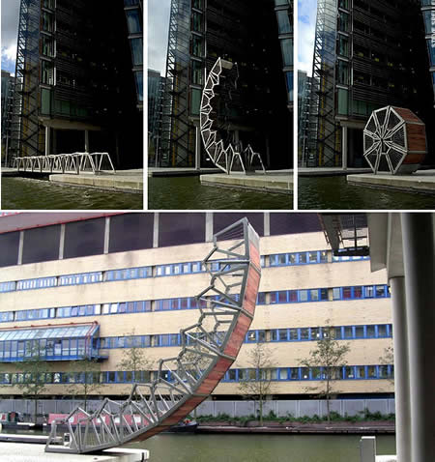
UK ROLLING

Slide 24
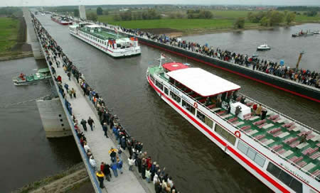
GERMANY

Slide 25
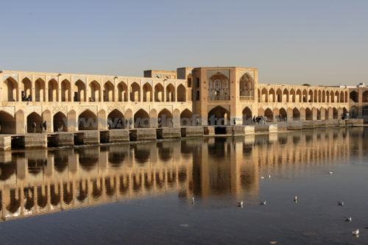
IRAN

Slide 26
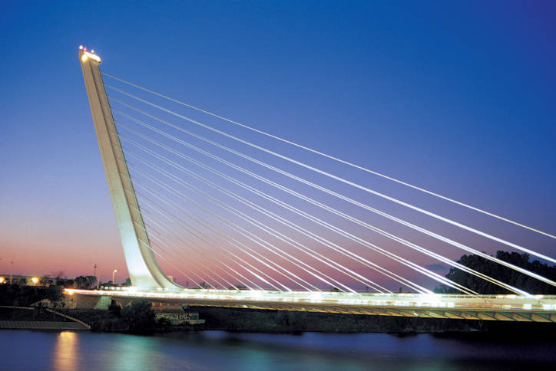
SPAIN

Slide 27
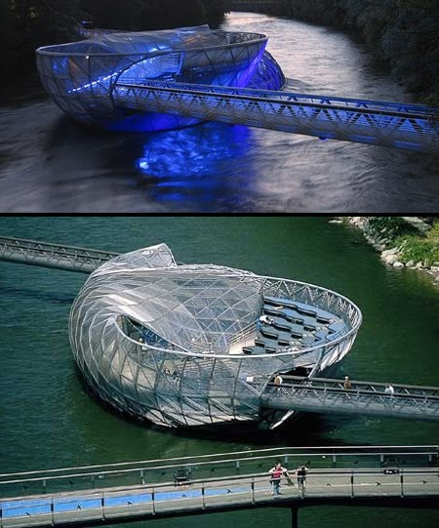

Slide 28
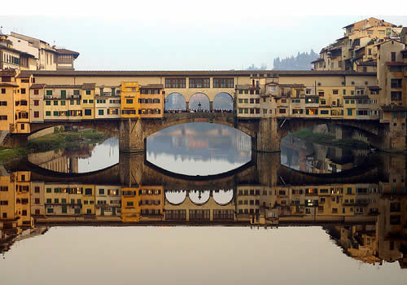

Slide 29
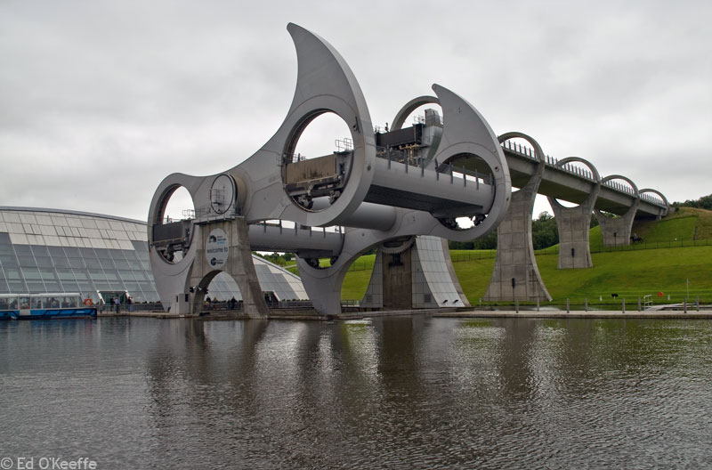

Slide 30
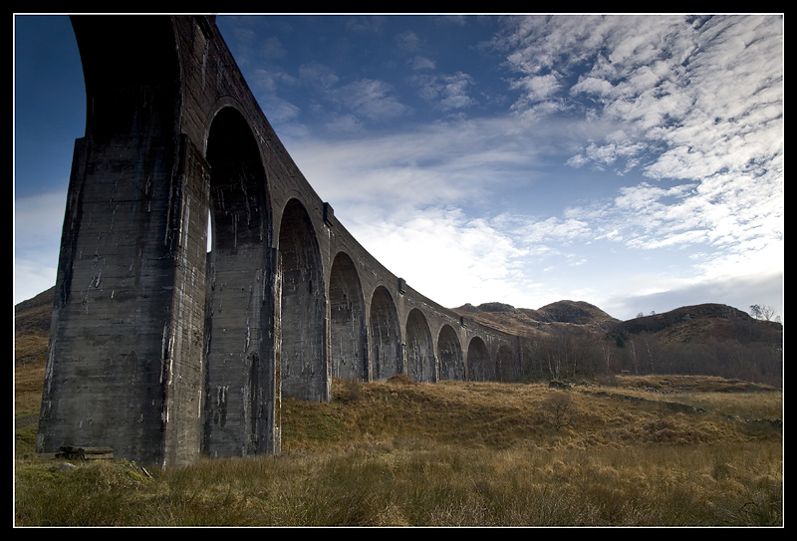
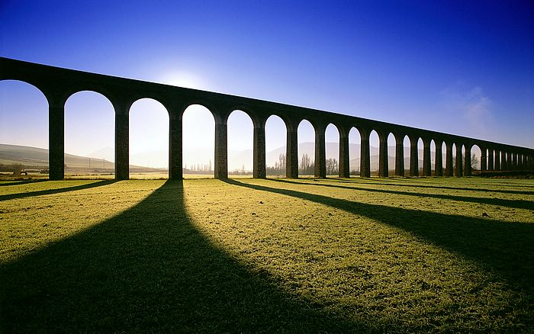
Glennfinnan Viaduct Scotland

Slide 31
