Slide 1
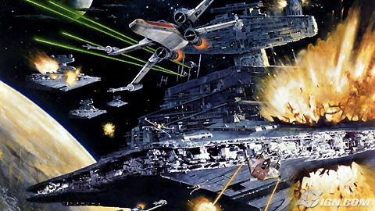
Energy

Slide 2
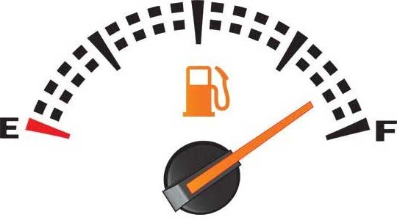
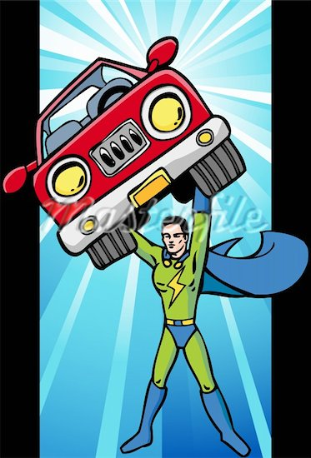
What is energy?
“The ability to do work”
You can think of Energy as the “universal fuel” needed to do work
….And when work is done on an object, that object gains energy.

Slide 3
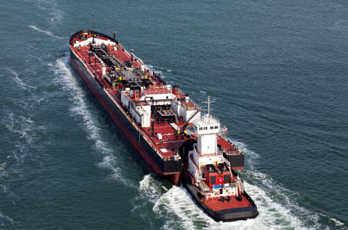
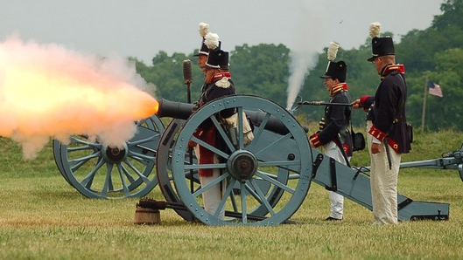
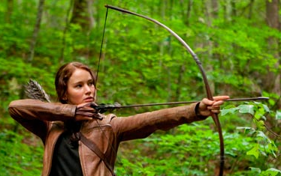
Examples:
You use energy when you do work to pick up your back-pack.
A tug boat uses energy when it does work to push a barge.
The gunpowder does work on the cannonball which gives the cannonball energy.
Katniss does work pulling back on the bowstring which gives the bowstring energy.

Slide 4
Work
The transfer of energy to an object by using a force that causes the object to move in the direction of the force
W = F x d
Units (J)

Slide 5
Important Concept:
Work and energy are VERY CLOSELY related…
The work done on an object is equal to the amount of energy the object gains
OR…
The amount of energy an object gains is equal to the amount of work done on the object.

Slide 6
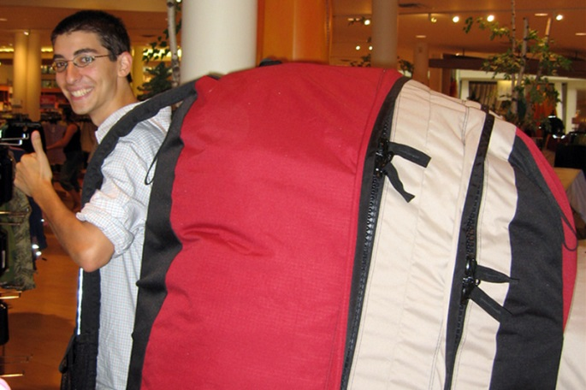
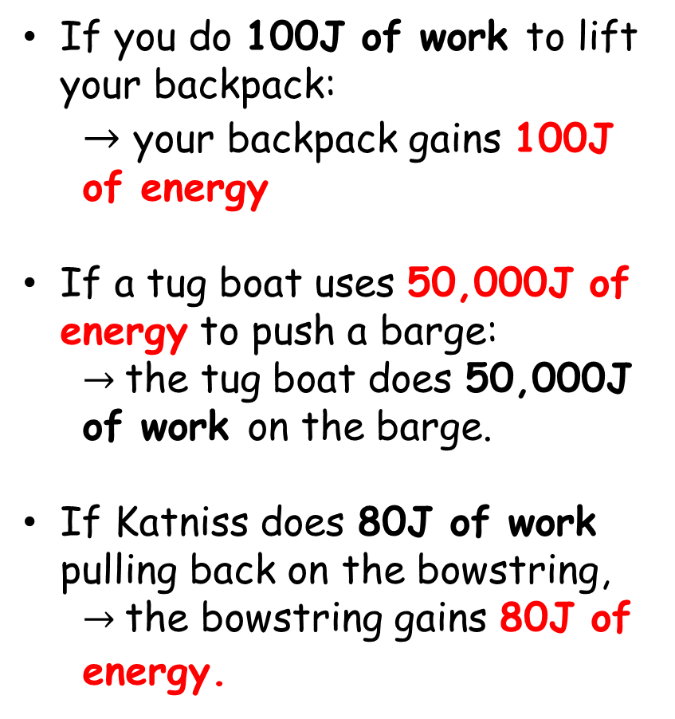
Examples:
If you do 100J of work to lift your backpack:
  $→$ your backpack gains 100J of energy
If a tug boat uses 50,000J of energy to push a barge:
  $→$the tug boat does 50,000J of work on the barge.
If Katniss does 80J of work pulling back on the bowstring,
  $→$the bowstring gains 80J of energy.

Slide 7
So….
The work done on an object is equal to the amount of energy the object gains…
Work = Change in Energy
W = ⬇E
⬇ means “change in”

Slide 8


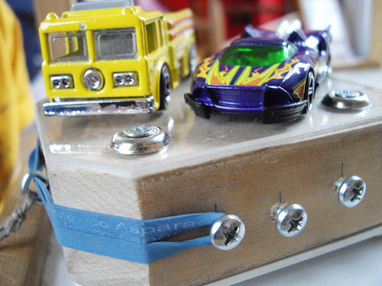
Understanding Check
If you do 150 J of work to lift your binder off the table, how much energy did your binder gain?
If you pull back the launcher block of the matchbox car launcher by doing 20 J of work on it, how much energy did you give the rubber band?

Slide 9
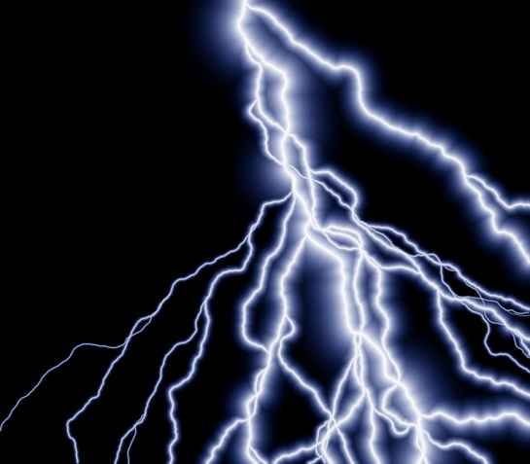

POWER
The rate at which work is done
or energy is transferred
Unit = Watt
Increasing Power –when an amount of work is done in less time
        Longer it takes to accomplish “work”, the less power output

Slide 10
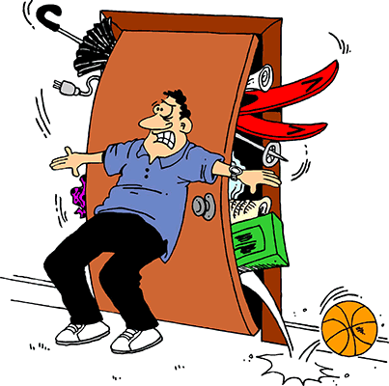
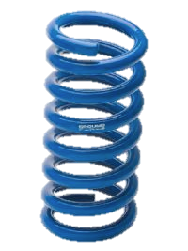


Potential Energy
Def: The energy an object has due to its position or condition.
It is energy that is stored and ready to use.
Elastic P.E.
Chemical P.E.
Gravitational P.E.

Slide 11
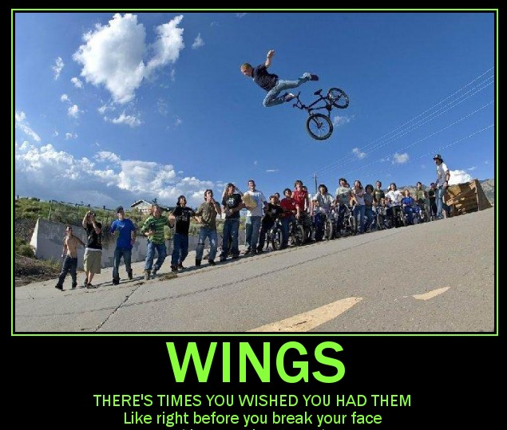
For us, the most common type of P.E. is gravitational potential energy
Def: The P.E. of an object due to its elevation above a surface.

Slide 12

Remember W = ΔE.
So the G.P.E. of each Grumpy Cat is equal to the work it took to lift him up on to his post:
G.P.E. = Work
G.P.E. = Force x Distance
More G.P.E.
Less G.P.E.
2m
1m
Weight of the cat
Height of cat above ground
G.P.E. = Weight x Height

Slide 13

Example
G.P.E. = Weight x Height
Calculate the GPE of each 5kg Grumpy Cat.
Step 1: We need the weight of the cats.
5kg x 9.8 m/s² = 49N
Cat 1: GPE = W x H
GPE = 49N x 2m = 98J
Cat 2: GPE = W x H
GPE = 49N x 1m = 49J
2m
1m

Slide 14
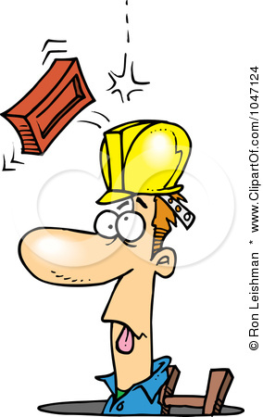
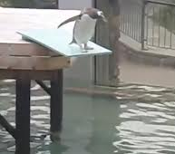
You Try It!
A brick with a weight of 20 N falls off a building from a height of 50 m. What is the gravitational potential energy of the brick before it falls?
A 100 kg diver is standing on a platform 7m above the surface of the water. What is the gravitational potential energy of the diver relative to the water’s surface?

Slide 15
Work and GPE
Remember W = ⬇E
10m
4m
The bowling ball has a weight of 50N. The work done to lift it straight up to the top of the ramp is:
50N x 4m = 200J
200J is also the amount of GPE the ball will have at the top of the ramp.
So…how much work will you do pushing the same bowling ball up the ramp?
When the ball gets to the top it has to have 200J of GPE so you must have done 200J of work to get it there.

Slide 16
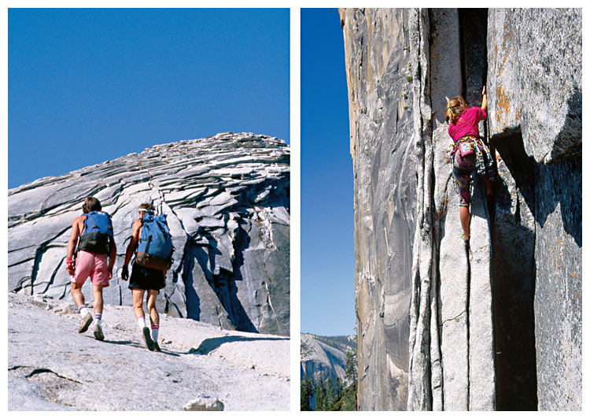
Lifting the same object the same vertical height requires the same amount of work, no matter the path.
Figure 4 Climbers going to the top of a mountain do the same amount of work whether they hike up a slope or go straight up a cliff.

Slide 17
Kinetic Energy
If an object is moving:
It is capable of doing work
It has energy
Kinetic Energy (KE) is the energy of motion

Slide 18
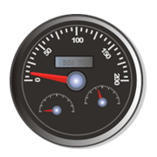
Since Kinetic Energy is the energy of motion it depends on both:
  Mass of the object
  Speed (velocity) of the object
KE = 1 Mass x Velocity²
²
Or… M(V)²
2

Slide 19
The mass of an object kinetic energy
The speed of an object the kinetic energy
However one has more impact on kinetic energy. Which variable is it and why?

Slide 20
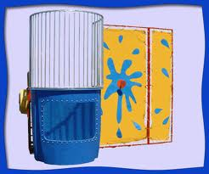
Example:
Mrs. Lusardi throws a tennis ball at a dunk tank.
Mass of ball = 5kg
Speed of ball = 80 m/s
KE = 5 x 80² = 5 x 6,400 = 32,000 = 16,000J
2 2 2

Slide 21
Increase Mass
Unsuccessful, Mrs. Lusardi picks up an throws a tennis ball with more mass.
Mass of ball = 10kg (doubled)
Speed of ball = 80 m/s
KE = 10 x 80² = 10 x 6,400 = 64,000 = 32,000J
2 2 2

Slide 22
Increase Speed
Just then… a unicorn appeared and with all of its magical powers, handed Mrs. Lusardi a magic tennis ball with more speed!
Mass of ball= 5kg
Speed of ball = 360 m/s (doubled)
KE = 5 x 360² = 5 x 129,600 = 648,000 = 324,000J
2 2 2

Slide 23

Energy Conversions
Energy conversion is a change from one form of energy to another
Any form of energy can change into any other form of energy
Energy can change into multiple forms

Slide 24
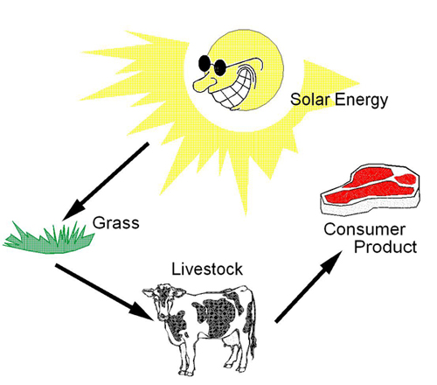
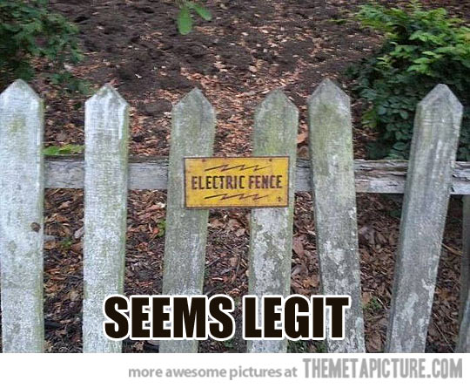
Examples
Light (radiant) energy from sun chemical energy in our food
kinetic energy in our bodies
2. Solar cells change light energy electrical energy

Slide 25
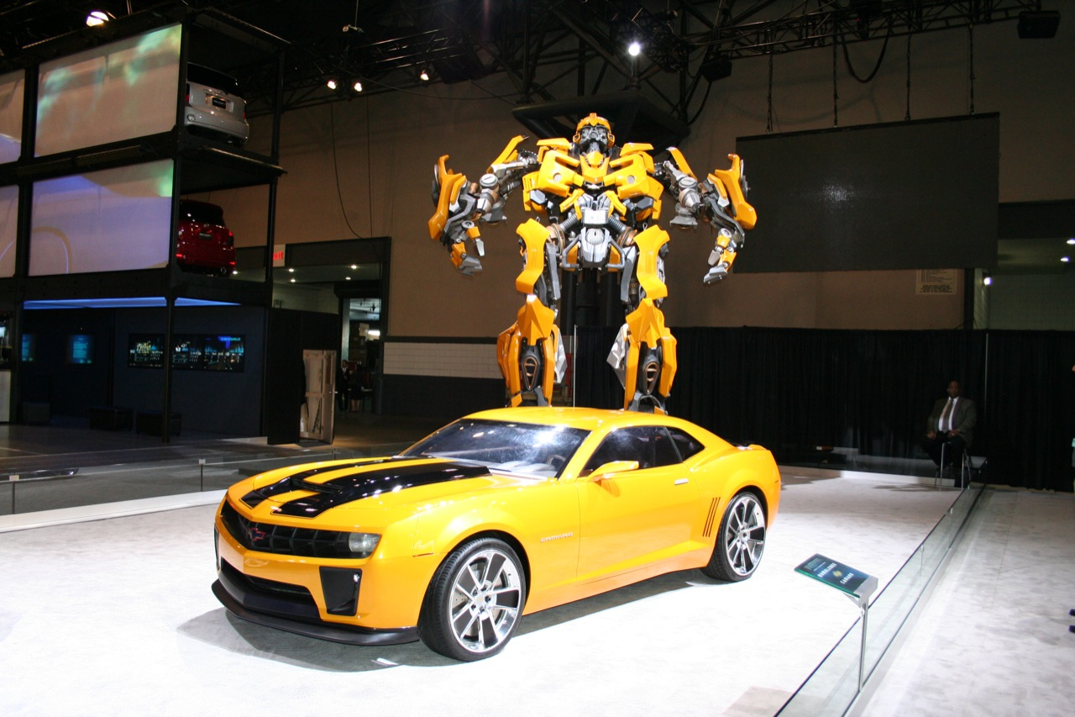
3. A car engine burns gasoline, converting the chemical energy in gasoline mechanical energy.

Slide 26
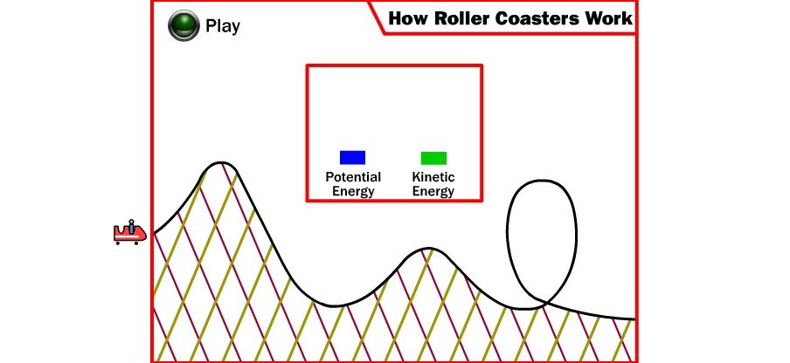
Roller Coaster Conversion
PE KE and KE PE

Slide 27
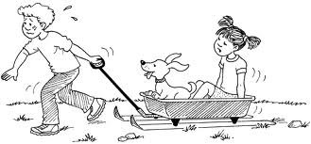
Friction
Anytime one form of energy is converted into another form, some of the original energy always gets converted into thermal energy due to friction!
Thermal energy due to friction not useful energy
Cannot be used to do work!

Slide 28

Conservation of Energy
When we use energy, it doesn’t disappear.
Energy changes form, but the total amount of energy in the universe stays the same.
The Law
The law states that energy cannot be created or destroyed but can be changed from one form to another

