Slide 1
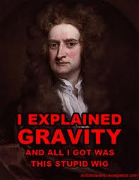
Newtons 2nd Law

Slide 2
Newton's second law of motion can be formally stated as follows: The acceleration of an object as produced by a net force is directly proportional to the magnitude of the net force, in the same direction as the net force, and inversely proportional to the mass of the object.
YIKES!!

Slide 3
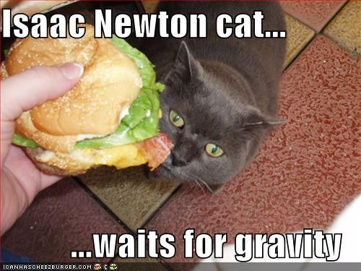
Instead…
The second law states that the acceleration of an object is dependent upon two variables:
force
mass
If force acting upon an object
the acceleration of the object is
Direct
If the mass of an object is
The acceleration of the object is
Inverse
Because its funny

Slide 4
Newtons 2nd law can be expressed using this formula…
Force = Mass x Acceleration or
F= M x A
F
We can also re-write the formula to solve for acceleration
What would that look like??
F
m
a
What about solving for mass?

Slide 5
UNITS!!
These formulas only work if the units are correct:
Mass in KILOGRAMS (kg)
Force in NEWTONS (N)
Acceleration in METERS/SECOND/SECOND (m/s/s or m/s² )

Slide 6
Let’s try a few problems…
1. What net force is required to accelerate a car at a rate of 2 m/s² if the car has a mass of 3,000 kg?
F=_______
m=______
a= __________
2. What net force is required to accelerate a bowing ball at the same rate of rate of 2 m/s² if the bowling ball has a mass of 10 kg?
F=______
m=______
a=______
6000 N
20N

Slide 7
3. What is the acceleration of a softball if it has a mass of 0.5 kg and the player throws it with a force of 200 N?
F=______
m=______
a=______
4. What is the acceleration of the 10 kg bowling ball thrown by the same player, throwing with a force of 200N?
F=______
m=______
a=______
400m/s²
20m/s²

