Slide 1
Newton’s Third Law of Motion:
“For every action there is an equal and opposite reaction”
The correct way to say it:
For every action force there is an equal and opposite reaction force.

Slide 2
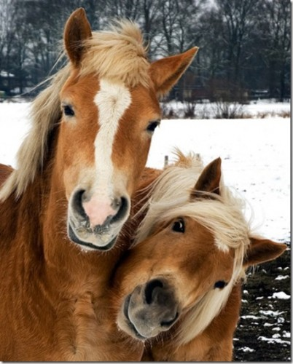
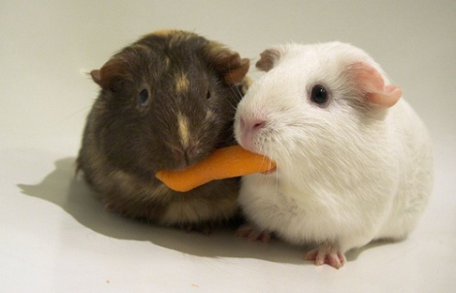
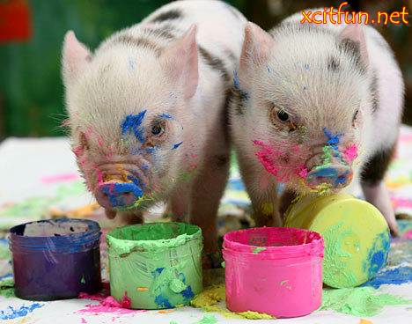
Forces always occur in PAIRS
An action force…
…and a reaction force

Slide 3
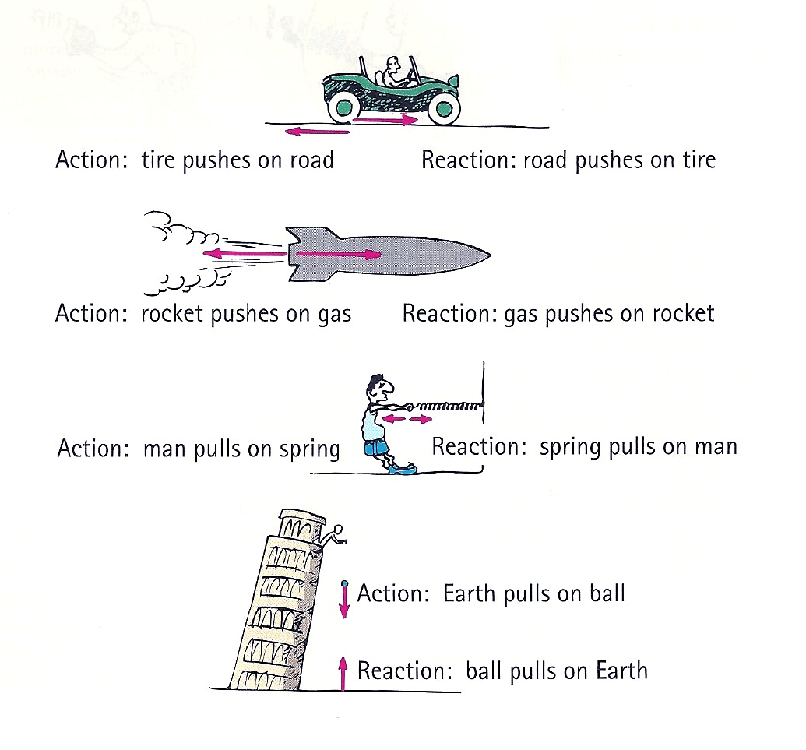
Some examples:

Slide 4
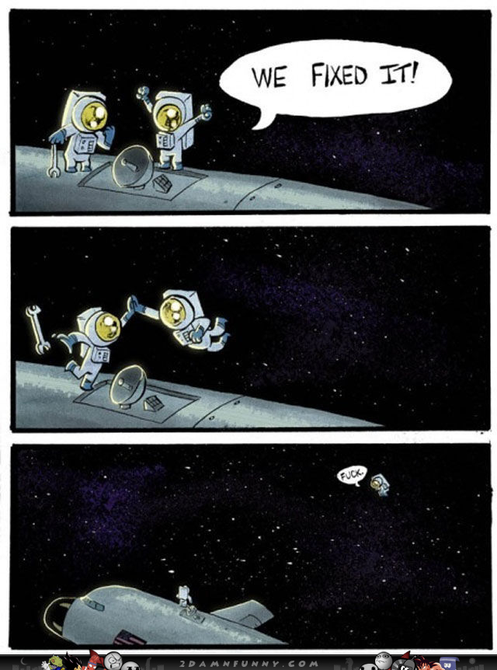
Nooooo…..

Slide 5
See the pattern???
A pushes on B, so B pushes on A
OR
A pulls on B, so B pulls on A

Slide 6
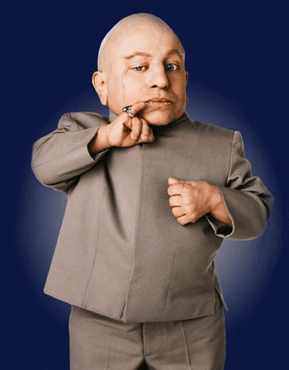
Question:
If force pairs on two objects are always equal and opposite, how is it that sometimes only one of the objects moves????

Slide 7
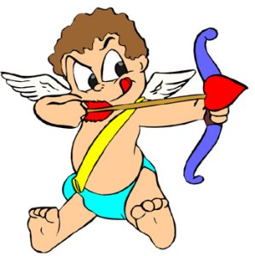
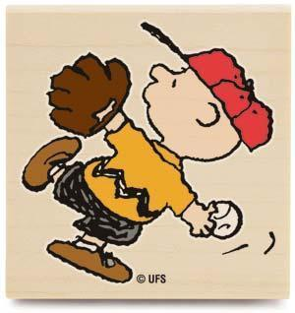
For example:
Shooting an arrow?
Throwing a baseball?
Hitting a hockey puck?

Slide 8
Answer:
Wait……
What??
The pair of forces acting on the objects has to be the same, but the REACTION of the objects to the forces does NOT have to be the same!

Slide 9
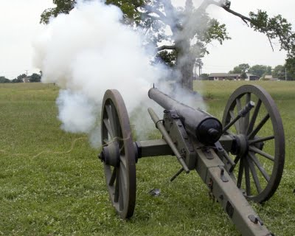
Example: a canon firing
According to Newton’s 3rd Law of Motion, both the canon ball and the cannon experience the SAME FORCE from the gunpowder.
So why does the cannon ball move so fast while the cannon only moves back a little?

Slide 10
Explanation 1 - The math:
The Cannon:
The Cannonball:
BIG mass:
SMALL mass
So according to Newton’s 2nd Law of Motion:
F
M
F
M
=
A
=
A
= SMALL acceleration!
= LARGE acceleration!

Slide 11
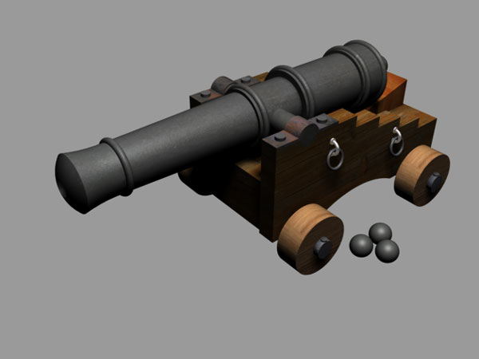
Explanation 2 – Inertia:
The cannon has much more INERTIA than the cannon ball.
Therefore the same force can move the cannon ball much more easily than it can move the cannon!

