Slide 1
Balanced Literacy and Mathematics
Jennings School
PTA Presentation-October 6, 2016
Mrs. Hyder and Mrs. Schaper-Language Arts Specialists
Mrs. Ruppert- Math Science Teacher

Slide 2
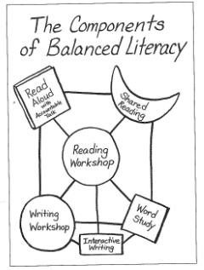
Balanced Literacy is a little more like cooking than baking…
Notes:
Tara - Discuss how certain components look different in upper grades (i.e. shared reading/close read).

Slide 3
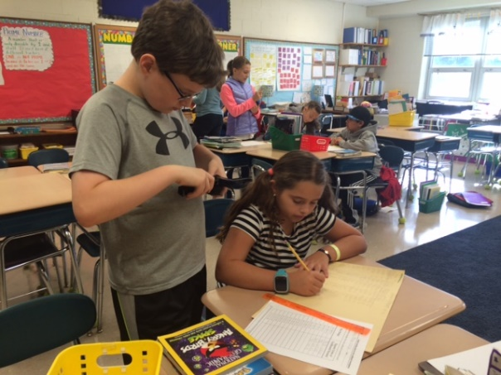
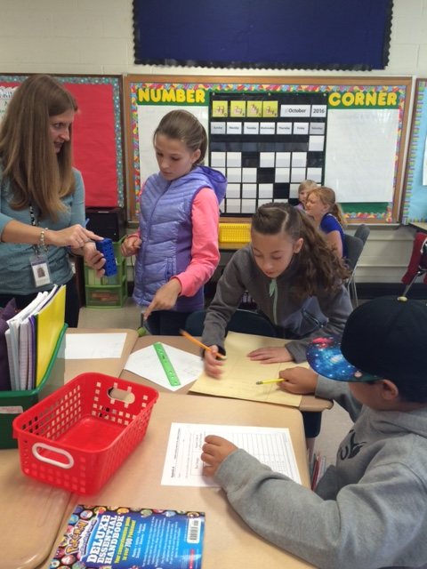
Balanced Mathematics
Students develop understanding of number and place value.
There is an emphasis on algebraic thinking/patterns and relationships.
Content is rich and learners build on prior knowledge.
Students engage in mathematics through investigations, solving meaningful problems and developing models.
Students work together and share ideas.
Students communicate their mathematical ideas and justify their reasoning.

Slide 4
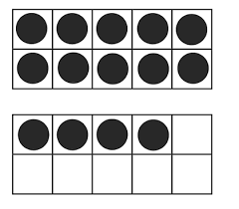
Tools and Models in Mathematics
Tenframe
Math Rack
Problem String
Grade 4
8 x 10
4 x 20
16 x 5
32 x 5
16 x 10
Open Number Line

Slide 5
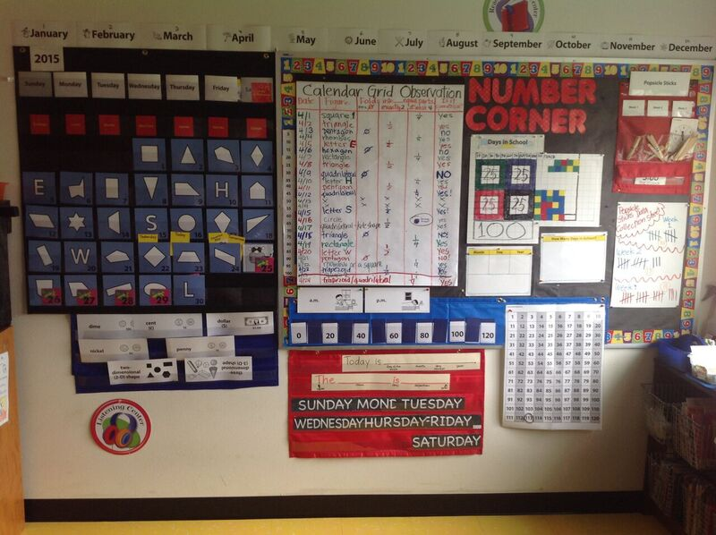
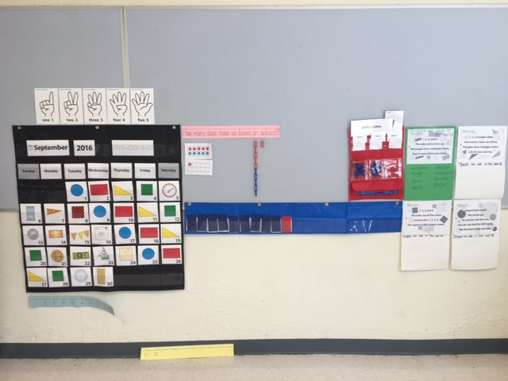
Number Corner
Part of daily math fluency
Introduces new skills
Reinforce and extend skills
Activities incorporate
Games
Demonstration
Discussion
Number Corner Student book

Slide 6
Workshop Model
The workshop structure is deliberately kept predictable and simple.
The bulk of the time is spent on students reading/writing/solving problems.
Whole class instruction teaches skills and strategies within a unit of study.
Notes:
Monica

Slide 7
Explanation of Components
Components of Literacy Workshop: Components of Math Workshop:
Mini Lesson ( 5-7 min) Fluency/Number Corner (5-10 min)
Independent Application (25 – 45 min) Mini Lesson (5-7 min)
Strategy and guided reading/writing groups Active Problem Solving (30-40 min)
1:1 Conferences Independent work or group work
Small Group Instruction Conferring and small group
Possible: mid-workshop teaching point (1-3 min) Share (3-5 min)
Share (3-5 min)
Notes:
Tara and Kathleen - Students are reading just right books from individual reading bins. Differentiation through SGI and 1:1 conferences as well as through use of JRBs.

Slide 8
Word Study
Whole class and small group instruction is determined by data gathered from spelling inventories, process writing and oral reading.
Word study sessions begin with a mini lesson applicable to most of the students. Then students work independently, in partnerships, or in groups applying word work skills to decode while reading and encode while writing.
Students will draw on what they’ve learned during word study while they read and write to encourage transfer.
No spelling tests – authentic assessment in reading and writing application
Notes:
Monica - Formally known as spelling, but different than what we experienced as students – integrated within small group instruction in both reading and writing – Not a stand alone subject. Word study serves reading and writing.

Slide 9
Tips For At Home
Unit of study parent letters
Set aside a time and a place for reading and math daily.
Model the love of reading and math.
When solving math problems ask students how they might start and why they chose that particular strategy.
Notes:
Kathleen - Specific questions can be addressed by classroom teacher. General questions can be directed to us.

Slide 10
Conversation Starters
Tell me about the book you’re reading.
What are you working on as a writer?
What are you working on in math? What strategies are working best for you?
What math strategies are you talking about in class?
In class today, what is something you are proud of?
What was something that was a challenge?
Notes:
Monica - Unit of study letters can guide you to make these conversations more specific.

Slide 11
Math Sites for Support and Resources
https://fairfieldpublicschoolsk5math.wikispaces.com/
http://www.mathlearningcenter.org/resources/families

