Slide 1
Jennings 7th Annual
Science Expo
November 17, 2016

Slide 2
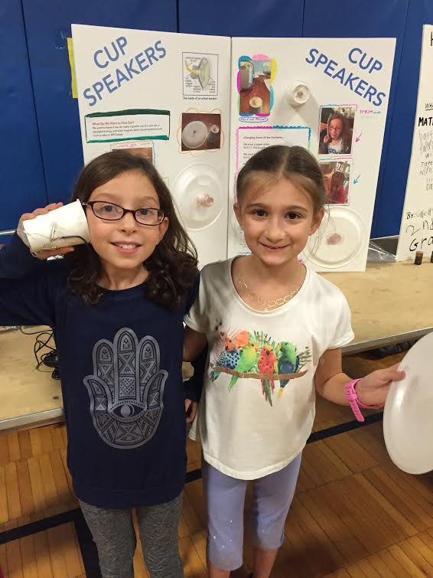
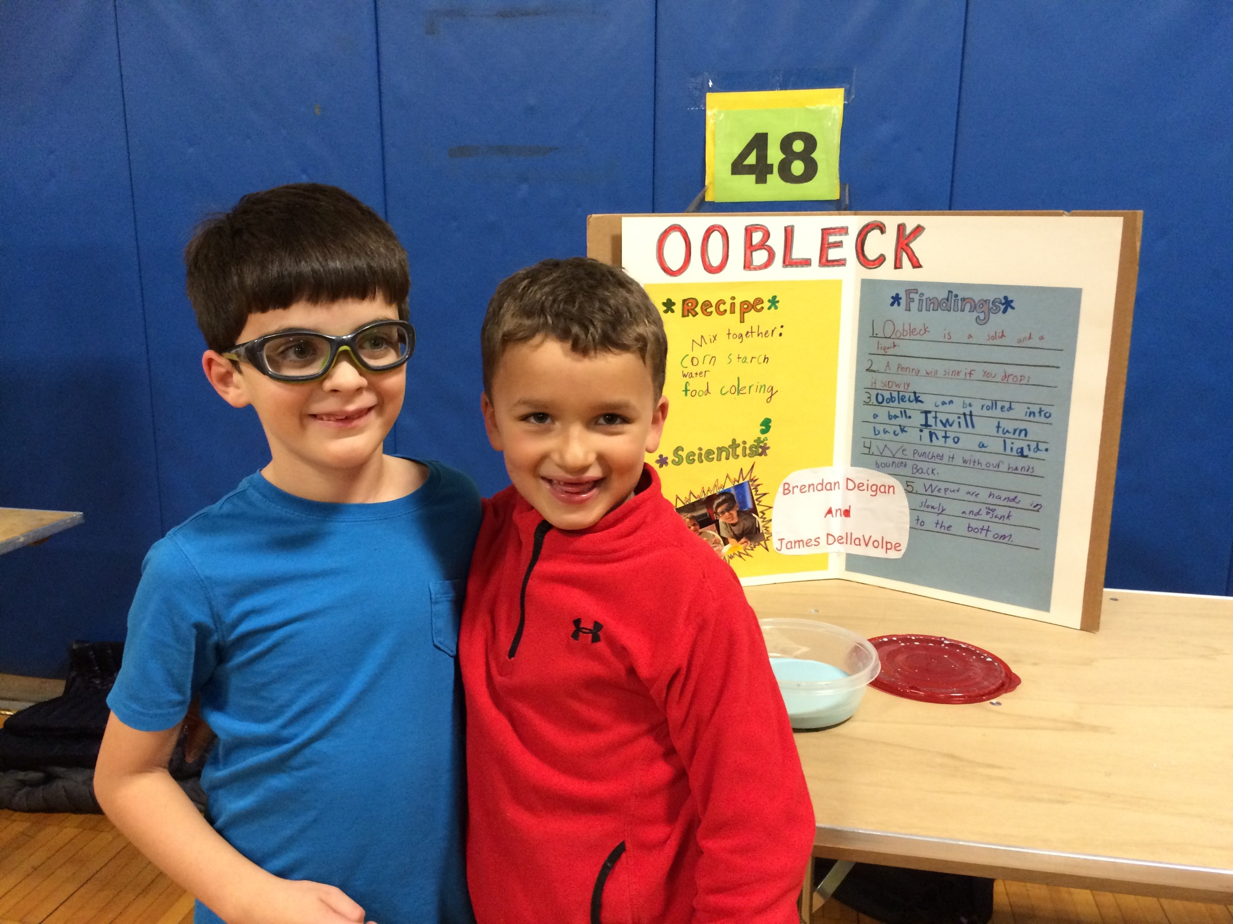
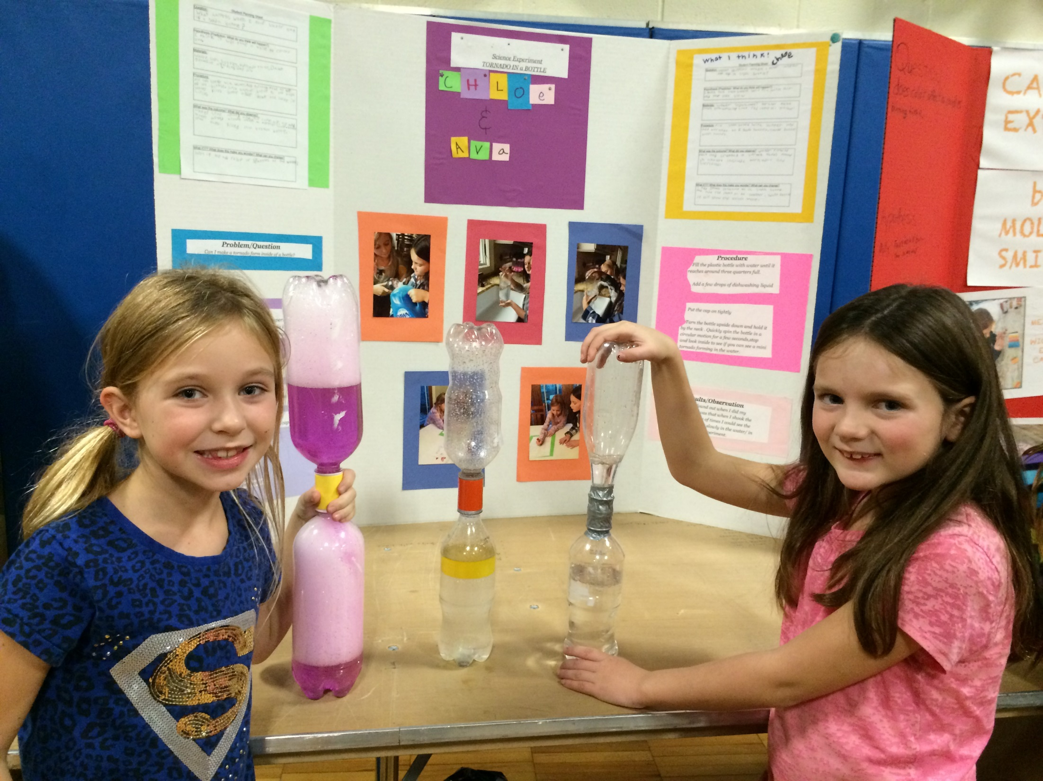
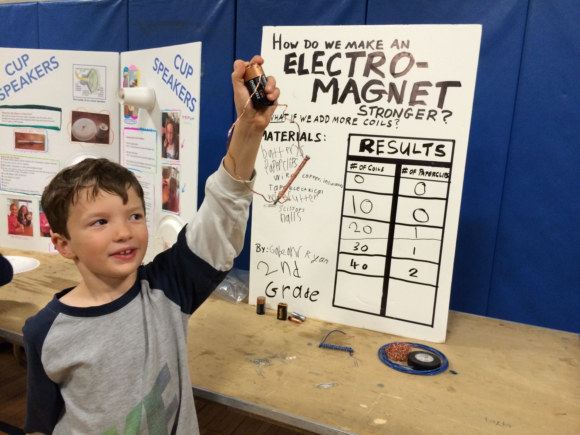

Slide 3
WHAT????
Science Expo. takes place each year
Conduct an experiment/study at home
Share it with Jennings Community

Slide 4
WHEN and WHERE
Science Expo will take place on Thursday, November 17, 2016
6:30-8:00
Jennings gym

Slide 5
WHO PARTICIPATES?
Students in grades 2-5

Slide 6
Monday Memo/Blast
Information about Science Expo.
Science Expo Participation Form
Form due by Nov. 4th in main office

Slide 7
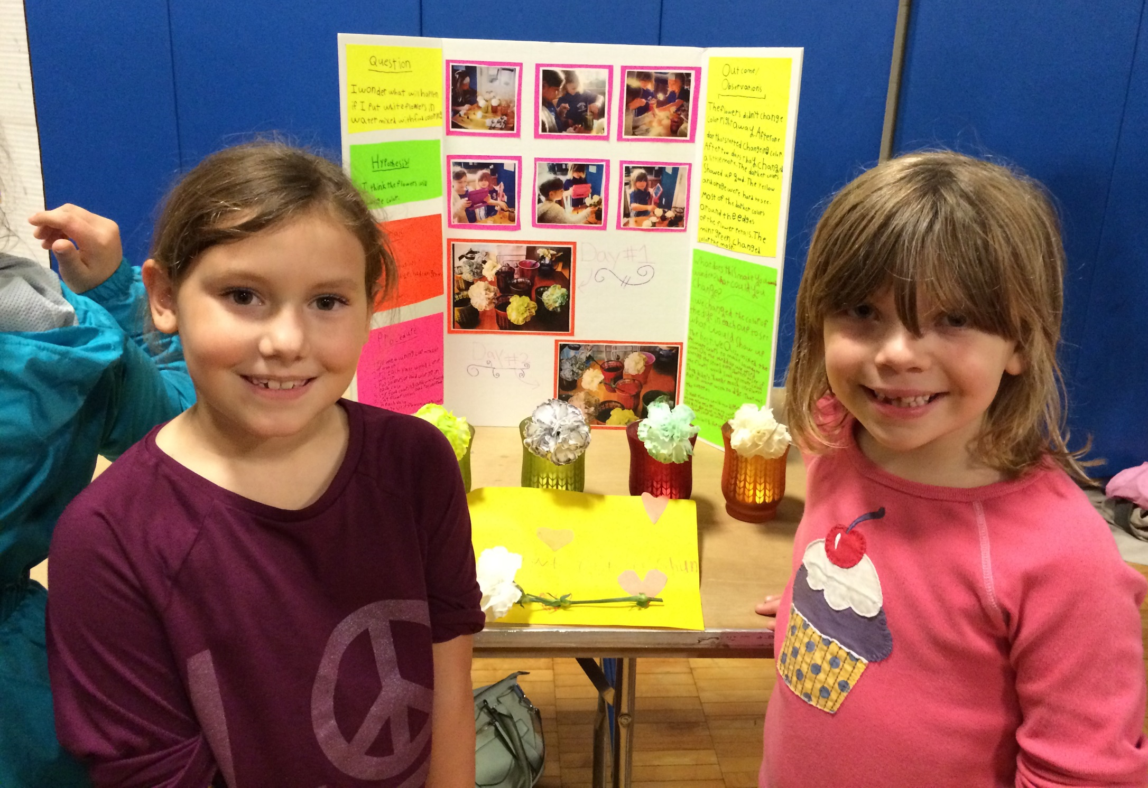
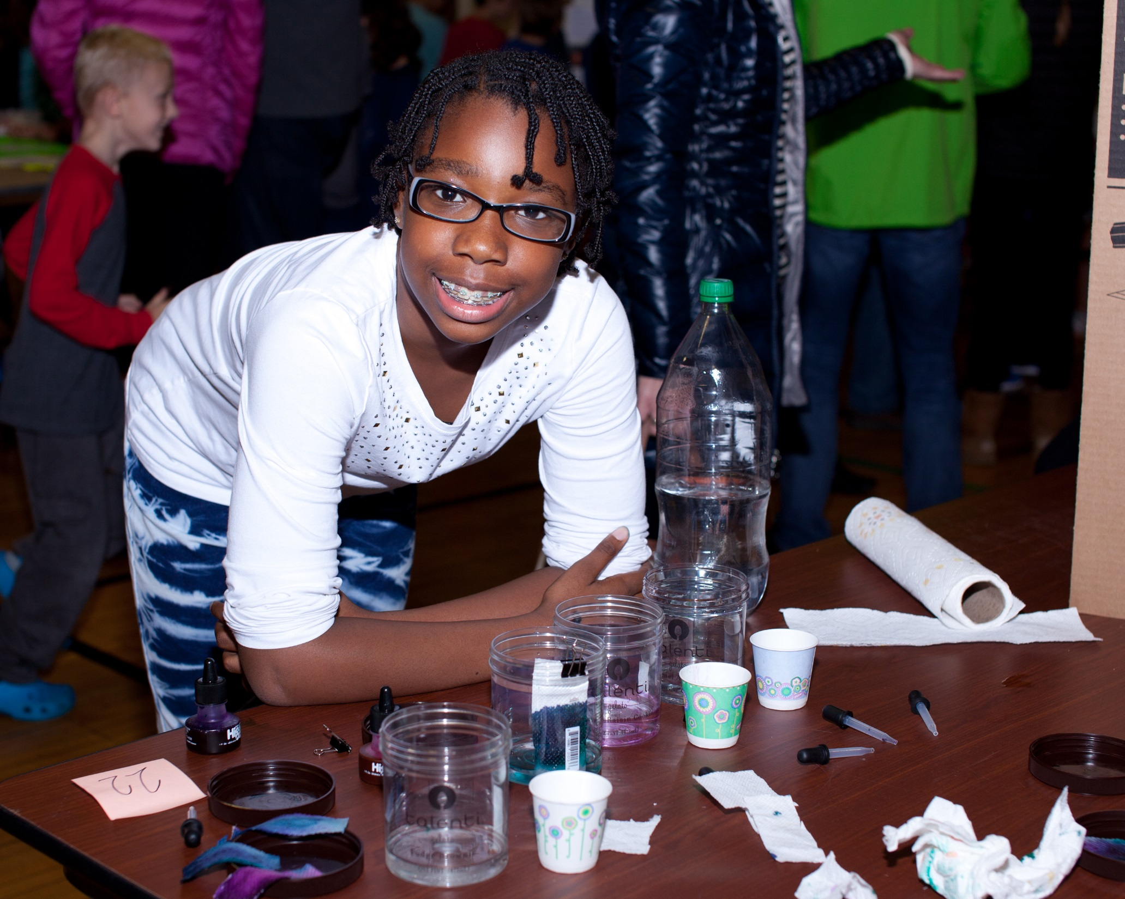
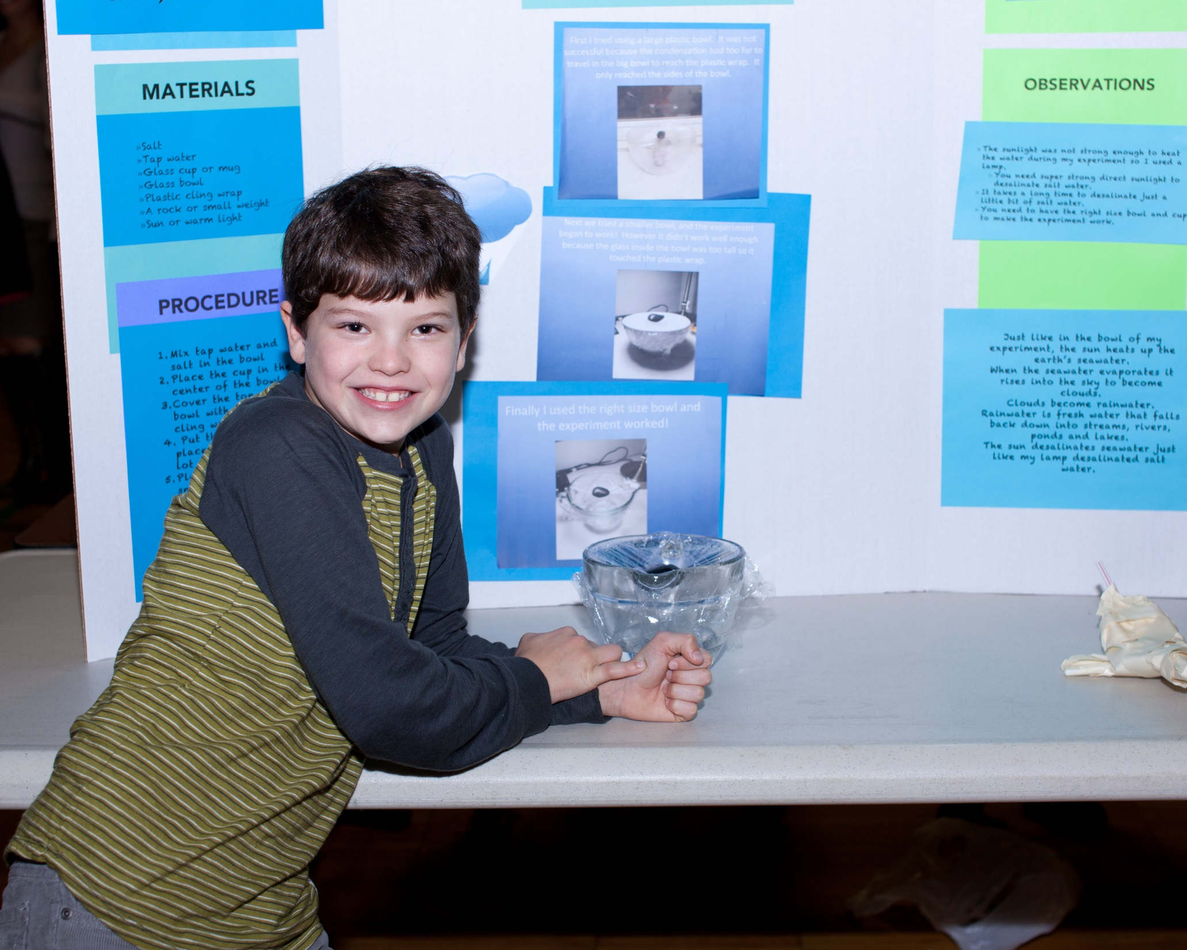
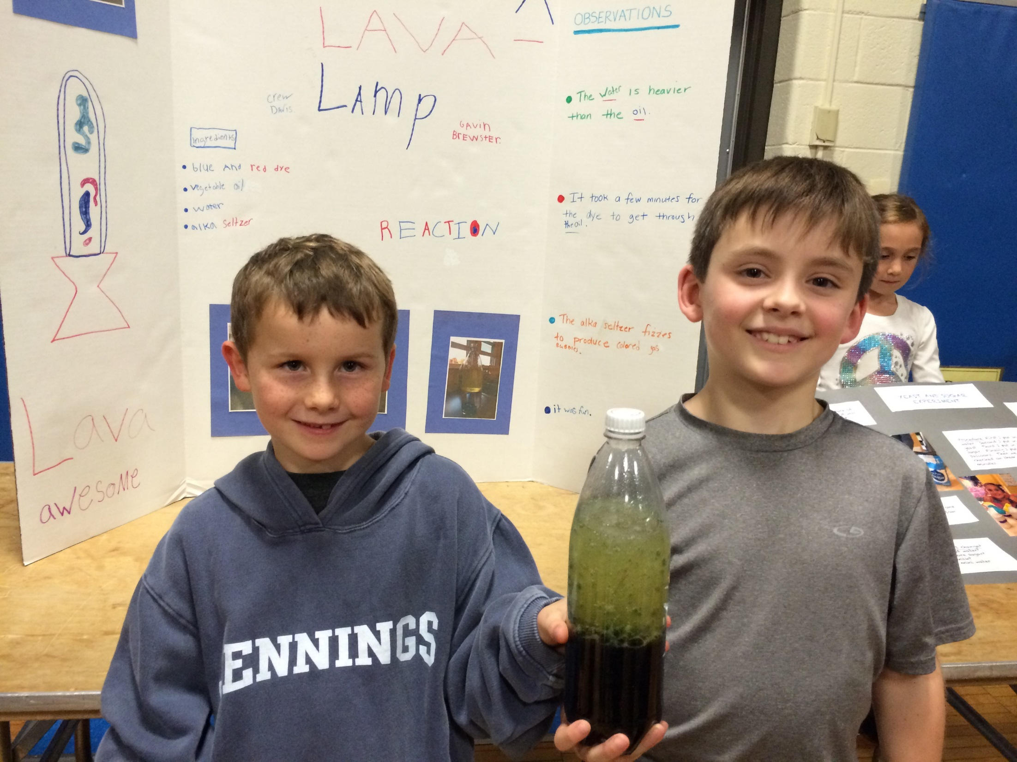

Slide 8
Getting Started
Books in LLC or public library
Websites
What do you wonder about?
What would happen if???

Slide 9
Scientific Process
Ask a question
Make a hypothesis/prediction
Materials
Procedure
Observations/Outcome/Data
What can you change? (variable)

Slide 10
Guidelines
Any food items must be securely sealed or you can take photos of the food
Groups of 1 or 2 accepted. No more than 2 in a group.

Slide 11
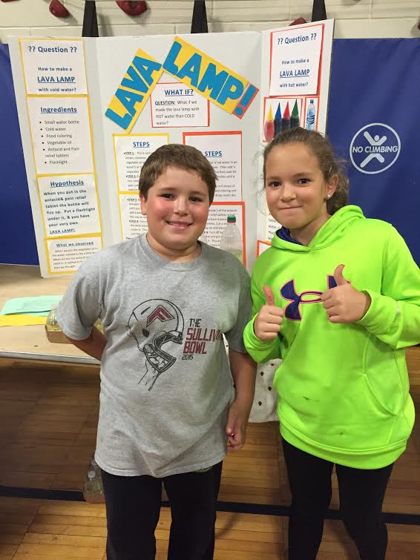
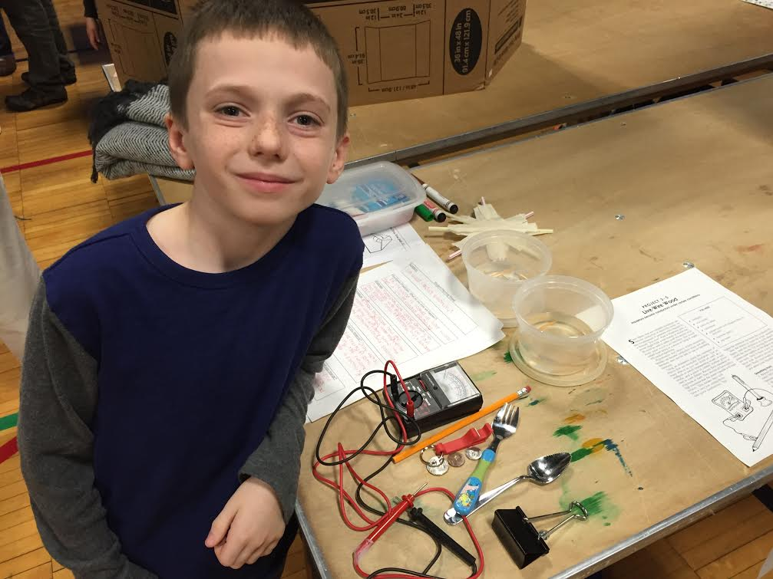
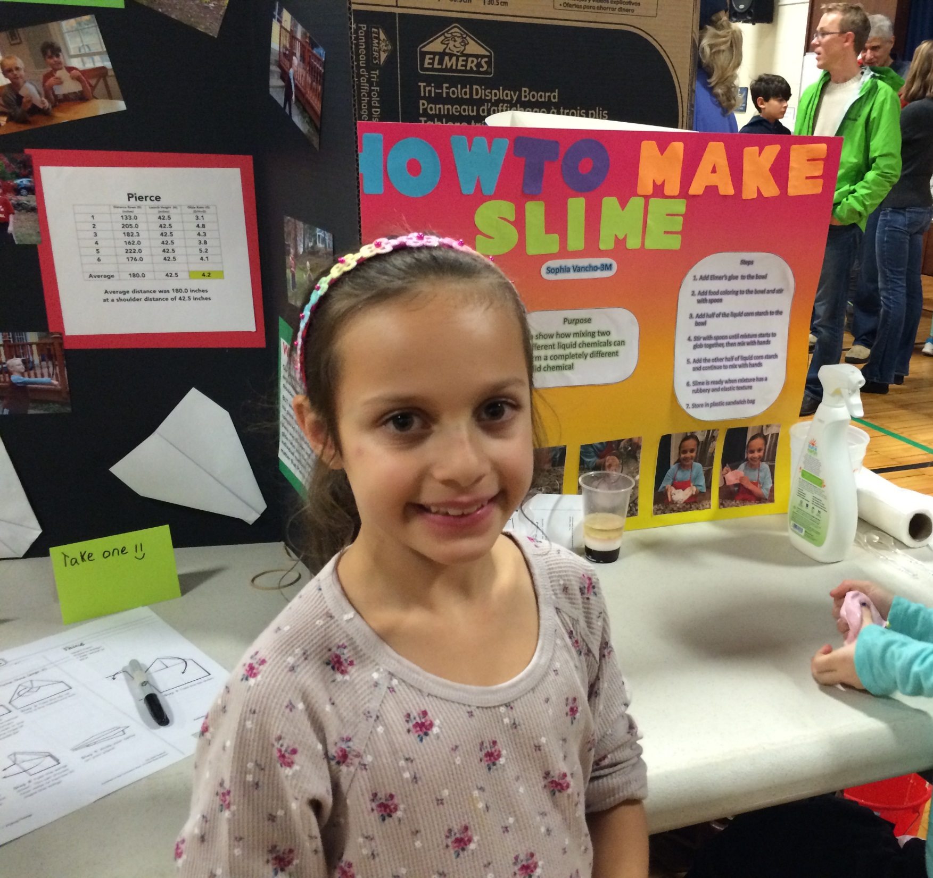

Slide 12
Parachutes
Question:
Which materials and design will produce a parachute that descends at the slowest rate possible?

Slide 13
Hypothesis and Materials
I think that …
Coffee filter, construction paper, washers, plastic, string, tape

Slide 14
Procedure
Build 4 parachutes
Each uses a washer and string 12 inches long
Each parachute is made from different material

Slide 15
Observations/Results
I dropped each parachute from 2 meters
When I timed each parachute I noticed…

Slide 16
Data
 | Drop Height (m) | Drop Time (s) | Velocity (m/s)
Test 1
Test 2
Test 3
Test 4
Average

Slide 17
What would you CHANGE?

Slide 18
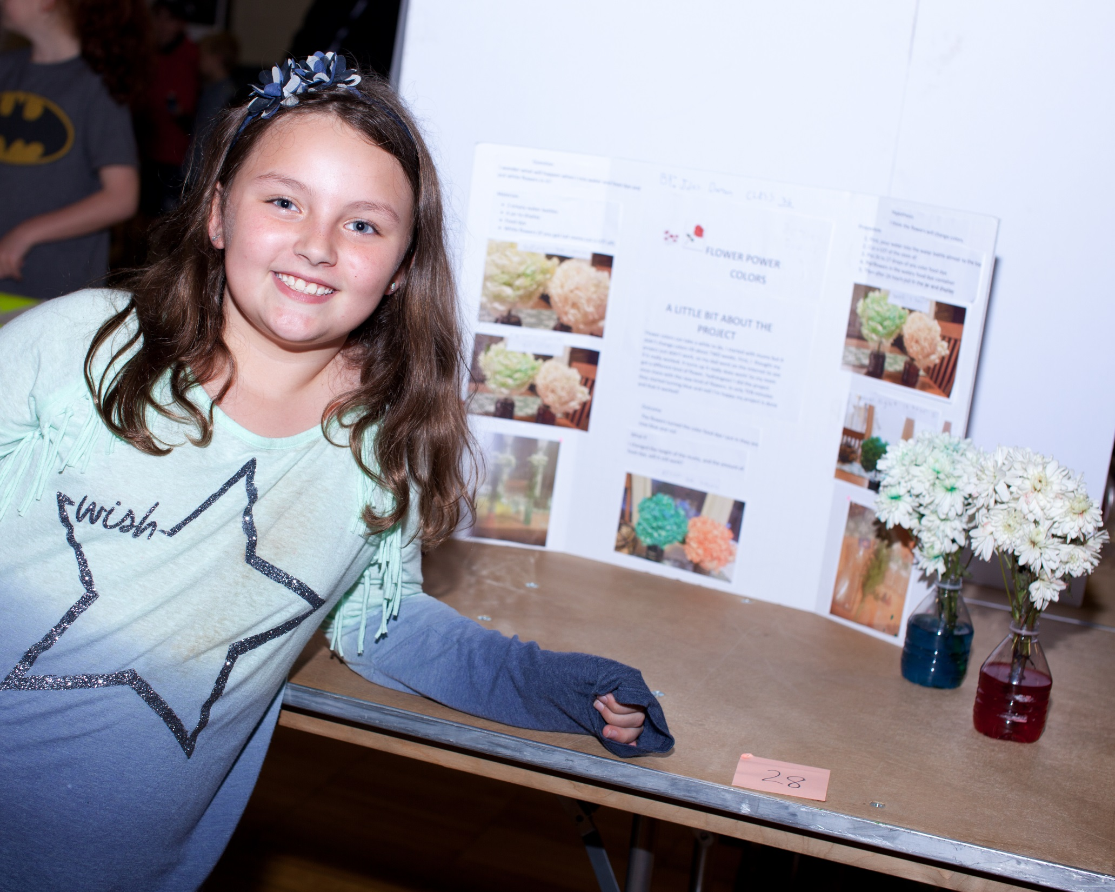
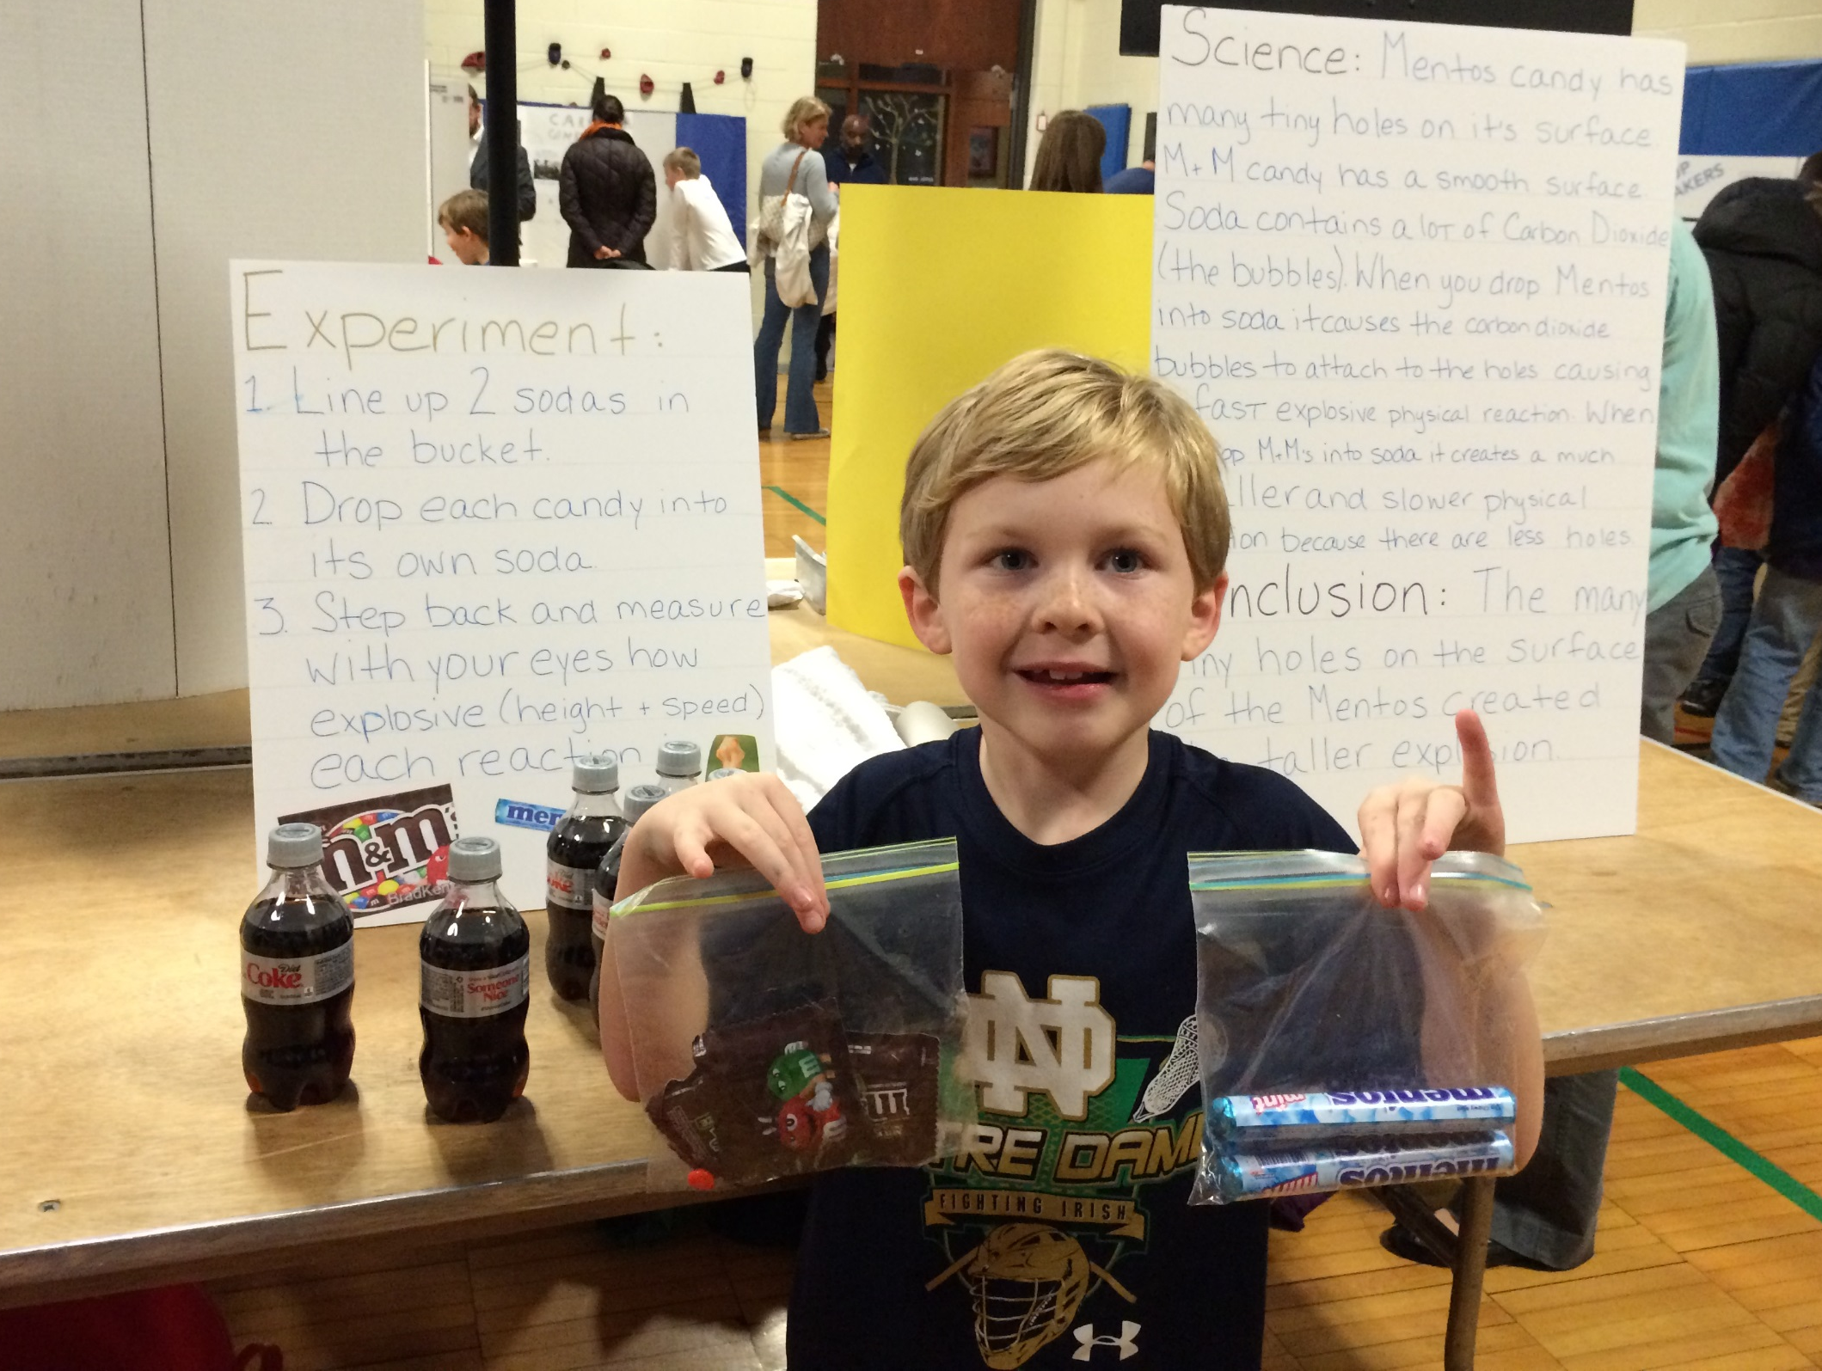
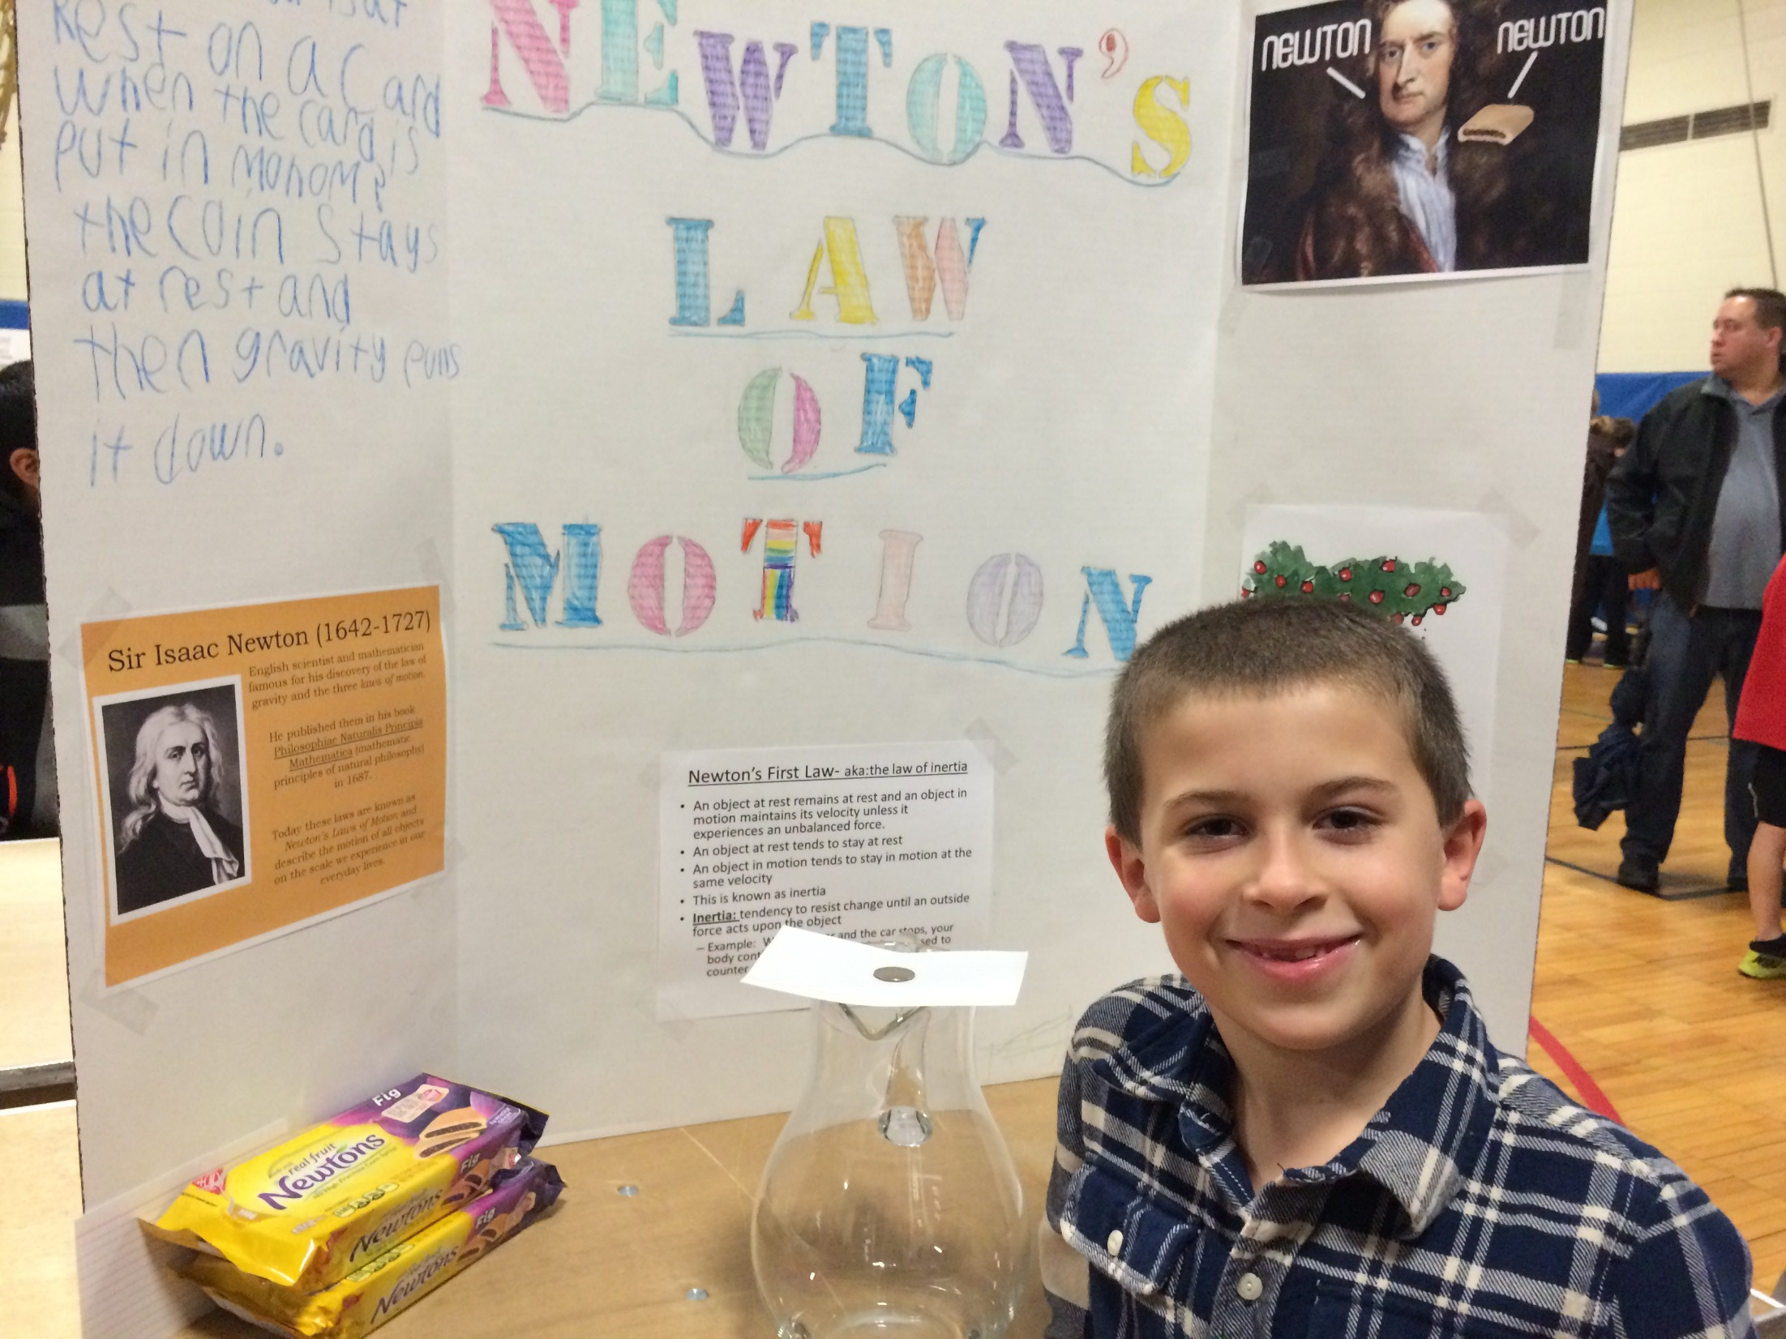
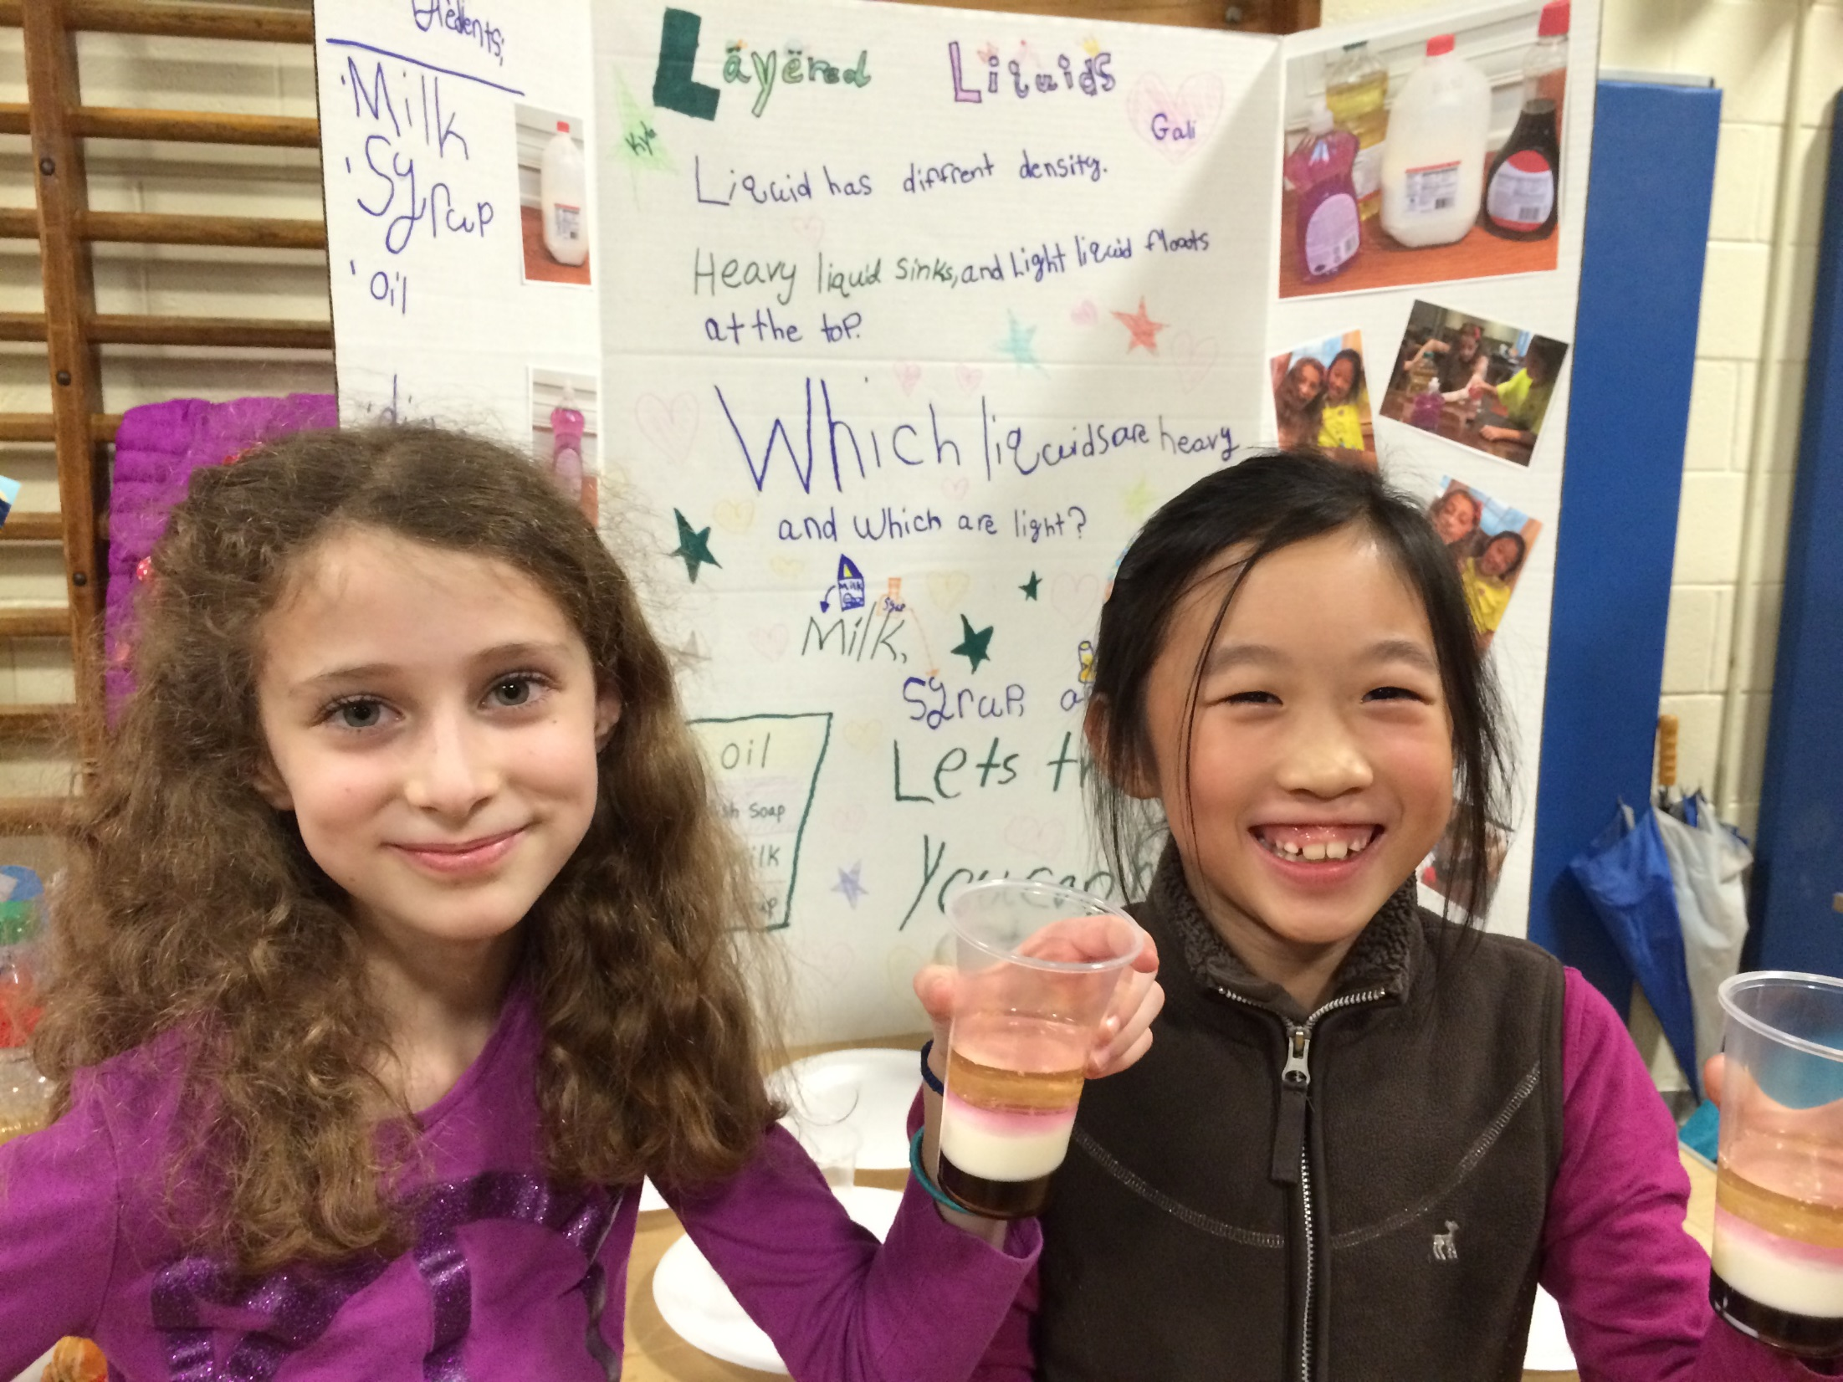

Slide 19
BE PART OF THE JENNINGS SCIENCE EXPO

