Slide 1
Jennings Math Engineering Night
Thursday, January 29th
6:30-8:00

Slide 2
Engineering
Is a creative endeavor
Involves problem solving
Combines objects in new ways
Produces new uses for objects
Invents things
Identify problems/needs and develop solutions

Slide 3
Some ways engineering touches our lives
Engineers design products such as televisions, computers, packages for food, can openers, windows, football helmets, heating systems…
Engineers design buildings, transportation systems, airports, tunnels, waste disposal systems…
Engineers create items like sticky notes and waterproof fabric to make our lives easier, but also work on large scale problems such as designing new medical technology to help the sick and efficient ways to use energy.

Slide 4
Engineers
Identify a problem
Explore different ideas
Try out possible solutions
Learn from mistakes
Continually improve a process or product.

Slide 5
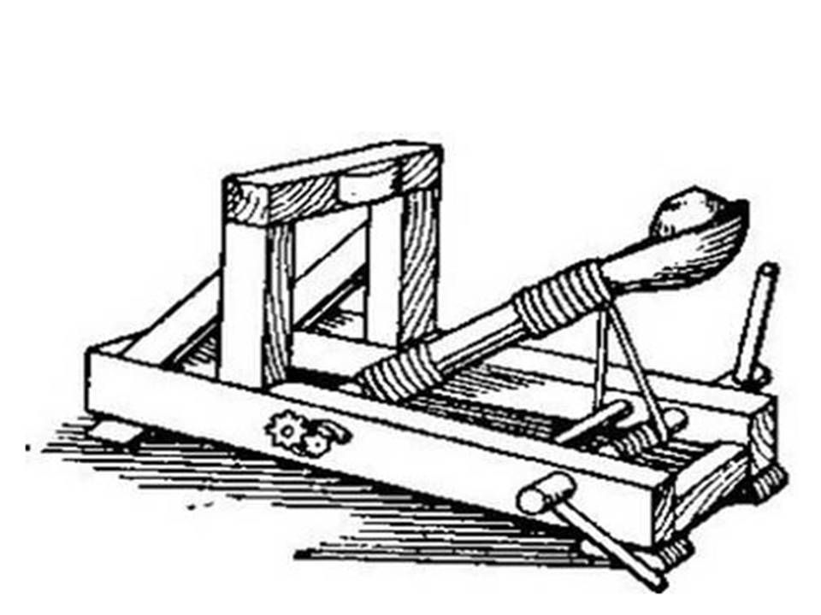
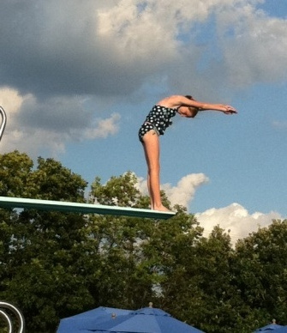
LAUNCHER
Today you and your team of engineers will create a launcher.

Slide 6
Engineering design process
Ask
Imagine
Plan
Create
Improve
Your Materials:
12 craft sticks
6 rubber bands
Plastic spoon
Cotton ball

Slide 7
Have Fun!

