Slide 1




Welcome to
Jennings Elementary School
“The Journey Begins Here”

Slide 2

Happy Birthday to…
Oct 20th Gabriella Rodriquez
Oct 21st Sydney Mieczkowski,
Chloe McDonald
Oct 22nd Connor & Lucas Silverfarb
Oct 24th Shane Hillis
Oct 25th Ms. Garavel

Slide 3

Lunch This Week
Monday Chicken nuggets
Tuesday Pasta with meat sauce
Wednesday Macaroni & cheese
Thursday Soft turkey taco
Friday Pizza wedge
Daily Alternatives
Ham & Cheese sandwich
Tossed garden salad plate
Bagel & yogurt plate

Slide 4


Saturday, Oct 25 11am – 2pm

Slide 5
This Week’s Events
Tricky Tray Tickets on sale Wed, Thurs & Friday
“A” Monday ATB American Girl & Legos
“B” Tuesday Grade 4 Orchestra at 8:00am
ATB Golf
Grade 3 Brownies
“C” Wednesday ATB Running at 8:00am
ATB FishKids, Garden & Soccer
“D” Thursday Early dismissal at 1:40pm for evening conferences
ATB Halloween cookie decorating
Evening conferences 6:00-8:00pm
“E” Friday Grade 5 Band & Orchestra at 8:00am
Grade 2 trip to Fairfield Historical Society 9:00am
Life Safety Trailer 3Ax 11am, 3G 12:30, 3M 1:15p
ATB Tennis
Saturday Jennings Spooktacular 11:00am – 2:00pm

Slide 6


Character Education Extended
October’s Theme
Making the World a Better Place

Slide 7


All It Takes is One

Slide 8

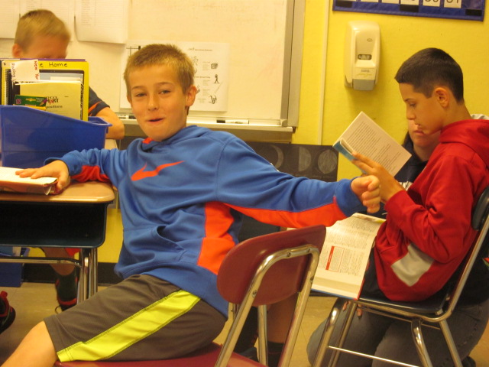
Friendship
Our friends mean the world to us!
Make sure to choose ones that make you a better person.

Slide 9
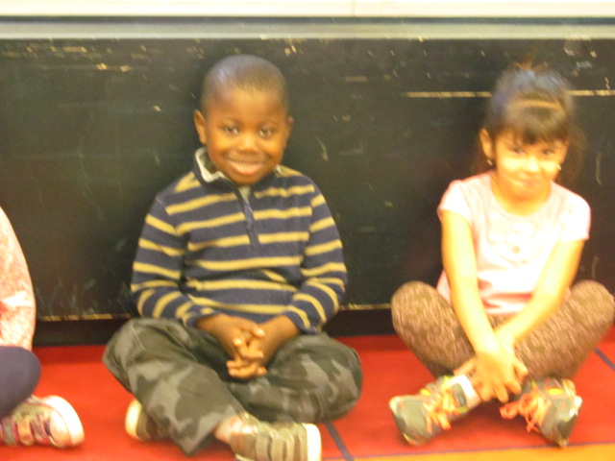
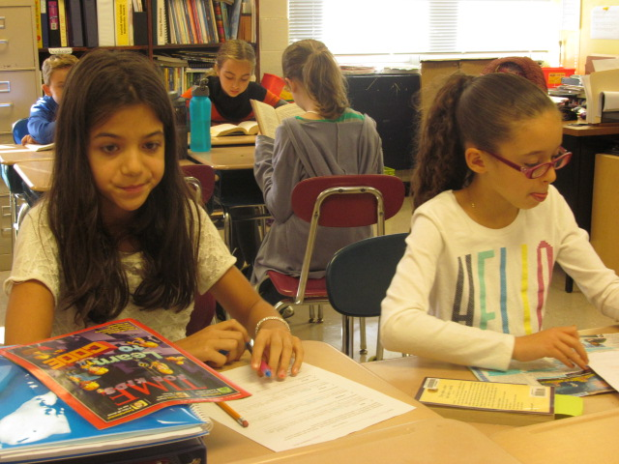
We Show CARES Everyday

Slide 10
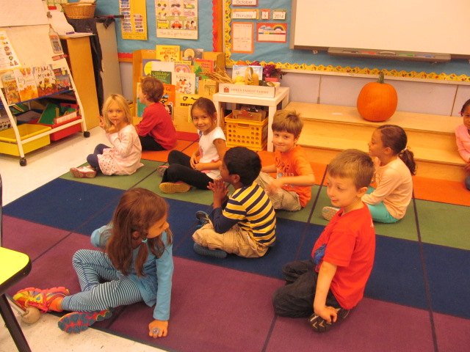
CARES = Cooperation
Jennings students cooperate by listening to the directions given by adults.

Slide 11
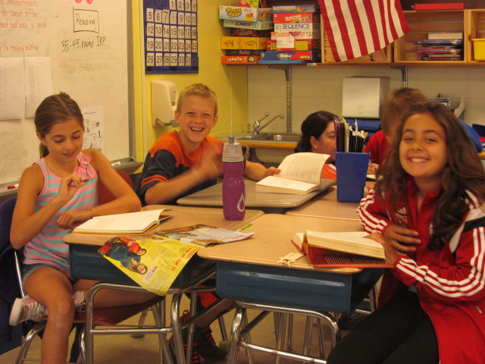
CARES = Assertion
Jennings students are assertive when standing up for friends.

Slide 12
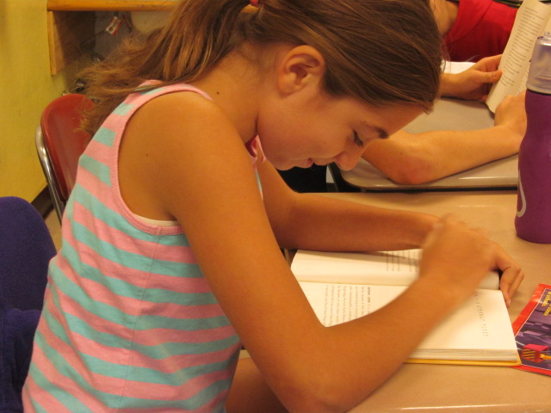
CARES = Responsible
Jennings students are responsible when they remember to do their homework.

Slide 13
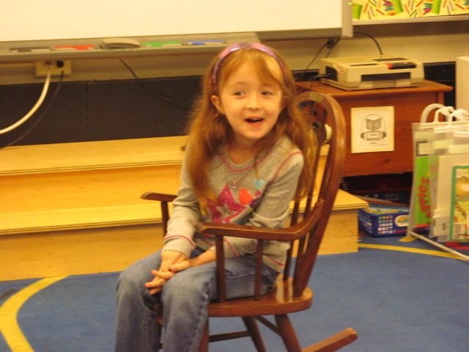
CARES = Empathy
Jennings students show empathy while including all friends in at recess.

Slide 14
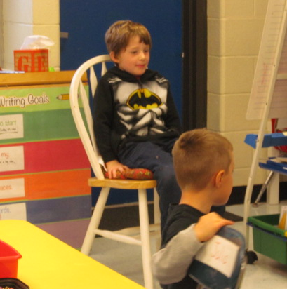
CARES = Self Control
Jennings students show self control while concentrating in class.

Slide 15
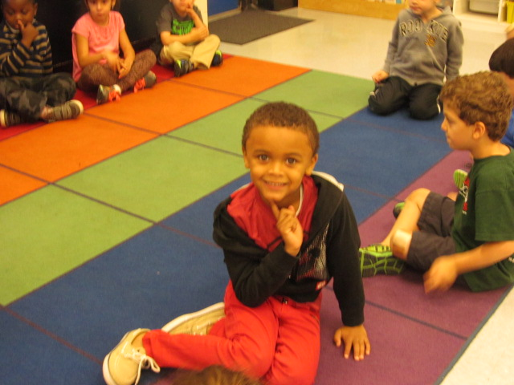

Kindness
Friends are there to help you when you need it. They also put a smile on your face!

Slide 16

Jennings School
Work Hard and Have a Great Day!

