Slide 1
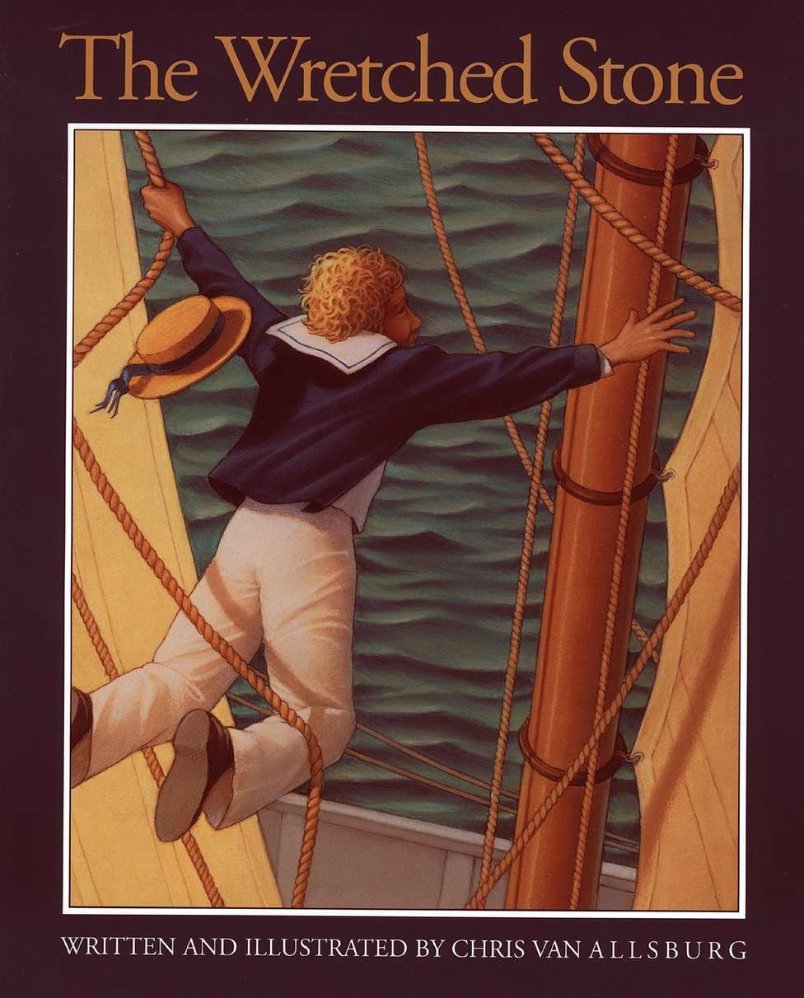

Slide 2
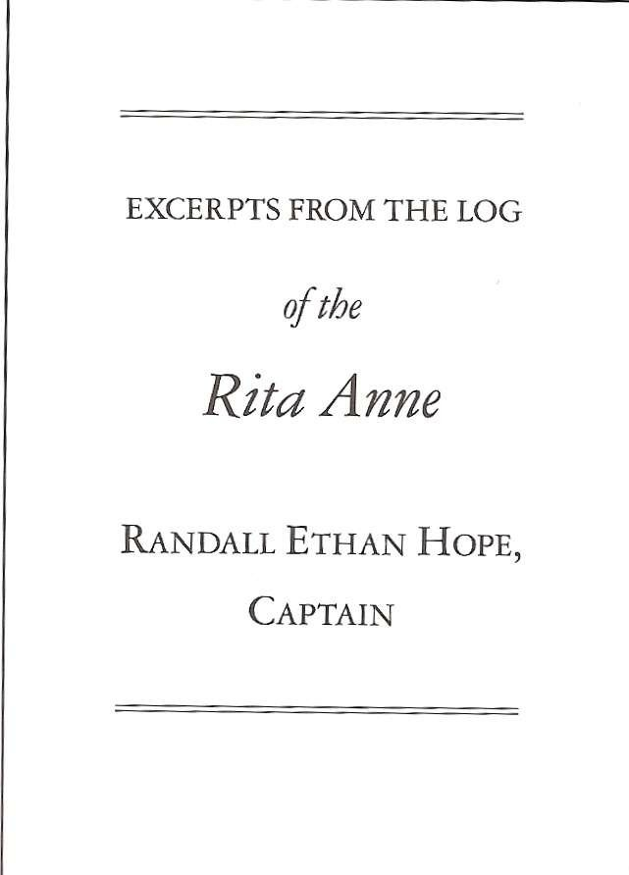

Slide 3
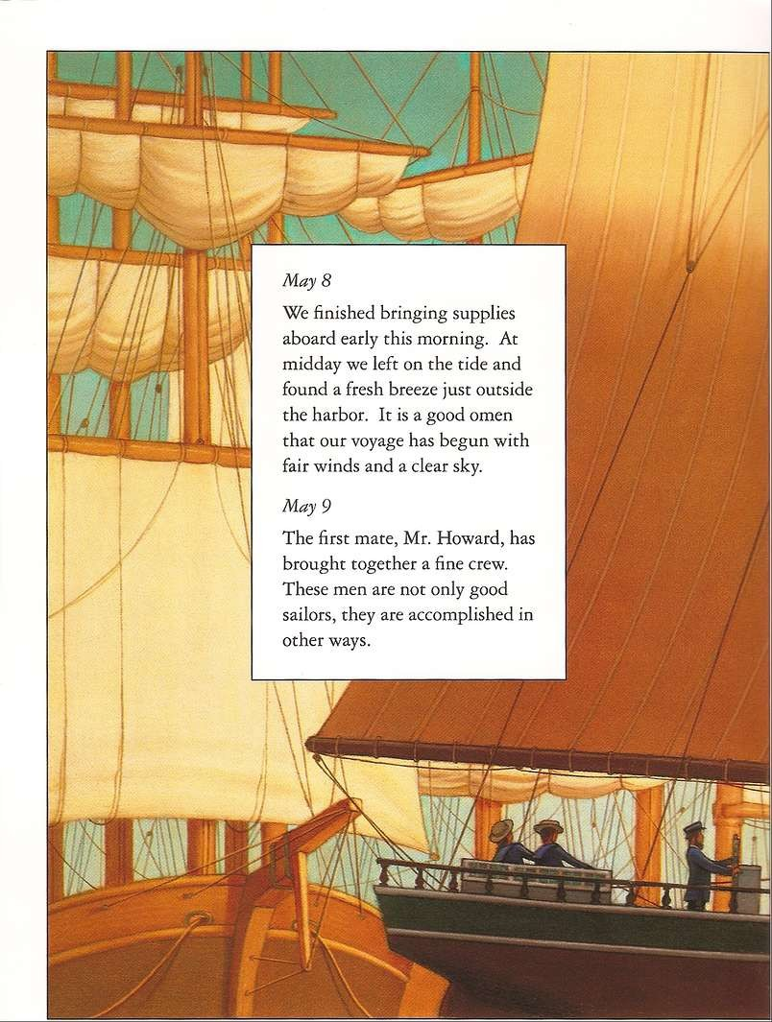

Slide 4
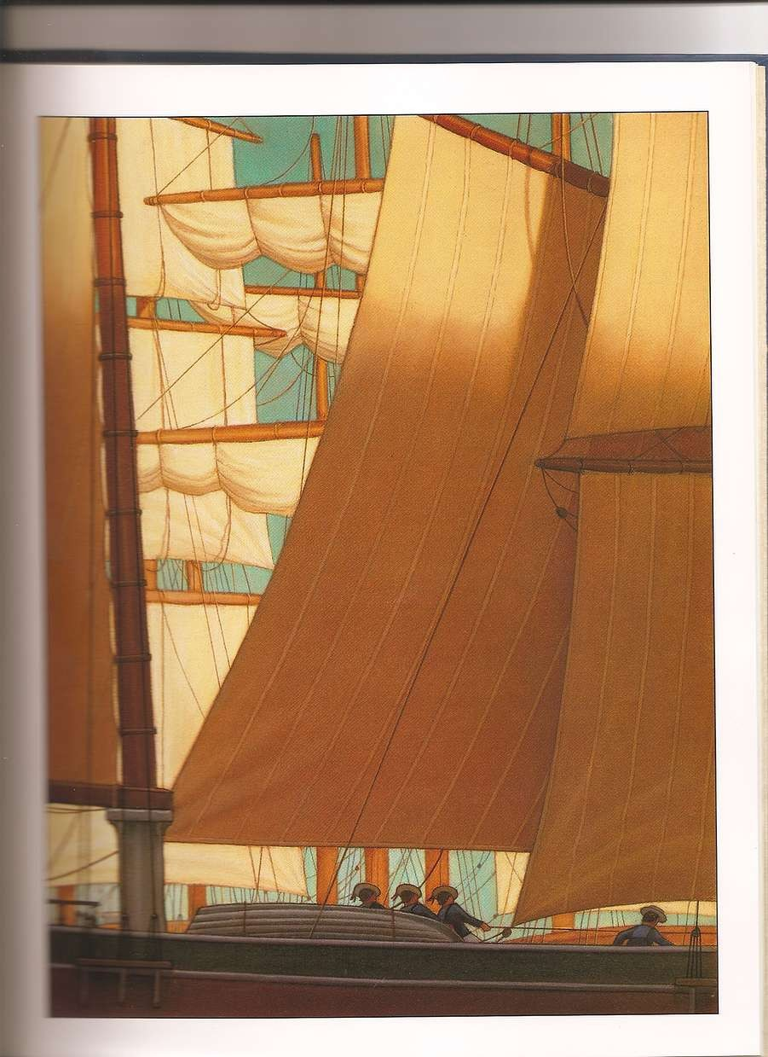

Slide 5
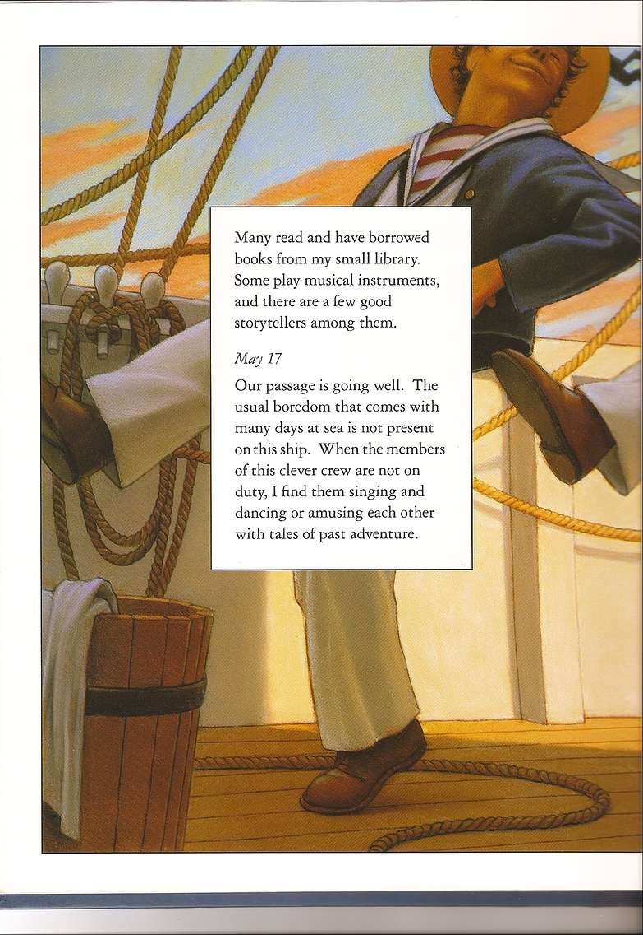

Slide 6
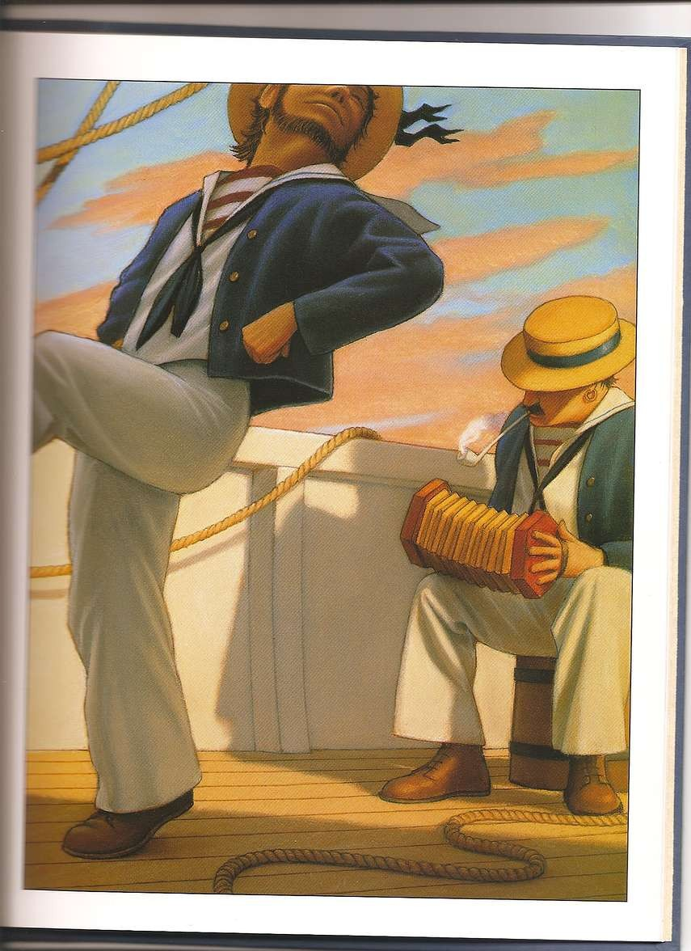

Slide 7
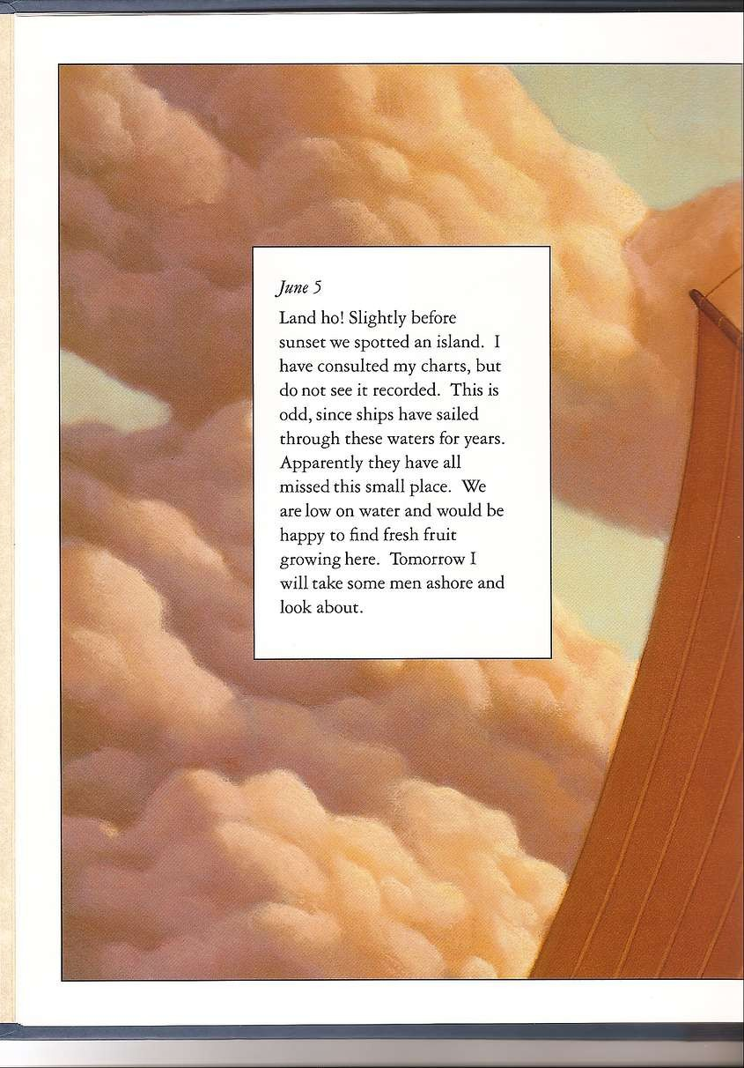

Slide 8
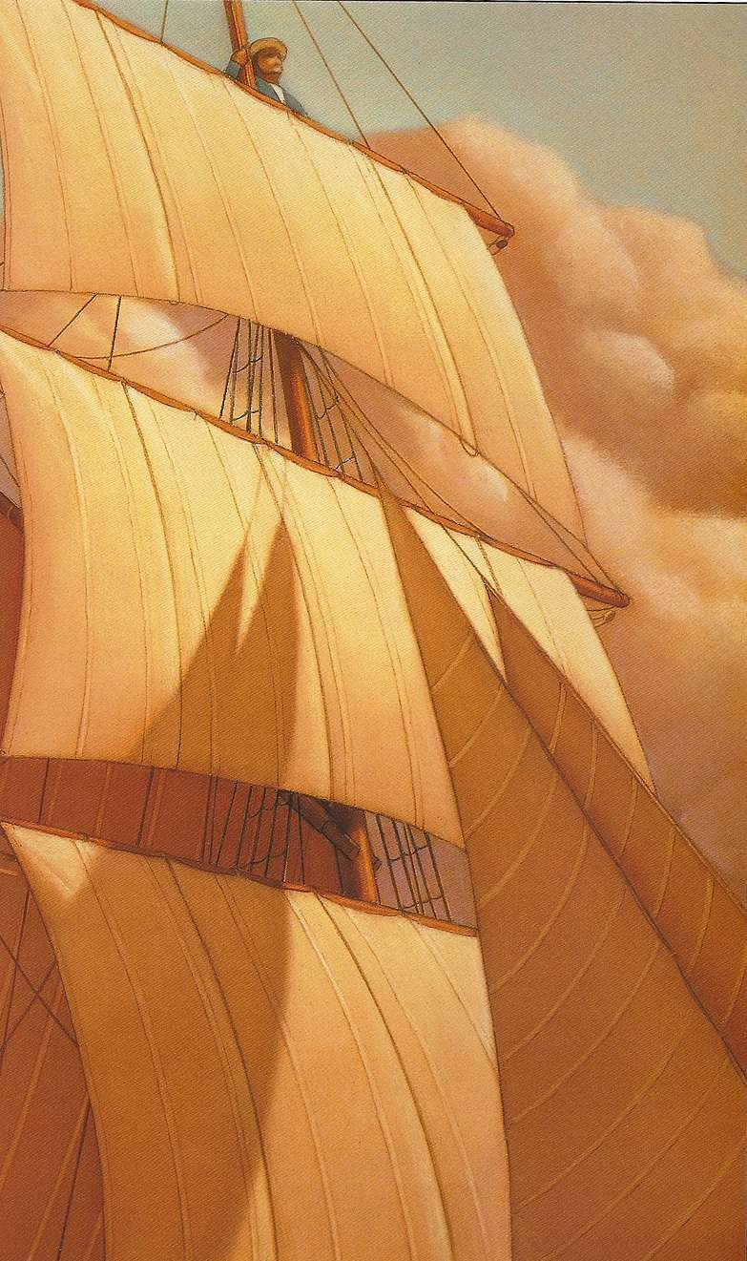

Slide 9
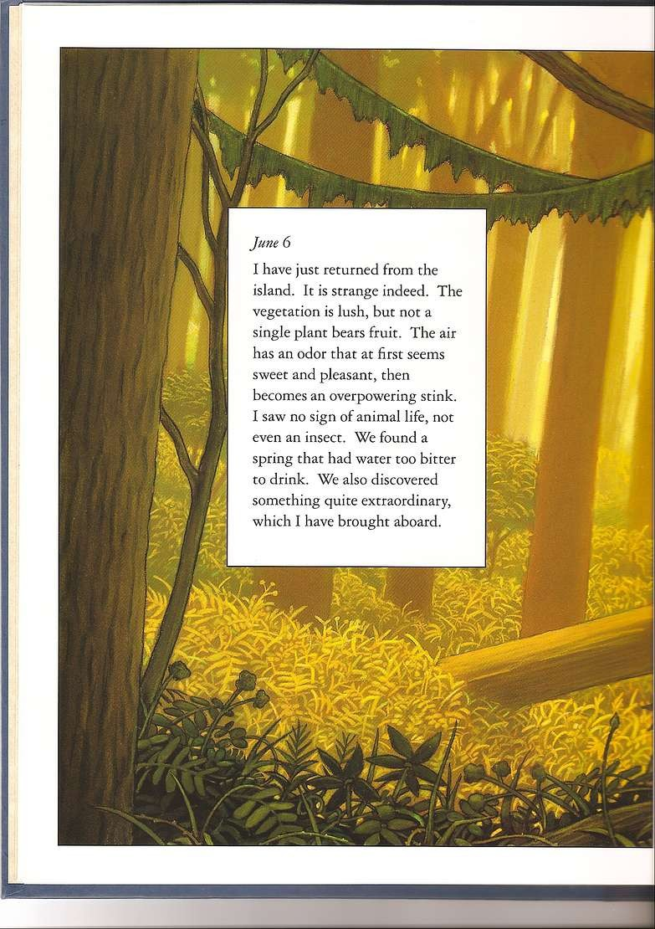

Slide 10
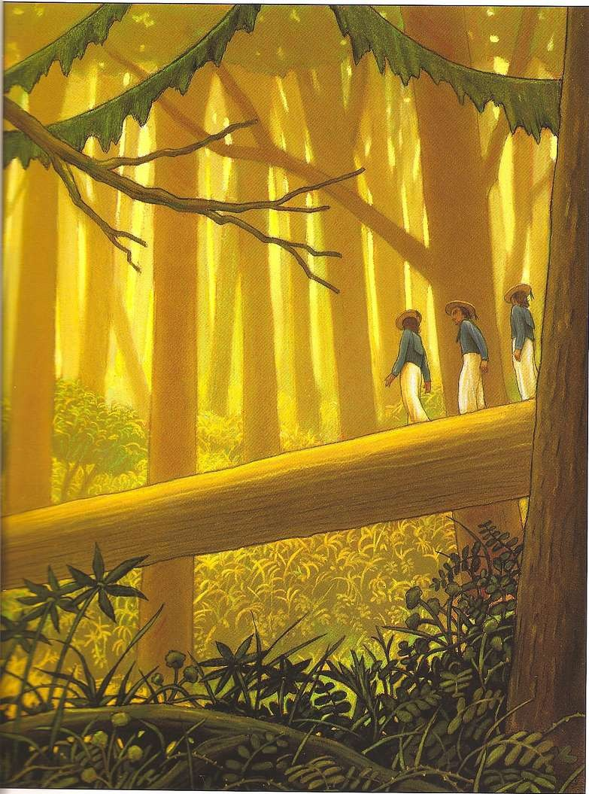

Slide 11
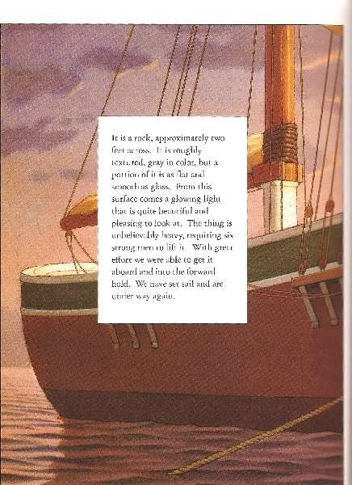

Slide 12
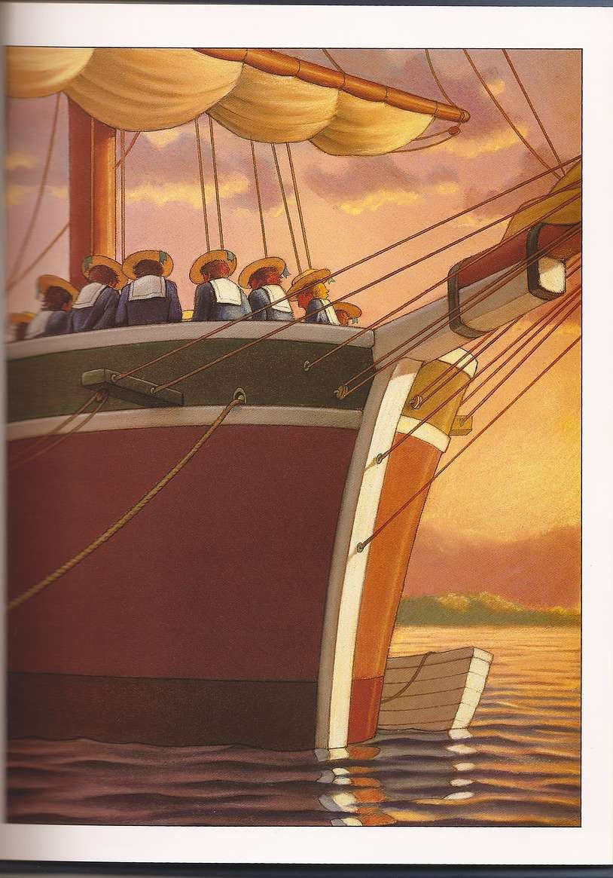

Slide 13
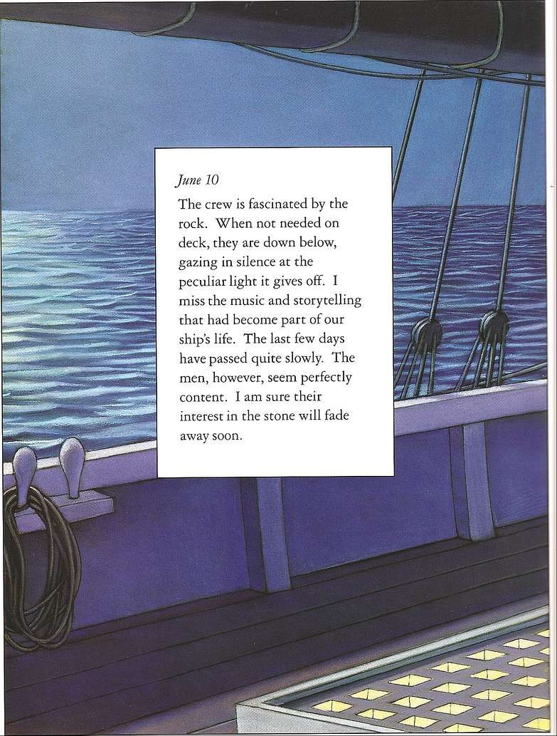

Slide 14
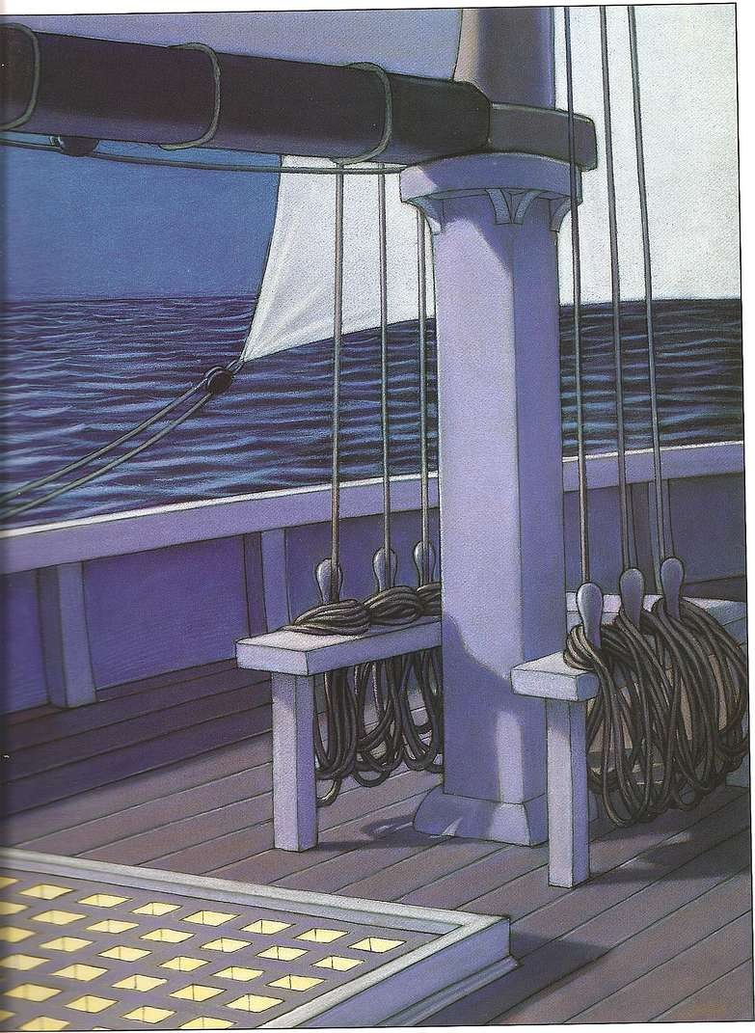

Slide 15
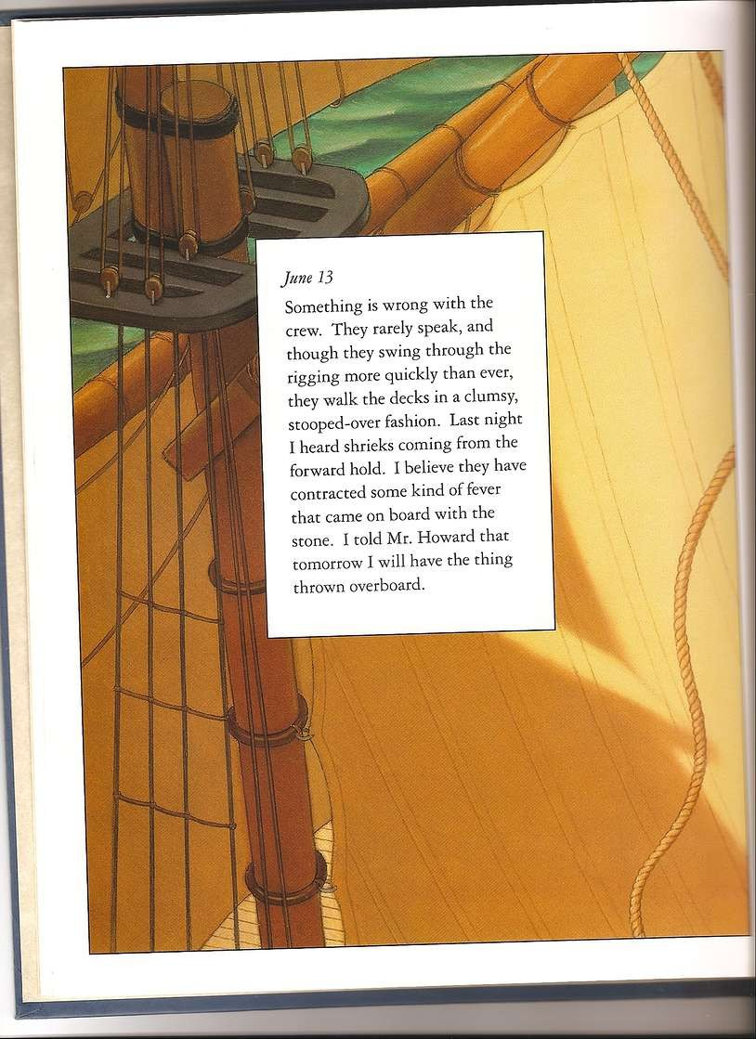

Slide 16
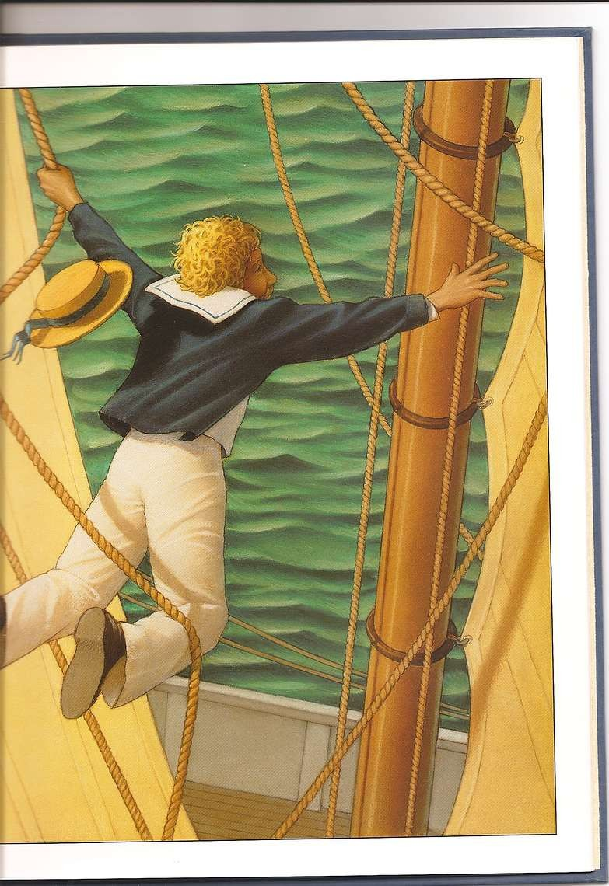

Slide 17
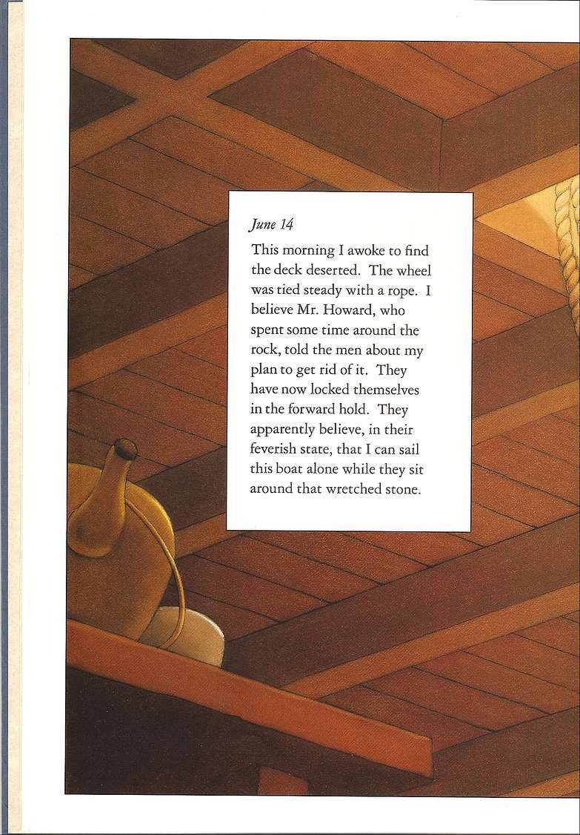

Slide 18
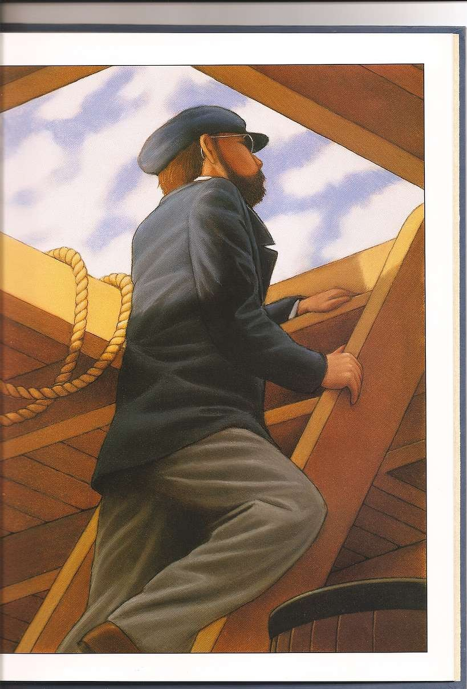

Slide 19
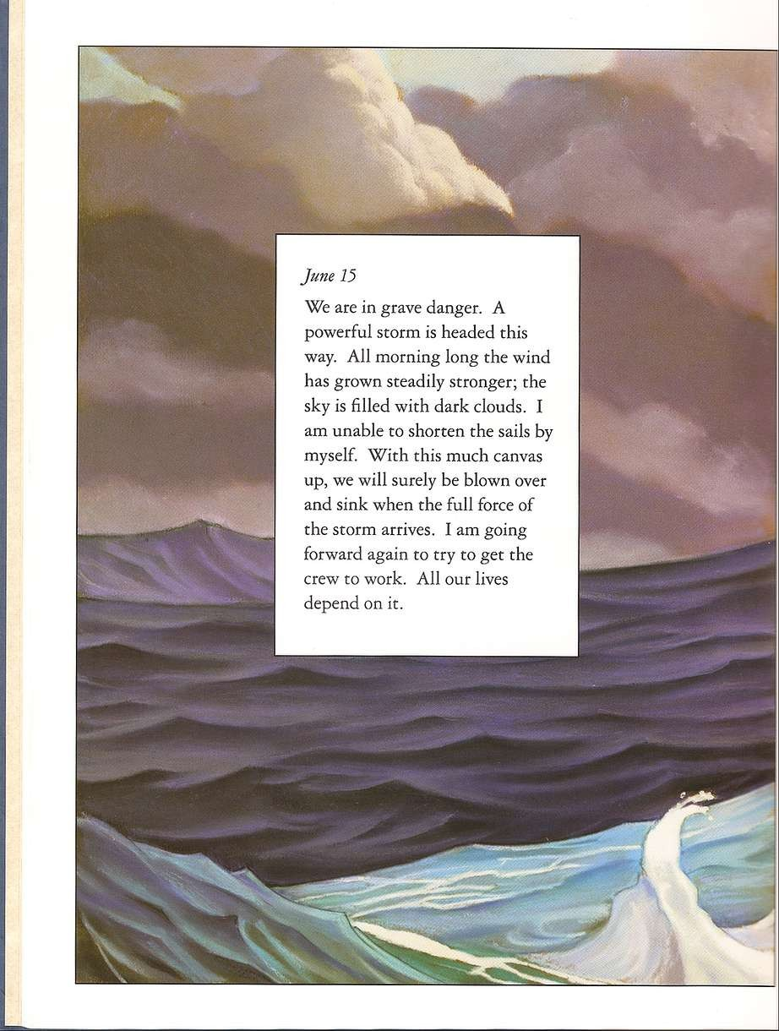

Slide 20
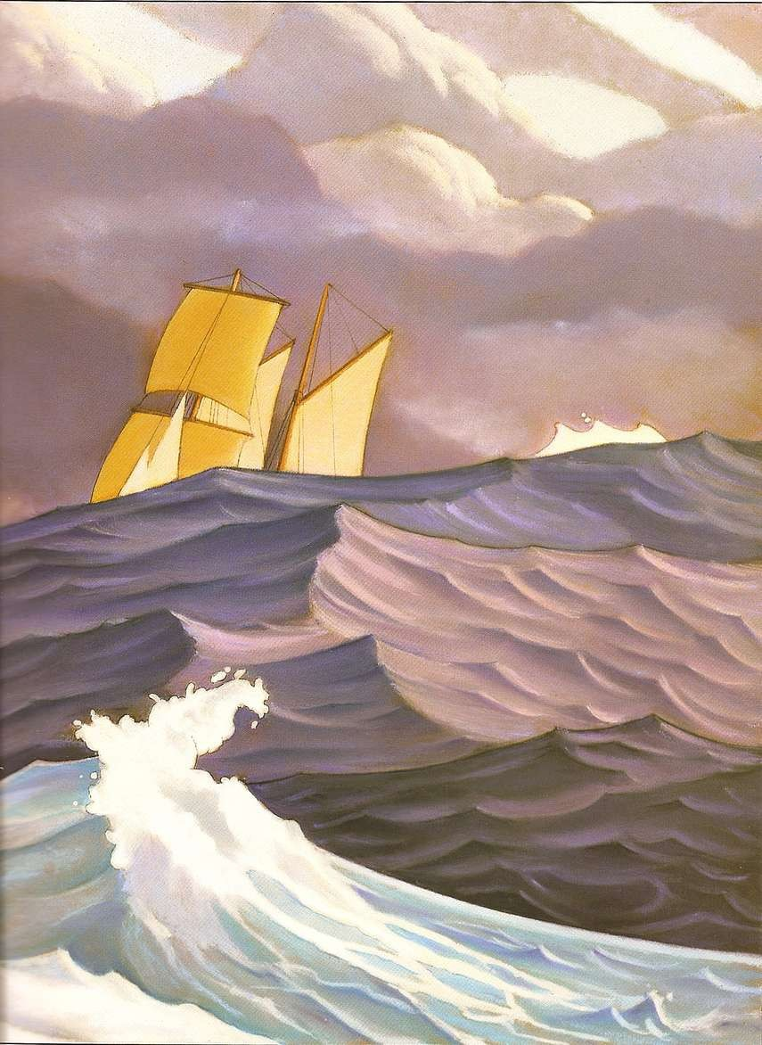

Slide 21

Th is is, I am sure, my last entry. What Ihave just seen is so horrifying Ibarely have rhe strength to write it down. After
Ipounded at the door ro the forward hold, it finally swung open. Bue it was nor a man who opened the door, it was an ape. The whole crew has curned into hairy beasts. They just sac there, grinning at that terrible rock.
They don't understand a word I
say. We are doomed .

Slide 22
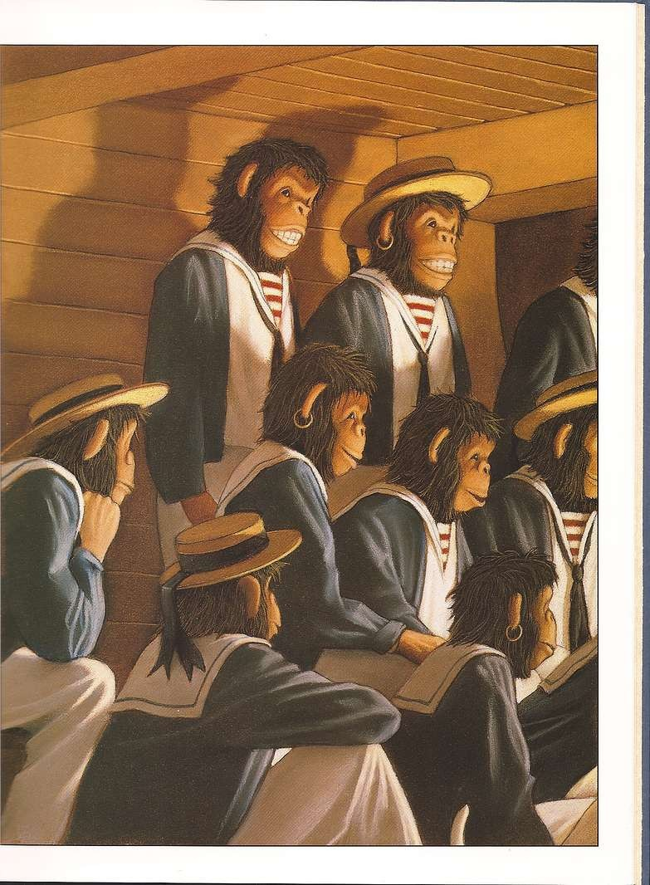

Slide 23

June 16
The storm has passed. The Rita Anne is still afloat, but both masts and rudder are lost. The scone has gone dark. We were struck by lightning twice during the storm. I believe that was the cause. Unfortunately, the crew is unchanged. They are still
beasts, but seem sad and lost
without the glowing rock. I have moved them back co their quarters. We have food for two weeks. I am hopeful of a rescue.

Slide 24
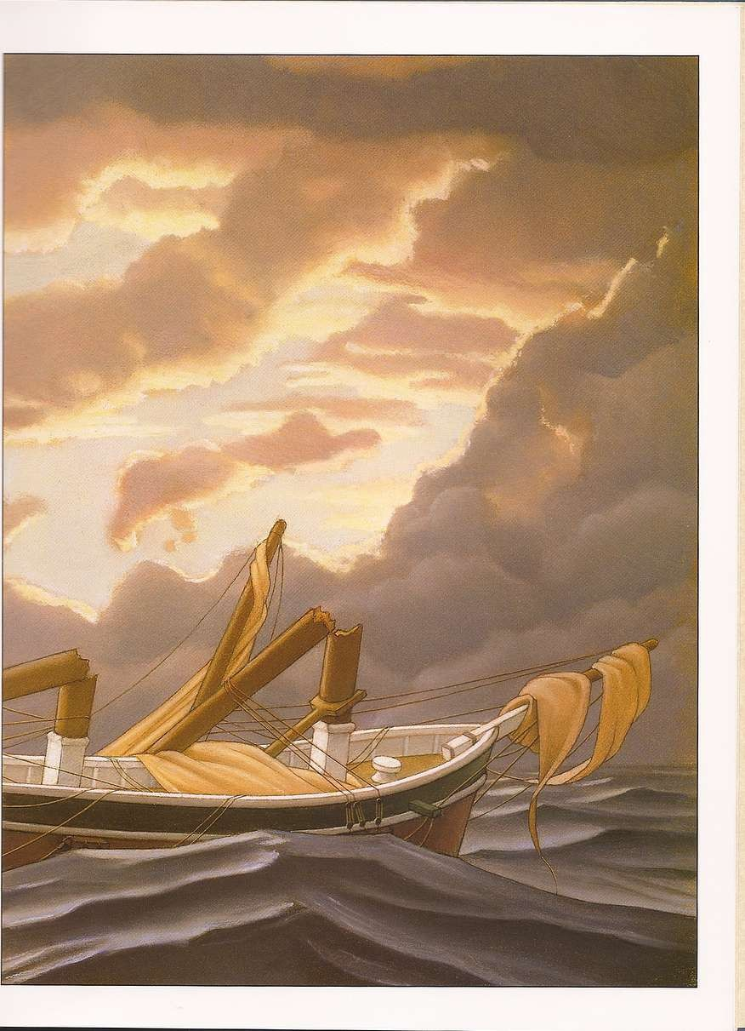

Slide 25
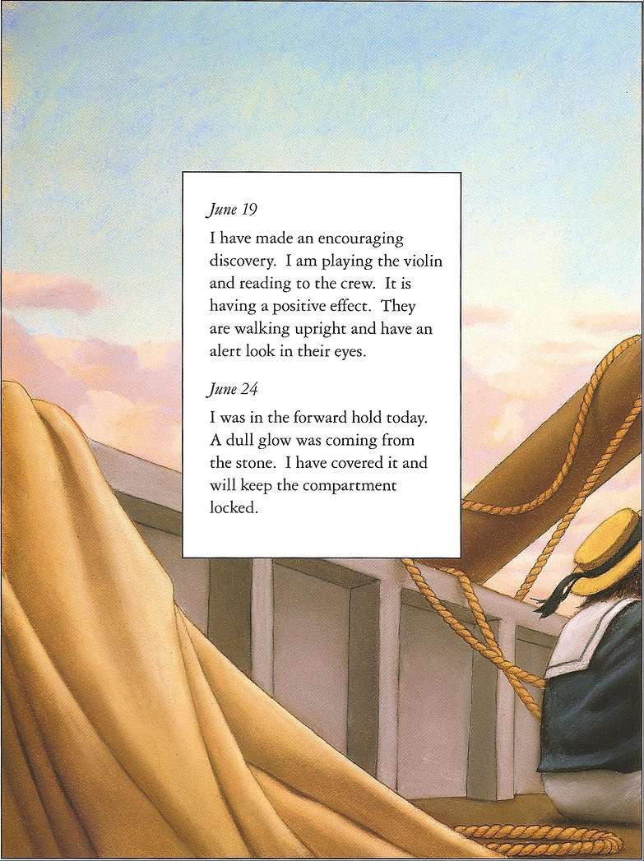

Slide 26
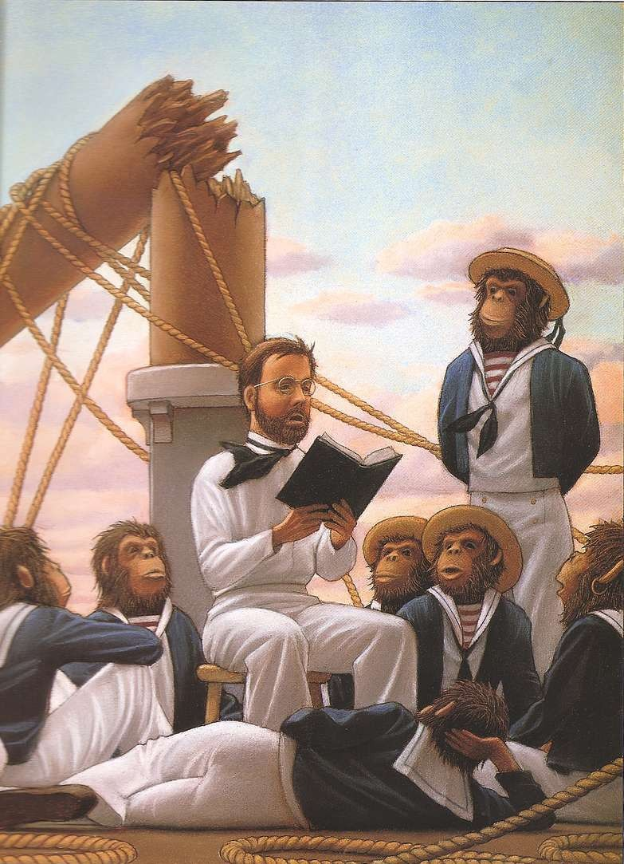

Slide 27
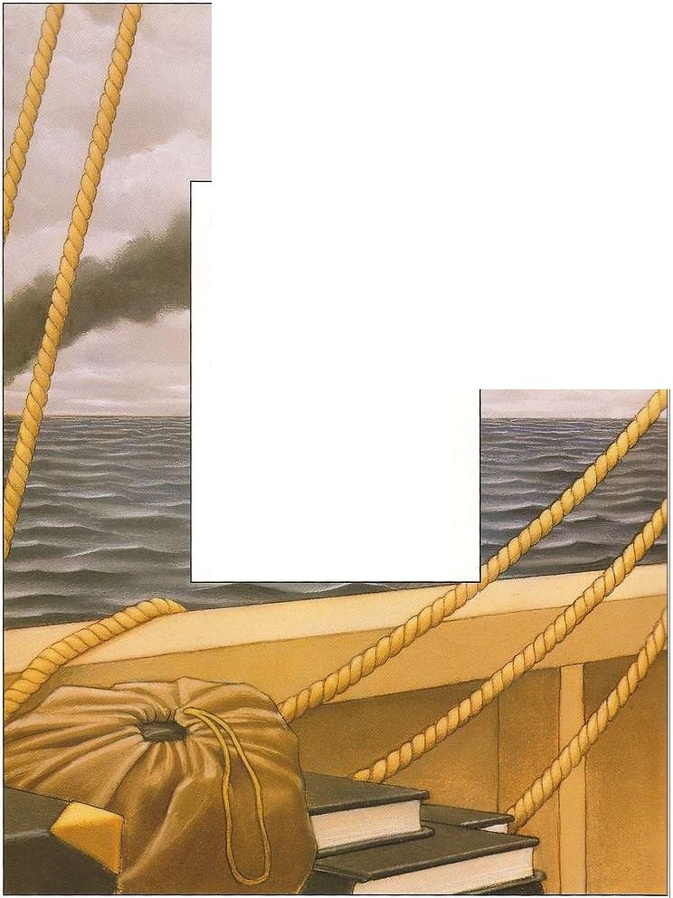
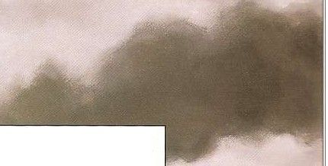
June 28
I am happy to report that che men have returned co normal. Ic seems chat those who knew how to read recovered most quickly.
}ttne 30
We are saved! A ship has been spotted off our starboard side. I have decided co scuttle che Rita Anne. There is only one place for the wretched scone. Before we abandon ship, I will sec a fire chat will send this vessel and her cargo co che bottom of che sea.

Slide 28
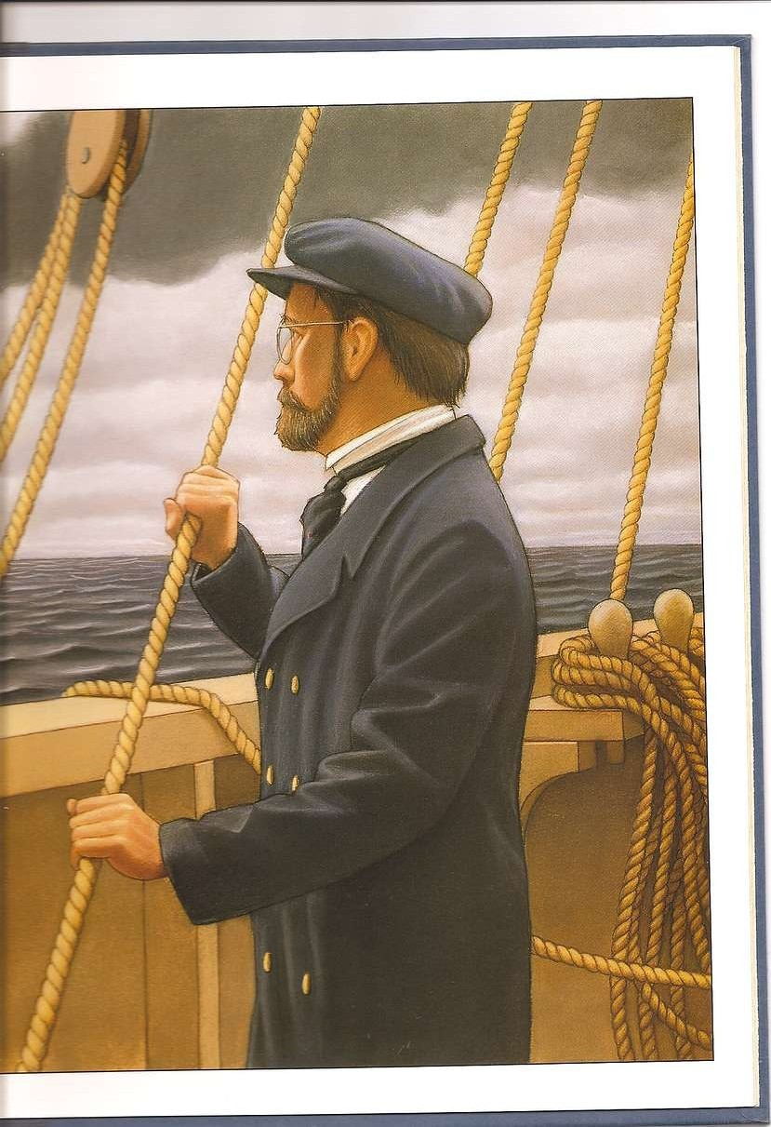

Slide 29
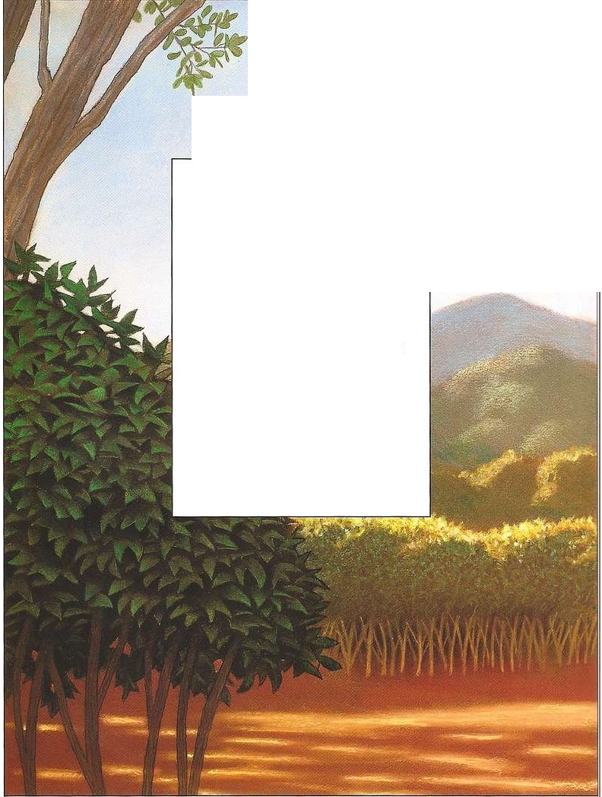
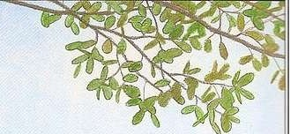
July 12
Our rescuers have left us in the harbor town of Santa Pango.
One by one the crew should be able to sign on to ships passing
through and work their way home. We have made an
agreement not to talk about the strange events that took place aboard the Rita Anne. The
men appear co have recovered completely, though some
show an unnatural appetite for the fruit that is available here.

Slide 30
