Slide 1
Jennings Elementary School
Welcome to
The Journey Begins Here

Slide 2
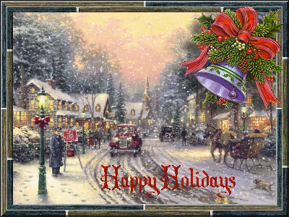
Lunch This Week
Monday Cheese stuffed breadsticks
Tuesday Pancakes
Wednesday Mac & cheese
Daily Alternatives Hummus Platter Tossed garden salad plate Bagel & yogurt plate

Slide 3
This Week’s Events
“A” Monday ATB FishKids 8:00am ATB Chess & Prof. Egghead 3:30pm
“B” Tuesday Grade 4 Orchestra 8:00am ATB Hula Hoop & Scrapbooking 3:30pm
“C” Wednesday Report cards available on Infinite Campus Holiday Sing-a-long 1:30pm ATB Floor Hockey 3:30pm

Slide 4
Persevere! Where is the snow? Where is the snow? Where is the snow?

Slide 5
Friendship
Our friends mean the world to us! Make sure to choose ones that make you a better person.

Slide 6
Wednesday is Christmas
Christmas is a joyous celebration of the birth of Jesus Christ and a widely observed holiday celebrated on December 25 by millions of people around the world. Jesus is believed to have been born 2015 years ago in Bethlehem.

Slide 7
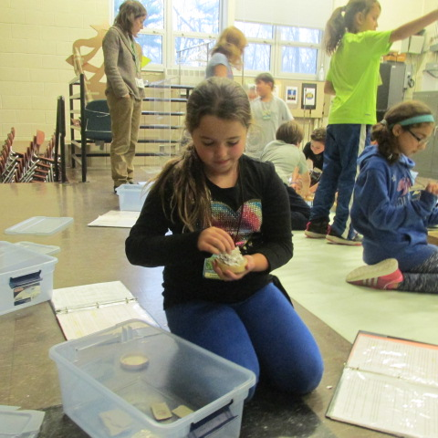
We Show CARES Everyday

Slide 8
CARES = Cold
Will it be cold enough to snow and build a snowman soon?

Slide 9
CARES = Awake
Will you stay awake to welcome the new year on Dec 31st at midnight?

Slide 10
CARES = Restful
Have a restful Winter Break and be ready to go strong again on January 4th.

Slide 11
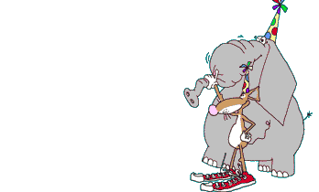
CARES = Energized
Jennings students are energized by making others feel better.

Slide 12
CARES = Sledding
When will it snow? We want to go sledding this winter.

Slide 13
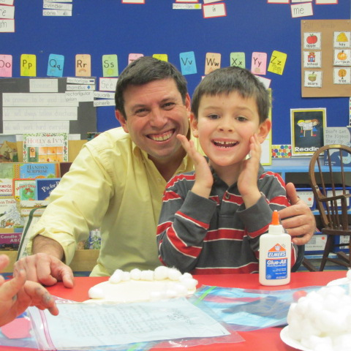
Kindness
Friends are there to help you when you need it. They also put a smile on your face!

Slide 14
As gentle as a snowflake, may peace come to your heart.
Japanese proverb
Wishing the Jennings community peace and joy for the holidays and the coming year.

Slide 15
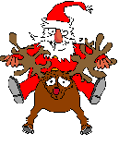
Jennings School
Work hard and have a great day!

