Slide 1
100s of millions of websites
Search Engine
Internet
Web Browser
Internet Search Engine
Web Browser
Notes:
Before we begin, you need to understand what you are doing.
What is the internet.
100s millions of websites all connected through a network
If you needed information, how long would it take to search 800 million websites.
Way too long.
So we have search engines that are programmed to do that in seconds.

Slide 2
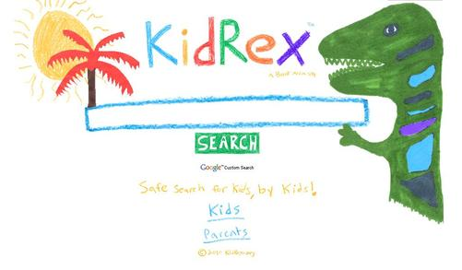
How do we use a Search Engine?
Keywords……

Slide 3
Keywords……

Slide 4
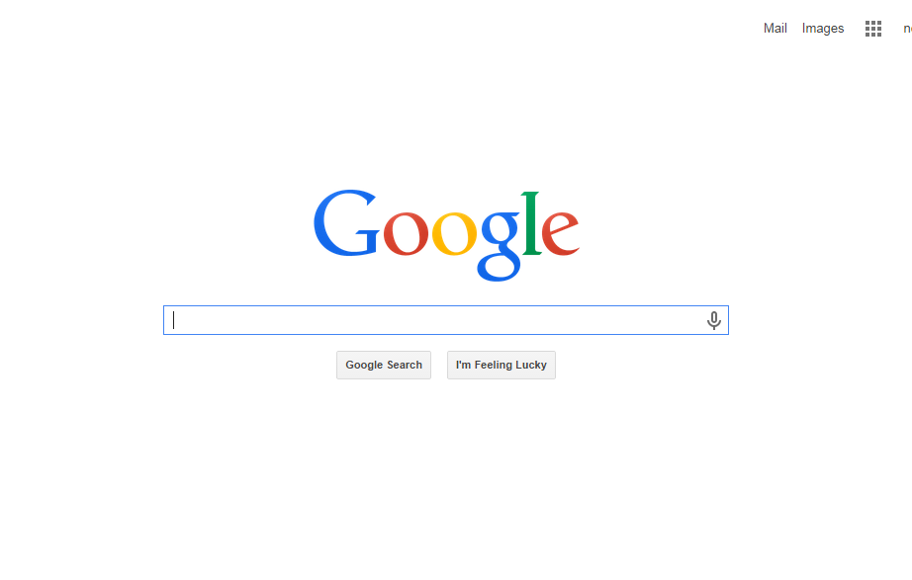
Keywords……

Slide 5
Where do keywords come from?
Keywords come from your question!
How do gardeners grow purple, pink and blue hydrangea flowers?
What are the keywords?
What do you really need to know?

Slide 6
Four keyword strategies
1. Combining keywords
Who invented the television?
2. Eliminating keywords
Get rid of words that are not necessary
3. Synonyms
Japanese outfits
4. Refining your search
Adding words to be more specific – let’s see.

Slide 7
More Keywords Solving Problems
Your friend is Chinese-American and has invited you to celebrate the Chinese New Year with her family.
You have a lot to learn!
Do you bring a gift?
What food do you eat?
What color means good luck?
What does the dragon mean?
Notes:
Try each one in KidRex
See the differences in the Search Results

Slide 8
Practice Using Keywords in KidRex
(complete handout and hand in to Mrs. Callahan)
Notes:
2nd lesson
What did we learn last time?
Spend the whole period doing the attached handout using keyword searches in KidRex.

