Slide 1
More than 200 frog species have
become extinct since the 1970's.

Slide 2
People
destroy
frog habitats
for building.

Slide 3
Trees are
cut down
destroying
habitats and
changing
food webs.

Slide 4
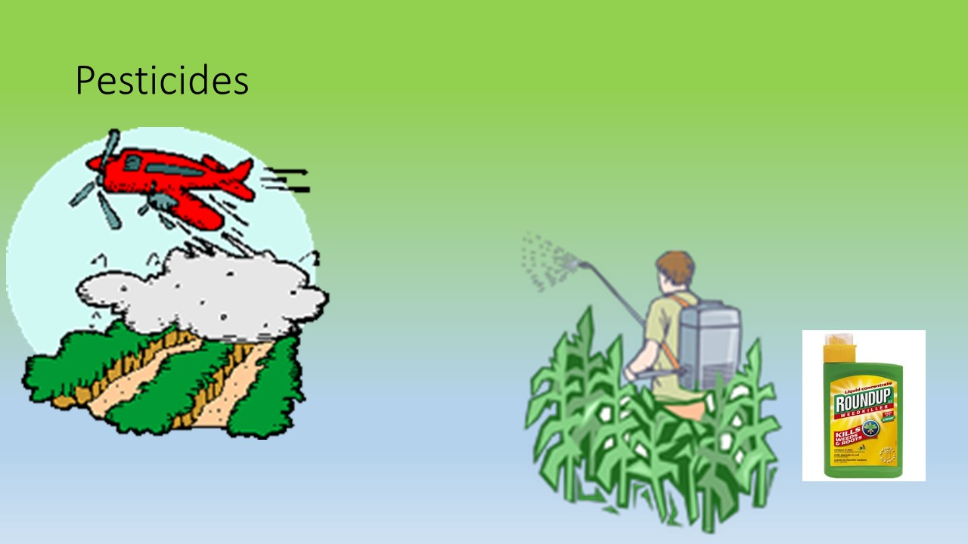
Chemicals are used to kill insects that bother people and plants. Frogs can be harmed by the chemical and have less insects to eat.

Slide 5
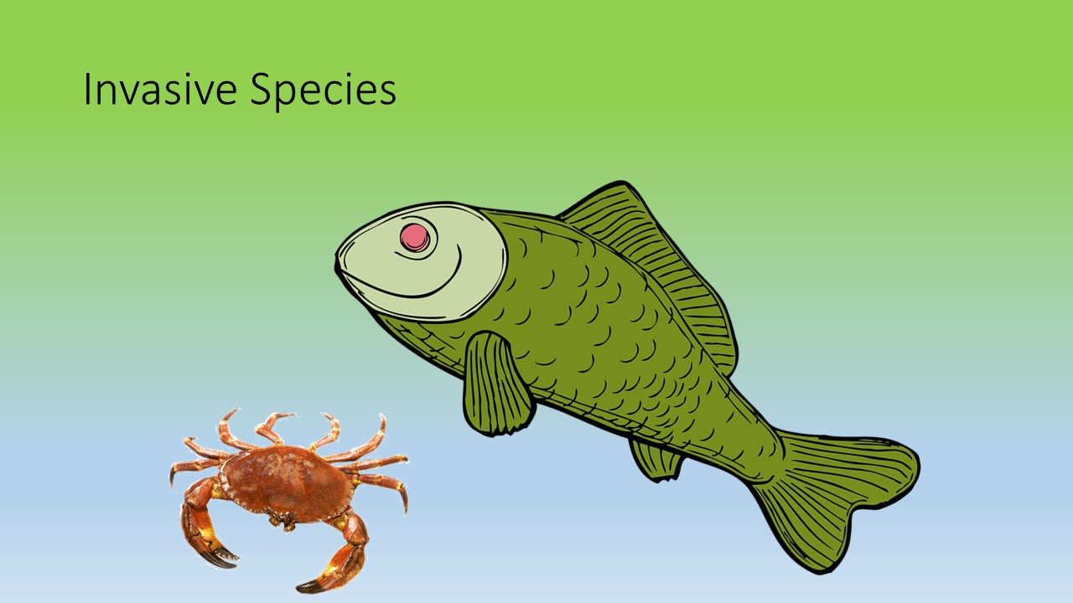
Animals that are brought into
the frog's habitat by people.
They eat the frogs or the frog's food.

Slide 6
What can we do to help save frogs?
Keep frog habitats safe
Stop cutting down trees
Don't use pesticides
Never release animals into a frog's habitat if they don't belong there

