Slide 1
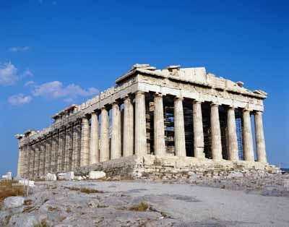
Ancient Greece

Slide 2
8-1 Mountains and Seas
What to Know: How did geography influence the development of early civilizations in Greece?
Vocabulary
Peninsula: A stretch of land almost completely surrounded by water
Isthmus: A small strip of land connecting larger land areas

Slide 3
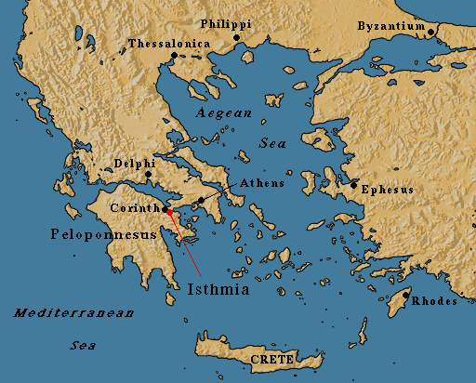
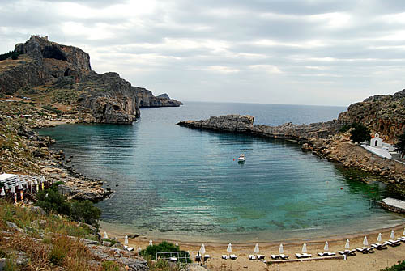
Harbor: A sheltered place with deep water close to shore

Slide 4
The Land of Greece
Located on the Balkan Peninsula
Surrounded by Ionian, Mediterranean, and Aegean Sea
Asia Minor now referred to as Turkey
An isthmus connects the peninsula with southern peninsula
Southern area of peninsula is called the Peloponnesus
¾ is covered in mountains
Soil is thin and rocky
Over 2,000 islands, largest is Crete
First settlements were on islands, mainland, and coasts of North Africa, Italy, and Spain

Slide 5
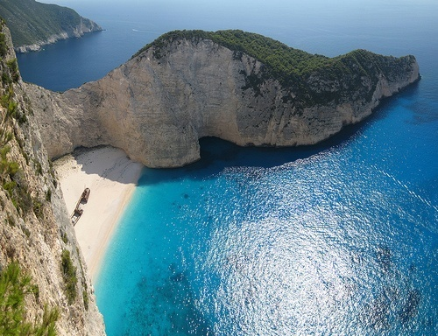
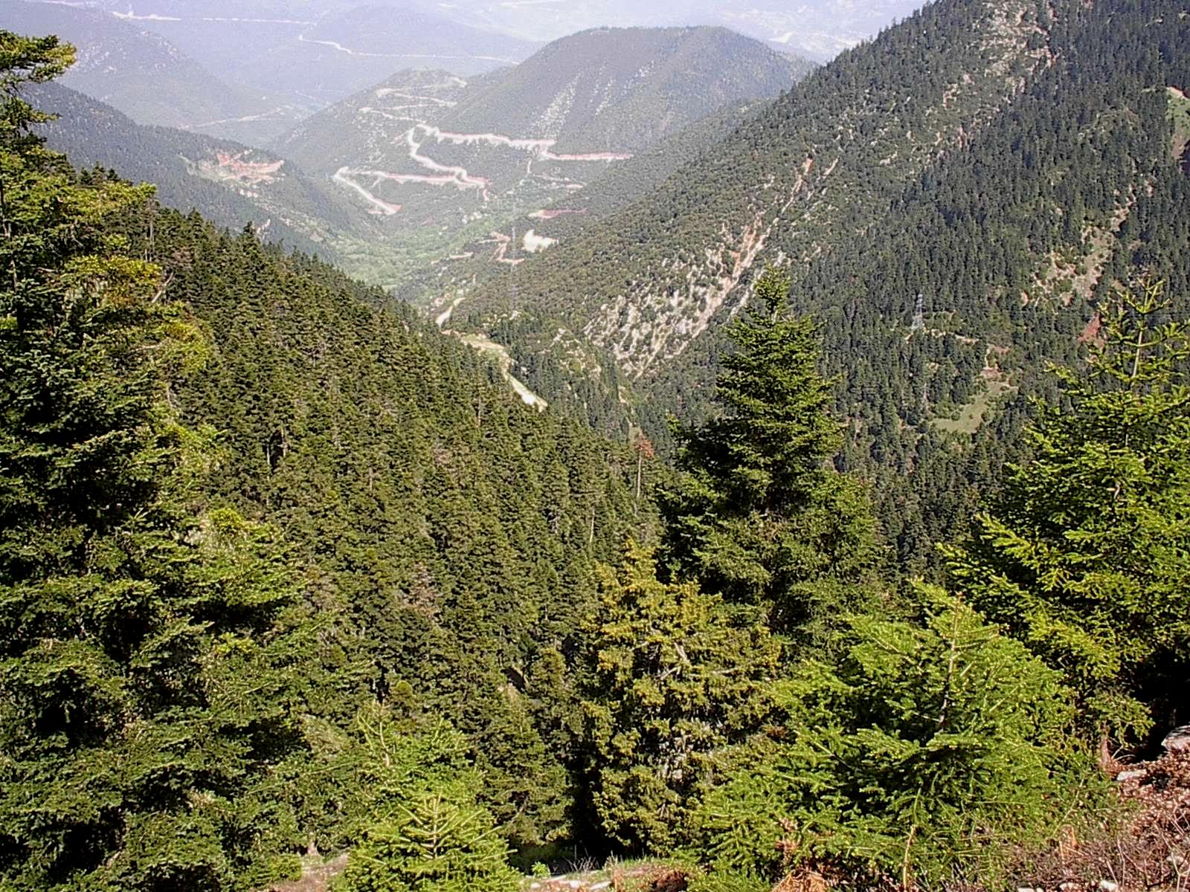
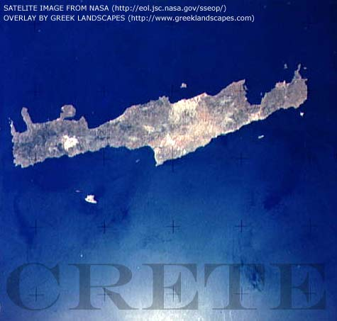

Slide 6
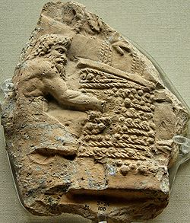
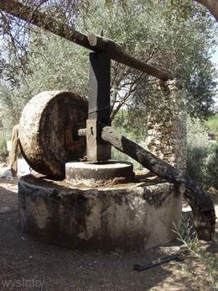
Life Among Mountains
People settled in mountain valleys
Kept people separate, not under one rule
Trade was difficult by land, rivers could not be used for transport because they would dry up
Land was difficult to farm
Raised sheep, goats, and pigs
Got wool, hides, and cheese
Grew grapes, olives, wheat, and barley
Made wine and olive oil

Slide 7
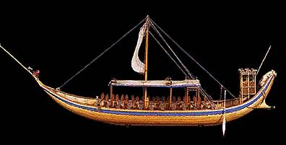
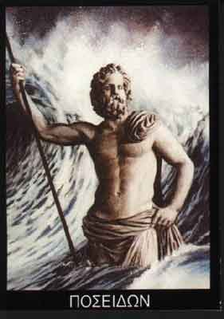
Life by the Seas
Many settled by coast because of fish and travel
Became a seafaring culture
Sailed from harbor to harbor
Sea allowed contact with other Greek settlements
Exchanged ideas and religious beliefs
Sea was dangerous in winter
Poseidon was god of the sea, showed anger through rough waters
Sea connected the Greeks with other cultures

Slide 8
Exchange and Trade
Could produce food surplus
Population grows
Specialized jobs begins
Made wine and olive oil
Greeks imported wheat
Exported wine olive oil, pottery, and wood
Shared ideas with other cultures
Learned to make bronze from the Mesopotamians

Slide 9
8-2 Early Civilization in Greece
What to know: How did people in the earliest civilizations of ancient Greece live?
Vocabulary
Peasant: A poor farmer
Cultural Borrowing: The process by which a culture takes ideas from other cultures

Slide 10
Bard: A professional storyteller who traveled from town to town, telling stories and singing songs about Greek gods, goddesses, and heroes
Legend: A story handed down from earlier times that explains the past
Epic: A long poem
Myth: A story about how the actions of gods and goddesses affected the lives of people
Mythology: A collection of myths passed down from generation to generation

Slide 11
The Minoans
Minoans begin on the Island of Crete
Named for legendary King Minos
Greek Poet Homer described Crete as fertile and highly populated
2000 B.C. Minoans build cities
Palaces were large and maze like
The palace was the center of government, religion, and food storage
Largest palace was at Knossos in 1700 B.C.
It was three acres and three stories high

Slide 12
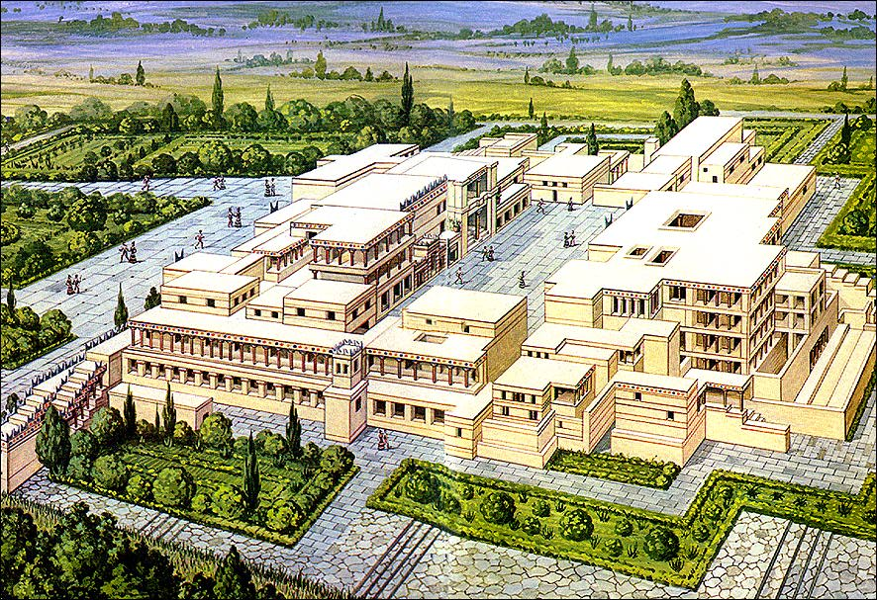
Notes:
Palace of king Minos at Knossis

Slide 13
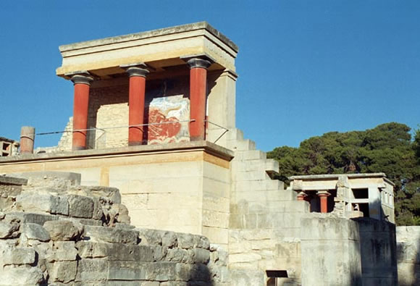

Slide 14
Minoan Life
They enjoyed sports, dancing, and music
Men and women had long hair and gold jewelry
The sea was very important to them
Traded with Egypt, Mesopotamia, and other early Greeks
They traded pottery, olive oil, wine, and wool for copper, tin, and gold.
Had a system of writing, but we don’t understand it
1100 B.C. Minoan culture ends
Earthquake, volcano, or Mycenaean invasion may have led to end

Slide 15
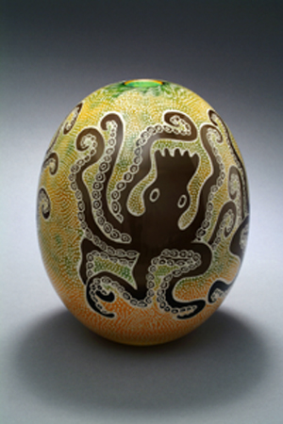
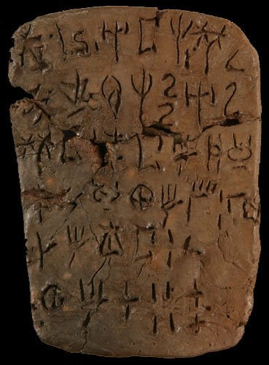
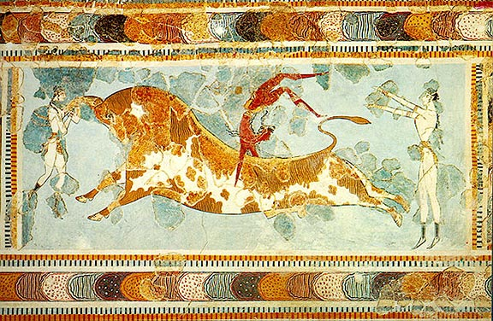

Slide 16
The Mycenaeans
Named for the city of Mycenae on the Peloponnesus
They were war-like
Spoke an early form of Greek language
Mycenaeans borrowed culture and ideas from Minoans
Borrowed sailing, writing, and art styles
1450 B.C. Mycenaeans invade Crete
Mycenaeans control Peloponnesus and Crete until 1100 B.C.
1100 B.C. Mycenaeans weakened by Dorians and fighting themselves

Slide 17
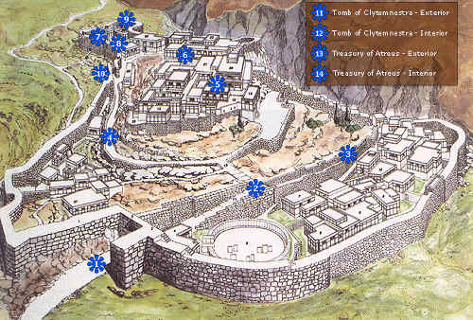
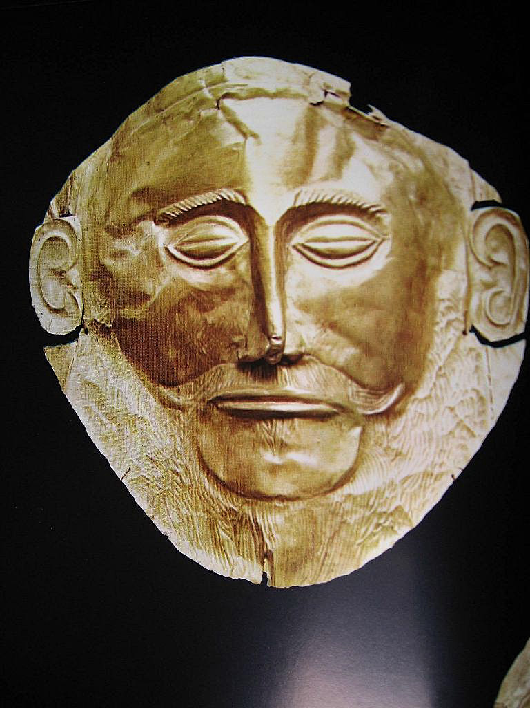
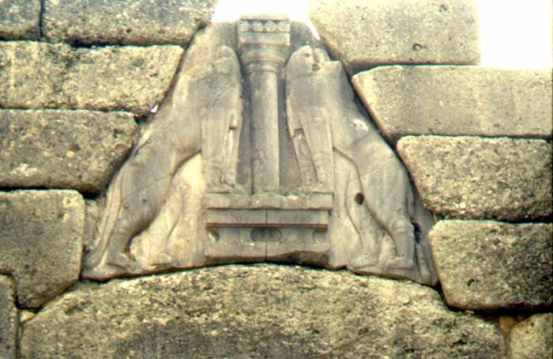

Slide 18
Legends and Myths
Stories told by bards were entertaining
Also taught ideals, values, and beliefs
Some legends may be based on actual events
1200 B.C. Mycenaeans conquer Troy in Trojan War
700 B.C. Homer writes two epics about Trojan War
Iliad was story about Trojan war, Troy was actually attacked according to archeologists
Odyssey was story of Odysseus’ ten year return home from Trojan war
He fought a Cyclops

Slide 19
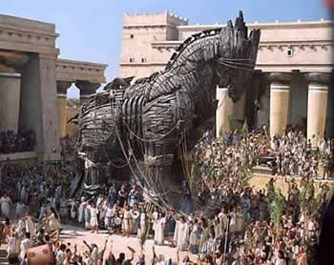
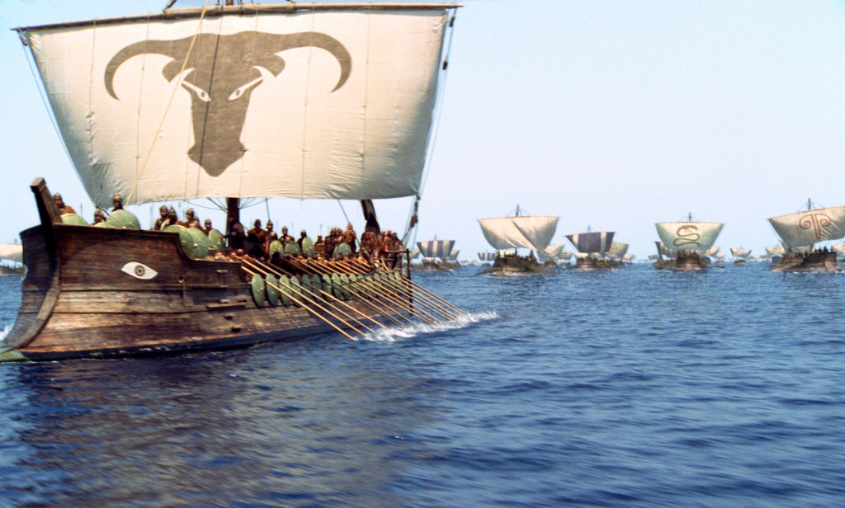
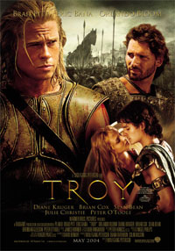

Slide 20
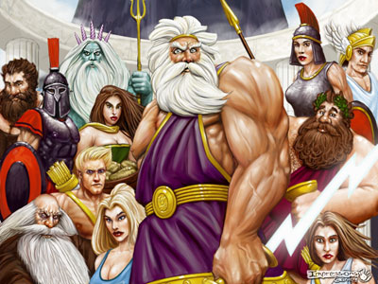
Myths were an important part of Greek religion
Explained things in nature
Told of God’s personalities
Each god had control of specific parts of life and nature

Slide 21
The Greek Dark Age
1100 B.C. Dark age begins
Cities were abandoned and trade stops
Mass poverty
People return to simple farming life
Writing, pottery, and bronze techniques are lost or forgotten during Dark Age
Legends and myths survive
750 B.C. the Dark Age begins to end

Slide 22
8-3 Greek City-States
What to Know: How did the governments of Greek city-states change over time?
Vocabulary
Polis: A Greek city-state that connected a city and the farms, towns, and villages around it.
Acropolis: A fort built on top of a large hill
Agora: An open-air market where people gathered to trade and discuss the news of the day in Greek city-states

Slide 23
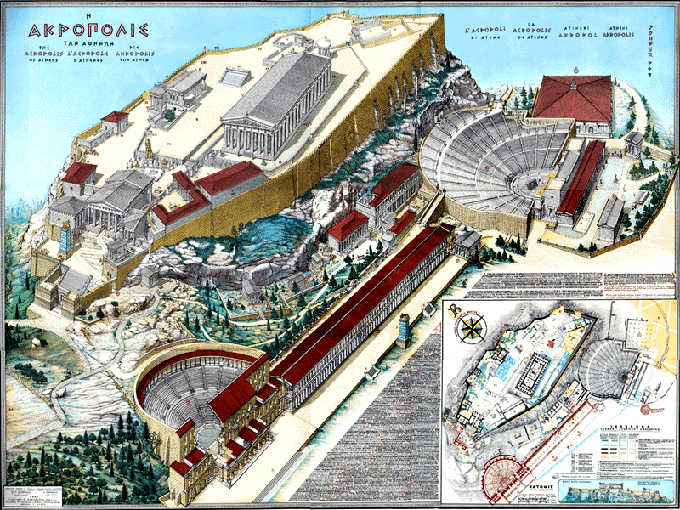

Slide 24
The Rise of City-States-
Oligarchy: Rule by few
Tyrant: A person who takes control of a government by force
Democracy: Rule by the people
750 B.C. city-states of Athens, Sparta, Argos, and Corinth
Greek city-states were called a polis
Polis is where we get the word politics
All people were free citizens unless parents were foreign
Philosopher Aristotle believed it was natural for people to live in city-states
Most polis had 5,000 people; Corinth had 10,000, Athens may have had 20,000

Slide 25
Most city-states began on the base of hills with an acropolis on the top
People would be protected in the acropolis during attacks
Later the acropolis became a center of religion
The agora was located outside the acropolis
Agora was center of government and trade
Mountains kept city-states separate
Natural barriers meant no central government of all city-states

Slide 26
Polybius Theory -cycle of Government
Monarchy Aristocracy Democracy
Anarchy Tyranny Oligarchy Mob Rule

Slide 27
an = without anarchy= without rule
archy = to rule
mon = single monarchy= single ruler
aristo = best aristocracy = “best” ruler
olig = few, little oligarchy = few, little rulers
demo = common people democracy = rule by common people
tyrant = cruel, oppressive tyranny = rule by force or fear
ochlocracy = mob rule

Slide 28
New Ways of Governing
750 B.C., groups of wealthy aristocrats rule city-states
Oligarchy
Controlled every part of society: army, religion, economy, and laws
600s B.C. individual oligarchs take power as tyrants
Tyrants, in the beginning had support of people
Over time tyrants were seen as cruel leaders
500 B.C. tyrants over thrown
Some city-states, like Athens, move to democracy
Only free males over 18 could vote in Athens

Slide 29
Commerce and Colonies
Commerce: Large-scale trade
700 B.C. Greek city-states become part of commerce
Traded grain, wood, olive oil, wine, pottery, and iron weapons and tools
Iron tools led to a food surplus and greater populations
City-states started colonies in search of more resources like iron
Colonies become independent but maintain contact with original city-state through religion and trade
500 B.C. Greek colonies in Europe, northern Africa, and Asia Minor

Slide 30
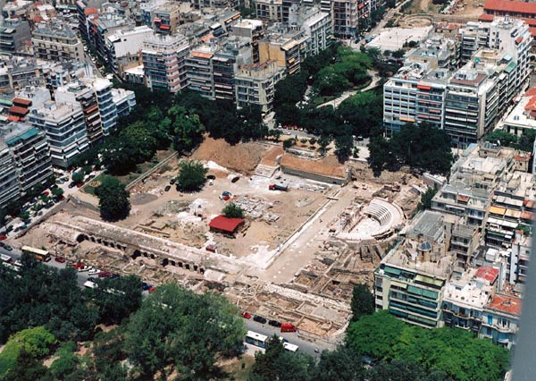
Colony: A new settlement separated from but ruled by a homeland

Slide 31
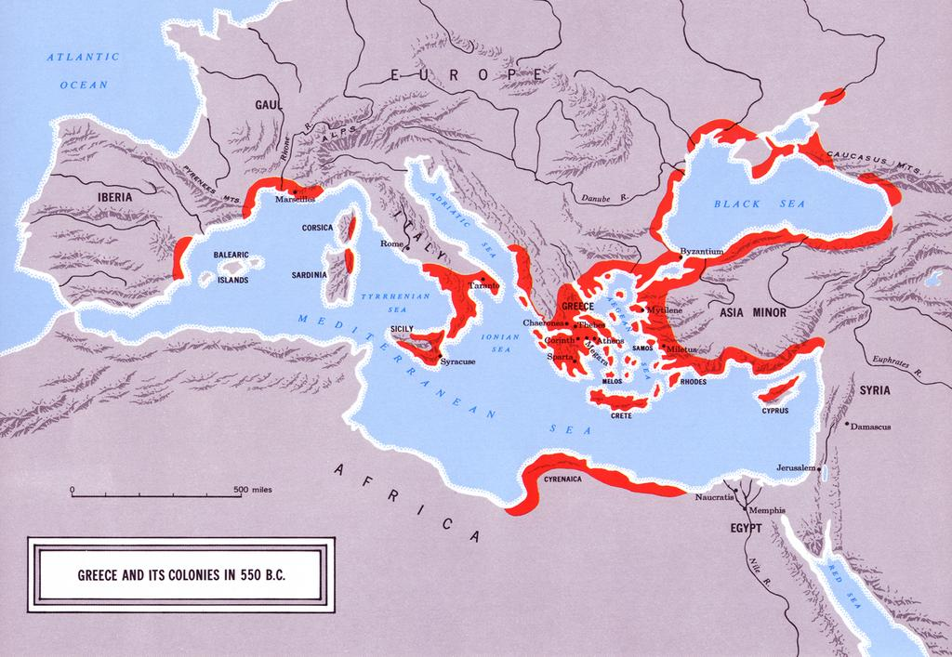

Slide 32
Greek Culture
Identified with city-state
All city-states share religion, history, language, writing, culture, and athletics
700s B.C. Greek alphabet developed
Based on Phoenician alphabet
Symbols based on single sounds like our language
Recorded business, laws, and government with language
Homer uses Greek language to write Iliad and Odyssey

Slide 33
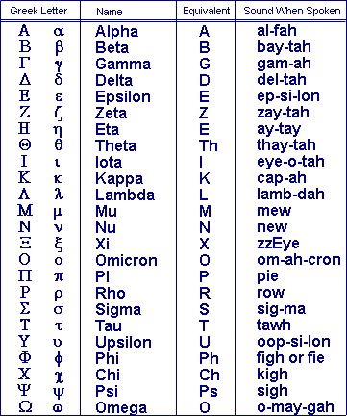
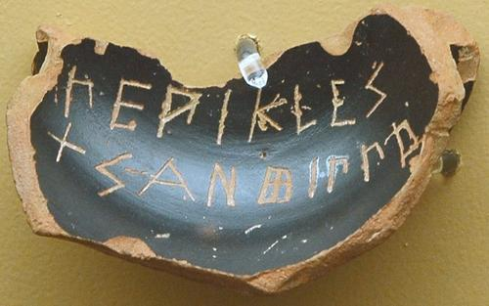
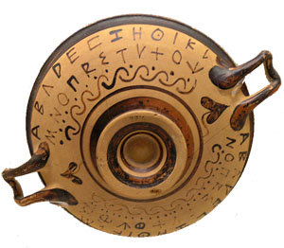

Slide 34
Believed Zeus and the gods controlled daily life
Went to oracles to get advice
Delphi was most famous Oracle
Was temple of Apollo
776 B.C. Olympics begin
Olympics included wrestling, javelin, discus, long jump, boxing, and running
Winners crowned with olive wreath
Lasted for 1,200 years
Would stop wars to compete

Slide 35
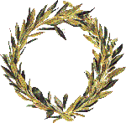
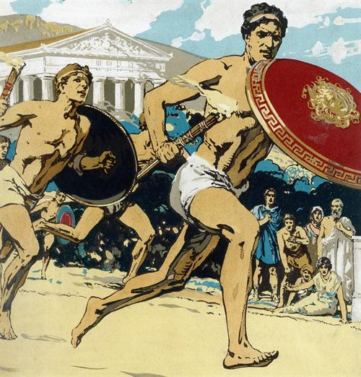
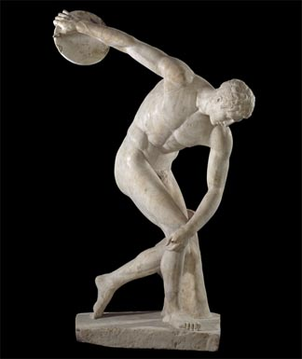

Slide 36
A New Kind of Warfare
City-states often fought each other over resources despite common culture
Between 725 B.C. and 650 B.C. developed new organized warfare technique
All male citizens of a polis spent some time in the army
Your rank was determined by wealth
Cavalry, hoplites (foot soldiers), archers and stone throwers
Armor was 70 pounds of bronze
Had to pay for own weapons and armor

Slide 37
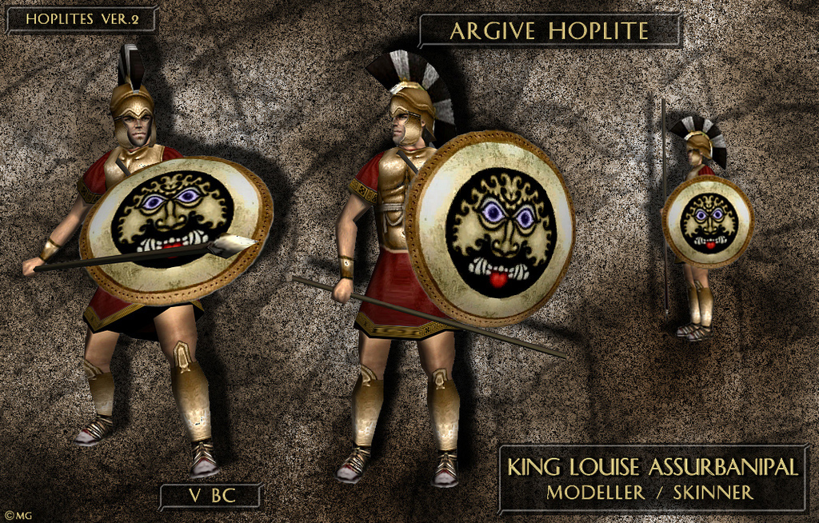

Slide 38
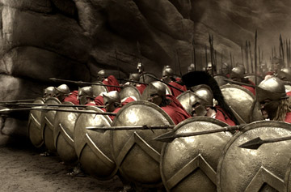
Had rectangular formation
Would stand shoulder to shoulder to form shield wall
Archers, chariots, and cavalry provided backup
During battles, wall formations would push up against each other
Method was used for hundreds of years

Slide 39
8-4 Sparta and Athens
What to know: How were Sparta and Athens alike, and how were they different?
Vocabulary
Helot: A person conquered by Sparta who became a slave
Assembly: A lawmaking group

Slide 40
Reform: A change
Majority Rule: A system in which every member has one vote, and in which the person or idea that receives the most vote is chosen
Fable: A short story that uses animal characters to teach a lesson
League: A group of allies

Slide 41
Sparta’s Government
Sparta on Peloponnesus, but separated from other city-states
600s B.C. most powerful city-state
Used helots, state owned slaves, to do work
Helots outnumbered citizens 4 to 1
To prevent rebellion, Spartans trained in war
Had two kings during times of war
Had Oligarchy in times of peace
Oligarchy was a group of 30 male of citizens who were 60 years old or more

Slide 42
Life in Sparta
Age 7 boys left home and trained in military barracks
Learned combat, hardships, and to obey orders without question
At 18 began true military training
Lived in barracks until age 30
Served as soldiers until 60
Women trained physically
Had more freedoms than women in other city-states
Sparta had little contact with other city-states
Believed there was no greater honor than to die in battle

Slide 43
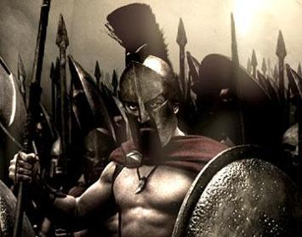

Slide 44
New Ideas in Athens
Because of location, Athens had many trading partners
620 B.C. Draco wrote first Athenian laws, but were harsh
600 B.C. Solon reforms Athens, frees slaves, and makes laws more fair
Toward Democracy
Solon based rights on wealth not birth
Could change social class by the amount of land or money you have

Slide 45
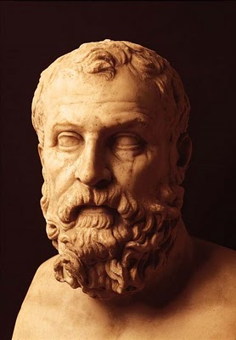
All male citizens were allowed to attend the assembly to make laws
Used Majority Rule to pass laws
Had a council of 400 that served 1 year terms
Members were selected at random
Solon’s reforms begin democracy in Athens

Slide 46
Life in Athens
Education was important
Children learned morals from fables written by Aesop
From 7-14 boys went to school to study math, reading, writing, physical education, art, poetry, and music.
Past 14, wealthy children would have tutors.
Most boys learned their father’s trade: blacksmith, potter, or carpenter
Girls studied at home
Learned home skills: cooking, sewing, and childcare
One third of Athenian population was slaves
Many slaves were educated and could be doctors and teachers
Women and slaves could not vote

Slide 47
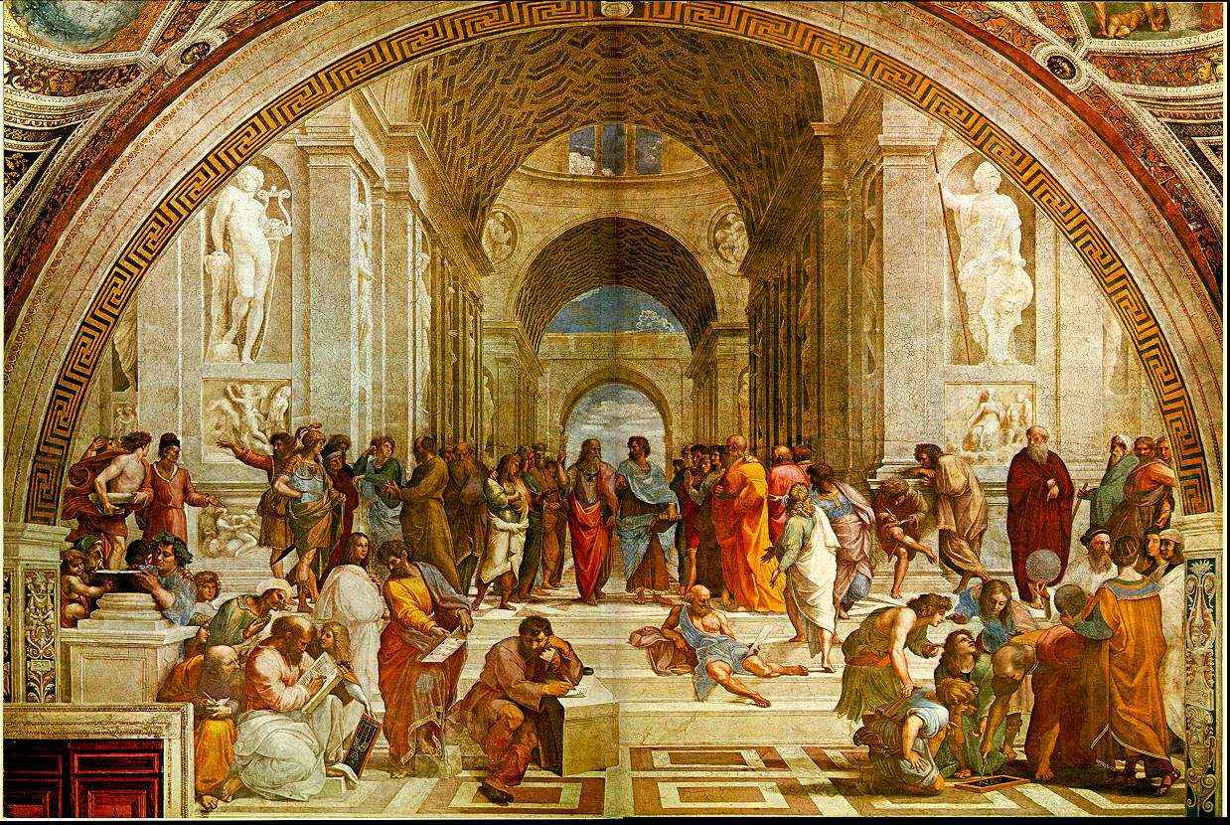

Slide 48
Concerns About Persia
539 B.C. King Cyrus II creates Persian Empire through conquering Mesopotamia and Babylon
Egypt is conquered
Darius I makes the empire its largest
Darius I divides empire into provinces
Built roads to link empire
Persia conquers some Greek colonies
500s B.C. Sparta creates Peloponnesian League
First purpose was to defend against Athens
League is now for defending against Persia

